Slide 1
HYPERTENSION
Ahmed Elsharawy
Assistant Lecturer of medicine and cardiology
Sohag University

Slide 2
Vital Investment Program (VIP)
Education Goals
Basic Disease Understanding
Disease Triggers & Smart Choices
Treatment & Technique
Warning Signs & Action Plans
Patient Responsibilities

Slide 3
Vital Investment Program (VIP)
VIP Education Goals
Basic Disease Understanding
Disease Triggers & Smart Choices
Treatment & Technique
Warning Signs & Action Plans
Patient Responsibilities

Slide 4
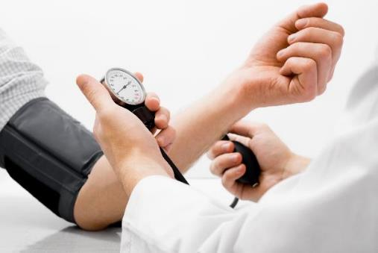
Hypertension: Basic Disease Understanding
Persistent high blood pressure is called
HYPERTENSION

Slide 5
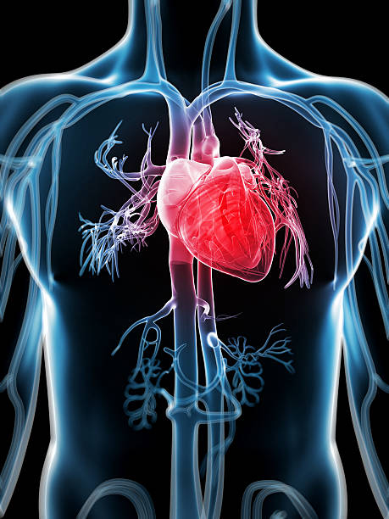
The heart
is a pump.
It moves blood
throughout the entire body.

Slide 6
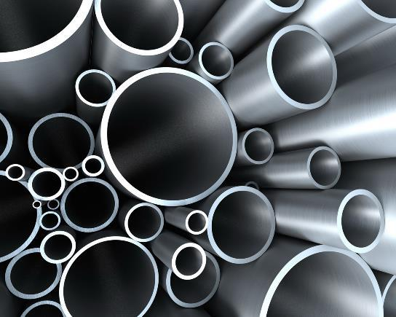
Blood travels through pipes in our body called
blood vessels.
Some of these pipes are naturally larger, while others are tiny.

Slide 7
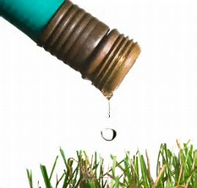
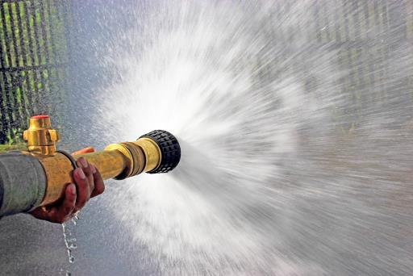
As blood is pumped, it pushes on the walls of these pipes.
This causes pressure.
Blood Pressure
Low pressure High pressure

Slide 8
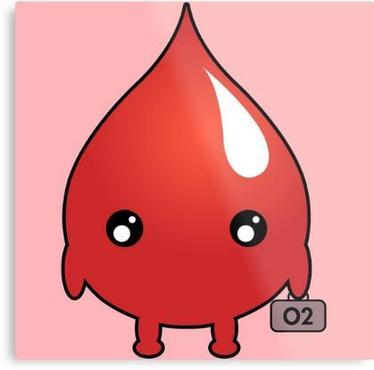
Blood is important.
Blood carries oxygen and other vital nutrients to the cells, tissues, and organs.
It also moves carbon dioxide and other waste products out of the cells.

Slide 9
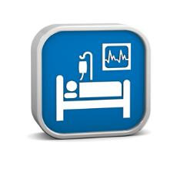
Without a healthy, normal blood pressure,
our cells, tissues, and organs become starved and over-worked;
they eventually stop working properly.
This causes disease.

Slide 10
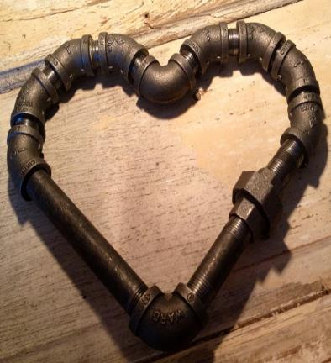
Elevated Blood Pressure affects both the
Heart & Pipes

Slide 11
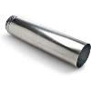
Blood Pressure is affected by
Blood Properties
Heart Muscle Properties
Pipe Properties
Risk Factors

Slide 12
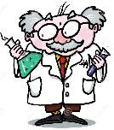
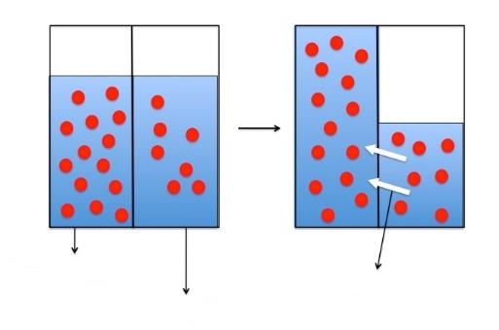
Blood Properties
Blood thickness and volume affect blood pressure.
You may remember from science class, that when you have a salty solution, water moves to it to dilute it. The same thing happens in the body when we eat too much salt (sodium) - we retain water to dilute it. The heart has to work harder to push all this extra fluid through the same size pipes. This contributes to hypertension.
osmosis
more salty
water moves to dilute the saltiness
less salty

Slide 13
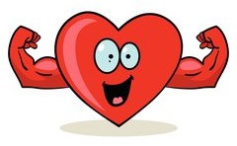
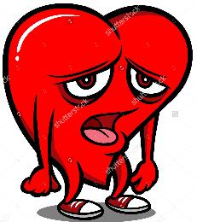
Heart Muscle Properties
The heart is a muscle. Like any other muscle, it must be exercised to keep it strong and healthy. And, like any other muscle, it can be injured or weakened from working too hard, from poor blood flow, from trauma, or from certain medications, electrolyte imbalances, or other insults.

Slide 14
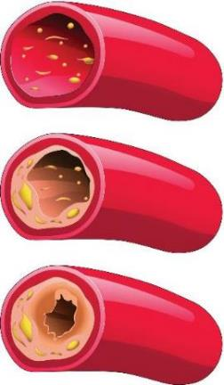
Pipe Properties
The more our hearts have to pump through pipes that are
narrower and narrower, the higher our blood pressure.
Size
Matters

Slide 15
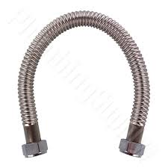
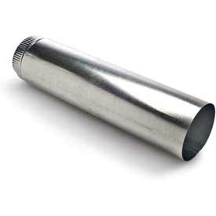
Pipe Properties
Persistent high blood pressure, over time, makes the normally flexible pipes become more rigid. The more our hearts have to pump through pipes that are less flexible, more rigid, the higher our blood pressure..
In larger pipes, this is called arteriosclerosis.
In smaller pipes, it is called arteriolosclerosis.
Because these smaller pipes feed organs, organ damage can occur.

Slide 16
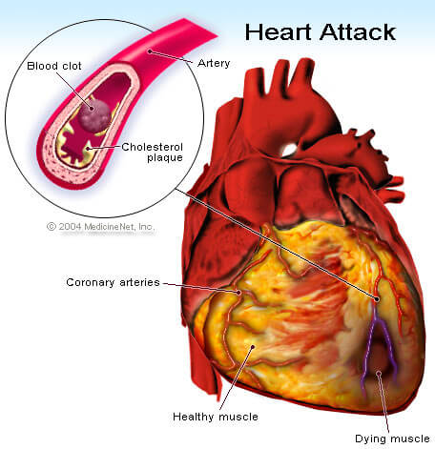
If a pipe of the heart is blocked, it may cause a
heart attack

Slide 17
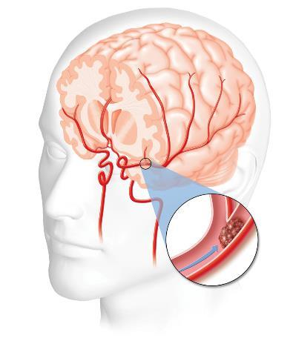
If a pipe of the brain is blocked, it may cause a
stroke

Slide 18
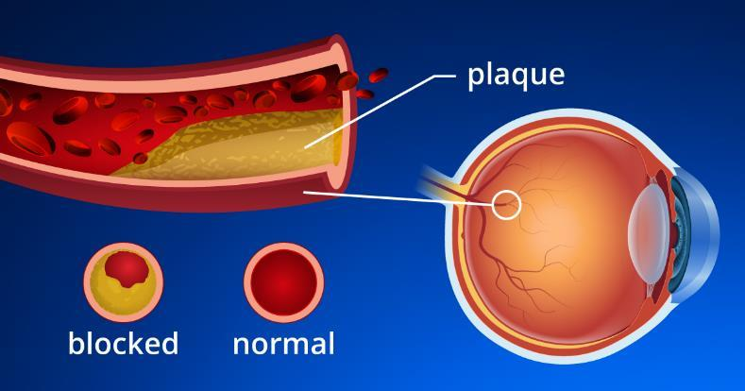
If a pipe of the eye is blocked, it may cause
Blindness

Slide 19
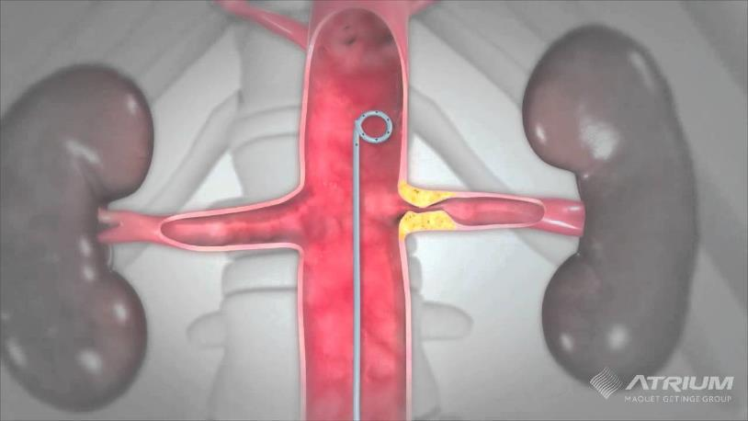
If a pipe of the kidney is blocked, it may cause
kidney failure

Slide 20
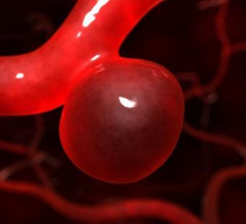
In pipes of all sizes,
persistent high blood pressure,
over time,
weakens areas in the walls of the pipes, causing them to balloon out.
This is called an aneurysm.
Aneurysms can rupture,
causing massive bleeding and death.

Slide 21
Vital Investment Program (VIP)
VIP Education Goals
Basic Disease Understanding
Disease Triggers & Smart Choices
Treatment & Technique
Warning Signs & Action Plans
Patient Responsibilities

Slide 22
Hypertension: Disease Triggers
Risk Factors

Slide 23
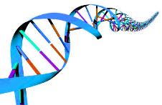
Some Risk Factors we have NO control over:
Genetics Age
Race Gender

Slide 24
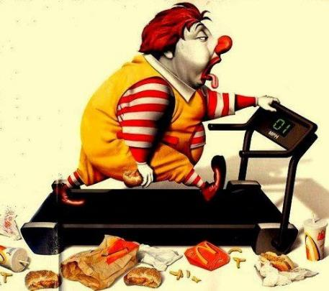
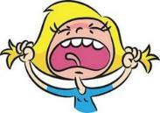
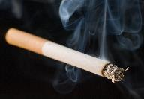
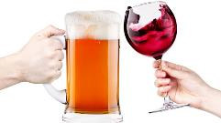
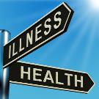
Other Risk Factors we DO have control over:
● Poor diet
● Obesity / large waist
● Inactivity
● Stress
● Tobacco
● Alcohol
● Other chronic conditions

Slide 25
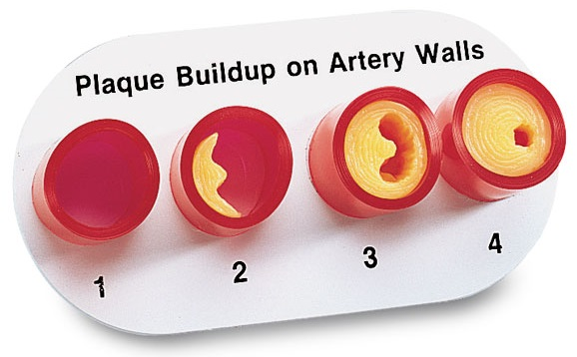
These Risk Factors put extra strain on the interior walls of the pipes causing damage.
In an effort to repair the damage, white blood cells and cholesterol latch on.
This is plaque.

Slide 26
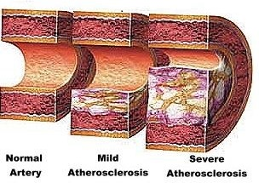
Plaque thickens and stiffens the interior walls of the pipes, requiring the heart to work harder to get the blood through the pipes.
This is atherosclerosis.

Slide 27
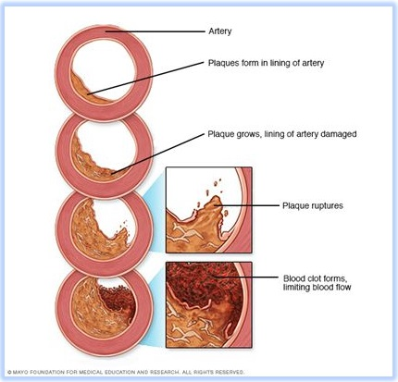
When plaque ruptures, platelets rush in to stop the bleeding.
This can clog up the pipe by forming a
blood clot

Slide 28
Hypertension: Smart Choices
Life Style Choices

Slide 29
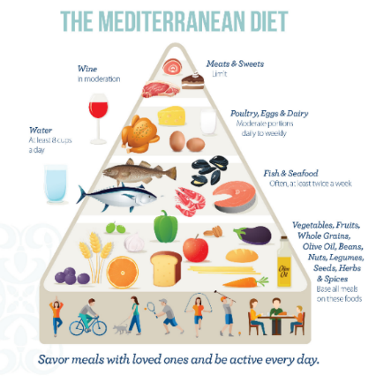
Choose
Healthier
Foods
≤

Slide 30
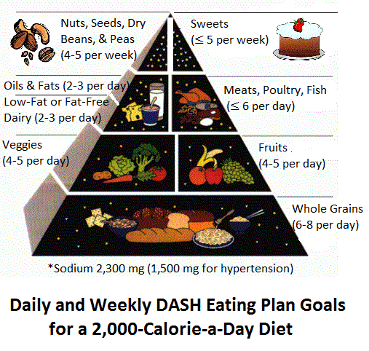

Slide 31
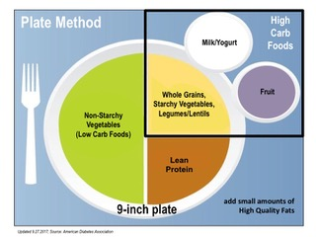
Choose Balanced Meals
Manage your portion sizes
Eat a variety of foods within each food
Group (there are different micronutrients in different foods of varying colors).
Eat more veggies, fruits, and whole grains
(they are rich in fiber, minerals, and plant chemicals that help lower blood pressure and cholesterol).
If you have diabetes, you may need to lower your carb intake and pair carbs with proteins or healthy fats to help slow the rapid rise in blood sugars.
**ask to see our Slide Show on Diabetes
Reduce sodium/salt intake ( ≤1500 mg/day; helps lower blood pressure which reduces risk for heart attack and stroke). **Low-sodium salt is not appropriate for some people with kidney disease or congestive heart failure.
Stay hydrated with plenty of water.
**Our in-house dietician can help (and it’s FREE!)

Slide 32
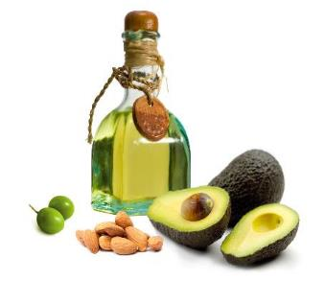
Choose Healthier Fats
Limit saturated fats (primarily found in animal products - meat & dairy; choose skim “fat-free” or 1% “low fat” options). Limit saturated fats to no more than 5-6 % of total calories).
Use unsaturated fats in moderation (primarily found in avocados, olive oil, nuts, and seeds).
Avoid trans fats & interesterified fats (often found in margarines and commercially baked cookies, crackers, and snack cakes).
Eat heart-healthy fish – (cod, tuna, halibut have less total fat than meat and poultry; salmon, mackerel, and herring are rich in omega-3 fatty acids which help promote heart health)
**Ask to see our Slide Show on Lipids

Slide 33
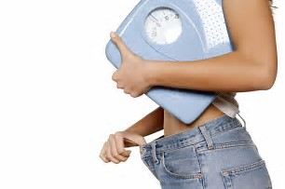
Choose to Lose Extra Pounds /Inches
& Maintain a Healthy Weight
Excess weight contributes to high cholesterol and blood pressure; losing even 5-10 pounds can help lower both of these numbers.

Slide 34
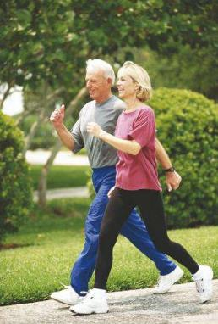
Choose to Exercise Regularly
- most days of the week
CARDIO
-Slowly work up to a minimum of 150 minutes per week after clearance from your Provider.
RESISTANCE
-Use weights 2-3 times a week.

Slide 35
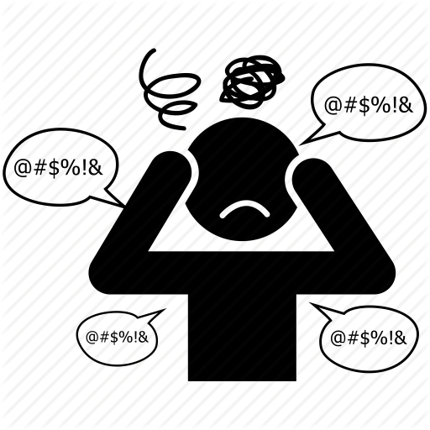
Choose to Manage Stress
Everyone has stress.
It’s how we manage it that matters most.
**Ask to see our Slide Show on Stress.

Slide 36
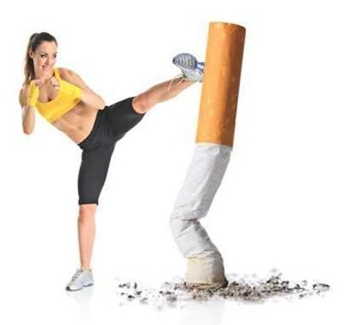
Choose to Quit Tobacco
Quitting tobacco in all forms is the single best thing you can do for your health. Tobacco increases your risk of heart disease because it damages your blood vessels and speeds up the accumulation of plaque within arteries.
**Ask us how we can help!

Slide 37
Choose Alcohol in Moderation (if at all)
Moderate use of alcohol may increase your levels of “good cholesterol” and may help lower stress levels and blood pressure, but the benefits aren’t strong enough to recommend alcohol for anyone who doesn’t drink already.
Women: ≤ 1 drink per day
Men: ≤ 2 drinks per day

Slide 38
Choose to Manage Other Chronic Conditions
Oftentimes, people have concurrent medical conditions (because the same poor lifestyle choices can lead to multiple conditions and/or for other reasons). What we know is that having certain conditions can make it more difficult to control other conditions. So, keeping all of your medical conditions under the best control possible is vital to managing your health.
EXAMPLES
Obesity
Diabetes
Thyroid disease
Kidney disease
Respiratory conditions
Sleep apnea
Hyperlipidemia
Steroid use
NSAID use

Slide 39
Vital Investment Program (VIP)
VIP Education Goals
Basic Disease Understanding
Disease Triggers & Smart Choices
Treatment & Technique
Warning Signs & Action Plans
Patient Responsibilities

Slide 40
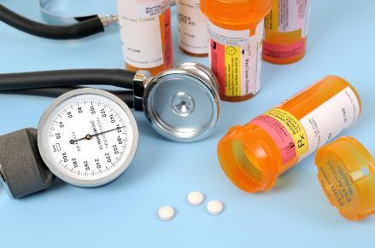
Hypertension: Treatment
Medication
may be prescribed for you if healthy lifestyle choices alone
are not enough to control your blood pressure.
**Remember, medications can help, but Lifestyle Changes are key.

Slide 41
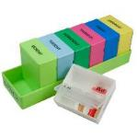
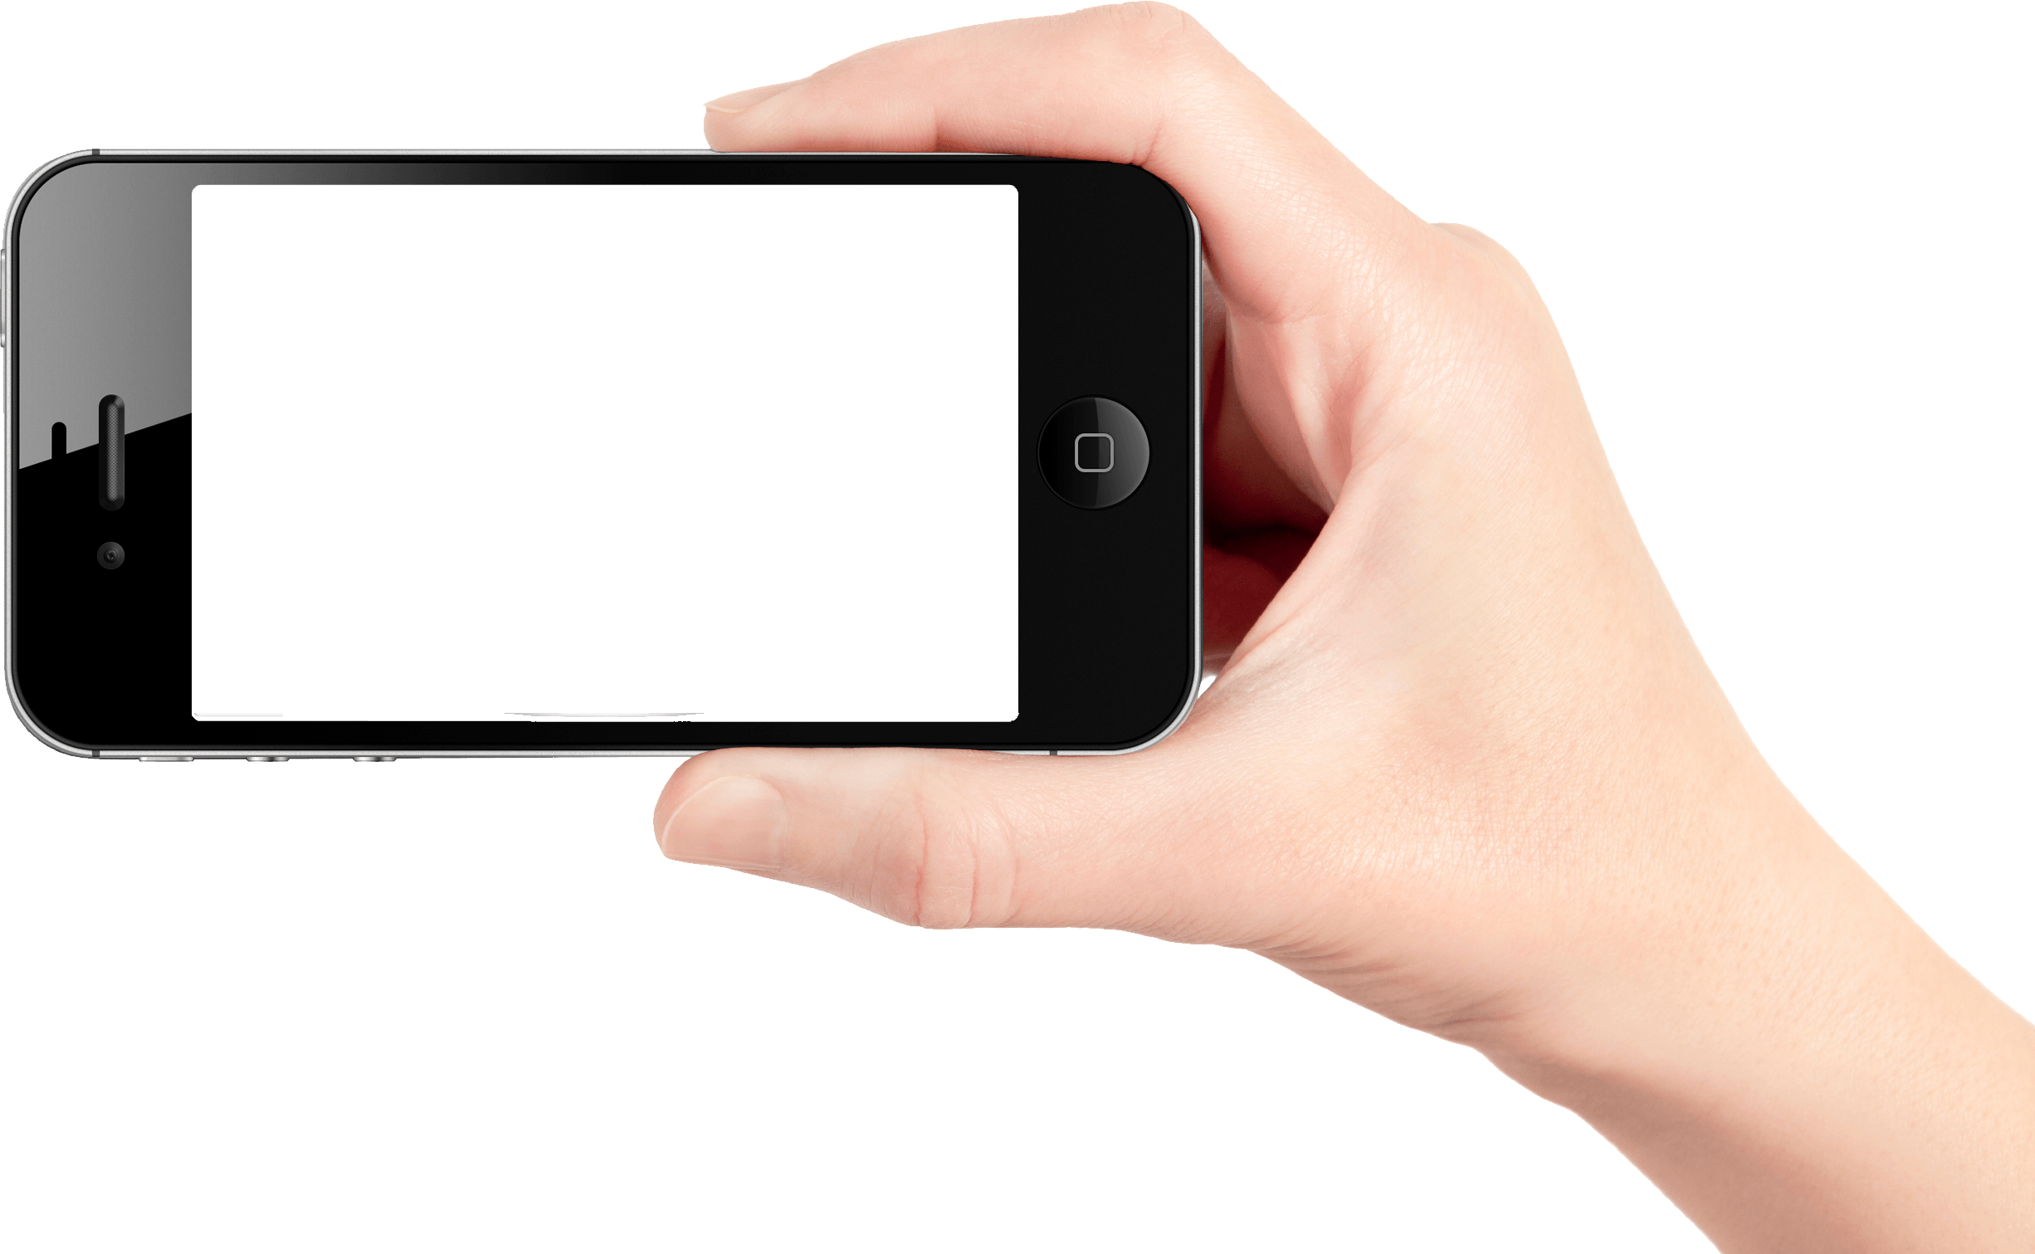
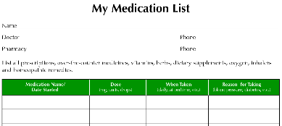
Always take all medications exactly as prescribed.
Know exactly what you take - drug name, dosage, instructions, & what
it’s for; make sure ALL of your Providers know, too - all prescriptions,
OTCs, herbs, & supplements. Keep a list or snap pictures with your cell.
Do not use medications past the expiration date.
Immediately inform your Provider of any concerning signs or symptoms.

Slide 42
Blood Pressure Medications
Diuretics “water pills” help the body get rid of excess fluid and sodium which helps lower blood pressure. (-ides, -ones, Lasix, Bumex, Microzide, etc.)
Beta-blockers reduce the heart rate, the heart's workload, and the heart's output of blood which helps lower blood pressure. (-olols, Tenormin, Lopressor, etc.)
ACE Inhibitors ACE stands for Angiotensin-converting enzyme. Angiotensin is a chemical that causes the arteries to become narrow, especially in the kidneys but also throughout the body. ACE inhibitors help the body produce less angiotensin, which helps the blood vessels relax and open up reducing blood pressure. (-prils, Lotensin, Vasotec, etc.)

Slide 43
Angiotensin II Receptor Blockers Angiotensin is a chemical that causes the arteries to become narrow. ARBs block the effects of angiotensin. Angiotensin needs a receptor-- like a chemical "slot" to fit into or bind with-- in order to constrict the blood vessel. ARBs block the receptors so the angiotensin fails to constrict the blood vessel. This means blood vessels stay open so blood pressure is reduced. (-artans, Benicar, Diovan, etc.)
Calcium Channel Blockers - This drug prevents calcium from entering the smooth muscle cells of the heart and arteries. When calcium enters these cells, it causes a stronger and harder contraction, so by decreasing the calcium, the heart’s contraction is not as forceful. Calcium channel blockers relax and open up narrowed blood vessels, reduce heart rate and lower blood pressure (-ipines, Cardizem, Procardia, etc.)
Alpha Blockers - These drugs reduce the arteries' resistance, relaxing the muscle tone of the vascular walls. (-osins, Cardura, Minipress, etc.)
Alpha-2 Receptor Agonists - These drugs reduce blood pressure by decreasing the activity of the sympathetic (adrenaline-producing) portion of the involuntary nervous system. (-idines, Catapres, Zanaflex, etc.)

Slide 44
Hypertension: Treatment
Referrals to Specialists
for Complications of Hypertension

Slide 45
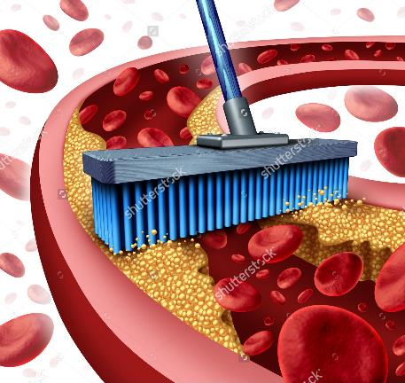
If there is too much plaque, you might see a heart specialist called a
Cardiologist for a balloon angioplasty & stent

Slide 46
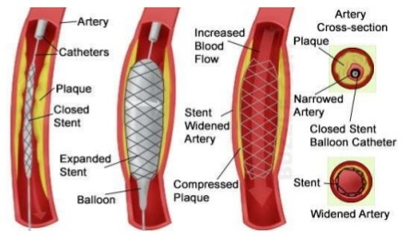
In Balloon Angioplasty, the pressure of the inflating balloon pushes against the plaque, opening up the pipe for better blood flow).
A Stent, or mesh framework, may also be placed to help keep the artery open for good blood flow.

Slide 47
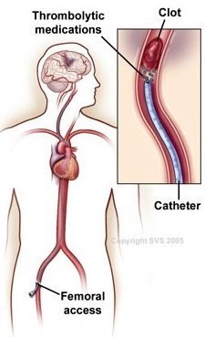
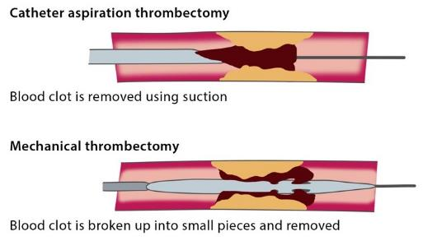
If pipe damage is severe, or if you have a clot, you might see a pipe doctor called a
Vascular Specialist
for thrombolytic therapy (injection of a clot-dissolving drug),
thrombectomy (surgical removal of the clot), or for other treatment.

Slide 48
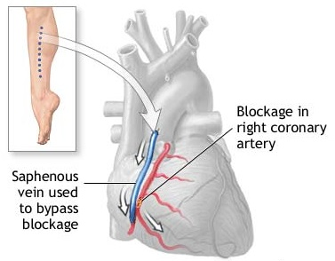
Or you might see a
Cardiothoracic Surgeon
for possible bypass graft surgery
(creation of a graft bypass using a blood vessel from another part of the body
or made from synthetic fiber)

Slide 49
Vital Investment Program (VIP)
VIP Education Goals
Basic Disease Understanding
Disease Triggers & Smart Choices
Treatment & Technique
Warning Signs & Action Plans
Patient Responsibilities

Slide 50
Hypertension: Warning Signs & Action Plans
Angina - Chest pressure or pain, squeezing in the chest, sense of fullness in the center of the chest, pain or discomfort in the shoulder, arm, back, neck, jaw, or upper abdomen – use nitroglycerine as instructed and/or call 911.
Heart Attack – pain or discomfort in the chest, shoulder, arm, back, neck, jaw, or upper abdomen; shortness of breath; profuse sweating; nausea or vomiting; heartburn or indigestion; extreme fatigue. Some heart attacks are “silent” (no symptoms at all). Women often times don’t get the typical “chest pain or left arm pain”. Trust your gut. – call 911.
Stroke – slurred, garbled speech; one-sided facial droop; one-sided limb weakness, numbness, or tingling; visual changes; confusion, change in level of consciousness, trouble understanding speech; vertigo or balance problems – call 911.

Slide 51
Hypertension: Warning Signs & Action Plans
Heart Failure – shortness of breath, lack of energy, fatigue, swelling, coughing, wheezing, recent weight gain or loss, confusion, poor ability to concentrate – call 911.
Hypertension– Blood pressure > 160/100 – Seek immediate medical advice.
Hypertension + Symptoms – Blood pressure > 160/100 with headache, visual blurriness, or other concerning symptoms – Go to urgent care / ER.

Slide 52
Hypertension: Warning Signs & Action Plans
Vision Loss – sudden change in vision, visual disturbances – see ophthalmologist same day or go to urgent care / ER.
Kidney Disease or Failure – nausea/vomiting, decreased appetite, increased urination, “foam” in pee, swelling, tired, shortness of breath, muscle cramps, dry itchy skin, sleeping poorly, weight loss – seek same day medical attention or go to urgent care/ER.
Peripheral Artery Disease – weak or tired legs, difficulty walking or balancing, cold feet/toes, numbness/tingling, sores slow to heal, absent/weak pulse, intermittent claudication (painful cramping of legs or hips when walking/exercising, usually disappears when activity stops), foot pain at rest, skin changes, erectile dysfunction – seek medical attention.

Slide 53
Vital Investment Program (VIP)
Education Goals
Basic Disease Understanding
Disease Triggers & Smart Choices
Treatment & Technique
Warning Signs & Action Plans
Patient Responsibilities

Slide 54
Hypertension: Patient Responsibilities
You are the leader of your healthcare team.

Slide 55
Hypertension: Patient Responsibilities
Lab Work and Provider Follow-up – make sure to come for regularly scheduled labs and follow-ups as recommended by your Provider (at least annually). Most people should be seen 2-4 times a year.
Reduce Risk Factors – healthy diet (watch carbs, sodium, fats, alcohol), exercise, manage stress, quit tobacco, alcohol only in moderation, manage other chronic conditions.

Slide 56
Hypertension: Patient Responsibilities
Blood Pressure –check your BP at least once or twice a week (and anytime you have concerning signs or symptoms). If you notice your blood pressure trending upward (getting higher), seek medical advice. Goal is < 140/80.
Medications - Take all of your medications exactly as prescribed. Do not stop and start medications on your own. Carry a current list of all medications and supplements you take, along with dosages and directions; this list can be on your phone or on paper. Immediately inform your Provider of any concerning signs or symptoms.

Slide 57
Hypertension: Patient Responsibilities
Vaccinations – make sure you are up to date on vaccinations; we carry some (like flu shots) here for free – just make an appointment.
Eye Exam – at least once per year; let your ophthalmologist know you have hypertension.
Dental Exam – at least once per year; floss daily; let your dentist know you have hypertension.

Slide 58
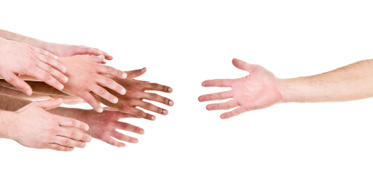
Hypertension: Patient Responsibilities
Please reach out to us.
We are here for YOU.

