Slide 1
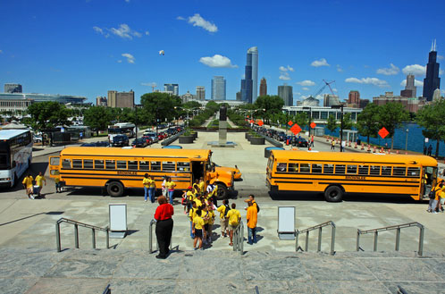
Field Trip

Slide 2
Definition
1- Is an educational procedure by which the student obtain first-hand information by observing place, objective, phenomena or activities and process in Their natural setting to further learning.

Slide 3
2- It is learning situation outside the regular classroom in which students travel to another location outside the facility.

Slide 4
Purpose of field trip
1-To provide real life situation for first-hand information.
2- To supplement classroom instruction.
3- To serve as a preview of a lesson and for gathering instructional materials.

Slide 5
4- To verify previous information, class discussion and conclusion of individual experiments.
5- To serve as a means of arouse specific interest in materials objectives, places, or process.
6- To create teaching situation for cultivating observation, values and skills.

Slide 7
Principles are needed for successful field trip:
1- Knowledge: teacher has to survey the area to know whether the
2- Field trip planned will contribute to the attainment of desired objectives.
3- Rapport: the teacher should establish and maintain cordial relations with those in charge of the situations to be visited.

Slide 8
4- Objectives: objectives should be stated carefully and completely.
5-Time and transportation: Necessary arrangements with the administrative personnel of the place to be visited regarding the time
6-Preparation of the students
7-Supervision

Slide 9
Types of field trip
1- Instructional trip.
Is a visit by a class or classes to a location outside the regular classroom.
2-A school contest festival or evaluation .
It provides an opportunity for students to demonstrate knowledge and skills.
3- Motivational filed trip.
It is not a part of the school it provides incentive for the school, group or the class

Slide 10
organization and procedure of field trip
A- Pre planning.
B- Actual conduct of the trip.
C- Evaluation.

Slide 11
A- Pre planning
By teacher:
1- Decide on the trip.
2- Know the resources.
3- Obtain administrative agreement of school /college.

Slide 12
4- Dealing with organization, obtain permission, data, time, visit and know the resources, inform the objective.
5- Arrange transport, time, date.
6- Prepare the students with theoretical base.

Slide 13
Teacher plan with student:
Formulate objectives.
2- List down specific information to be obtained.
3- Formulate questions to be asked to the guide and prepare guide sheet.
.

Slide 14
4- If a large group, divide and allot specific jobs.
5- Brief them-equipments or accessories needed, data and time transport, actual location, setup, conduct and behavior during trip, safety precaution to be observed

Slide 15
How to write filed trip report ?
the report must include :
-Name Telephone number Address
- objectives Workers Area served
- Budget (governmental) conditions
- Population served services given
- Future plan ways of referral

Slide 16
Advantages of filed trip:
1- Provides a real life experience.
2- It provides opportunities in learning and acquiring skills e.g. observation, communication, critical thinking and social skills.
3- It provide direct touch with persons and with community situations.

Slide 17
4- It provide opportunities in learning attitudes and positive values as cooperation.
5- Students develop better understanding of a etiologic factors of disease.
6- Provide opportunity to solve problems.

Slide 18
Disadvantages of filed trip:
1- Filed trip is time consuming.
2- Carefully planning is required.
3- Many parties to be involved, cooperation, coordination of various agencies required.
4- Trans potation may be a problem.

Slide 19
5- Since the student are going out of school/ collage premises it is risky, safety precaution essential.
6- If group is too large, effective observation become difficult.
7- It involves cost e.g. some time involvement is more.

Slide 20
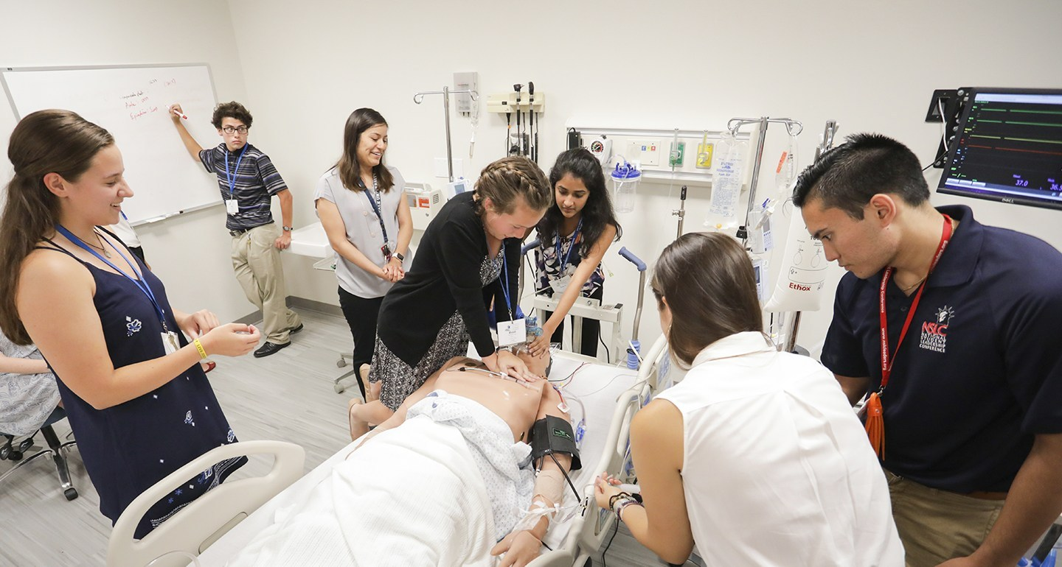

Slide 21
Case Study

Slide 22
Definitions of case study:
1- It is a learning activity that uses realistic scenarios focusing on a specific issue , topic or problem.
2- It describes the real life history of an individual or all factors which affect individual.

Slide 23
* Case study in nursing
Is a comprehensive study of patient is made for understanding of needed care.

Slide 24
Uses of Case Study:
1-Allow the application of theoretical concepts to be demonstrated, thus remove the gap between theory and practice.
2-Encourage active learning.

Slide 25
3-Provide an opportunity for the development of key skills such as communication, group working and problem solving.
4- Increase the student's enjoyment of the topic and increase their desire to learn.

Slide 26
Factors affecting of case study
A- factors related to teacher:
1- Lack of motivation to teach.
2- Lack of knowledge about this case.
3- Unsuitable time to teach.
4- put teaching to a low priority status.

Slide 27
B-Factors related to learners:
1- Lack of learner motivation.
2- Lack of support and positive reinforcement.
3- Lack of time to learn interfering with the ability and willingness to learn.
4- Denial of learning need and lack of willingness to authority.

Slide 28
C-Factors related to environment:
1- Too hot or too cold environment.
2- Unavailable resources.
3- Unsuitable size of class room.
4- Lack of control and lack of privacy

Slide 29
Steps of Case Study:
1-Analysis of the problem:
The students are asked to analyze the situation and determine source of problem.
2-Problem solution:
The students are asked to offer possible solution.
For example" How would you manage this case?"

Slide 30
3-Discussion of the responses:
The student discuss of the responses giving by different group.
4-Summary of key point:
Each group summarizes the key point of case study

Slide 31
* Advantages of case study:
1-It focus on practical thinking.
2-It provides real situation.
3-It is participating in nature.

Slide 32
4-Develops analytic and problem solving skills.
5-Allows for exploration of solutions for complex issues.
6-Allows student to apply new knowledge and skills

Slide 33
Disadvantages of case study:
1- Students may not see relevance to own situation.
2-Insufficient information can lead to inappropriate results.
3- Not appropriate for elementary level.
4-Complexity of these cases also means that take long time to prepare and for learner to fully comprehend.

