Slide 1

Sampling
إعداد
دنجلاء جمال الدين عبدالحافظ
مدرس تمريض الحالات الحرجه والطوارئ

Slide 2
Introduction
  Sampling is the process of selecting units (e.g., people, organizations) from a population of interest so that by studying the sample we may fairly generalize our results back to the population from which they were chosen.

Slide 3
Key terms
1- population:
Is the entire set of individuals, animals, situations or objects In which a researcher is interested.
2- Target population:
• It is total group of individuals who have the characteristics you are studying.
Example, all diabetic people in the United States.

Slide 4
3- Accessible population
The entire group of people or elements who meet the sampling criteria and are accessible for a study.
4- element
an object on which measurement is taken or the most basic about which information is collected.

Slide 5
5- Sample
is the group from the total population that will be studied
6- Sampling
is the process or technique of selecting a portion of the population to obtain data regarding a problem

Slide 6
Representative Sample
Is one whose main characteristics closely approximate of those
population.
Sampling bias
Sampling bias is caused by the researcher and it occurs when samples are not carefully selected.

Slide 7
7- eligibility criteria
the exact criteria by which it could be decided whether an individual would or would not be classified as a member of population.
it may be inclusion or exclusion criteria.
8-Sampling frame :
list of all sampling units

Slide 8
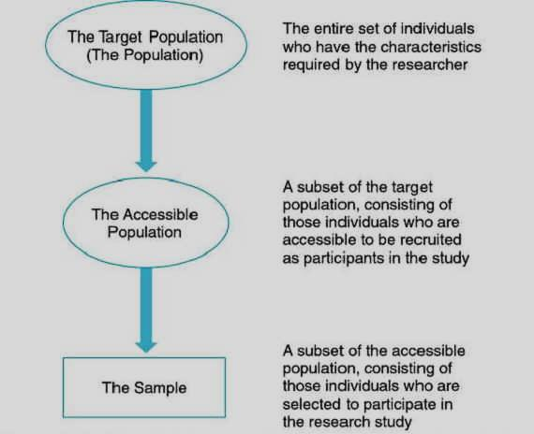

Slide 9
Purposes of sampling
1- sampling saves
.Time ,money, energy
2- sampling increases the efficiency of research.
3- sampling makes some impossible researches more .possible

Slide 10
Types of Samples
A- Probability (Random) Samples
B- Non-Probability Samples

Slide 11
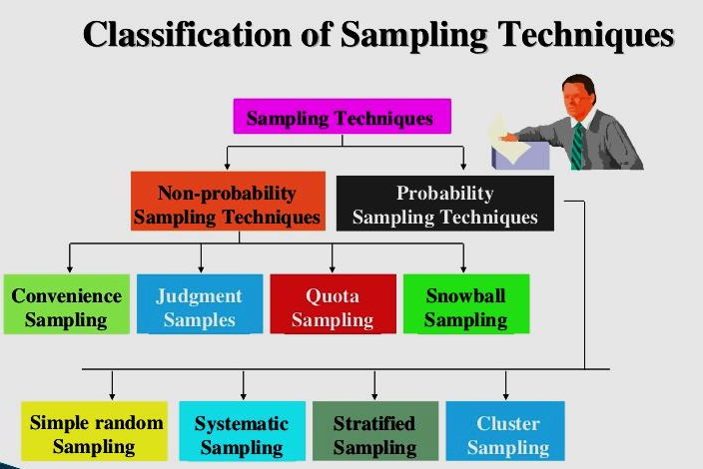

Slide 12
1.simple random sampling
Every member of the population has a known and equal chance of being .selected

Slide 13
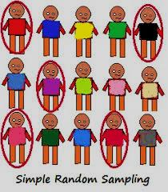

Slide 14
2.systematic sampling
It is conducted when an ordered list of all members of the population is available
(e.g 1000)and the sample size is known
(e.g 50) then the size of the group between members is selected from the list 1000/50=20 so every 20th member on the list would be included in the study.

Slide 15
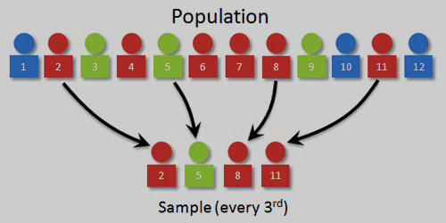

Slide 16
3. Stratified random sampling
The random selection of subjects from two or more strata of the population independently
here the population is divided into strata of homogeneous groups because each strata is characterized by some common .characteristics

Slide 17
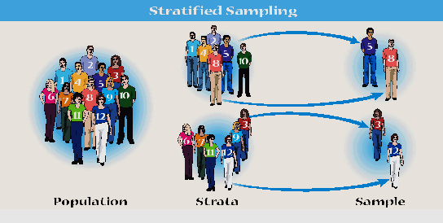

Slide 18
E.g if the population is university nursing student A stratified random sampling will be done as follows:
The students are classified into four strata(1st,2nd,3rd,4th years) then an equal proportion from each strata will be selected randomly

Slide 19
4. Cluster sampling
Divide the population into several subgroups.
Each subgroup is a representative of the .population
Randomly select some clusters and include all units from these selected clusters to form the sample.

Slide 20
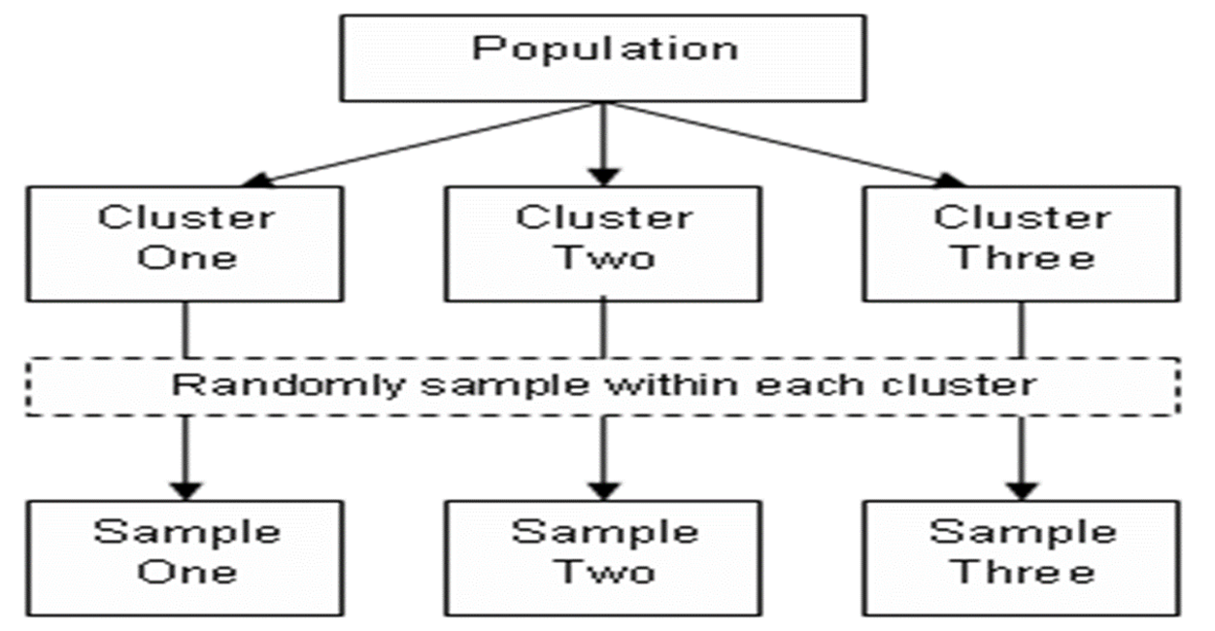

Slide 21
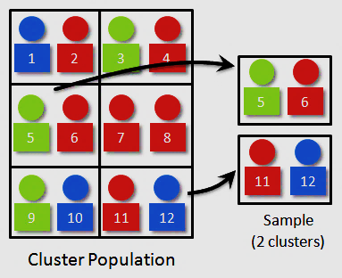

Slide 22
Advantages and disadvantages of probability random sampling
Advantages
.1- Eliminates researcher bias
2- a fast, easy, and inexpensive
3-Require limited knowledge about population
disadvantages
1- time consuming
2- Need a large sample size

Slide 23
Non probability sampling
It is the selection of subjects from a population using non random procedures not every member in the population has an opportunity for selection in the study sample
it has three types:
1.convenience sampling
2.quota sampling
3.Purposive sampling

Slide 24
1.convenience sampling
Some time called accidental or nonrandom sampling
Defintion :-Is the uses participants who are easily accessible to the researcher and who meet the criteria of the study
For ex. Take all patient admitted in surgical department with a particular diagnosis during this month

Slide 25
Advantages and Disadvantages of convenience sampling
Advantages:-
1. It easier for researcher to obtain subjects.
2. Save in time and money.
Disadvantages:-
1. The potential for sampling bias.
2. The use of a sample that may not represent population.
3. The limited generalization of the results.

Slide 26
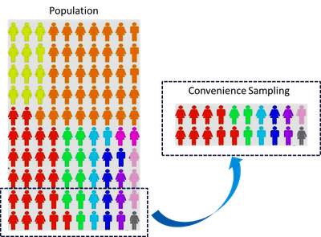

Slide 27
2.quota sampling
Quota sampling is similar to stratified random sampling in that participants are divided into strata based on specific characteristics to provide representativeness of different groups within the population.
Note :Quota sampling differs from stratified random sampling is that the participants are not randomly selected from each strata, are selected through convenience sampling

Slide 28
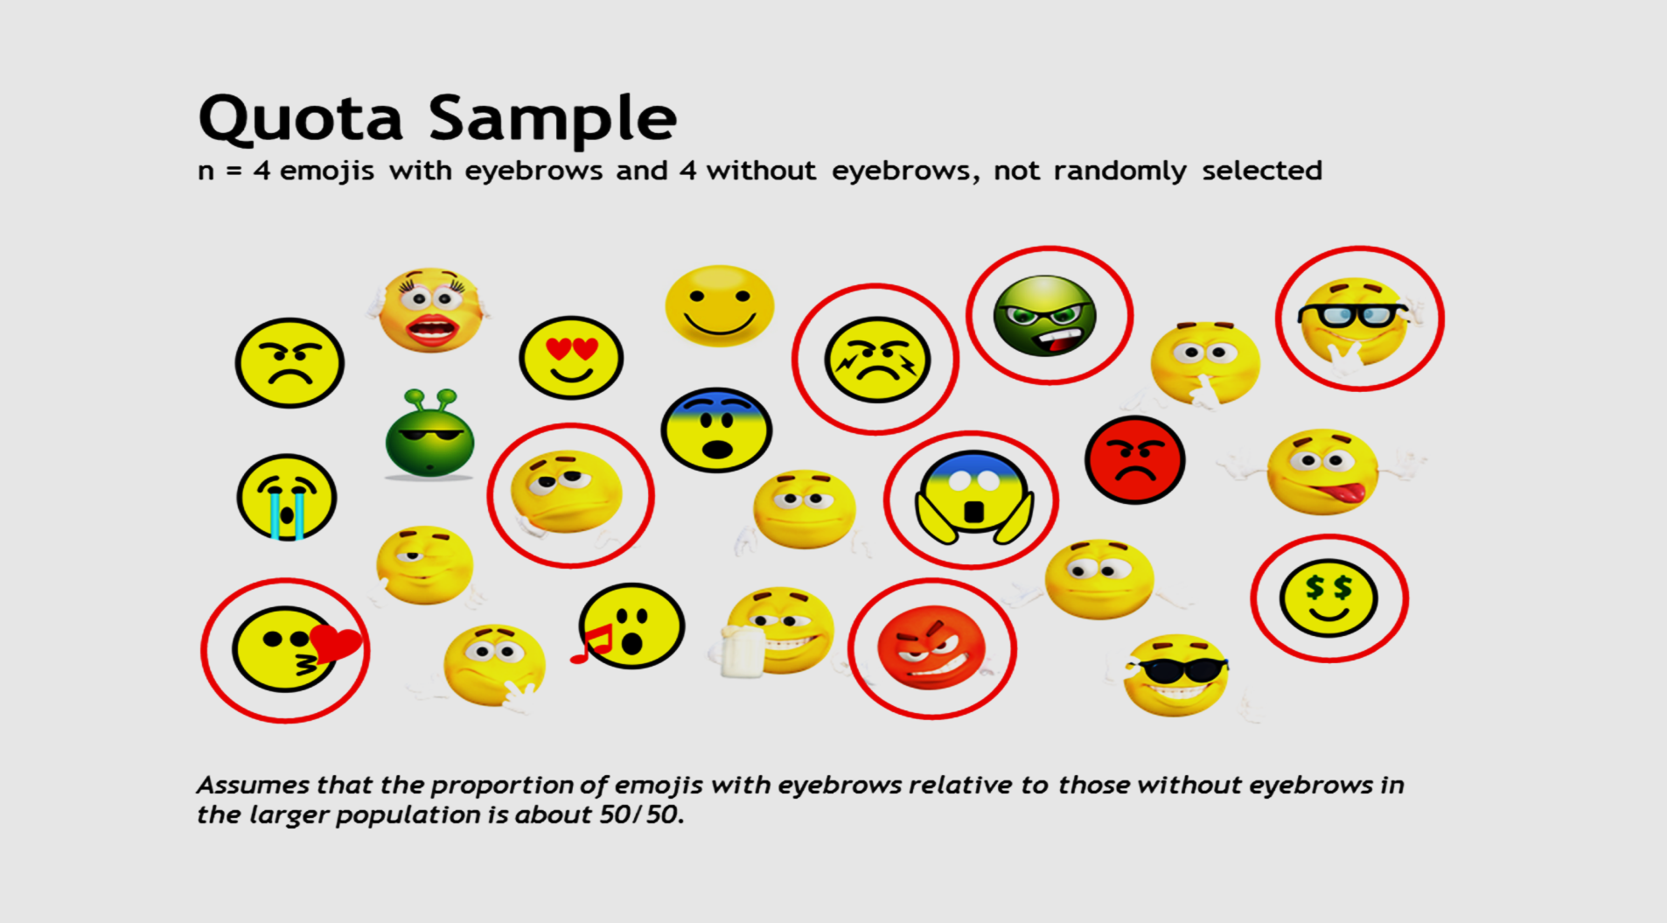

Slide 29
3.Purposive or judgment sampling
It involves the conscious selection by the researcher of certain subjects or elements to include the study.
It used to describe lived experience of a particular phenomena ( postpartum depression).

Slide 30
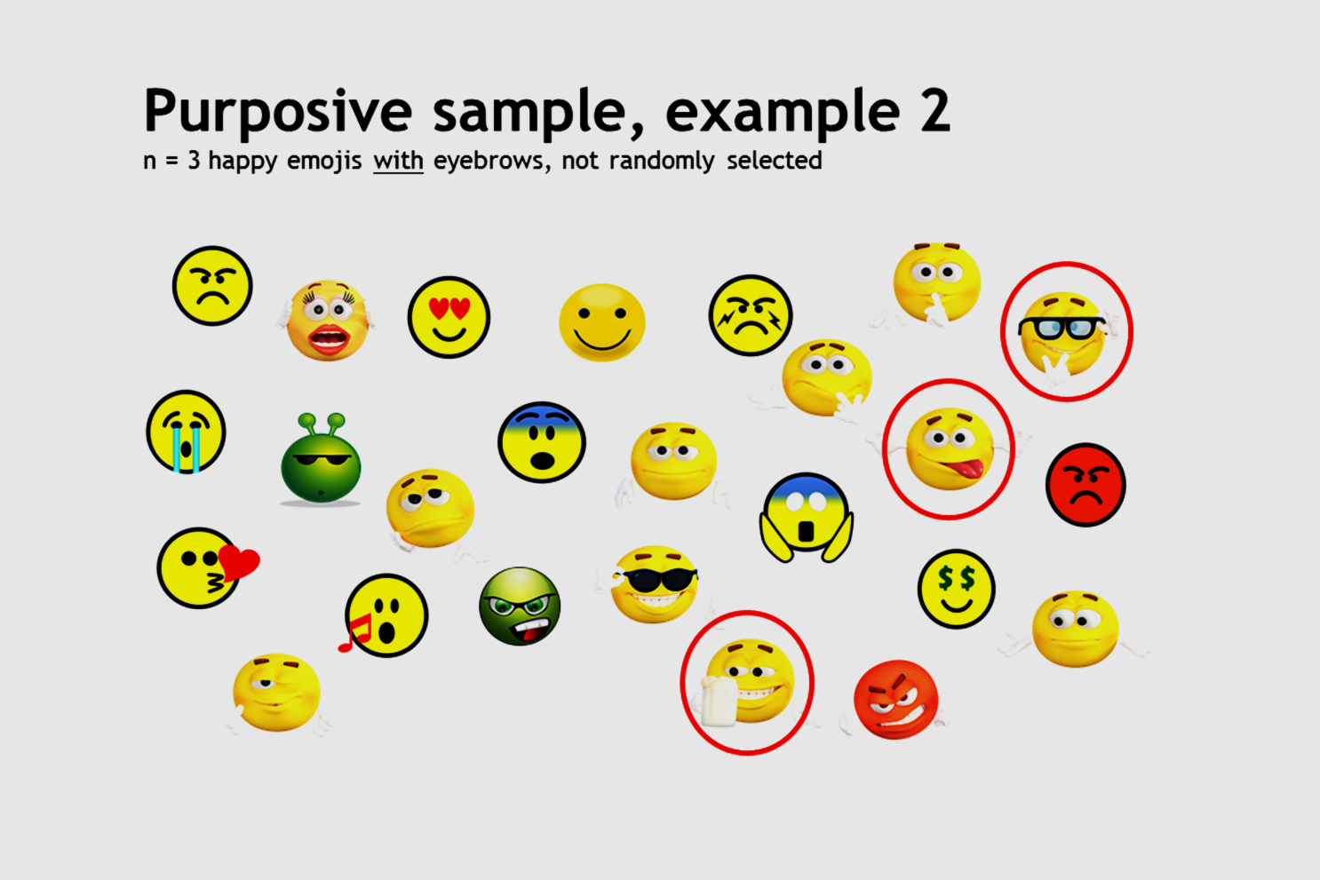

Slide 31
Snowball sampling
In this sampling technique, first one or two persons in the population are contacted and ask them to identify further persons.
Accordingly, new person are identified until there are as large as manageable sample.
The selection process is stopped when either no new people are identified or start to repeat the same people again and again.

Slide 32
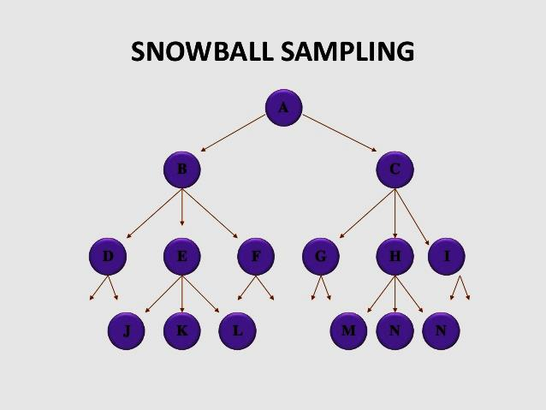

Slide 33
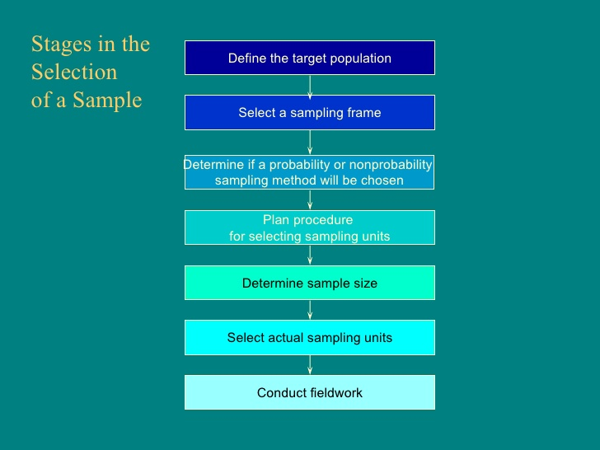

Slide 34


