Slide 1
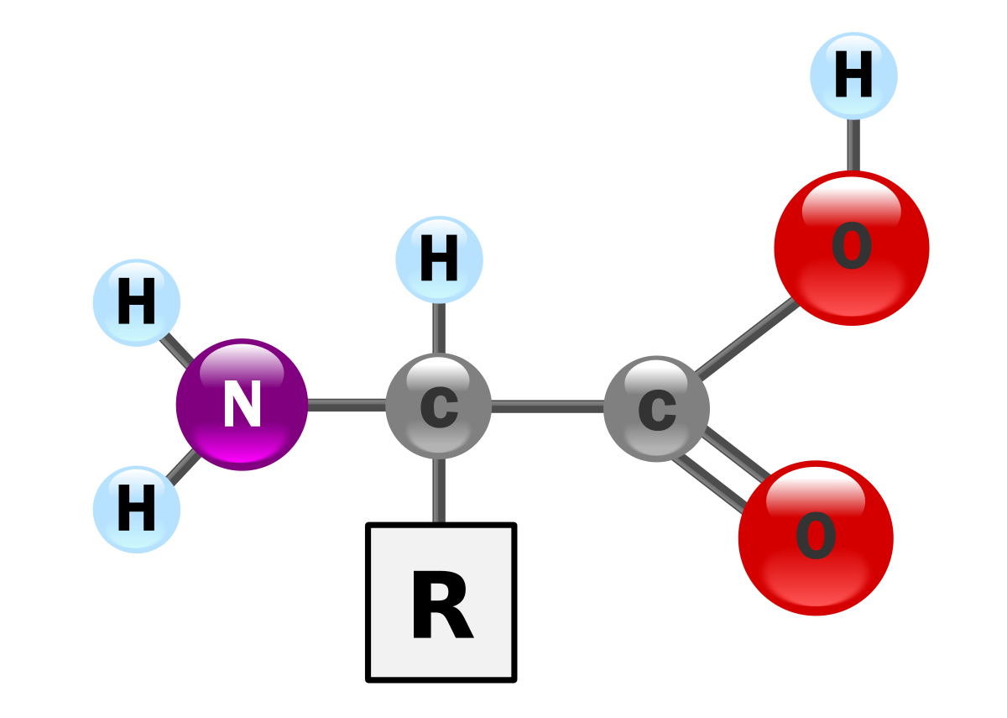

Reactions Of Proteins

Slide 2
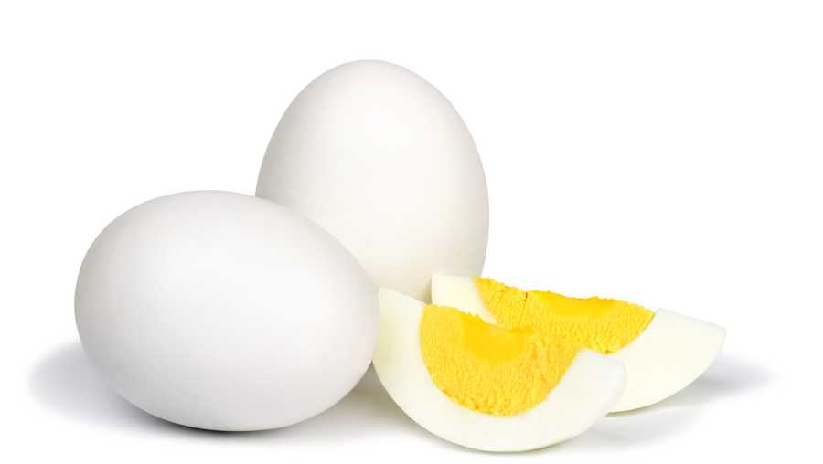
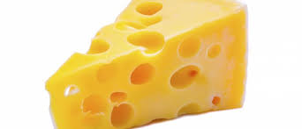
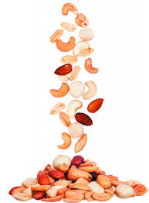
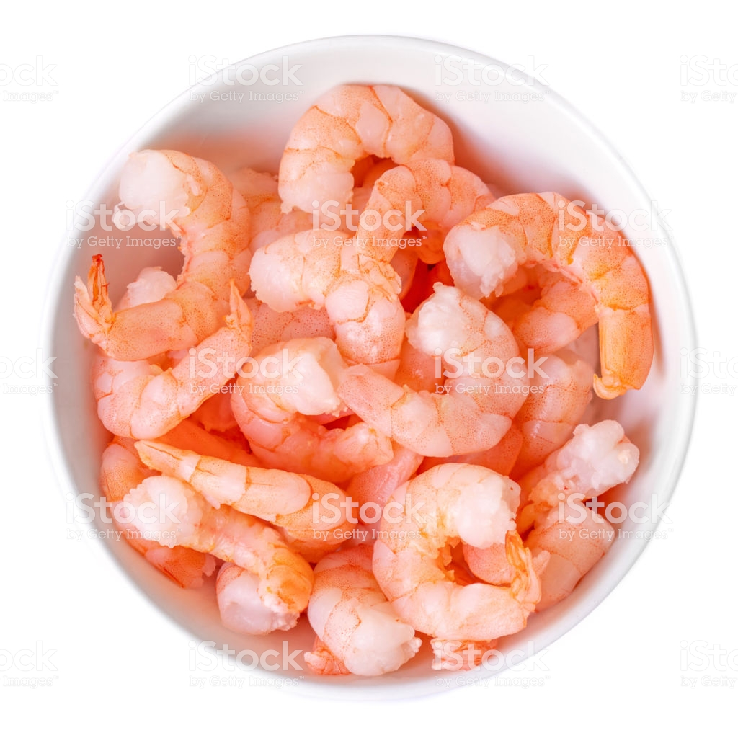
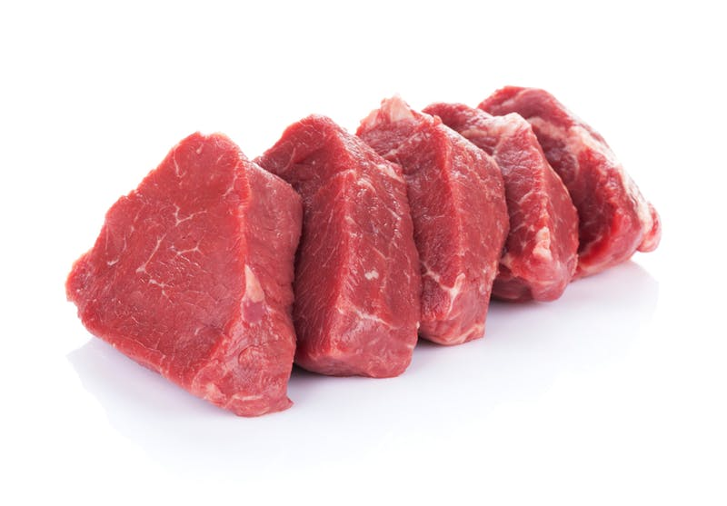
Proteins are found in variety of foods :

Slide 3
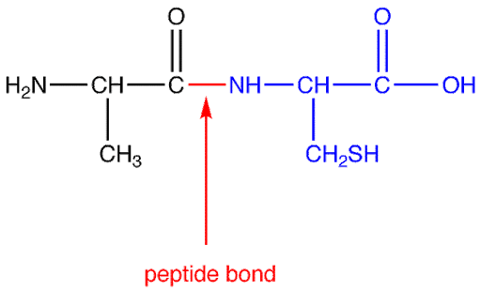
Proteins are Polypeptides formed from sequences of Amino Acids connected together by peptide bonds.
Carboxyl group
Amino group
Side chain

Slide 4
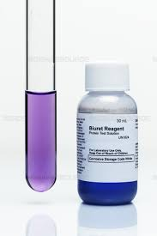
Biuret’s Test
General test for detection of proteins.
The reaction depends on the presence of at least 2 peptide bonds.

Slide 5
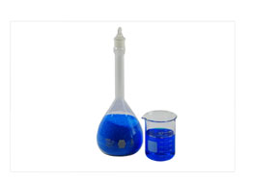
Reagents:
Sodium hydroxide ( NaOH ) alkalinizing reagent.
Colorless
Cupper Sulfate Solution (CuSo4 )
Blue in color

Slide 6
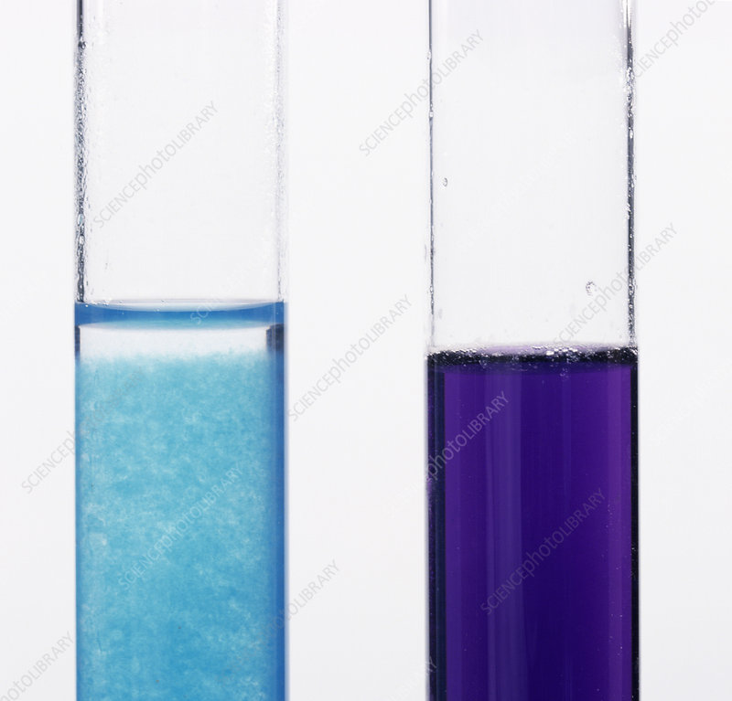
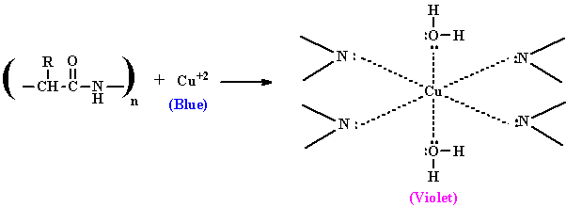
Principle:
In Alkaline medium Cupric ions reacts with peptide bonds to produce cupric peptide complex which gives Violet color.
-
+

Slide 7
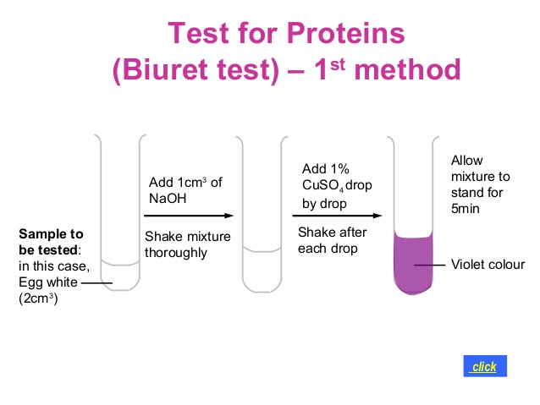

Slide 8
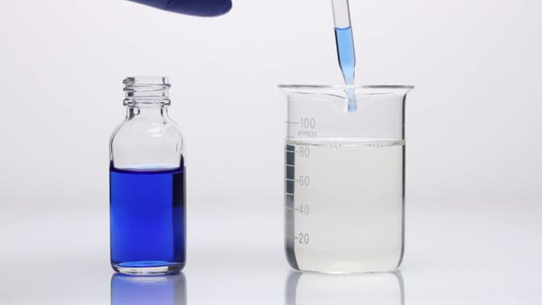
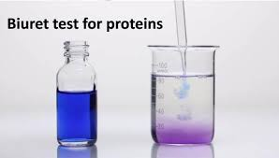
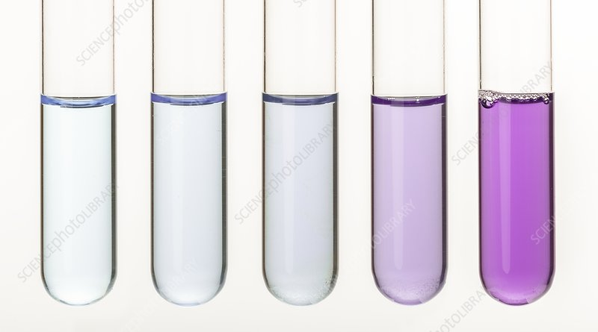

Slide 9
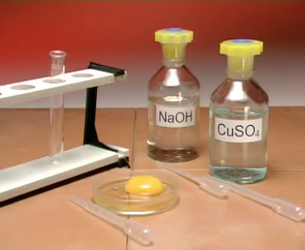
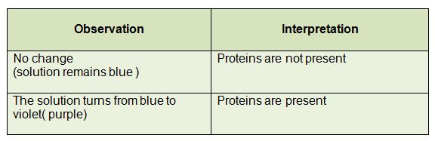

Slide 10
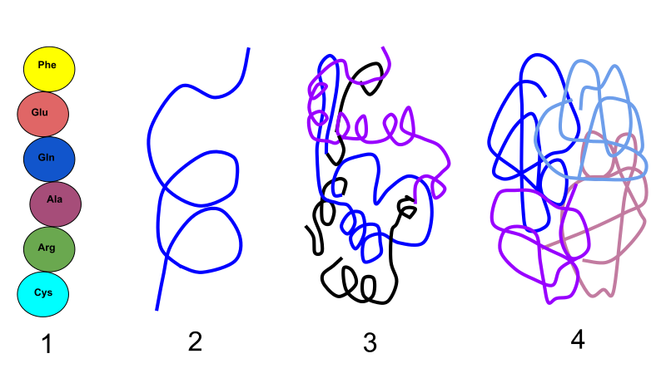
Heat Coagulation Test

Slide 11
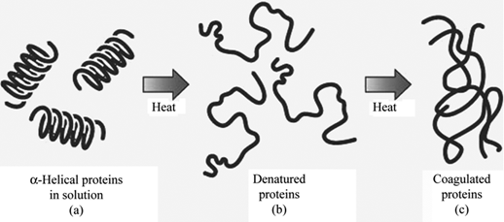
Heat Coagulation test:
Test used to differentiate between Albumin and Gelatin.
When protein is heated in acidic medium, it becomes denaturated because of breaking of certain bonds
Polypeptide chains become uncoiled and become melted together to form insoluble masses which is called coagulum.

Slide 12
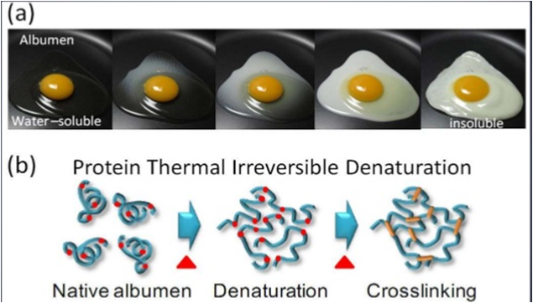
Principle:
Albumin is coagulated when heated, which is precipitated at the isoelectric point when acetic acid is added.

Slide 13
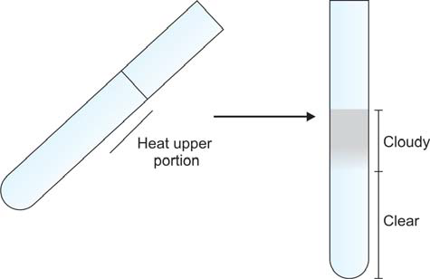
Procedure:
Fill 2\3 of test tube with the unknown solution.
Heat the upper portion of the test tube up to boiling.
  Turbidity indicates Albumin.
  No turbidity indicates Gelatin.
Add few drops of Acetic Acid in it as in alkaline medium heating may precipitate phosphate, So acidification is important.

Slide 14
Few drops of Acetic acid
If Turbidity persists
Albumin
I
if Turbidity disappears
Phosphate

Slide 15


Slide 16
Reactions of Proteins:
Biuret’s test
General test for detection of proteins.
Heat coagulation test
Differentiate between albumin and gelatin.

Slide 17
Thank You

