Slide 1


Slide 2

Physical examination
Prepared by:
Elham Atef Abdelazeem
Clinical Instructor of Pediatric Nursing Department

Slide 3
To encourage students to gain Knowledge, Skills and Positive Attitude toward Physical examination
Goal

Slide 4
Objectives
At the end of this lecture every student will be able to:
1- Define physical examination
2- List purposes of physical examination
3- Identify times of routine physical examination
4- Explain the sequence of physical examination in children

Slide 5
5- List assessment skills
6- Discuss preparation for examination
7- Perform complete physical examination

Slide 6
Outlines
1- Definition of physical examination
2- Purposes of physical examination
3- Times of routine physical examination
4- The sequence of physical examination in children
5- Assessment skills
6- Preparation for examination
7- Components of physical assessment

Slide 7
1- Definition of physical examination
Physical examination is a continuous process in which the body is examined from the head to toe and from general inspection to detailed investigation. It is performed by using the tools of inspection, palpation, percussion and auscultation.

Slide 8
2- Purpose of physical examination:-
To detect any abnormalities in its early stages.
To formulate nursing diagnosis.
To evaluate the effectiveness of interventions.

Slide 9
3- Times of physical examination:
Every month in the 1st year.
Every 3 month of the 2nd and 3rd year.
Each 6 month of 4th and 5th year.
Yearly after the 6th year.

Slide 10

4- Sequence of the assessment
head-to-toe sequence?
According to the child’s developmental needs.
For example : In quite infant start with auscultation of lung, heart and abdomen.

Slide 11
5-Assessment skills
1 – Inspection
2 - Palpation
3 - Percussion
4 - Auscultation

Slide 12

1 - Inspection:
Used for color, hygiene, mass, movement, behavior, flaccidity, symmetry, location, position
Careful inspection requires good lighting.

Slide 13
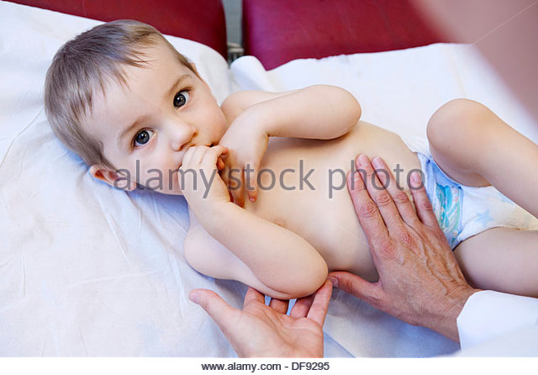
2 - Palpation:
the use of touch to detect both superficial and deeper characteristics of the body.
It is used to assess temperature, position, size, tenderness .

Slide 14
3 - Percussion:
Is tapping of the body surface to produce
Air filled spaces ------ resonance ( lung )
Solid objects --------dullness ( liver spleen heart kidney)

Slide 15

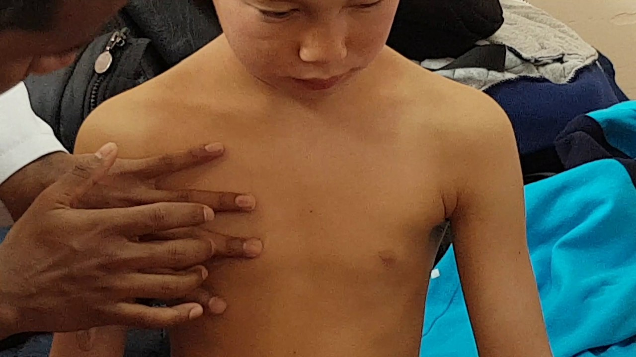

Slide 16

4 - Auscultation:
It used for assessment of the heart, lungs and abdomen using stethoscope.

Slide 17
6- Preparation for examination:
1- Hand washing
2- Prepare necessary equipment (gloves, gown, stethoscope, Thermometer, tongue depressor, tape measurement, swabs, . Mercury or digital sphygmomanometer , funduscope, otoscope , note paper, pen, hand wrist watch and paper bag )
3- Explain procedure to child or mother.

Slide 18
4- Place all strange and frightening equipment out of sight.
5- Place toys, bright posters
6- Limit number of people in room.
7- Provide privacy for school-age children and adolescents.
8- Provide time for play and becoming cooperative.
9- Have room temperature comfortably warm.

Slide 19
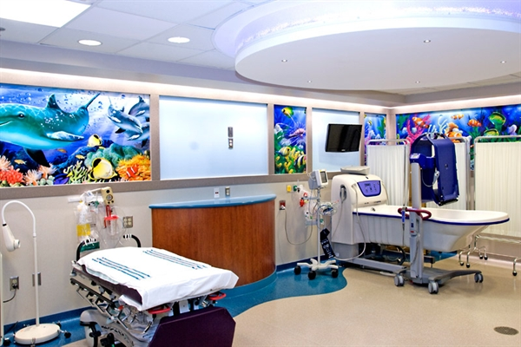

Slide 20
7- Components of physical assessment:
1- Growth measurement
2- Physiological measurements
3- General appearance
4- Skin
5-Accessory structures
6 -lymphnodes

Slide 21
7- Head
8- Neck
9- Eyes
10- Ears
11-Nose
12- Mouth and throat
13- Chest and Lung
14- Heart

Slide 22
15- Abdomen
16- Genitalia and anus
17- Musculoskeletal system
18- Nervous system

Slide 23
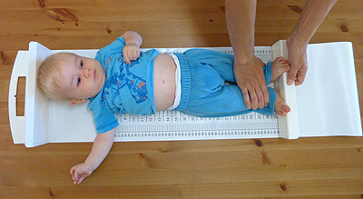
1- Growth measurement:
1- length

Slide 24
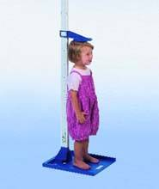
1- Height

Slide 25
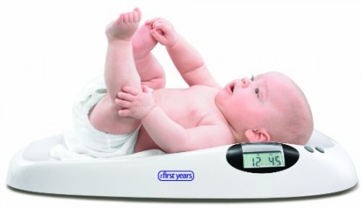
2- Weight

Slide 26
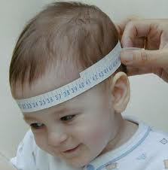
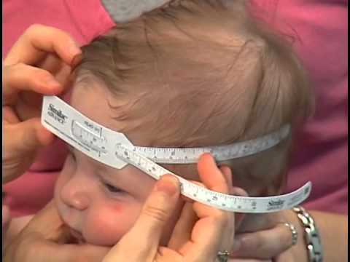
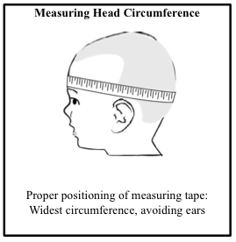
3- Head circumference

Slide 27
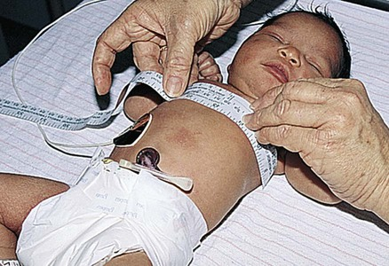
4- Chest circumference.
5- Mid arm circumference.

Slide 28
How to use Percentile growth charts to assess growth
Any child with a measurement below the 5th percentile or above the 95th percentile should be investigated for abnormal growth.

Slide 29
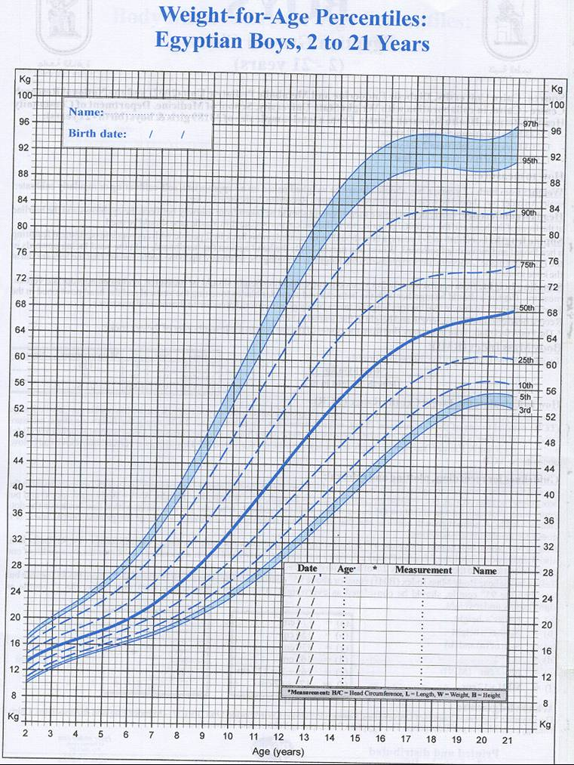
Growth chart

Slide 30
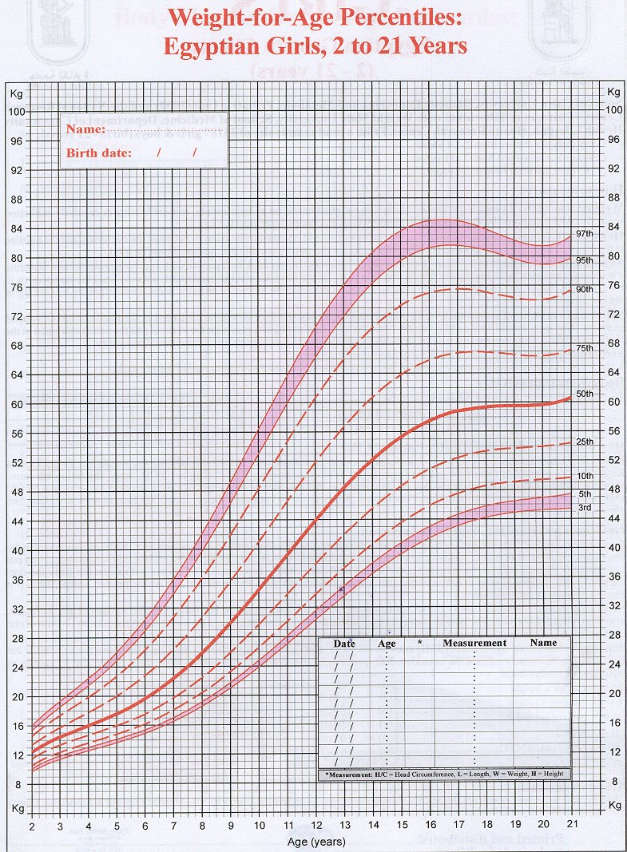
Growth chart

Slide 31
2- Physiological measurements (V/S) : -
1-Temperature
2- Pulse
3- Respiration
4- Blood pressure.

Slide 32
Blood pressure
Normal of the newborn's blood pressure:
Systolic: 46 -92 ( mmHg).
Diastolic: 38- 71 (mmHg).

Slide 33
The average Systolic blood pressure for Children:
1 to 7 years: age in year + 90
8 to 18 years: (2 x age in year) + 83
The average Diastolic blood pressure for children:
1 to 5 years: 56
6 to 18 years: age in year + 52

Slide 34
3 - General appearance
A- Facial expression
B- Posture and body movements
C- Hygiene
D- Nutrition
E- Behavior
F- Development

Slide 35
A- Facial expression
Emotional status (Pain, feel frightened, anxious)
Difficulty in breathing
Have mentally deficient or are acutely ill.

Slide 36
B- Posture and body movements:
The child with hearing or vision loss may his head in an awkward
The site of pain
Child in pain may favor a body part.

Slide 37
C- Hygiene
Note unusual odor, the condition of the hair, neck, nails, teeth and feet and the condition of the clothing.
Poor hygiene indicates :
----Neglect
----Poor socioeconomic status
----Lack of knowledge of children's needs

Slide 38
D- Nutrition
Signs of chronic under nutrition→ bony prominences, protuberant abdomen, flat buttocks, grunt faces and poor muscle tone, hair changes and skin changes.

Slide 39
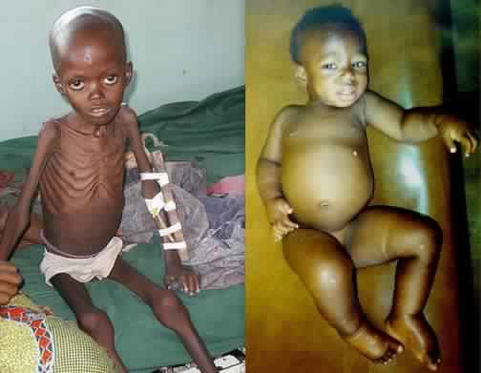
Marasmus --------------------------------kwashiorkor

Slide 40
E- Behavior
It includes child's personality, level of activity
Interaction with others,
Has short or long attention span or easy distracted.

Slide 41
F- Development
The child's speech development
Motor skills
Degree of coordination and recent area of achievement.

Slide 42
4- Skin
A- Color
B- Temperature
C- Turgor.

Slide 43
A- Color:
Abnormal skin color:
Pallor -------( anemia , internal bleeding )
Cyanosis ----- (respiratory and cardiac disorders).
jaundice. ------- ( liver disorders)

Slide 44
B- Temperature: -
Comparing upper areas with lower ones.
In cases of Coarctation of the aorta are warm upper extremities and cool lower ones.

Slide 45
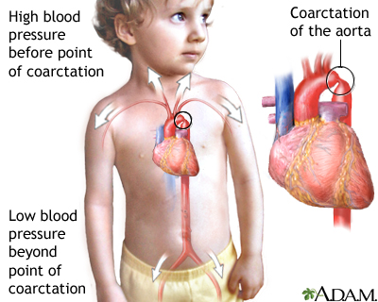

Slide 46
C-Turgor:-
---The amount of elasticity in the skin
---By grasping the skin on the abdomen between the thumb and index finger.
---Poor skin turgor is commonly associated with dehydration.

Slide 47
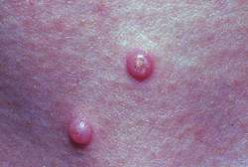
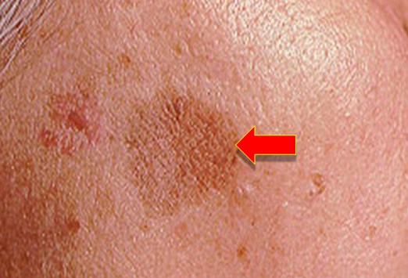
Skin is assessed for any lesions (macules, papules, vesicles, wounds)
Macules
Papules

Slide 48
5-Accessory structures:
A- Hair
B- Nails
C- Dermatoglyphics

Slide 49
A- Hair
Color
Texture and quality
Distribution
Elasticity.
Abnormality ( Alopecia, dandruff or lice).
Hair that is dull, brittle, dry, friable, and depigmented may suggest poor nutrition.

Slide 50
B- Nails: -
Color---------( pink)
Shape --------( convex)
Texture -----( smooth)
Quality -----( hard but flexible)

Slide 51
C- Dermatoglyphics: -
----The palm normally shows three flexion creases
in some situations the two distal horizontal creases are fused to form single horizontal creases called simian crease, which occurs in chromosomal abnormalities e.g., Down syndrome.

Slide 52
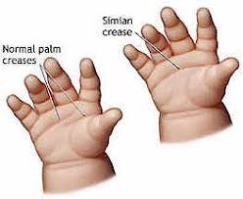

Slide 53
6 -lymphnodes
Using finger pads pressing in a circular motion
Size
Mobility
Temperature and tenderness.
Tender, enlarged, warm, and firm lymph nodes generally indicate infection or inflammation

Slide 54
The usual sites for palpating accessible lymph nodes are:
Occipital lymph nodes
Pre auricular and post auricular lymph nodes
Cervical lymph nodes
Tonsillar, sub mandible, sub lingual lymph nodes
Sub clavicles and supra clavicales lymph nodes
Axillary lymph nodes
Superficial inguinal and deep inguinal lymph nodes

Slide 55
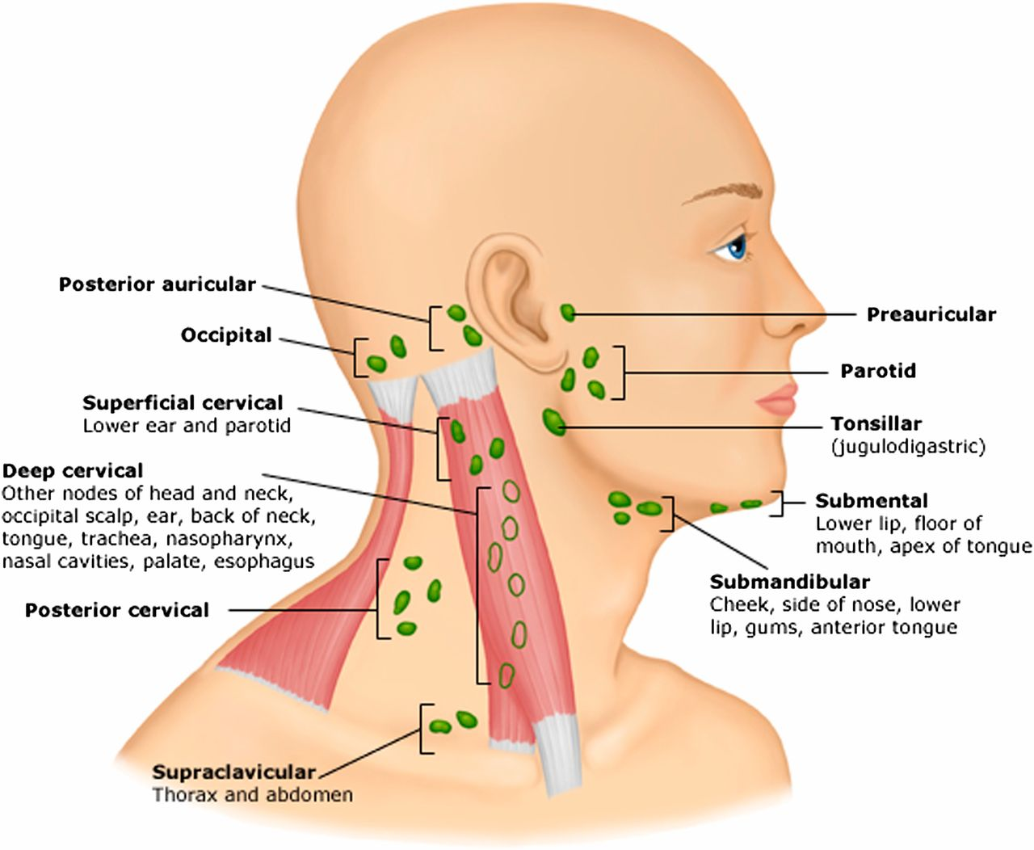

Slide 56
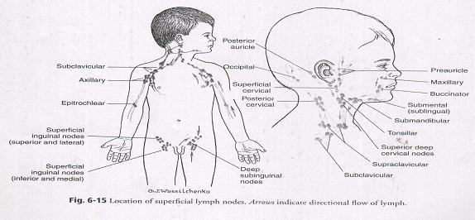

Slide 57
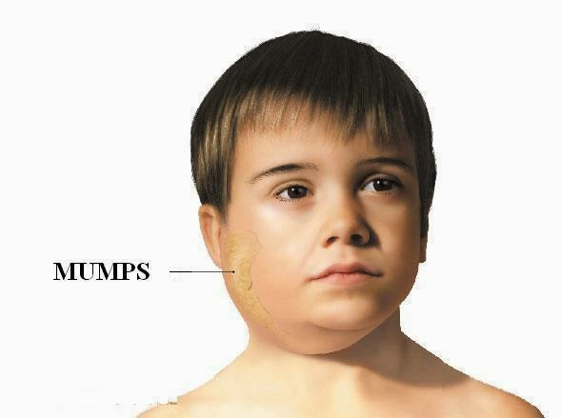

Slide 58
7- Head
1- Shape and symmetry. The scalp is examined for cleanliness, lesion, signs of trauma such an ecchymosis, masses, or scares.

Slide 59
2- The head circumference of infants and young children is routinely measured until 3 years of age to ensure that adequate growth for brain development has occurred.

Slide 60
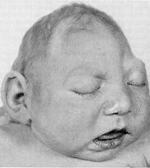
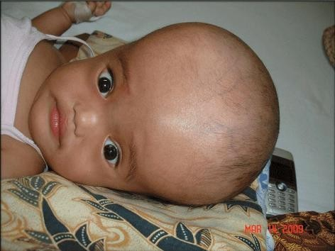
Microcephaly
Hydrocephalus

Slide 61
3- palpated for fontanels, fractures and swelling.
A tense fontanel, bulging above the margin of the skull, is an indication of increased intracranial pressure.
A soft fontanel, sunken below the margin of the skull, is associated with dehydration.

Slide 62
8- Neck
1- Short with skin folds between the head and shoulders during infancy
2- It lengthens during the next 3 to 4 years.
Abnormal findings as edema the nurse palpates for the thyroid gland, which is located at the base of the neck.

Slide 63
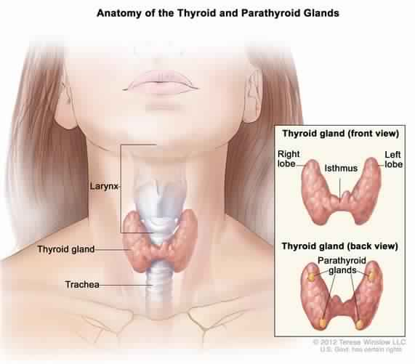
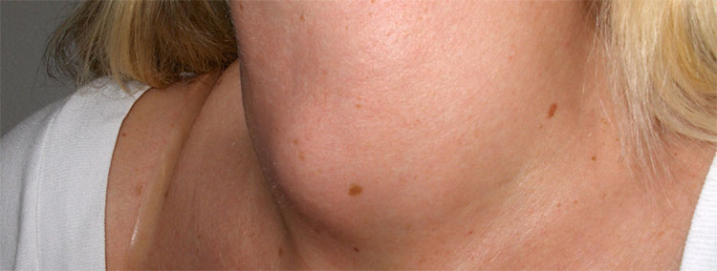

Slide 64
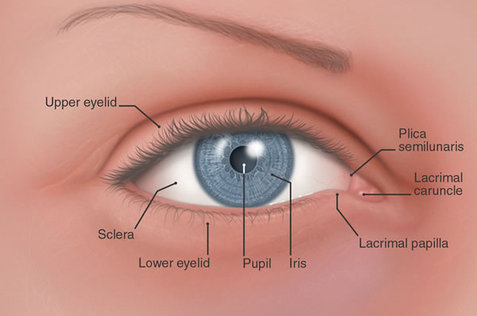
9- Eyes

Slide 65
Inspection of external structures
1- Note any excessive tearing, discharge, or inflammation of the lacrimal apparatus.
2- Inspect the iris and pupil for color, size, shape, and clarity.
They should be round, clear, and equal.

Slide 66
-----Permanent eye color is usually established by 6 to 12 months of age.
3- The cornea, or covering of the iris and pupil, should be clear and transparent.
4- Large spacing between the eyes is called hypertelorism this may suggest mental retardation (average space= 3 cm).

Slide 67

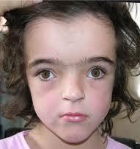
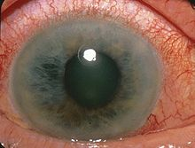
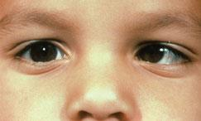
Hypertelorism
Conjunctivitis
Glaucoma
Strabismus

Slide 68
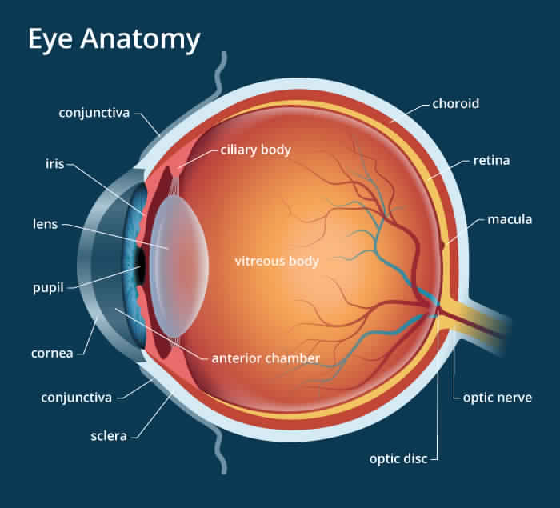

Slide 69
Inspection of the internal structures: -
The funduscopic examination allows inspection of the internal eye structures
(The retina, optic disc, arteries and veins, and macula).

Slide 70
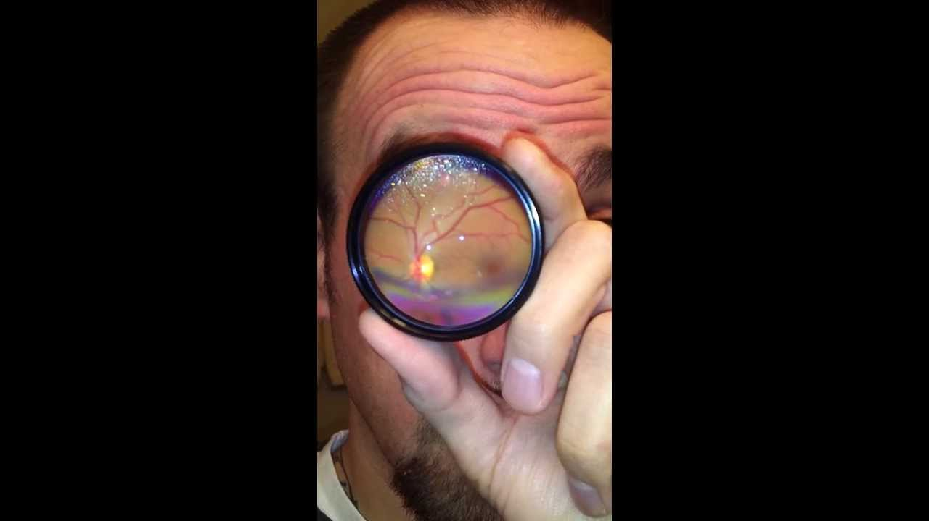
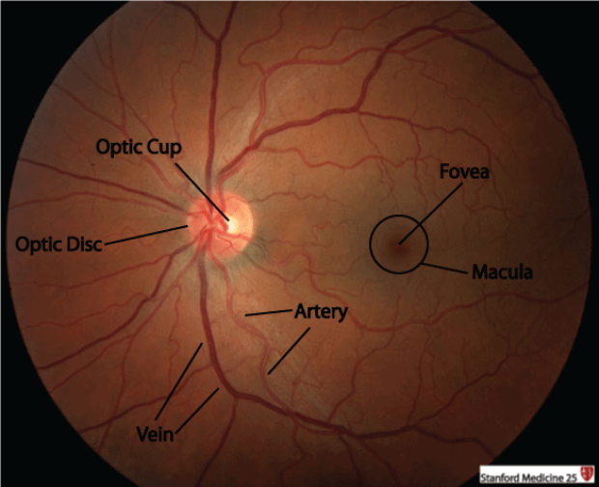

Slide 71
10- Ears
Inspection of external structures
1- Inspect the external ear canal for general hygiene, discharge; foul-smelling, yellow or green or bloody discharge may indicate rupture of tympanic membrane.

Slide 72
2- Placement and alignment: -
----The top of he ear should cross an imaginary line from the inner eye to the occiput.
----The ear should deviate no more than 10 degrees from a line perpendicular to the horizontal line.
Low or obliquely set ears are sometimes seen in children with Genitourinary or chromosomal abnormalities.

Slide 73
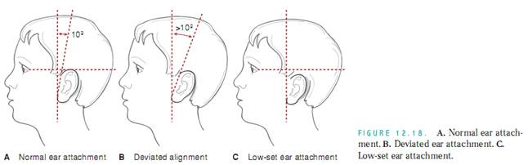

Slide 74
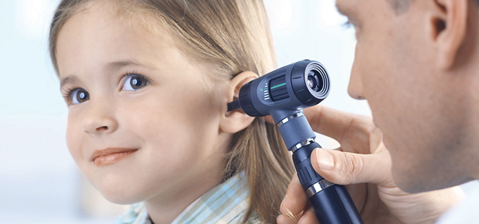
Inspection of internal structures
The color of the tympanic membrane is normally pink or gray color.

Slide 75
Pull pinna down and back More than 3 years Pull pinna up and back

Slide 76
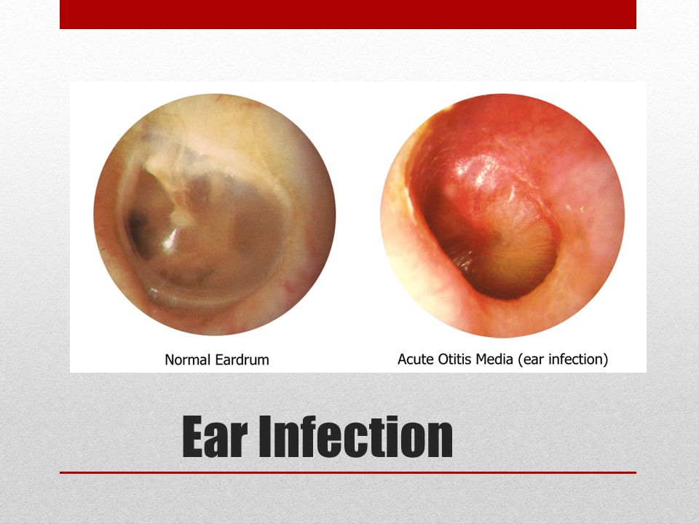

Slide 77
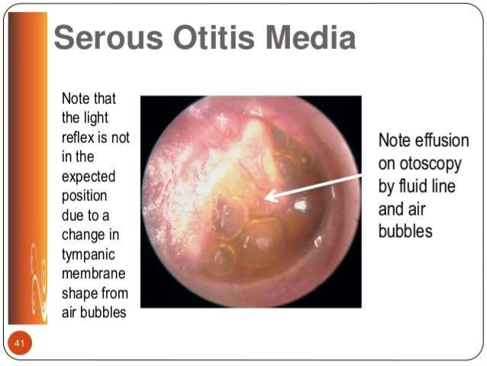
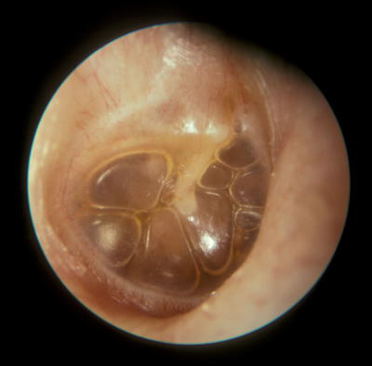

Slide 78
11-Nose
1- Note location or any deviation to one side asymmetry in overall size and in diameter of the nares.
2- Nose are noted for any sign of flaring which indication respiratory difficulty.
Inspection of the internal structure.
1- Note mucosal lining, any swelling, discharge, dryness or bleeding.
2- The septum is also inspected for any deviation.

Slide 79
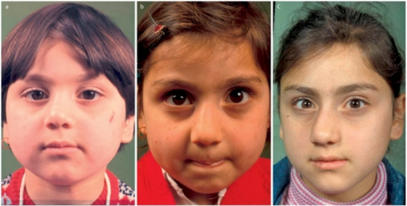
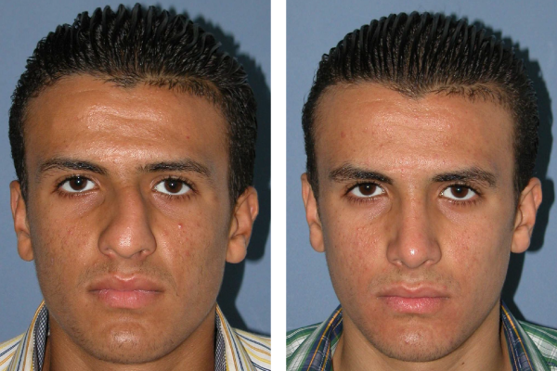
deviation of the nose

Slide 80
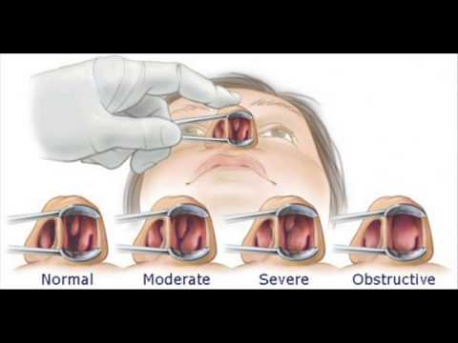
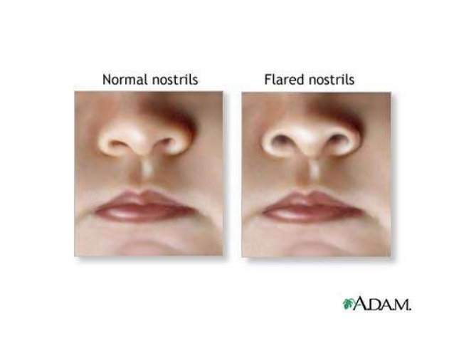
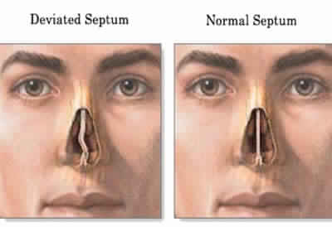
Polyps

Slide 81
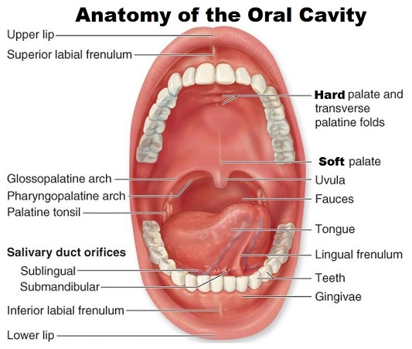
12- Mouth and throat
1- Inspection of the lips for color
2- Teeth for hygiene and number
3- Soft palate and hard palate for intactness
4- observe tongue movement

Slide 82
Abnormal mouth smells :
A cheesy smell usually indicates your bad breath has a nasal origin.
A fruity smell may indicate uncontrolled diabetes
A fishy smell may indicate kidney disease, as increased urea levels
A sweet, musty odor may signal liver cirrhosis
A fecal odor may point to a bowel obstruction

Slide 83
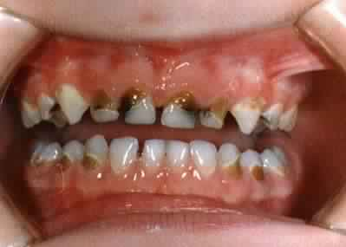
Tooth decay

Slide 84
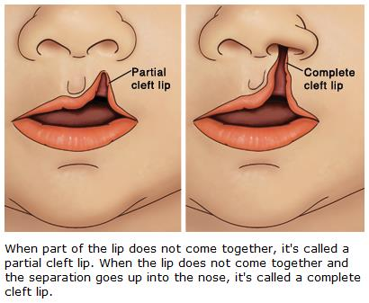

Slide 85
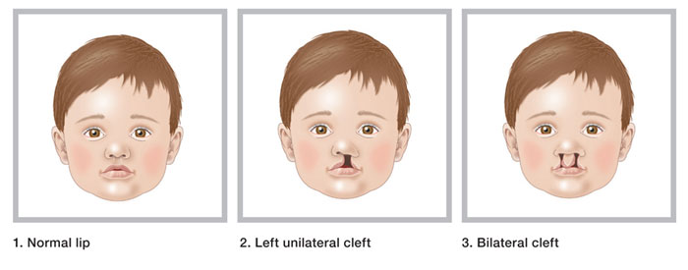

Slide 86
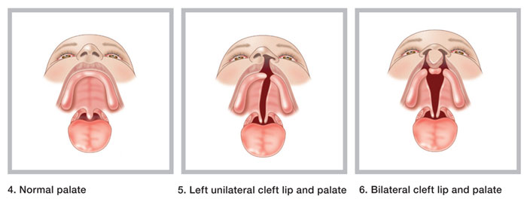

Slide 87
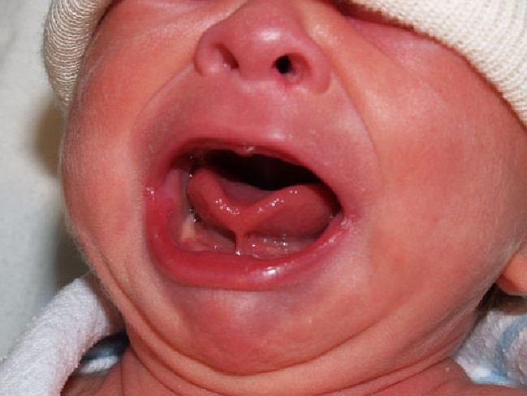
Tongue tie

Slide 88
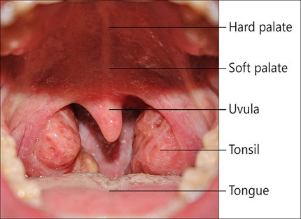

Slide 89
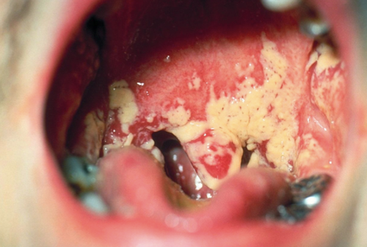
Diphtheria

Slide 90
13-Chest and Lung:
Inspection:
Note the chest movement. It should symmetric bilaterally and coordinated with breathing.
----- In children under 6-7 years of age respiratory movement is principally abdominal
----- In older children, respiration is chiefly thoracic.

Slide 91
B. Observe the rate and depth of respiration.
Normal respiration is regular in depth and rhythm.
An increase in the rate of respiration is called tachypnea; an increase in depth is called hyperpnoea.
Chest retraction is a sign of respiratory distress.

Slide 92
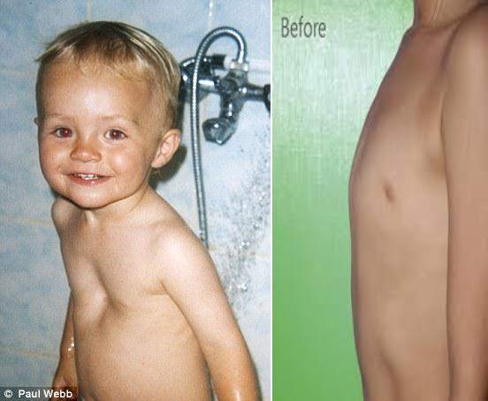
C- Inspect shape of chest
Funnel chest ------------------------------------------pigeon chest

Slide 93

D- Inspect for chest retractions

Slide 94


Intercostal retraction Substernal retractions

Slide 95
Palpation
1- Palpate the thorax for breast tissue and tenderness, masses, lesions
2- Respiratory Excursion
The estimation of thoracic expansion .

Slide 96


Slide 97
Anterior
-----The examiner's thumbs are placed along each costal margin, below the xiphoid process, while the hand rest along the lateral rib cage.
-----The patient is instructed to inhale deeply
examiner observes the movement of the thumps during inspiration and expiration.

Slide 98


Slide 99
A posterior
Placing the thumbs adjacent to the spinal column at the level of the 10 th ribs.
Respiratory lag or impairment is often the result of fractured ribs or trauma to the chest wall.

Slide 100


Slide 101
3- Tactile fremitus
---- Instructs the child to repeat the word (ninety-nine) with each movement of the examiner's hands.
------ The vibrations are perceived by placing the palmer surfaces of the fingers and hands on the thorax

Slide 102
Percussion:
Percussion of posterior chest:
Ideally the patient is in a sitting position with the head flexed forward and the arms crossed on the lap.
Percussion over the anterior chest:
Performed with patient in an upright position with shoulders arched backward and arms at the side.

Slide 103


Slide 104


Slide 105


Slide 106
Dullness noted to the left of the sternum between the 3rd and the 5th intercostal spaces is normal finding of the heart.
Similarly, there is a normal span of
liver dullness

Slide 107
The lateral walls are examined by having the patient alternately raise an arm and rest of the hand on his head while the examiner percusses from the axilla down to the costal margin.

Slide 108
Auscultation
1- Bronchial breath sounds: Heard only over the trachea near the suprasternal notch.
Expiration is louder, longer, and higher pitched than inspiration.

Slide 109
2- Broncho-Vesicular breath sounds: Heard over manubrium and in upper intrascapular regions where trachea and bronchi bifurcate. Inspiration = expiration.

Slide 110
3- Vesicular breath sounds Heard over entire surface of the lungs, with the exception of upper intrascapular area and area beneath manubrium. Inspiration is louder, longer, and higher pitched than expiration,

Slide 111
Intensity of breath sound usually diminished in many conditions e.g., bronchial asthma, collapse, fibrosis, emphysema, pleural effusion.

Slide 112
Abnormal sounds
Crackles, which result from the passage of air through fluid or moisture.
Wheezes, which are produced as air passes through narrowed passageways, regardless of the cause, such as exudate, inflammation, spasm, or tumor e.g., bronchial asthma, bronchitis

Slide 113
14- Heart
Inspection
---In semi-Fowler's position.
--- Observe chest wall from front and note obvious bulging.
--- Apical impulse some time appears in the thin child.

Slide 114
Note:
----The presence of all pulses (especially the femoral pulses), -------Distended neck veins
----Clubbing of the fingers
----Peripheral cyanosis
----Edema, blood pressure, and respiratory status.

Slide 115


Slide 116
Palpation:
1-Apical impulse (AI):
----LMCL and fifth ICS in children over 7 years of age.
----LMCL and fourth ICS in children less than 7 years of age

Slide 117
2- Capillary filling time
Press the skin lightly on a central site, e.g., forehead or peripheral site, e.g. top of the hand to produce a slight blanching.
(It is normally 1 - 2 seconds).

Slide 118
Percussion
In normal patient, only the left border of the heart is located by percussion. It extends from the sternum to the midclavicular line in the third to fifth intercostal space.

Slide 119


Slide 120
Auscultation
The heart sounds are produced by the opening and closing of the valves and the vibration of blood against the wall of the heart and vessels. "Normally, two sounds SI and S2 are heard, which correspond respectively to the familiar "lub dub" often used to describe the sounds.

Slide 121


Slide 122


Slide 123
The heart sounds are evaluated for:
1- Quality: should be clear and distant and not muffled or diffuse.
2- Intensity: especially in relation to location or auscultatory site.
3- Rate: should be the same as the radial pulse.
4- Rhythm: should be regular .

Slide 124
In general, recognize murmurs
Location, or the area of the heart in which the murmur is heard best
Time of the occurrence of the murmur within the S1-S2 cycle;
loudness.

Slide 125


Slide 126
S1 Systole S2 Diastole S1
Aortic stenosis
Pulmonic stenosis
Tricuspid regurgitation
Mitral regurgitation
Tricuspid stenosis
Mitral stenosis
Aortic regurgitation
Pulmonic regurgitation

Slide 127
Note:
Normally in many children is sinus arrhythmia, in which the heart rate increases with inspiration and decreases with expiration.

Slide 128
15- Abdomen
1- Supine position during examination with pillow under the Head
2- The knee flexed to enhance abdominal relaxation.
3- The abdomen is divided into four quadrants that correlate with underlying palpation because it may distort the normal abdominal sounds.

Slide 129
Inspection
1- The contour, symmetry, characteristics of the umbilicus, skin, pulsation and movement.
---------Normally, the abdomen of infant and child is quite cylindrical and in the erect position, fairly prominent because of the physiologic lordosis of the spine.
----------In supine position the abdomen appears flat.

Slide 130


Slide 131
2- Examine the umbilicus for size, hygiene, and evidence of any abnormalities, such as hernias. Inguinal hernia occurs mostly in males while femoral hernia occurs more frequently in girls.

Slide 132



Slide 133


Slide 134
Auscultation
Listen for is peristalsis-------- clicks and gurgles.
Their frequency per minute should be recorded e.g.
five bowel sound / minute.

Slide 135
The absence of bowel signs, except in patients who have just had surgery,
----------may indicate peritonitis or a paralytic ileus.
Hyperactive bowel sounds, on the other hand, may indicate gastroenteritis or a bowel obstruction.

Slide 136
Percussion
Hollow organs will produce tympanic sounds
Solid or fluid filled tissue will produce a dull sounds.

Slide 137
Palpation
Guide lines for promoting relaxation during palpation:
- Comfortable position with knee flexed
Warm hands
Use distraction such as telling stories or talking to the child
- Give infant a bottle, pacifier or toy
- Palpate painful areas last

Slide 138
---- The nurse can assist the ticklish child
by first placing the child's hands on the skin and gradually sliding hands over those of the child.

Slide 139


Slide 140
There are two types of palpation:
For superficial palpation,
------noting any areas of tenderness, muscle tone, and superficial lesions.

Slide 141
Deep palpation
------begins in the lower quadrants and proceeds upward to avoid missing the edge of an enlarged liver or spleen.
-----The lower edge of the liver is sometimes felt in infants and young children as a superficial mass 1 to 2 cm below the right costal margin.

Slide 142
Abnormalities:
-----If the liver is palpable 3 cm below the right costal margin
-----the spleen is palpable more than 2 cm below the left costal margin, these organs are enlarged.

Slide 143
16- Genitalia and anus
--In males assess for location of the scrotum, size of the penis, glands, and urethral meatus. While palpating scrotum for descended testes block inguinal canal with opposite hands.

Slide 144
-- The female genitalia are examined for size and location of the structures of the vulva, clitoris, labia majora, labia minora, urethral meatus and vaginal orifice.
-- Assess the tone of the anal sphincter and surrounding skin for rash or lesion.

Slide 145
17- Musculoskeletal system
General inspection
--comparing the two sides of the body for symmetry contour, size and involuntary movement.
swelling or edema and ecchymosis or other discoloration.

Slide 146

a- Spine
The back of a newborn is rounded or C- shaped from the thoracic and the pelvic curves.
------older child the typical double S- curve.

Slide 147


Slide 148


Slide 149


Slide 150
b- Extremities
Each extremity is inspected for symmetry of length and size.
1- Bow leg:
------The space between the knees is greater than 5 cm (2 inches). ------Unilateral or symmetric bowlegs that are present beyond the age of 2 to 3 years may represent pathological condition.

Slide 151
Knock-knee:
-----The knees are close together but the feet are spread apart
the distance between the malleoli, which normally should be less than 7.5 cm (3 inches).
------- It is normally present in children from 2-7 years of age.

Slide 152


Slide 153

Bowlegged

Slide 154

C- Feet
Feet are inspected. Infants' and. toddlers' feet
appear flat because the foot is normally wide and arch is covered by a flat pad. Development of the arch occurs naturally during the action of walking.

Slide 155


Slide 156
D- Joints
Joints are evaluated for range of motion, tenderness and swelling, redness and heat.

Slide 157


Slide 158
E- Muscles
To assess the strength of each muscle
--- ask the child to flex the muscle and then resist, as opposing force is applied against flexion.
Muscle tone should be firm on palpation.

Slide 159
-- A common site for testing tone is the "biceps muscle" by clenching their fist, strength is estimated by having the child use an extremity to push or pull against resistance (arm strength, hand strength and leg strength).

Slide 160
18- Nervous system
A- Assess mental status
( child's behavior, mood, affect, general orientation to surrounding and level of consciousness).
Test the vision and hearing.

Slide 161
B- Assess sensory intactness and discrimination
A- For sensory intactness
the examiner touch the child's skin lightly with a pin, then ask the child while he is closing his eyes to point to the stimulated area.

Slide 162
b- For sensory discrimination,
the examiner touch the child's skin with pin and cotton and ask him/her to describe it was sharp or dull.
C- Touch the child's skin with warm and cold object and ask him/her to differentiate between temperatures.

Slide 163
C- Assess reflexes for the newborn and infants
A- Permanent
1- Blinking reflex
2- Sneezing and coughing reflexes
3- Gagging reflex
4- Swallowing reflex

Slide 164
B- Temporary
1- Rooting reflex
It disappears when awake age of 4 months
and 7 months when a sleep.
2- Sucking reflex
It begins to diminish at 6 months of age.
3- Grasping reflex
It disappears between 6weeks and 3 months.

Slide 165
4- Moro reflex
It disappears by 4 months.
5- Tonic neck reflex:
It disappears by 18-20 weeks after birth.
6- Dancing reflex:
It disappears by 3- 4 weeks after birth.

Slide 166


Slide 167



