Slide 1



Slide 2

Phototherapy

Slide 3

Prepared by:
Elham Atef Abdelazzem
Demonstrator at Pediatric Nursing Department

Slide 4
Outlines
Introduction
Definition
Indications
Role of nurse during phototherapy
Side effects

Slide 5
Introduction:
Neonatal jaundice is a common condition among newborn babies and phototherapy is the effective and reliable method of its management

Slide 6
Definition:
Phototherapy is the procedure in which the baby is exposed to visible lights which causes the photo-oxidation and photo isomerization of bilirubin into water soluble, colorless form of bilirubin

Slide 7
Normal values of unconjugated bilirubin
are 0.2 to 1.4 mg/dl.
In the newborn, levels must exceed 5 mg/ dl before jaundice is observable

Slide 8
White/blue light fluorescent tubes are available
Double light system is also used
Intensive Phototherapy should produce a decline in total serum bilirubin of 1 - 2 mg/dl within 4-6 hrs.

Slide 9
Indications:
it is used when bilirubin level is:
1- 5-9 mg/dl at the 1st day of life
2- 9-15 mg/dl at the 2nd day of life
3- 15-20 mg/dl at the 3rd day of life

Slide 10
Role of nurse while giving phototherapy:
1- Check the lights of the phototherapy unit before use , no loose electric connection should be there
2- Clean the glass surface of the phototherapy unit
3- The lamp should be 5-8 cm over the incubator or 45- 50 cm from the baby skin

Slide 11
4- The eyes and the genitalia should be covered while phototherapy is in use
5- The eye shield should not be too tight or too loose
6- Eye patches should be removed every 4 hourly
7- Turn the position of the baby so that the entire body surface gets exposure

Slide 12
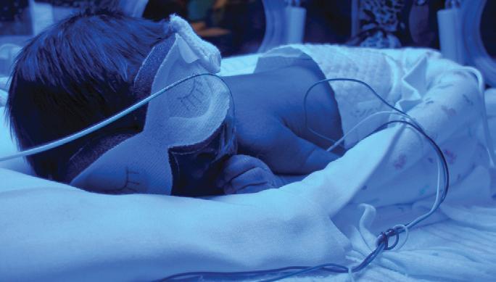

Slide 13
8- Cleanse skin frequently to prevent irritation
9- Monitor infant's temperature frequently
10- Daily weight and close monitoring of I/O must be done
11- Encourage breast feeding every 2 hourly
12- Observe skin, mucous membranes and stool

Slide 14
13- Take the baby out of the phototherapy at times ( while feeding )
14- Bilirubin level should be followed for at least 24hours after discontinuing phototherapy

Slide 15
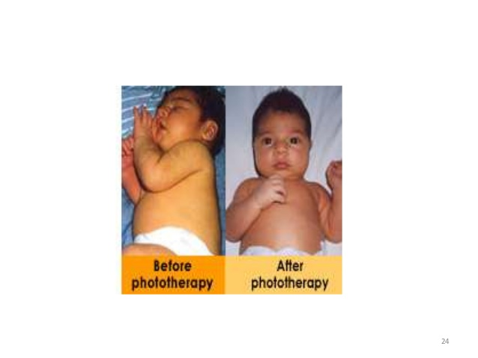

Slide 16
Side effects of phototherapy:
1- Dehydration due to Increase insensible water loss
2- GI effects such as diarrhea, increase passage of loose green stool
3- Dark yellow urine
4- Erythema and skin rashes

Slide 17
5- Hyperthermia
6- Irritability
7- Bronze baby syndrome
8- Retinal damage
9- Cell damage and mutations

Slide 18
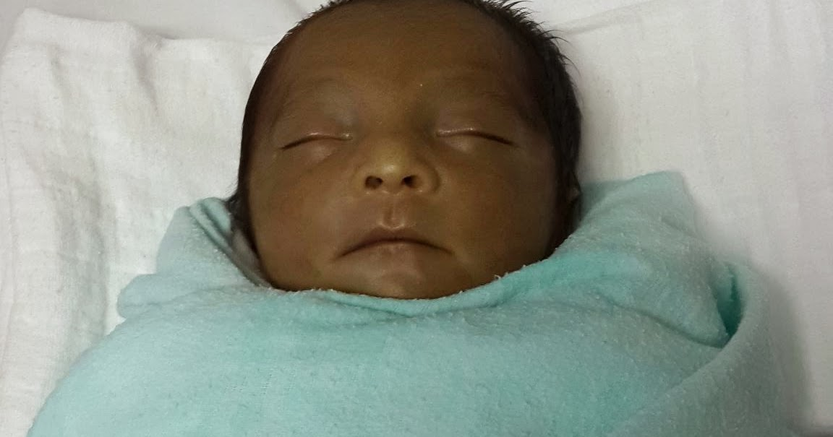

Slide 19
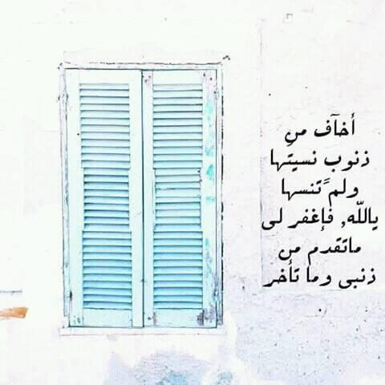

Slide 20


