Slide 1


Slide 2
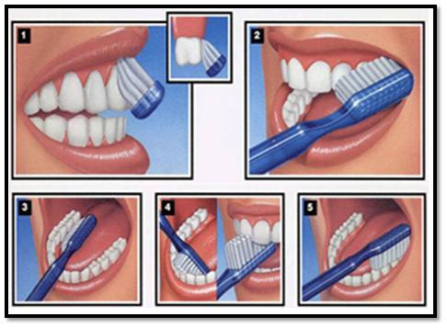
Oral Care
Prepared by:
Elham Atef Abdelazeem
Demonstrator at Pediatric Nursing Department

Slide 3
Outlines:
Introduction
Age related change effect on oral cavity
Oral health assessment
Definition of oral care.
Purpose of oral care.
Consequences of poor oral care
Agents used for oral care.
Equipment.
Procedure

Slide 4
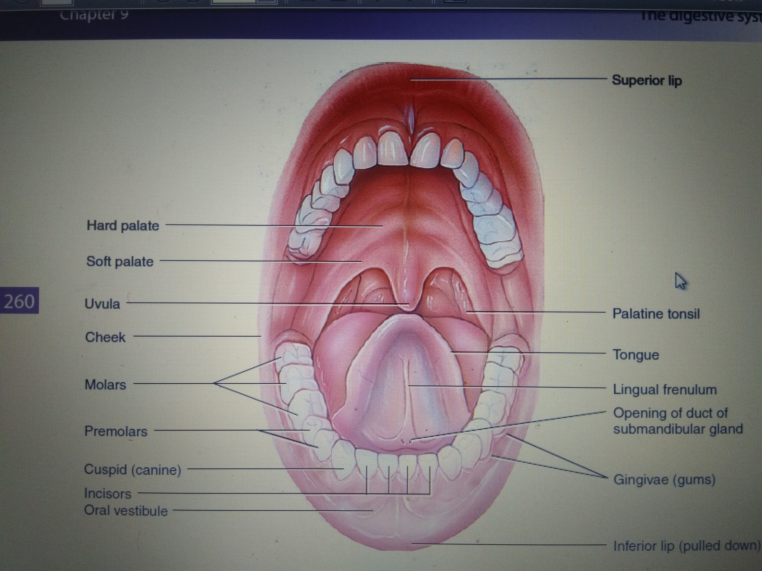

Slide 5
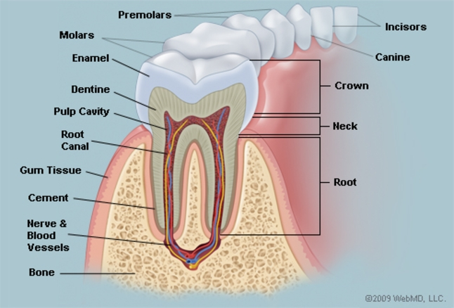

Slide 6
Age-Related change effect on Oral Cavity:
1- Tooth enamel and dentine wear down, so cavities are more likely

Slide 7
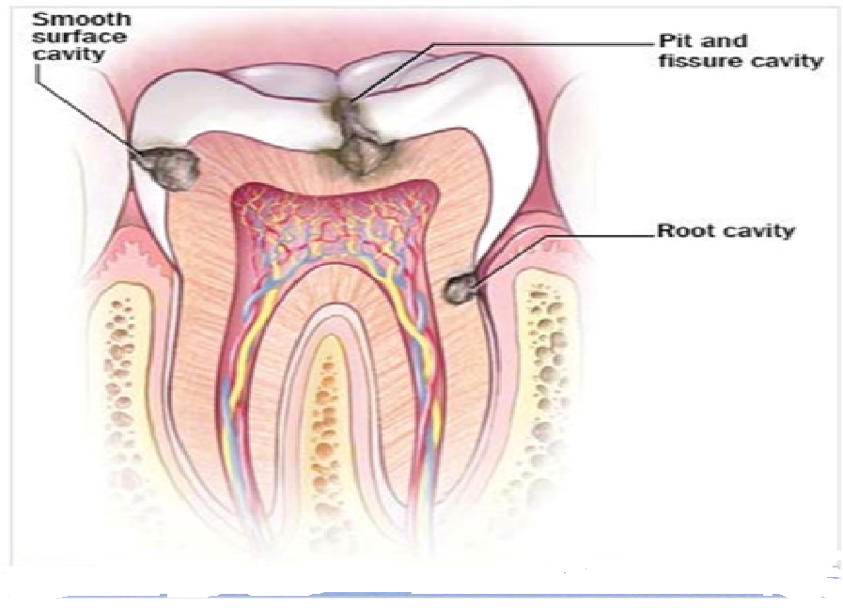

Slide 8
2- Teeth are lost :
- as a result of periodontal disease and roots that break easily
Accumulation of plaque, which may lead to inflammation of the gums (gingivitis)
dental decay and caries formation
Progressive loss of soft tissue attachments which results in root exposure
- There is increasing brittleness, making them more susceptible to damage

Slide 9
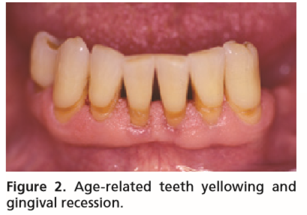

Slide 10
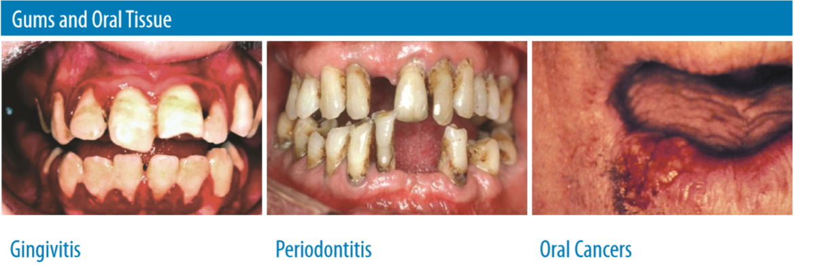

Slide 11
3- The blood vessels and nerves become less active with age
4- Abrasion, attrition, and erosion of teeth usually increase with advancing age.
5- The dental pulp becomes smaller because of secondary dentin and pulp stone formation, and sometimes root canals become totally sclerosed.

Slide 12
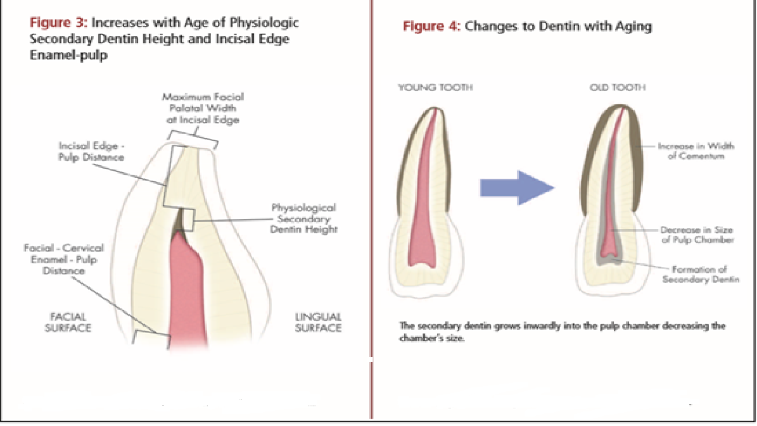

Slide 13
6- Atrophic changes occur in oral mucosa. the surface epithelium becoming thinner, drier, less elastic, less vascular, less firmly attached to the underlying connective tissue and bone, and more susceptible to injury from mild stresses.

Slide 14
7- xerostomia (mouth dryness) and sensations of pain or burning on the tongue, palate, or oral mucosa may be associated with age-related changes

Slide 15
8- decline in protective barrier function of the oral mucosa could expose the aging host to myriads of pathogens and chemicals that enter the oral cavity during daily activities

Slide 16
The most important oral health problems for older population include:
tooth loss,
dental caries,
periodontal diseases,
xerostomia (dry mouth)
and oral cancer

Slide 17
3- Oral health assessment:-
Brief Oral Health Status Examination (BOHSE)

Slide 18
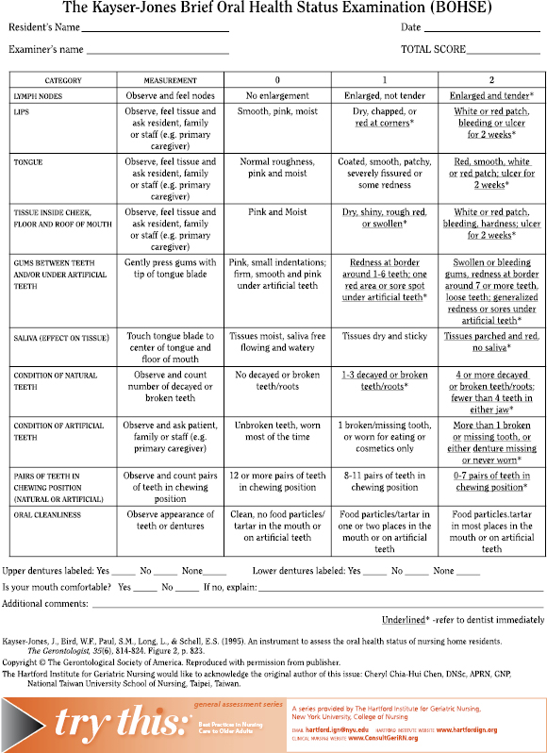

Slide 19
4- Definition:
It's the procedure used to care of teeth and mouth.

Slide 20
5- Purpose:
1. To keep the mucosa clean, soft, moist and intact.
2. To keep the lips clean, soft, moist and intact.
3. To prevent oral infections.
4. To remove food debris as well as dental plaque without damaging the gum.
5. To alleviate pain, discomfort and enhance oral intake with appetite.
6. To prevent halitosis (bad breath) or relieve it and freshen the mouth.

Slide 21
6- Consequences of poor oral health:
♣Poor self-esteem
♣ Decreased social interaction
♣ Problems with eating
♣ Problems with sleeping
♣ Problems with speech
♣ Mouth pain

Slide 22
7- Equipment required:
1. Tray (1)
2. Gauze-padded tongue depressor (1)
3. Torch (1)
4. Appropriate equipment for cleaning:
Tooth brush or Foam swabs
Cotton ball with artery forceps (1) and dissecting forceps (1)

Slide 23
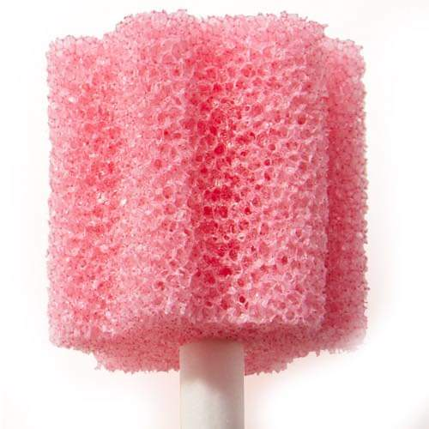
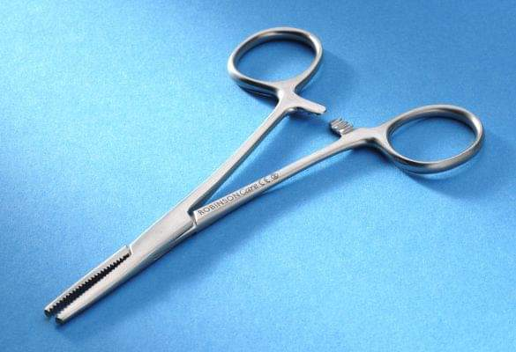
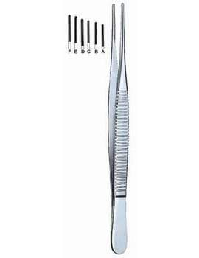
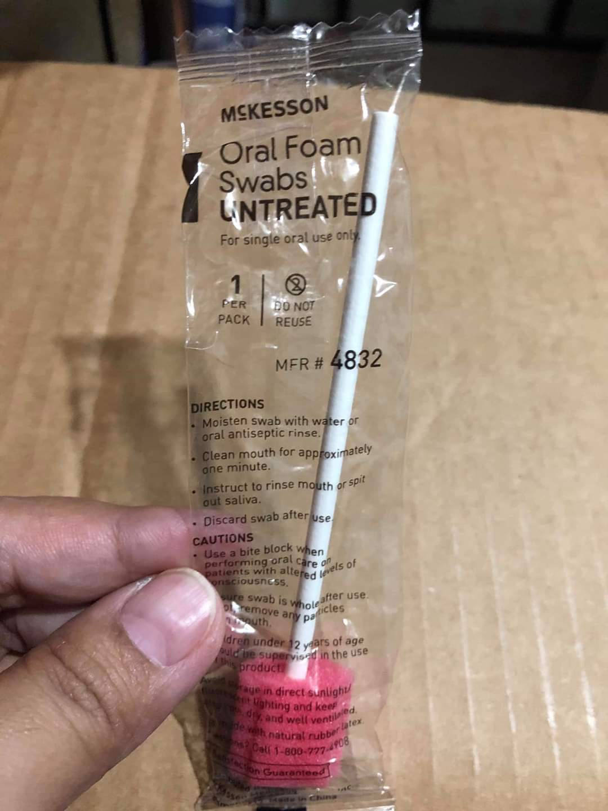

Slide 24
5. Oral care agents:
Tooth paste/ antiseptic solution
7. Cotton ball
8. Kidney tray (1)
9. Mackintosh (1): small size
10. Middle towel (1)

Slide 25
11. Jug with tap water (1)
12. Paper bag (2): for cotton balls (1) for dirt (1)
13. Gauze pieces as required: to apply a lubricant
14. Lubricants: Vaseline/Glycerin/ soft white paraffin gel/ lip cream (1)
15. Suction catheter with suction apparatus (1): if available
16. Disposable gloves (1 pair): if available

Slide 26
8- Agents used for oral care:-
Agents | Potential benefits | Potential harms
Tap water | • To refresh. • be available. | • Short lasting. • not contain a bactericide.
Tooth paste | • Not specified. • To remove debris. • To refresh. | • It can dry the oral cavity if not adequately rinsed.
Nystatin | • To treat fungal infections. | • Tastes unpleasant.
Sodium bicarbonate: | • To dissolve viscous mucous. | • Tastes unpleasant. • may bring burn if not diluted adequately. • can alter oral pH allowing bacteria to multiply .

Slide 27
Sucralfate: a mouth-coating agent. | Initially for the clients under radiotherapy and chemotherapy To reduce pain of mucositis. | • not reported.
Fluoride | • To prevent and arrest tooth decay •especially radiation caries, demineralization and decalcification. | • To show toxicity in high density.

Slide 28
9- Oral care Procedure:
1.Explain the procedure.
2. Collect all instruments required.
3. Close door and /or put screen.
4. Perform hand hygiene and wear disposable gloves if possible.
5. If you use solutions such as sodium bicarbonate, prepare solutions required.
6.Assist the client a comfortable upright position or sitting position.

Slide 29
7. Inspect oral cavity:- 1) Inspect whole the oral cavity such as teeth, gums, mucosa and tongue, with the aid of gauze-padded tongue depressor and torch. 2) Take notes if you find any abnormalities, e.g., bleeding, swollen, ulcers, sores, etc.
8. Place face towel over the client chest.
9.Put kidney tray in hand or assist the client holding a kidney tray.

Slide 30
10. Instruct the client to brush teeth
Points of instruction:-
1) Client places a soft toothbrush at a 45 °angle to the teeth.
2) Client brushes in direction of the tips of the bristles under the gum line with tooth paste.
Rotate the bristles using vibrating or jiggling motion until all outer and inner surfaces of the teeth and gums are clean.
3) Client brushes biting surfaces of the teeth.
4) Client clean tongue from inner to outer and avoid posterior direction.

Slide 31
11. If the client cannot tolerate toothbrush (or cannot be available toothbrush), form swabs or cotton balls can be used.
12. Rinse oral cavity:- 1) Ask the client to rinse with fresh water and void contents into the kidney tray. 2) Advise him/her not to swallow water. If needed, suction equipment is used to remove any excess.
13. Ask the client to wipe mouth and around it.

Slide 32
14. Confirm the condition of client’s teeth, gums and tongue. Then apply lubricant to lips.
15. Rinse and dry tooth brush thoroughly. Return to the proper place for personal belongings after drying up.
16. Replace all instruments.
17. Discard dirt properly and safety
18. Remove gloves and wash your hands.
19.Document the care and sign on the records.
20. Report any findings to senior staffs.

Slide 34



