Slide 1


Slide 2
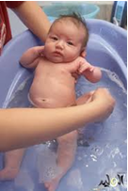
Infant bath

Slide 3

Objectives
At the end of this lecture, every student will be able to:
Identify the purposes of infant bath
Identify equipment of infant bath.
Apply procedures of infant bath

Slide 4

Outlines
purpose of infant bath
Equipment of infant bath.
procedures of infant bath

Slide 5
Purposes
1-To keep skin clean
2-To stimulate circulation
3-To promote comfort
4-To observe the child body

Slide 6
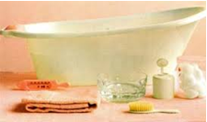
Equipment:
1-A wash basin with warm water (about 38ºC).
2-Clean gloves
3-Wash cloth
4-Cotton ball
5-Towel (at least two)
6-Baby comb
7-The infant cloths
8-Mild soap

Slide 7
Procedure
 | Steps | Rationale
1 | Wash hands | Standard precaution to reduce transmission of microorganisms
2 | Prepare equipment | Promotes efficient time management and provide an organized approach to procedure
3 | Explain procedure to the mother | Operational authority to implement administrative decision

Slide 8
Procedure, cont.,
 | Steps | Rationale
4 | Close window and doors | Prepare the environment to be thermally stable. Heat loss can occur by convection. An infant's temperature regulating mechanisms are immature, and the infant is at high risk for heat loss, especially premature infants
5 | Count apical pulse, measure temperature and respiration before the infant disrupted
6 | Fill the bath basin one-half full of warm water

Slide 9
Procedure, cont.,
 | Steps | Rationale
7 | Test temperature of water by your wrist or elbow | Prevents scalding of infant skin, if a thermometer is not available, test the temperature of the water with the sensitive skin on the inside of your wrist or elbow
8 | Place the rubber sheet on bed
9 | Undress the infant, and wrap him in bath towel

Slide 10
Procedure, cont.,
 | Steps | Rationale
10 | Clean the eye using wash cloth with water only from the inner to outer aspect of the lid | Following the nature tear flow will prevent the spread of microorganisms
11 | Wash the infant face with water only | Using plain water will prevent soap from irritating the eyes
12 | Wash infant's ears and neck giving particular attention to skin fold of the neck, behind the ears and the external part of the ears | Prevents possible packing of the discharge farther down the ear canal. Prevents damage to eardrum

Slide 11
Procedure, cont.,
 | Steps | Rationale
13 | Place the infant again on his back, Wash, rinse and dry each arm and hand , pay attention to the axilla, dry it thoroughly
14 | Wash, rinse and dry the infant's chest and abdomen. Keep him covered with bath blanket or towel between washing and rinsing

Slide 12
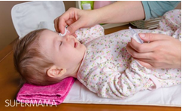
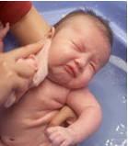
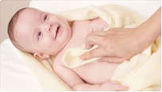
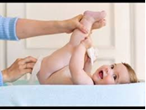

Slide 13
Procedure, cont.,
 | Steps | Rationale
15 | Turn the infant on his stomach or side, wash, rinse and dry the back
16 | Wash, rinse and dry the infant legs and feet, pay attention to areas between the toes

Slide 14
Procedure, cont.,
 | Steps | Rationale
17 | Place the infant on his back, clean and dry the genital areas from front to back, the rectal area is cleansed last since it is the most contaminated | Wash from front to back to reduce the transmission of microorganisms from the anus
18 | Pick the infant up using football hold position the baby's head over the wash basin. Lather the scalp using mild soap and message the scalp using your finger tips

Slide 15
Procedure, cont.,
 | Steps | Rationale
19 | Rinse and dry the scalp | Wash from front to back to reduce the transmission of microorganisms from the anus
20 | Dress the infant
21 | Clean the finger nails with , cutting toe nails, comb the hair
22 | Clean the equipment

Slide 16
Procedure, cont.,
 | Steps | Rationale
23 | Wash hands thoroughly with soap and water, dry with clean and dry cloth | Standard precaution to reduces the transmission of microorganisms
24 | Record the following : time, observation, reaction of infant

Slide 17


