Slide 1
Growth measurements 'Anthropometry'

Slide 2
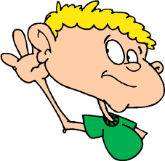

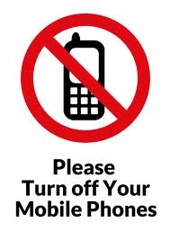
Presentation rules

Slide 3

Objectives
At the end of this lecture, every student will be able to:
Identify the purposes of Anthropometry
Identify equipment of Anthropometry
Apply procedures of Anthropometry

Slide 4

Outlines
Definition of anthropometry
Measurements of Infant’s weight
Measuring recumbent length
Measurements of body height
Measuring head circumference (Cephalometry)
Measuring chest circumference
Measuring Mid-Arm circumference

Slide 5
Definition of Anthropometry:
Assessment of growth is vital. It provides a sensitive guide to a child‘s:
Health
Development
Nutritional status
Response to treatment
The technique that deals with the measurement of the size, weight, and proportions of the human

Slide 6
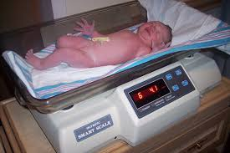
Infant’s weight

Slide 7
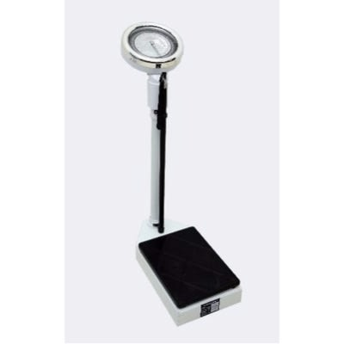
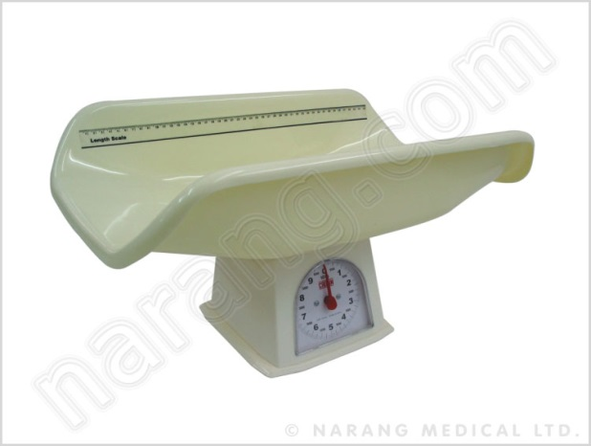
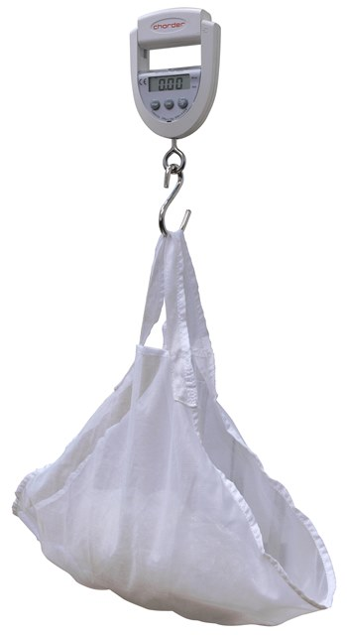
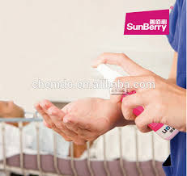
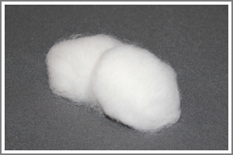
Equipments:
1- Appropriate sized balance scale
2- Cotton with alcohol

Slide 8
Definition
The mass or quantity of heaviness of an individual. It is expressed by units of pounds or kilograms.
1 Pound = 0.453592 kilogram
To determine child‘s risk.
To determine progress.
To control child‘s weight
To determine the medication dosage
To determine BMI
Purposes

Slide 9
Procedure
 | Getting ready
1 | Wash hands
2 | Verify the correct child using two identifiers
3 | Locate the appropriate measuring devices and growth charts based on the child‘s age and mobility
4 | Explain the procedures to the child and his parents
5 | Place the scale horizontally on a firm surface.
6 | Check to see that the scale is balanced by setting it at zero, and noting if the balance registers exactly in the middle of the mark.
7 | Close windows & doors

Slide 10
Procedure Cont.,
 | During Procedure
1 | Obtain the appropriate scale for the age and condition of the child. For children younger than 2 years of age, use a flat pan scale. For bedridden children more than 2 years of age, use a sling scale or special scale. For children who are able to stand, use a standing scale
2 | Wipe the scale using cotton with alcohol
3 | Remove the infant's shoes and clothes
4 | Put a scale paper on the scale.
5 | Gently lift the infant from his bed and place him in the scale basket.
6 | For reason of the safety, hold one hand over the body of the infant.
7 | Adjust the weight to balance scale by the right hand.

Slide 11
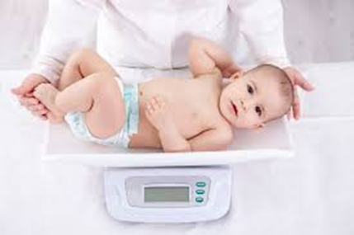
Procedure Cont.,
 | During Procedure
8 | Read the scale when the infant is lying still.
9 | Return the infant to his bed.
 | After The Procedure
1 | Record it in the infant's chart.
2 | Remove and dispose the scale paper.
3 | Wash hands

Slide 12
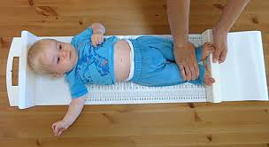
Recumbent length

Slide 13
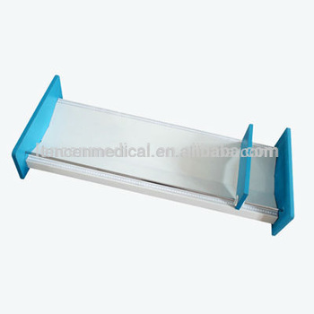
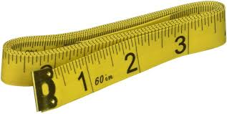
Equipments:
Measuring board for infant, measuring tape

Slide 14
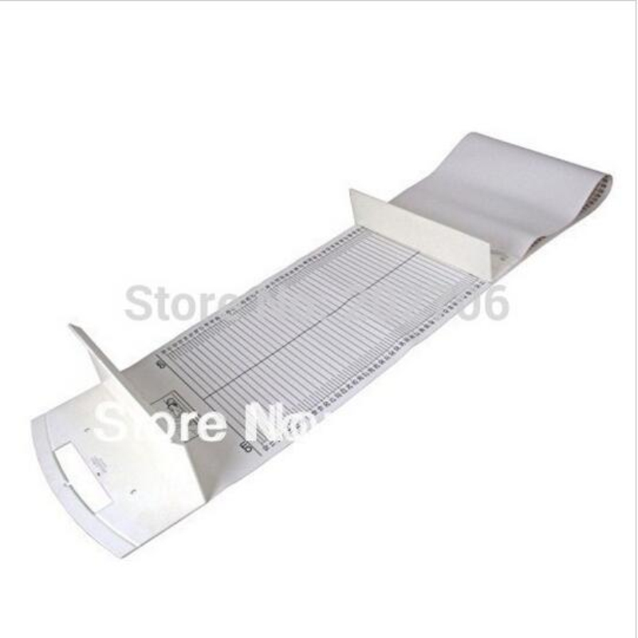
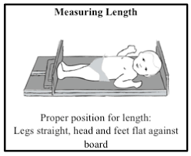

Slide 15
Procedure using the board
 | Getting ready
1 | Wash hands
2 | Secure the help of an assistant, who may be a family member
3 | Prepare the necessary equipments and supplies
4 | Explain the procedures to the child's parents
5 | Obtain a length board
 | Steps of The Procedure
1 | Place the towel on the board.
2 | Assist the child with removing shoes and clothes
3 | Place the child supine on the length board.

Slide 16
Procedure Cont.,
 | During Procedure
4 | One assistant hold the head against the head of the board firmly
5 | Grasp the knees together gently
6 | Push down on the knees until the legs are fully extended and hold the legs firmly
7 | Bring the footboard against the soles of the heels firmly.
8 | Read and record the result

Slide 17
Procedure using tap measure
 | Getting ready
1 | Wash hands
3 | Prepare the necessary equipments and supplies
4 | Explain the procedures to the child's parents
 | Steps of The Procedure
1 | Place the infant on a proper-covered hard surface.
2 | Push down the knees and against a firm surface.
3 | Make points of the top of the head and heel of the feet by a pen.

Slide 18
Procedure Cont.,
 | During Procedure
4 | Remove the child from his place.
5 | Measure between these two points
6 | Read the result
 | After The Procedure
1 | Return and clean the reused equipments
2 | Wash hands

Slide 19
Crown to heel recumbent length

Slide 20
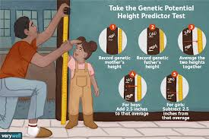
Measurements of body height

Slide 21
Definition of body height
The distance from the sole to the crown of the head with body standing on a flat surface and fully extended.

Slide 22
Procedure using scale
 | Getting ready
1 | Wash hands
3 | Prepare the necessary equipments and supplies (stadiometer or measuring tape)
4 | Explain the procedures to the child and/ or his parents
5 | Obtain a stadiometer to measure standing height
 | Steps of The Procedure
1 | Remove the child's shoes and socks
2 | Have the child stand erect with feet flat on the floor, looking straight ahead, with the heels, buttocks, shoulders, and head against the measuring board. Ensure the heels are touching, the knees are fully extended, and the heels are flat

Slide 23
Procedure cont
 | Steps of The Procedure
3 | Lower the horizontal ruler of the stadiometer firmly onto the crown of the child‘s head, so it is at a right angle to the vertical ruler. Ensure enough pressure to compress the hair.
4 | Read the measurement at eye level.
5 | Record the child‘s stature measurement to the nearest 0.1 cm.
 | After The Procedure
1 | Return and clean the reused equipments
2 | Wash hands
3 | Recording

Slide 24
Procedure using tap measure
 | Getting ready
1 | Wash hands
3 | Prepare the necessary equipments and supplies (a tape measure)
5 | Explain the procedures to the child and/ or his parents
 | Steps of The Procedure
1 | Attach a measuring tape to the wall
2 | Place the child adjacent to the tape.
3 | Place a three dimensional object, such as thick book or box on the top of the head.

Slide 25
Procedure
 | Steps of The Procedure
1 | The side of the book must rest firmly against the wall to form a right angle
2 | Length of stature is measured to the nearest centimeter
3 | Read and record the result
 | After The Procedure
1 | Return and clean the reused equipments
2 | Wash hands
3 | Recording

Slide 26
Calculating body mass index (BMI)
After obtaining weight and length or height measurements, use the following formula to determine BMI:
BMI = (weight in kilograms) ÷ (height in meters squared)
For a child who weighs 16 kg and has a height of 105 cm (1.05 m), the calculation would be BMI = 16 ÷ (1.05 × 1.05) = 16 ÷ 1.1 = 14.5 kg/m2

Slide 27
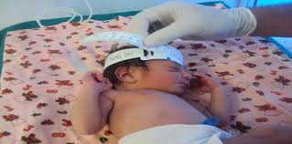
Measuring head circumference (cephalometry)

Slide 28
Definition
The measurement of the dimensions of the head
It should be measured in the children:
1- Under 36 months of age
2- With neurological defects

Slide 29
Procedure
 | Getting ready
1 | Wash hands
2 | Verify the correct newborn using two identifiers
3 | Prepare the necessary equipments and supplies (a tape measure)
4 | Explain the procedures to the child and/ or his parents
 | Steps of The Procedure
1 | Position the newborn supine
2 | Place a flexible tape measure around the occipito-frontal circumference (the widest diameter) of the newborn's head, positioning it above the ears and just above the eyebrows. Adjust the tape measure at the occipital bone to obtain the largest measurement, and read the tape in centimeters

Slide 30
Procedure
 | Steps of The Procedure
1 | A second measurement if the first was abnormal for the newborn's gestational age or overall size.
2 | Remove the tape measure by gently lifting it or rolling the newborn off the tape.
3 | Document the procedure in the newborn's record
 | After The Procedure
1 | Return and clean the reused equipment
2 | Wash hands

Slide 31
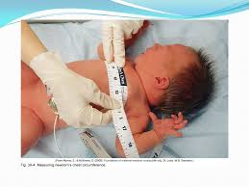
Measuring chest circumference

Slide 32
Definition:
The measurement of the dimensions of the chest at the level of the nipples

Slide 33
Procedure
 | Getting ready
1 | Wash hands
2 | Verify the correct newborn using two identifiers
3 | Prepare the necessary equipments and supplies (a tape measure)
4 | Explain the procedures to the child and/ or his parents
 | Steps of The Procedure
1 | Remove the child's clothing of upper half.
2 | Place on the flat table in a supine position for infant, stand alone for children
3 | Place the tape across the nipple line.

Slide 34
Procedure
 | Steps of The Procedure
4 | Take measurement during inhalation and expiration.
5 | Record the average of the two values.
 | After The Procedure
1 | Return and clean the reused equipment
2 | Wash hands
3 | Recording

Slide 35
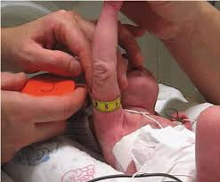
Measuring Mid-Arm Circumference

Slide 36
Procedure
It is an indirect measure of total muscle mass
 | Getting ready
1 | Wash hands
3 | Prepare the equipment needed ( measuring tape)
4 | Explain the procedures to the child and/ or his parents
 | Steps of The Procedure
1 | Let the child's right arm flexed 90º at the elbow
2 | Mark the midpoint between the acromion and the olecranon on the posterior aspect of the arm .
3 | Wrap a paper or steel measuring tape around upper arm at midpoint

Slide 37
Procedure
 | Steps of The Procedure
4 | Measure to nearest 1 cm
5 | Read the result
 | After the procedure
1 | Record the result
2 | Clean and return the used equipment
3 | Wash hands

Slide 38
LOOK AT INDEXES of Egyptian growth charts for boy & girls pages

Slide 39
How to use Percentile growth charts to assess growth
Any child with a measurement below the 5th percentile or above the 95th percentile should be investigated for abnormal growth.

Slide 40
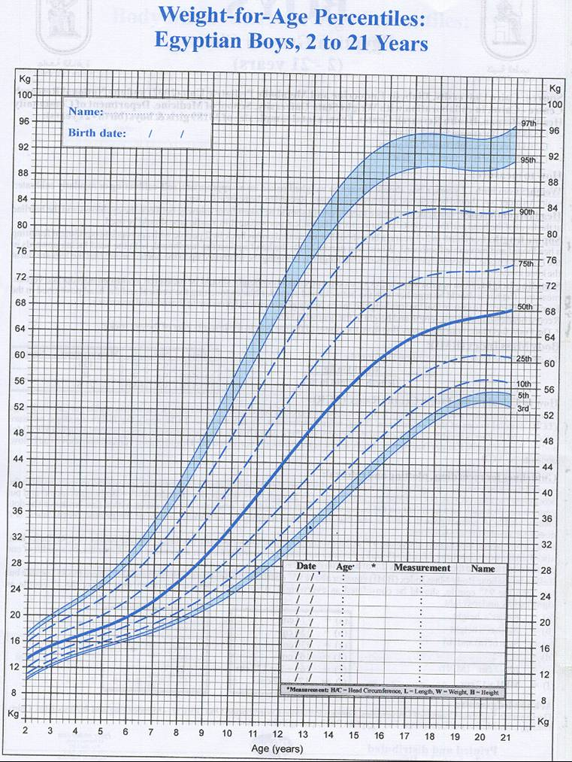
Growth chart

Slide 41
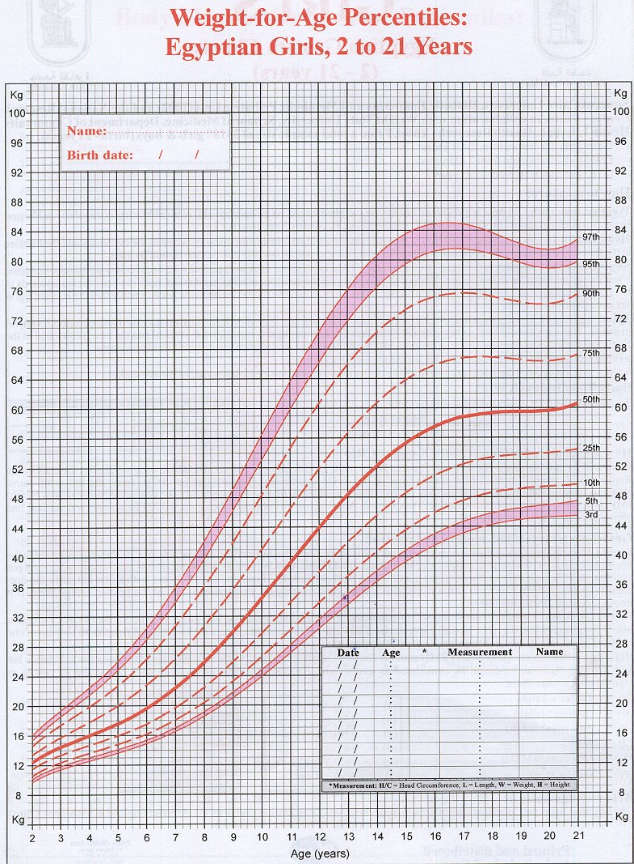
Growth chart

Slide 42


