Slide 1
Diabetic crisis
اعداد
دنجلاء جمال الدين عبدالحافظ
مدرس تمريض الحالات الحرجه

Slide 2
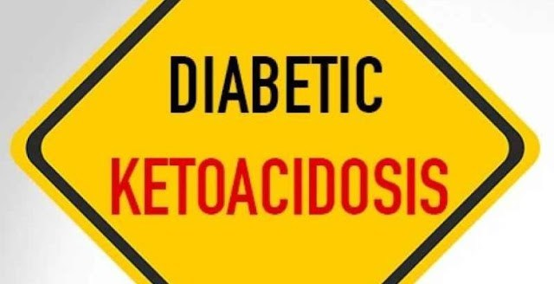

Slide 3
  Diabetic Ketoacidosis
Definition:
A potentially life threatening complication in patients with diabetes mellitus. Lead to disorder metabolism of protein, carbohydrates and fats from sever insulin deficiency with type 2 diabetes and type I

Slide 4
A etiology
1-Severe diabetes , usually type 1.
2- Precipitating factor: stress, which needs high energy as:
Infection. -Severe exertion.
Trauma & operations. - Pregnancy & labour.
Severe vomiting -Starvation.
Excess intake of fats. -Neglegence of treatment.
Myocardial infarction. -Cerebrovascular stroke.

Slide 5
Pathogenesis
↓↓ insulin → hyperglycaemia → osmotic diuresis→ dehydration.
↑↑ utilization of fat to produce energy → ketone bodies → ketone acidosis→metabolic acidosis.

Slide 6
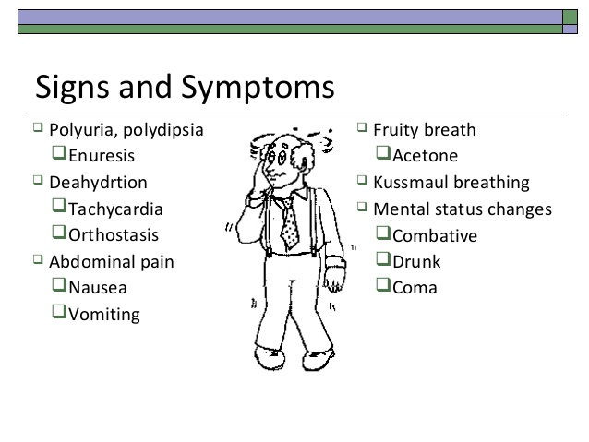

Slide 7
Diagnostic & laboratory finding
1- Urine analysis: Contains glucose & acetone.
2- Blood glucose: Markedly elevated Blood glucose levels may vary from 300 to 800 mg/dL
3-Blood electolvtes: K: ↑↑ due to extra-cellular shift.
4-blood gases :- HCO₃: ↓↓: due to acidosis.,PH ↓<7.4 and↑lactic acid
5-Other tests such as (chest x-ray, ECG, urine analysis, and possibly CT scan of the brain)

Slide 8
Management of diabetic ketoacidosis
1-Hospitalisation: Is a must in every case.
2-Measures to care for the comatosed patient.

Slide 9
3-Insulin replacement:
Blood glucose level should not fall too fast or too far.
Not :- Sudden and rapid lowering of the blood glucose lead to vascular collapse Low doses of soluble insulin are given regularly either IV or IM
Subcutaneous insulin injections given every 1 to 2 hours for mild or moderate DKA,.

Slide 10
IV bolus of regular insulin at 0.15 units/kg body weight followed by a continuous infusion of regular insulin at a dose of 0.1 units/kg/h (5 to 10 units/h).
When the blood glucose reaches 250 mg/dL, decrease the insulin infusion to 0.5 units/kg/h and add dextrose (5% or 10%) to the IV fluids.
To prevent cerebral edema that may occur when the blood–brain barrier is affected by extreme fluid shifts, avoidance of hypoglycemia

Slide 11
Fluid replacement:
After establishing an IV line, infuses 0.9% (normal) saline solution. (to reverse the severity of the extracellular volume depletion and restore renal perfusion as soon as possible).
1st liter infused in 1 hour in patients with normal cardiac function; on average, the rate will be equal to 15 to 20 mL/kg body weight per hour.

Slide 12
Fluid replacement continues at roughly 1 L/h until the heart rate, blood pressure, and urine flow indicate that hemodynamic stability is attained.
Hypotonic solutions, such as 0.45% (half normal) saline solution, can be administered at a rate of 150 to 250 mL/h after the intravascular volume has been restored
plasma expanders, such as albumin and plasma concentrates, may be necessary if low blood pressure and other clinical signs of vascular collapse do not respond to saline solution alone.

Slide 13
The subsequent rate will depend on:
-The clinical State: judged by the BP, neck veins & lung crepitations.
- CVP. -The urine output.
- 5% glucose is given instead of saline:
- When blood glucose reaches 200 mg / ml, to avoid hypoglycaemia. - KCL: 20 mmol is added to each litre of infused fuid.
-monitor vital signs every 1hour and assess dehydration, tachy cardia,PH and bicarbonates

Slide 14
5. Monitoring & correction of potassium levels:
- Hyperkalaemia is present at first due to extracellular shift ofk
- Hypokalaemia occurs with insulin due to intracellular shift of K.
- K level is monitored /4 hours & corrected if needed.monitor ABG
6-Correction of acidosis: By sodium bicarbonate infusion.
Treatment of cause: Ex. treatment of myocardial infarction.
Broad spectrum antibiotics: If there is infection.
N.B: Complications of therapy are:
-Hypoglycaemia.
Hypokalaemia, shock, seizure
Pulmonary oedema, pulmonary cracals, renal failure

Slide 15
Collaborative nursing care for DKA
Oxygenation/Ventilation
Provide chest physiotherapy, turn, deep breath, cough, incentive spirometer every 4 h and PRN.
Continuously monitor patient’s respiratory rate, depth, and pattern. and other signs of respiratory distress.
Monitor arterial blood gases, pulse oximetry, and, if intubated, end tidal CO2.
Provide supplemental oxygen.
Prepare for intubation and mechanical ventilation
Auscultate breath sounds every 2 h and PRN.
Take daily chest x-ray.
Provide chest physiotherapy every 4 h.
Mobilize out of bed as soon as patient is stabilized.

Slide 16
Monitor vital signs hourly and PRN.
Assess for dehydration/hypovolemia: tachycardia, decreased central venous pressure (CVP) and pulmonary artery occlusion pressure (PAOP).
Assess for hypervolemia: neck vein distention, pulmonary crackles and edema, increased CVP and PAOP.
Administer vasopressor agents if hypotension is related to vasodilation.
Monitor electrocardiography (ECG) continuously.
Evaluate and treat the cause of dysrhythmias (eg, acidosis, hypoxia, hypokalemia/ hyperkalemia).

Slide 17
Fluids/Electrolytes
Infuse normal saline or lactated Ringer’s solution, then 0.45% normal saline solution.
Monitor serum osmolality, urine output, neurological status, and vital signs closely during rehydration. Observe for complications of DKA (eg, shock, renal failure, decreased LOC, and seizures).
Assess BUN, creatinine, and urine for glucose and ketones.
Assess and replace electrolytes, Mg, and PO4, as indicated.
Closely monitor potassium fluctuations as serum glucose is decreased and acidosis reversed.
Assess arterial pH and bicarbonate level every 2–4 h during rehydration and insulin administration.
Monitor serum glucose every 30–60 min, then every 1–4 h after level is <300 mg/dL.
Administer intravenous (IV) insulin bolus then continuous low-dose infusion.
Infuse D5 half normal saline solution or D5W, after glucose level is <300 mg/dL.

Slide 18
Nutrition
Provide parenteral feeding if patient is fasting (NPO).
Provide clear, then full liquid diet, and assess patient response Progress to diabetic diet (ADA).
Consult dietitian or nutritional support service regarding special nutritional needs.
Monitor albumin, prealbumin, transferrin, cholesterol, triglycerides, glucose, and protein levels.

Slide 19
Comfort/Pain Control
Assess pain and discomfort. If pain present, use objective pain scale every 4 h PRN and following administration of pain medication.
If analgesics are needed, administer cautiously due to risk of respiratory and neurological complications.
Consider nonpharmacological pain management techniques (eg, distraction, touch).
Maintain nasogastric tube patency.
Assess bowel sounds every 1–2 h.
Administer antiemetic as ordered.
Provide ice chips and frequent oral hygiene.

Slide 20
Skin Integrity
Assess risk for skin breakdown using the Braden Scale
Initially assess skin and circulation every 1–2 h for 12 h.
If risk for skin breakdown is low, assess skin every 8 h and each time patient is repositioned.
Turn patient every 2 h.
Consider pressure relief/reduction mattress if at risk for skin breakdown.

Slide 21
Hyperosmolar Hyperglycemic Nonketotic Syndrome (HHNS)
Definition:-
An acute complication of Diabetes mellitus (particularly type 2 DM) characterized by hyperglycemia, Dehydration, and serum hyper osmolality without ketosis

Slide 22
Pathophysiology
A reduction in circulating insulin leads to the hyperglycemia .The acidosis that these patients develop is attributed to lactic acidosis and patients often experience polydipsia, polyuria, and progressive decline in LOC.

Slide 23
Causes
Infection is a major cause of HHS( Urinary tract infections and pneumonia )
Acute illness such as CVA, myocardial infarction, or pancreatitis.
HHS may also occur secondary to extreme stress
Drugs, such as corticosteroids, thiazide diuretics, sedatives,

Slide 24
Clinical manifestations
The clinical manifestations may take days to weeks to develop,
polyuria, polydipsia, and impaired mental state ranging from confusion to coma.
Dehydration is manifested by tachycardia, hypotension, low cardiac output, poor skin turgor, rapid respirations without Kussmaul’s breathing, and warm, flushed skin. The presence of hypothermia is a poor prognostic sign in HHS.

Slide 25
Management
correcting the volume depletion, controlling hyperglycemia, identifying the underlying cause of HHS and treating it.
Isotonic saline or hypotonic saline solution is administered initially to correct the fluid imbalance, and some patients may require as many as 9 to 12 L of fluid overall. The
low doses of insulin because these patients are vulnerable to the sudden loss of circulating blood volume that occurs with higher doses of insulin and a rapid blood glucose reduction.

Slide 26
Hypoglycemia
Definition:-
is a complication among patients with type 1 diabetes, and it is the most common diabetes-related emergency

Slide 27
Aetiology
Over dose of insulin or sulphonylurea.
Missing a meal or excercising while using hypoglycaemic drugs.
Excess intake of alcohol while using hypoglycaemic drugs.
Stress
Weight loss
Severe liver disease
Severe sepsis

Slide 28
Pathogenesis
Hypoglycaemia causes lack of energy to the brain, confusion & coma.
Adrenaline is secreted to convert liver glycogen to glucose.
Hyperadrenalism causes stimulation of the sympathetic system.

Slide 29
Clinical features
S & S of sympathetic over activity:
The onset is usually sudden.
The patient is irritable, confused & then comatosed.
Palpitation & sense of fear. - Sweating & tremors.
Wet skin. - Dilated pupil.
Rapid & strong pulse. - Increased systolic BP.
Exaggerated deep reflexes. - Rapid response to oral or IV glucose.

Slide 30
Inves­tigations
1-Urine:Contains glucose.
Blood glucose: Markedly decreased.
Treatment:-
A- education:-
Diabetic patient should be educated about early symptoms of hypoglycemia (fatigue, lack of concentration)
Should keep a piece of sugar always with him
b –does of insulin should be reduced in such conditions:-
1- in winter (as exposure to cold increase break down of glucose )
2- Split evening dose of insulin
3- before vigorous exercises

Slide 31
3- before vigorous exercises
Treatment of hypoglycemic coma:-
I.V 50 ml of 50% dextrose till regains conscious
Oral CHO and IV infusion of 5% to 10% dextrose
IM glycogen is given unless in starvation or hypoglycemia due to increased oral hypoglycemic
Treatment of other causes
The usual recommendation is for 15 g of a fast-acting concentrated source of carbohydrate such as the following, given orally:
1-Oral glucose in early hypoglycemia
2- IV glucose in sever hypoglycemia
• Three or four commercially prepared glucose tablets
• 4 to 6 oz. of fruit juice or regular soda
• 6 to 10 Life Savers or other hard candies
• 2 to 3 teaspoons of sugar or honey

