Slide 1
Cell Response to Injury
Dr. Rasha Mokhtar Abdelkareem
Lecturer of Pathology
Faculty of Medicine,
Sohag University

Slide 2
Causes of Cell Injury
Hypoxia: the main cause of cell injury.
Decrease oxygen supply is caused by:
Ischemia e.g. arterial occlusion and atherosclerosis.
Inadequate oxygenation e.g. cardiac and pulmonary diseases.
Decreased oxygen carrying capacity of the RBCs e.g anemia and carbon monoxide poisoning.

Slide 3
2- Infectious agents: Bacteria, viruses, rickettsia, fungi and parasites.
3- Physical agents: Trauma, heat, cold, radiation and electric shock.
4- Chemical agents: Acids, alkalies, animal and plant poisons and some therapeutic drugs.
5- Immunologic reactions: autoimmune reactions against one’s own tissues and allergic reactions against environmental substances in genetically susceptible individuals.

Slide 4
6- Nutritional Imbalances: obesity markedly increases the risk for type 2 diabetes mellitus.
Moreover, diets rich in animal fat are strongly implicated in the development of atherosclerosis as well as in increased vulnerability to many disorders, including cancer.
7- Genetic and enzymatic derangements: as the congenital malformations associated with Down syndrome or sickle cell anemia
8- Aging: Cellular senescence leads to alterations in replicative and repair abilities of individual cells and tissues. All of these changes result in a diminished ability to respond to damage and, eventually, the death of cells and of the organism.

Slide 5
Effects of Cell Injury:
The effects of cell injury depend upon:
Type of injured cell
Nature of injurious agents
Severity of injurious agents

Slide 6
Reversible cell injury (degeneration):
Caused by mild injury or injury of short duration.
Active parenchymatous cells with higher rate of metabolism suffer more than supporting stromal cells.
Reversible cell injuries include:
a. Acute cellular swelling (cloudy swelling and hydropic swelling).
b. Fatty change.
c. Hyaline change.

Slide 7
Irreversible cell injury:
Caused by severe injury or injury of long duration→ damage to the nucleus and cell death occur.
The morphologic patterns of cell death:
a. Necrosis.
B. Apoptosis.

Slide 8
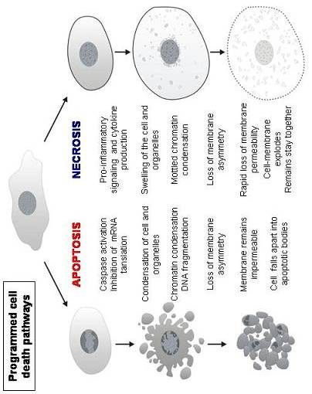
CLOUDY SWELLING
Definition:
Reversible cell injury characterized morphologically by swelling of the cells and granularity of the cytoplasm.
Cellular swelling is due to water accumulation.
Excess water accumulation inside the cells forming vacuoles in the cytoplasm (Hydropic degeneration)

Slide 9
Pathogenesis:
The activity of plasma membrane energy dependant sodium pump is reduced due to depletion of ATP leading to increase intracellular accumulation of sodium and decrease diffusion of potassium out of the cell This, in turn, leads to rapid flow of water into the cell.

Slide 10
Pathological Features
Organs affected: As Iiver cells, renal convoluted tubules and heart muscles.
Gross picture: The affected organ appears swollen, soft, bloodless due to compression of the capillaries by the swollen cells.
The borders are rounded.
The cut surface appears cloudy (less glistening), opaque and bulges outwards.

Slide 11
Examples of hydropic degeneration are:
Epidermal cells in burns, urticaria & viral infections as small pox.
Liver cells in viral hepatitis and alcohol poisoning.
Beta cells of islets of Langerhans early in diabetes mellitus.
Renal tubules in potassium deficiency caused by severe diarrhea.

Slide 12
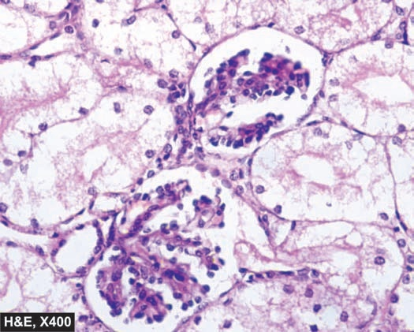
Hydropic degeneration:

Slide 13
FATTY Change
Definition:
a reversible cell injury characterized by pathological accumulation of excess neutral fat in parenchymatous cells.

Slide 14
Liver is the commonest site for accumulation of fat because it plays central role in fat metabolism.
Depending upon the cause and amount of accumulation, fatty change may be
mild and reversible, or severe producing irreversible cell injury and cell death.

Slide 15
Gross Picture:
The affected organ is enlarged and soft in consistency.
The capsule is tense.
The color is pale yellow.
The borders are rounded.
The cut surface bulges and is greasy to touch.

Slide 16
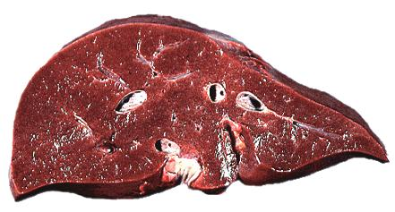
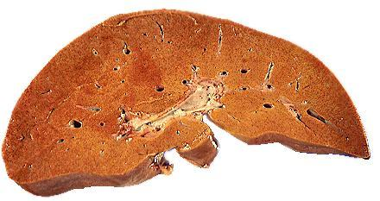
Normal Liver
Fatty Liver

Slide 17
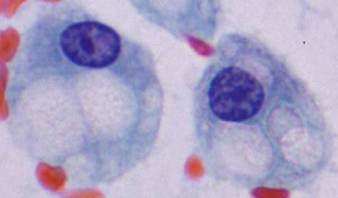

Slide 18
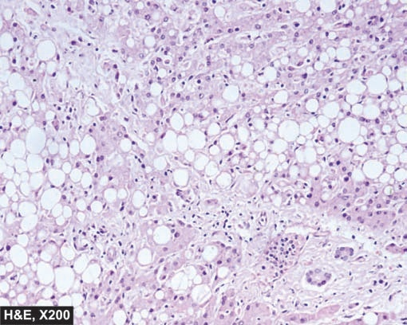
Fatty Degeneration of the liver

Slide 19
Hyaline change
The word ‘hyaline’ means glassy (hyalos = glass). Hyaline is a descriptive histologic term for glassy, homogeneous, structureless, eosinophilic appearance of material in haematoxylin and eosin-stained sections and does not refer to any specific substance.

Slide 20
INTRACELLULAR HYALINE
Mainly seen in epithelial cells. A few examples are as follows:
1- Mallory’s hyaline represents aggregates of intermediate filaments in the hepatocytes in alcoholic liver cell injury.
2- Russell’s bodies representing excessive immunoglobulins in the rough endoplasmic reticulum of the plasma cells
3- Corpora amylacea are rounded masses of concentric hyaline laminae seen in the prostate in the elderly

Slide 21
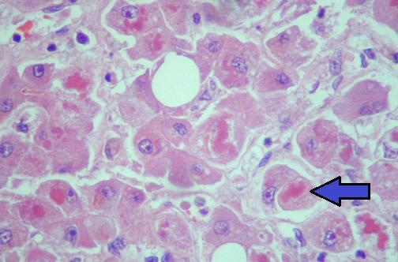

Slide 22
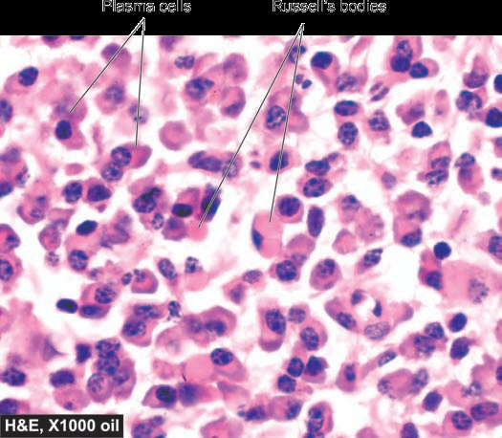

Slide 23
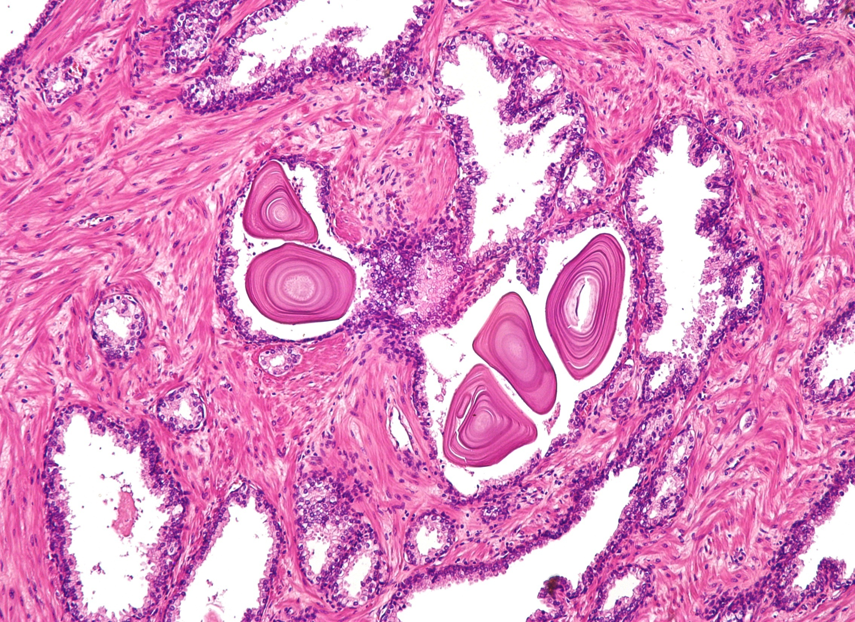

Slide 24
EXTRACELLULAR HYALINE
Seen in connective tissues. A few examples of extracellular hyaline change are as under:
1. Hyaline degeneration in leiomyomas of the uterus
2. Hyalinised old scar and keloid of fibrocollagenous tissues.

Slide 25
3. The wall of blood vessels
- the arteries in atherosclerosis
- the arterioles in benign hypertension
- the central arterioles of the lymph follicles of the spleen in old age and hypertension
- the blood vessels of atrophic organs as that of the ovary

Slide 26
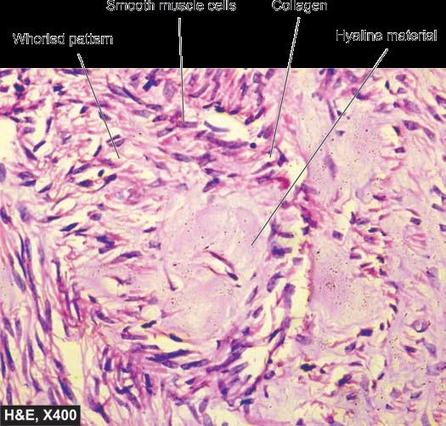

Slide 27
Irreversible cell injury
NECROSIS
Definition:
Local death of cells or tissues within the living body.
Necrosis occurs either directly or follows reversible injury.

Slide 28
Macroscopic Picture:
Necrotic tissue appears opaque and whitish or yellowish in color.
The surrounding tissue appears red due to inflammatory hyperemia.

Slide 29
Microscopic Picture:
Immediately after necrosis dead cells appear like living cells.
Then a series of changes take place rapidly in the structure of the dead cells caused by the lytic lysosomal enzymes.
The changes are nuclear and cytoplasmic.

Slide 30
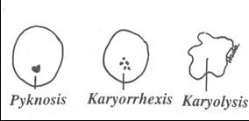
Nuclear Changes:
Pyknosis: The nucleus shrinks, its DNA condenses into a solid shrunken mass and it stains darkly.
Karyorrhxis: The nucleus breaks up into multiple small fragments due to breakdown of DNA and chromatin.
Karyolysis: The nucleus appears to dissolve and fails to take the stain due to chromatin hydrolysis.

Slide 31
Cytoplasmic Changes:
The cells appear swollen (cytomegaly).
In hematoxylin and eosin stained sections there is increased cytoplasmic eosinophilia.
The cells loose the cell membrane and become indistinct from each other (pink stained homogenous structureless tissue) .

Slide 32
Types of Necrosis

Slide 33
1- Coagulative Necrosis
Types of Necrosis
Commonly caused by sudden cut of the blood supply as in infarcts.
It seems likely that the cellular protein and enzymes denatured causing the tissue to become firm and opaque white.

Slide 34
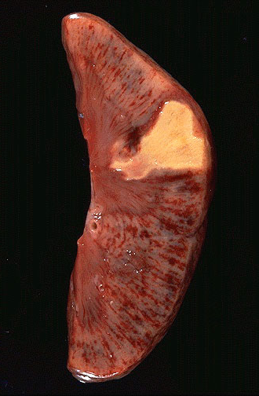
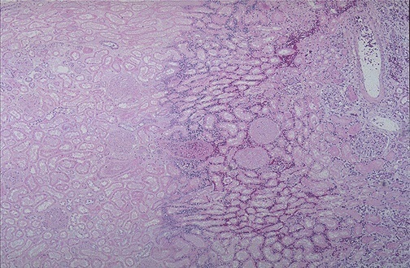
Infarction of the kidney

Slide 35
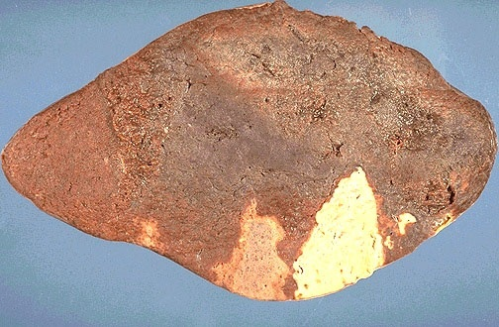
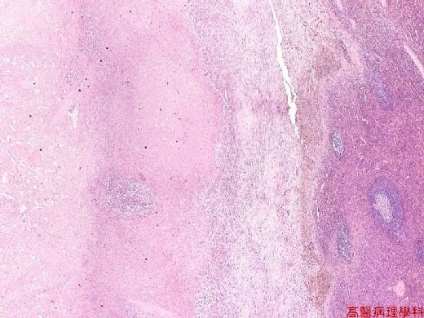
Infarction of the spleen

Slide 36
2- Liquefactive Necrosis
Types of Necrosis
The necrotic tissue is rapidly liquefied.
It occurs in:
Infarctions of the brain and spinal cord:
The softening and liquefaction is due to the high lipid and fluid content of the nervous tissue.
Pyogenic abscess: The central necrotic core is liquefied by the proteolytic enzymes released from the pus cells.
Amoebic abscess: The liquefaction is due to the action of liquefactive enzymes produced by the parasite.

Slide 37
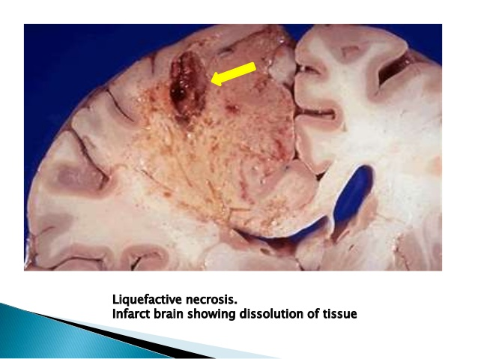

Slide 38
3- Caseation Necrosis
Types of Necrosis
Caseous means “cheese-like,”
referring to the friable yellow-white appearance of the area of necrosis
Necrosis followed by slow partial liquefaction.
Grossly the caseating material is dry, pale yellow and resembles creamy cheese or casein.
Microscopically the necrotic focus appears as a collection of fragmented or lysed cells with an amorphous granular pink structureless, appearance; the all cellular details are lost

Slide 39
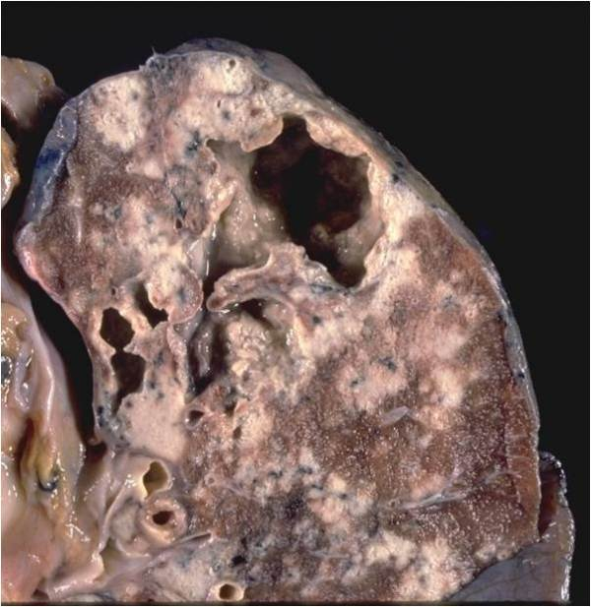
Caseation occurs in tuberculous lesions and in gumma of syphilis.

Slide 40
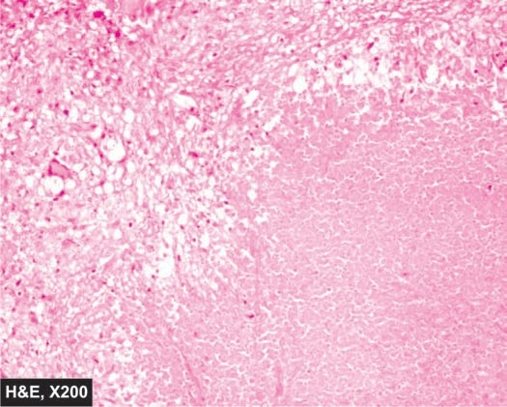
Caseation necrosis

Slide 41
4- Fat Necrosis
Types of Necrosis
It is of two types:
Enzymatic fat necrosis:
It occurs in acute hemorrhagic pancreatitis.
The enzyme lipase which escapes from the ruptured pancreatic ducts acts on the fat of the omentum, mesentery and abdominal organs.

Slide 42
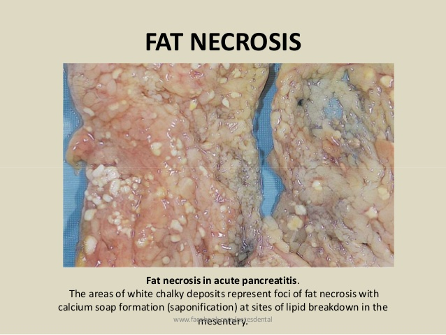
Lipase splits fat into glycerol and fatty acids.
Glycerol is absorbed in the blood.
. The released fatty acids combine with
calcium to produce grossly visible chalky white areas (fat saponification).

Slide 43
Traumatic fat necrosis:
It occurs as a result of trauma to the adipose tissue of the breast and subcutaneous fat.
The fat cells rupture and self-digestion takes place.

Slide 44
5- Fibrinoid necrosis
Types of Necrosis
Type of connective tissue necrosis seen particularly in autoimmiune diseases e.g. rheumatic fever and polyarteritis nodosa. Collagen and smooth muscle in the media of blood vessels are involved
Fibrinoid necrosis of arterioles in malignant hypertensions

Slide 45
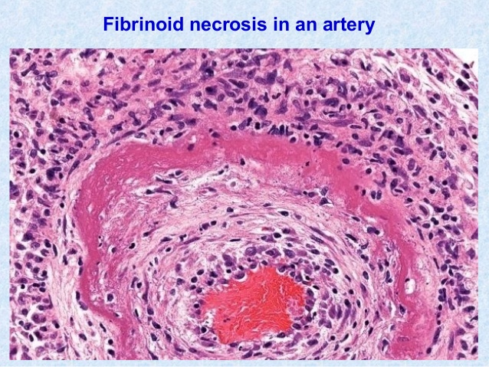
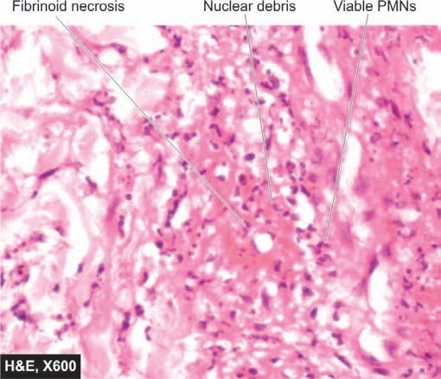

Slide 46
Fate of Necrotic Tissue:
Small area of necrosis: Part of the necrotic tissue is removed by the macrophages.
The rest gets liquefied and drained by the lymphatics and veins.
Healing occurs by regeneration or by granulation tissue formation followed by fibrosis.
Large area of necrosis: Gets surrounded by a fibrous capsule and may show dystrophic calcification later on.

Slide 47
APOPTOSIS
Definition:
Apoptosis is an energy-dependent programmed cell death involves single or small group of cells for removal of unwanted individual cells.
Apoptosis literally in Greek means “dropping off’.

Slide 48
Morphological Changes
1. Involvement of single cells or small clusters of cells in the background of viable cells.
2. The apoptotic cells are round to oval shrunken masses of intensely eosinophilic cytoplasm (mummified cell) containing shrunken or almost-normal organelles with and dense chromatin fragmentation

Slide 49
3- Shrinkage of the cell.
4- Condensation and fragmentation of chromatin.
5- Rapid break down of the cell to form apoptotic bodies.
6- Apoptotic bodies are phagocytosed by neighboring cells or macrophages.
7- Lack of inflammation in surrounding tissues.

Slide 50
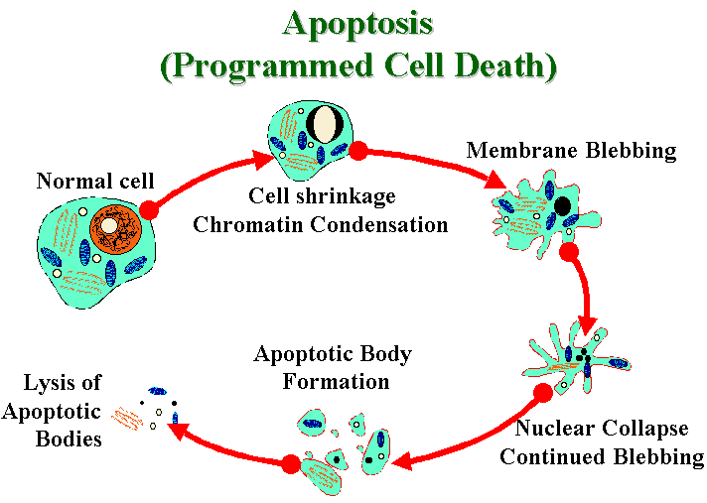

Slide 51
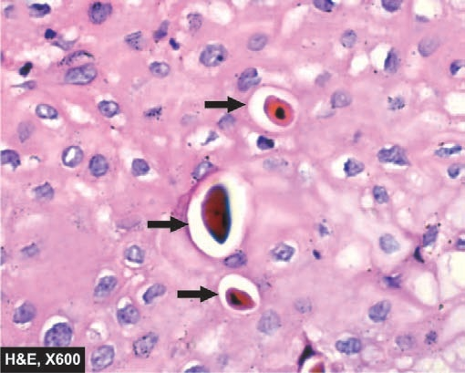
APOPTOSIS:

Slide 52
Occurrence:
I- Physiologic Processes
Occur in normal cell turnover (Normal cell destruction followed by replacement proliferation such as in intestinal epithelium)
Programmed cell destruction during embryonic development (e. interdigital clefts).
Endocrine dependent involution of tissues e.g. shedding endometrium during the menstrual cycle and regression of breast after weaning.
4. Involution of the thymus in early age.

Slide 53
II- Pathologic Processes:
1. Cell death in tumors exposed to chemotherapeutic agents or radiation.
2. Cell death in viral infections e.g. in viral hepatitis.

Slide 54
 | Necrosis | Apoptosis
Stimulus | Always pathologic (Hypoxia, Toxins,.....) | Physiologic and Pathologic conditions
Number of cells | - Group of cells | - Single cells
Histologic picture | Cellular swelling Nuclear disruption Rupture of cell & release of cellular contents | Cell shrinkage Chromatin condensation Formation of apoptotic bodies
Tissue reaction | - Inflammation | - No inflammation - Phagocytosis of apoptotic bodies
Molecular changes | Lysosomal breakdown with liberation of hydrolytic enzymes | Lysosomes and other organelles intact

Slide 55
Gangrene
Definition
Massive tissue necrosis, followed by putrefaction

Slide 56
AETIOLOGY
1- Necrosis
Tissue necrosis is caused by either sudden ischemia, or bacterial toxins.
2- Putrefaction
Putrefaction is caused by the action of saprophytic bacteria on dead tissue.
- These bacteria breakdown the protein of necrotic tissue, leading to liberation of hydrogen sulphide, which gives the tissue a foul odour.
- Hydrogen sulphide unites with iron of hemoglobin, with formation of iron sulphide, which stains the gangrenous tissue black.

Slide 57
TYPES OF GANGRENE:
1- Dry
2- Moist
3- Infective
4- Gangrenous

Slide 58
Dry and moist types based on the amount of blood and tissue fluids in the part affected at the time of its death. Dry gangrene occurs in parts poor in blood supply and tissue fluids, while moist gangrene occurs in parts rich in blood supply and tissue fluids.

Slide 59
1- Dry gangrene
AETIOLOGY:
- Dry gangrene occurs in limbs, especially feet.
- It occurs when there is arterial occlusion, while veins remain patent.
- Arterial occlusion may result from:
1- thrombosis, especially in old patients with atherosclerotic vessels (senile gangrene).
2- embolism
3- Buerger's disease
4- Raynaud’s disease
5- surgical ligature.

Slide 60
This type of gangrene is dry because:
1- Limbs are not rich in body fluids (due to surface evaporation)
2- Distal to arterial occlusion, tissue fluid formation will stop, but as veins are patent, the already present tissue fluid will be drained by veins

Slide 61
Usually affects old males. Atherosclerosis in old age predisposes to arterial thrombosis and poor collateral circulation (Senile Gangrene of lower limb).

Slide 62
PATHOLOGICAL FEATURES:
Arterial occlusion occurs either spontaneously or as a result of slight injury as that caused by tight shoes.
Distal to the occlusion massive necrosis occurs.
The affected part is pale and cold due to ischemia. Sensations are lost. Later on the necrotic area stains red by the blood escaped from the necrotic vessels.
Drainage and evaporation of blood and tissue fluids causes dryness of the dead part. It becomes shrunken and mummified.

Slide 63
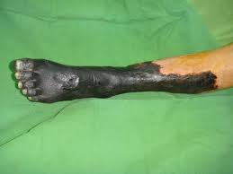
Saprophytic bacteria as bacillus subtilis and diphtheroids invade the necrotic tissue and causes putrefaction.
The gangrenous process advances slowly along the limb because the gangrenous part irritates the living one and initiates inflammation of its tissue with thrombosis of its vessels and further tissue necrosis and extension of the gangrene.

Slide 64
When gangrene reaches a level with good blood supply it stops. The toxic products of putrefaction act as an irritant and cause a zone of acute inflammation in the neighboring healthy part. It appears as a narrow red line between the healthy and gangrenous part called line of demarcation.

Slide 65
From the healthy side granulation tissue grows towards the gangrenous part with the formation of a groove on the surface called line of separation.
This groove may slowly deepen until it separates the gangrenous part leaving a conical stump. The stump is conical as the gangrene spreads higher up in the skin and subcutaneous tissue than in the muscles and bone as the blood supply of the skin and subcutaneous tissue is less abundant

Slide 66
2- Moist gangrene
AETIOLOGY:
- Wet gangrene is caused by sudden arterial and venous occlusion.
- It occurs mainly in internal organs (as intestine ), but may also occur in limbs in certain conditions.
The presence of rich tissue fluids aids rapid putrefaction, rapid spread of gangrene, and causes severe toxemia.
The line of demarcation is poor and the line of separation is absent.

Slide 67
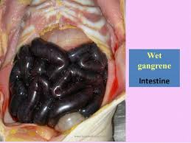
PATHOLOGICAL FEATURES
1- Intestinal gangrene:
This is a very serious type of gangrene
because intestines are very rich in tissue fluids and saprophytes, leading to very rapid spread of gangrene.
- It may occur in cases of intussuseption, volvulus, strangulated hernia, and mesenteric vascular occlusion.
- The gangrenous loop is swollen, oedematous, and black in color.
- the patient suffers from acute intestinal obstruction, severe toxemia, and intestinal rupture may occur leading to severe peritonitis.

Slide 68
2- Moist gangrene of the limbs:
This may occur in the following conditions:
- Severe crushing injury: both artery and vein are injuried and occluded
- Tight tourniquet: leading to occlusion of both artery and vein
- Diabetic gangrene: because tissue hyperglycemia and low immunity
help multiplication of bacteria, with inflammatory occlusion of blood vessels.

Slide 69
3- Infective gangrene
DEFINITION:
This is a moist gangrene in which bacteria cause both tissue necrosis and putrefaction:
- Pathogenic bacteria cause tissue necrosis by their toxins
- Next, saprophytic bacteria act on dead proteins causing putrefaction.

Slide 70
EXAMPLES:
1- Lung gangrene: due to putrefaction of lung abscess.
2- Bed sores: these are skin ulcers developing over bony prominces (as sacrum) in cases of prolonged recumbence (paralysis, coma, bone fracture).
It is due to both ischemic necrosis (blood stagnation and thrombosis of the vessels) and secondary bacterial infection (putrefaction in the ulcers).
3- Cancrum oris: this is infective gangrene of cheeks of debilitated children

Slide 71
4- Gas gangrene
- This is a subtype of infective gangrene affecting mainly muscles.
- It complicates deep seated wounds contaminated by soil containing gram positive anaerobic spores of Clostridia.
- Clostridia organisms are normal intestinal commensals in man and animals, and their spores contaminate soil (through fecal material).

Slide 72
- There are two groups of Clostridia organisms:
1- Saccharolytic group: Cl. welchii
Cl. oedematiens
They cause muscle necrosis and fermentation of muscle carbohydrates, with production of gases (CO2 & H2).
2- Proteolytic group: Cl. Histolyticum
Cl. Sporogens
They cause putrefaction in dead muscles with production of hydrogen sulphide & iron sulphide
- Gas gangrene is highly fatal due to severe toxemia.

Slide 73
Grossly :
the affected part is swollen, edematous, painful and crepitant (accumulation of gas bubbles). Subsequently the affected tissue becomes dark black with foul smelling

Slide 74
 | Dry gangrene | Moist gangrene
Cause Sites Gross picture Putrefaction Toxemia Line of demarcation Line of separation | Occlusion of artery only Occurs in the limbs Gangrenous part is dry and mummified Slow Mild Prominent Present | Occlusion of both artery and vein Occurs in internal organs and limbs The gangrenous part is edematous and swollen Rapid Severe Poor Absent

Slide 75
Thank you

