Slide 1
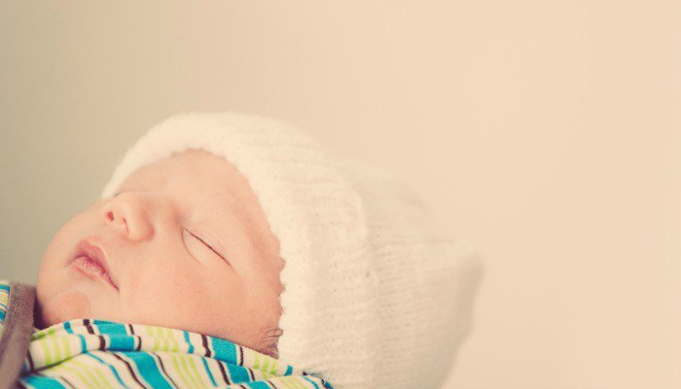
Specimen collection
Prepared by
Dania Gaballah
demonstrator in obstetrics and gynecological Nursing

Slide 2
Common types of specimen collection
1- Blood samples
2- Urine samples
3- Stool culture
4- Throat culture
5- Respiratory secretions

Slide 3
General principles
Before collection of a specimen
1- The requested examination and nature of specimen should be confirmed from the doctor's laboratory form
2- Proper specimen container should be choosen
3- The label with required particulars should be attached, stating name, age, unit, ward, name of specimen, the date of collection and time.

Slide 4
Collection of specimen
1- Routine specimen should be collected during laboratory working hours, to prevent deterioration.
2- For sterile specimens contamination of specimens should be avoided by collecting specimen straight into a sterile container.

Slide 5
After collecting specimens
1- Date and time of collection should be entered on the form
2- The completed label should be attached to the body of the container and upright position should be maintained
3- The written laboratory report should be attached to the record and inform the doctor

Slide 6
1-Blood samples
There are two methods of obtaining blood samples in children:
1- Capillary puncture
2- Venipuncture

Slide 7
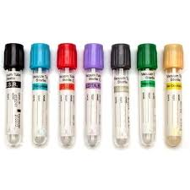

Slide 8
1- Capillary puncture:
punctures sites include;
The planter surface of the heel (for newborns and children under the age of 1 year)
The great toe (for children over than 1 year)
The lateral surfaces of the third or fourth finger

Slide 9
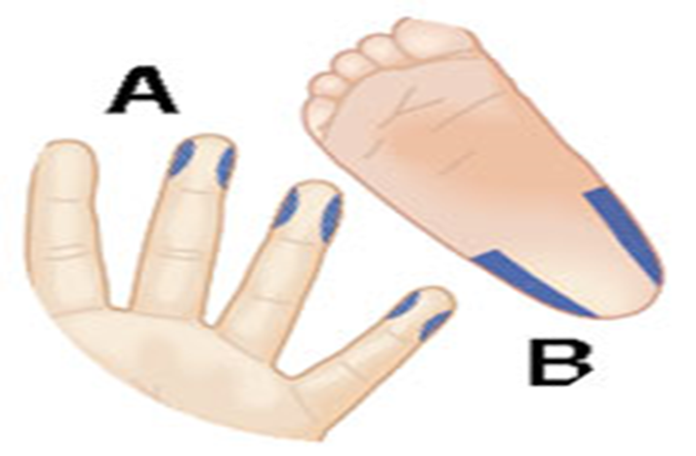

Slide 10
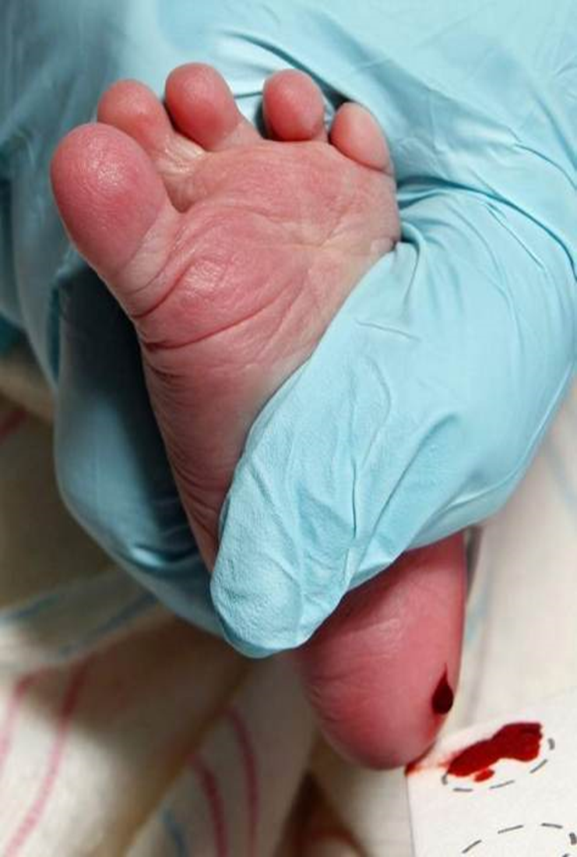

Slide 11
2- Venipuncture
Appropriate site. The veins of the ante-cubital fossa or forearm are usually the best choice because of their accessibility. However, the dorsum of the hand or foot also may be used

Slide 12
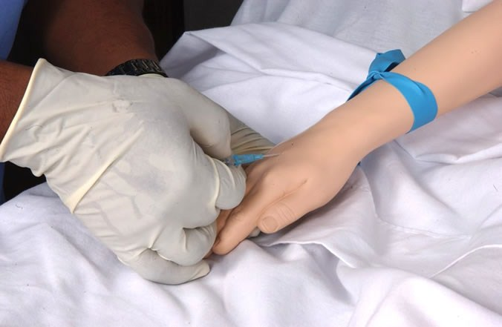

Slide 13
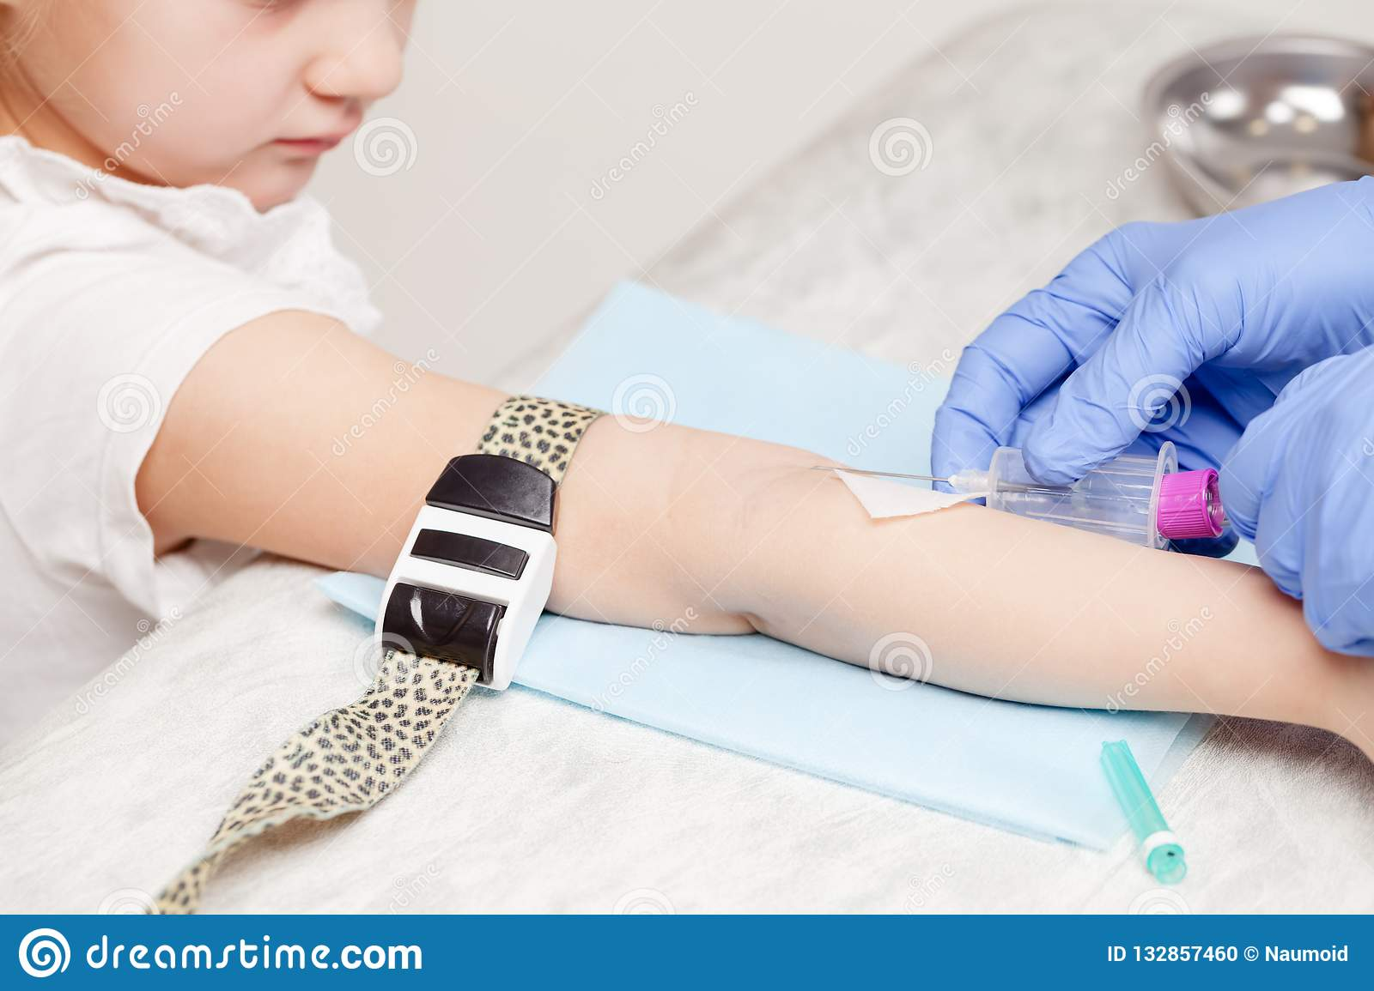

Slide 14
2-Urine sample
1- Applying a urine collecting bag (infants)
2- Collecting a clean-catch midstream urine specimen

Slide 15
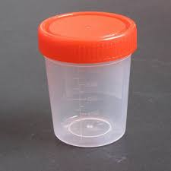

Slide 16
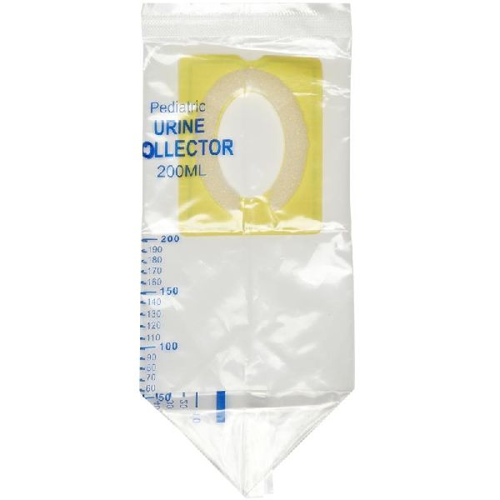

Slide 17
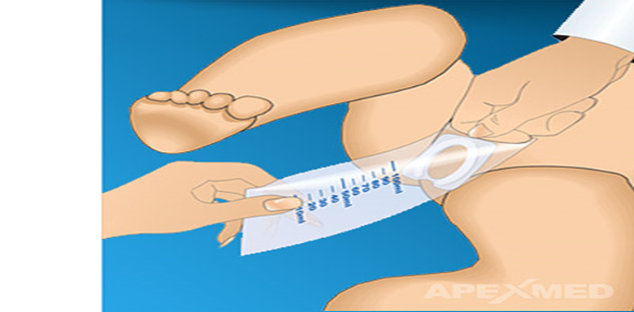

Slide 18
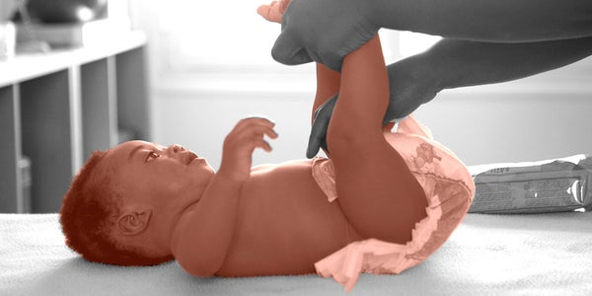
3-Stool culture

Slide 19
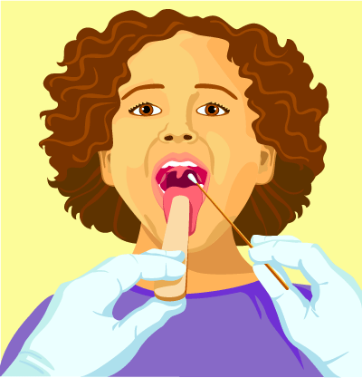
4-Throat specimen

Slide 20
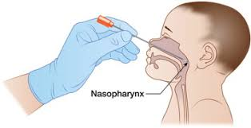
5-Respiratory secretions
1- Collecting respiratory secretions from an infant:

Slide 21
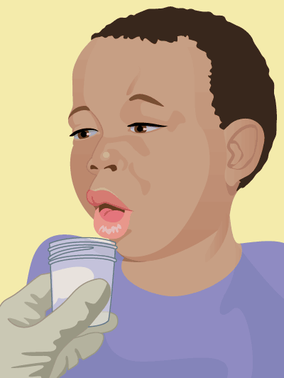
2- Collecting respiratory secretions from a child:

Slide 22


