Slide 1

Restraining
Prepared By:
Dania Gaballah
demonstrator in obstetrics and gynecological Nursing

Slide 2

Definition:
Temporary mechanical restraining therapies are used to decrease the child᾽s movement and to allow the health care provider to carry out a procedure.

Slide 3
Types of restrain:
1- Chemical: used to restrict child movement and this type include ( hypnotic\ tranquilizer )
2- Physical: used to restrict child movement and this type include:
- Mummy restrain
- Elbow restrain
- Jacket restrain
- Crib Net restrain

Slide 4
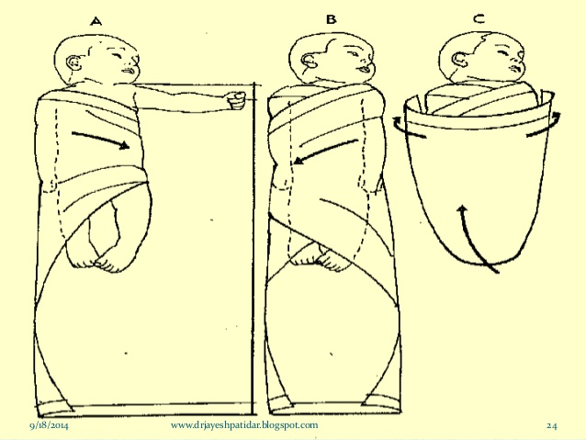
1- Mummy Restrain
Mummy immobilizer consist of wrapping the child securely in a blanket or sheet.

Slide 5
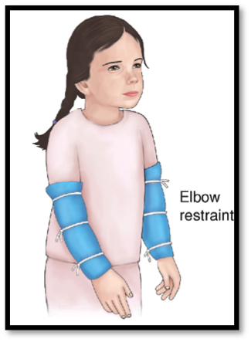
2- Elbow Restrain:
Device used to restrict the movement of child , the device must be on the child for an extended period , a medical order required and agency policy is followed for assessment and periodic removal of the device.

Slide 6
Purposes of elbow restrain:
Prevent the child to reaching his or her face or head , if he have scalp vein infusion or surgery to cleft lip or palate.

Slide 7
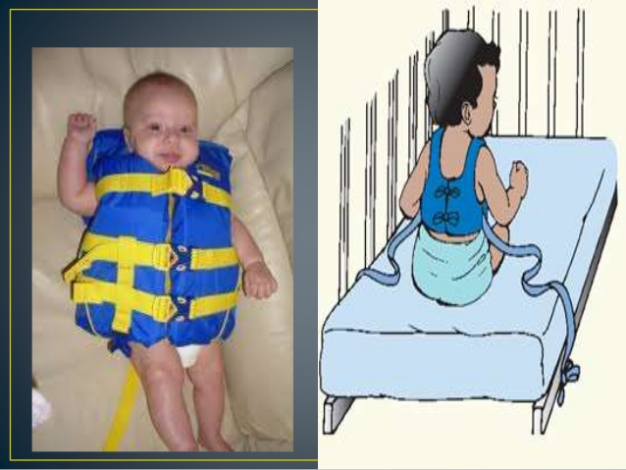
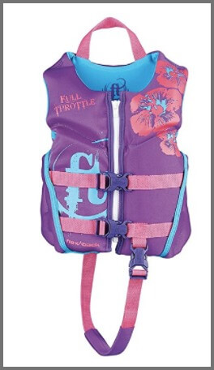
3- Jacket Restrain:
Purposes:
- Keep child lying on his back to protect him if he has chest surgery.
- Prevent falling from bed or wheel chair.

Slide 8
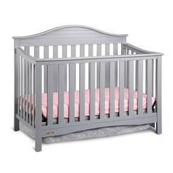
4- Crib Net Restrain:
Purposes:
Crib net applied to the crib of infant capable of climbing over crib side.

Slide 9
General Principles:
1- Place infant in comfortable position.
2- Check restrains frequently for circulation.
3- Check the skin every two hours.
4- The restrain should be removed every four hours and check the skin for inflammation or irritation.
5- Don᾽t use restrain as punishment.
6- Restrain is used only when needed.

Slide 10


Slide 11
1- Define Restraining
2- Mention types of restrain
3- Mummy restrain (procedure)

Slide 12


