Slide 1
Repair
By
Dr/Nagwa Abd El-Sadek A.
Department of Pathology

Slide 2
Contents
Definition
Factors affecting repair
Types of healing
Wound healing
Complications of wound healing
Causes of failure of wound healing & bone healing

Slide 3
Definition
Repair : is replacement of damaged tissue by new healthy one.

Slide 4
Factors affecting repair
1- General factors
Age: repair is more rapid in young age.
Protein and vitamin deficiency delay repair.
Drugs as steroids and cytotoxic drugs delay repair.
Diseases as D.M. delay repair.

Slide 5
2- Local factors:
Severity of tissue damage.
Blood supply.
Type of damaged cells.
Local infections and presence of foreign bodies.

Slide 6
Types of repair
1- Healing by regeneration.
2- Healing by fibrosis.

Slide 7
1- Healing by regeneration
It means replacement of damaged cells by new healthy cells of the same kind by proliferation of the surrounding living cells.

Slide 8
Cells of the body are divided according to power of regeneration into three groups:
Labile cells: cells proliferate continuously throughout life. As cells of skin and blood cells.
Stable cells: they do not proliferate under normal conditions, but only when there is a need. As cells of liver.
Permanent cells: they do not proliferate at all.

Slide 9
2-Healing by fibrosis
Replacement of damaged tissue by granulation tissue that mature into fibrous tissue.

Slide 10
Mechanism of wound healing
The damaged area is cleaned by macrophages
Filled with granulation tissue from the surrounding living tissue.
The granulation tissue is formed of new capillary loops , proliferated fibroblasts. and collagen.
Granulation tissue is moist, insensitive to touch, bleeds easily and has red granular surface.
Stratified squamous epithelium of the skin is healed by regeneration. It started from the basal layer till restoring the full thickness.

Slide 11
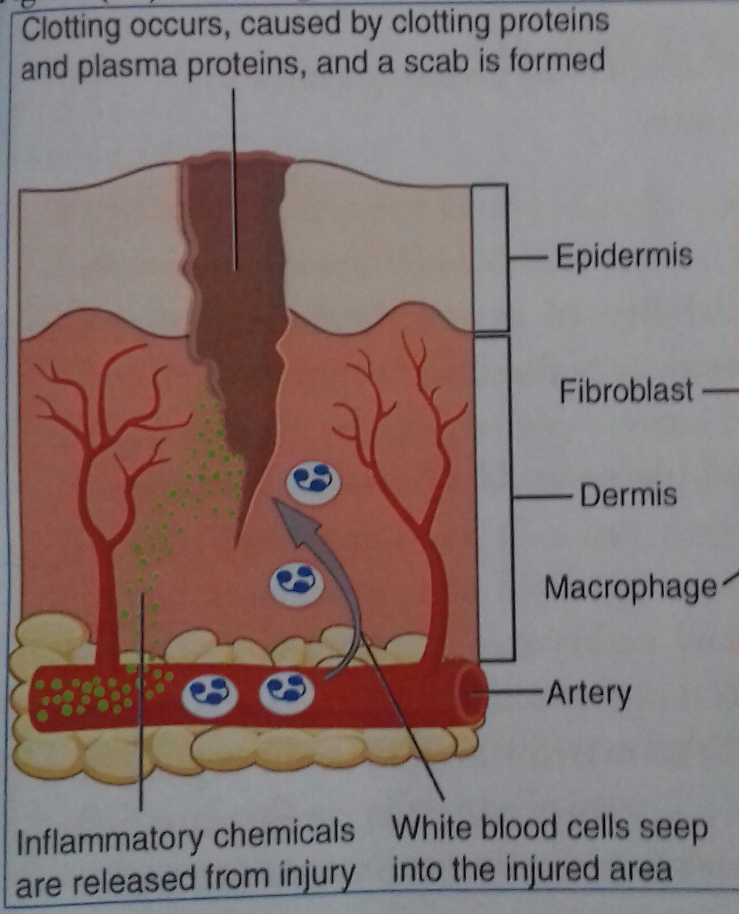

Slide 12
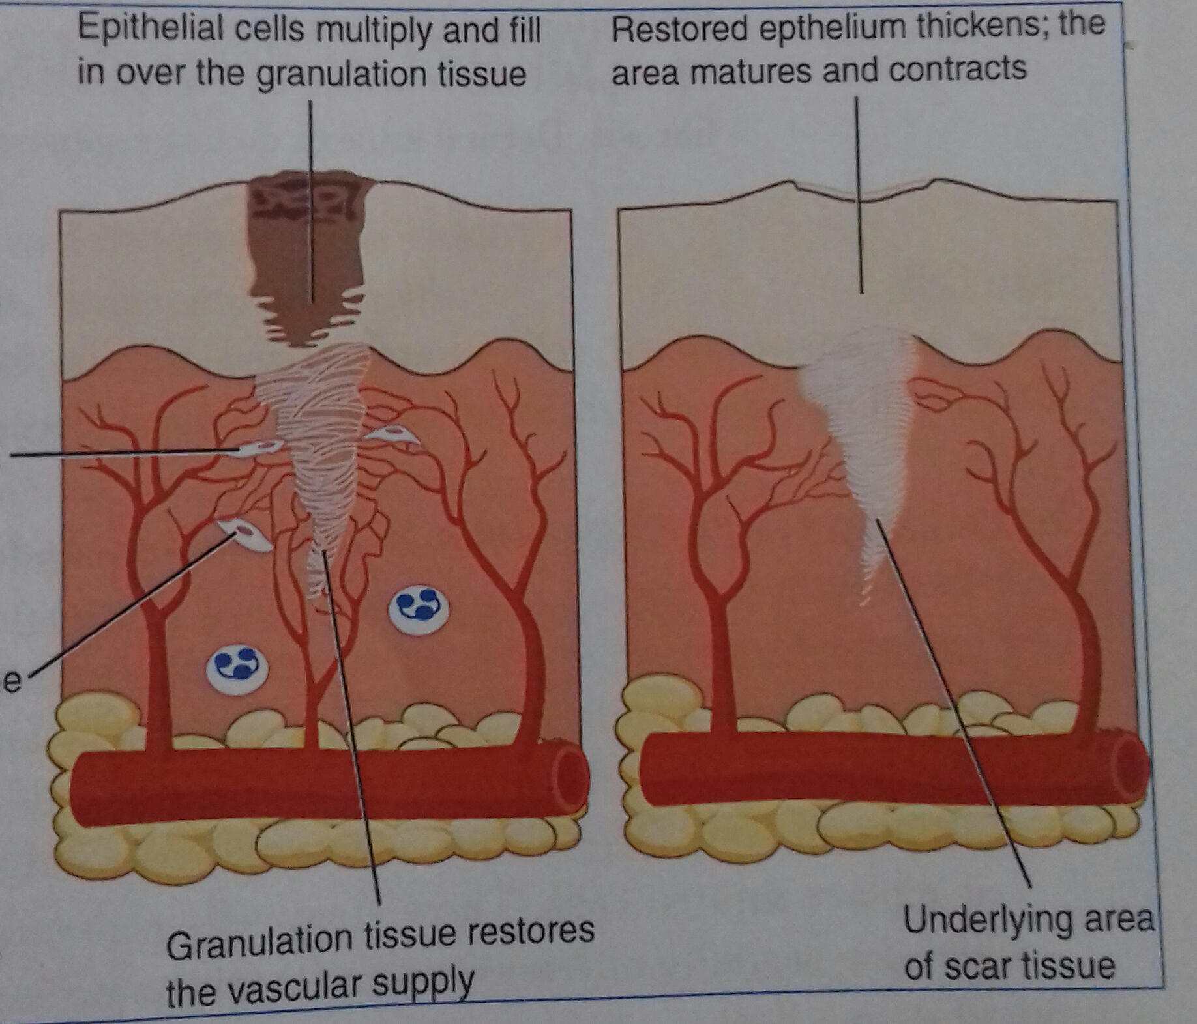

Slide 13
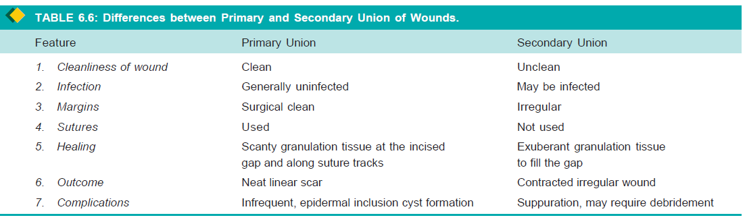

Slide 14
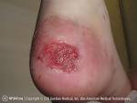
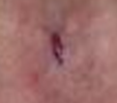
Complications of wound healing
1- Ulcer: means permanent loss of surface
epithelium of skin or mucous membrane.
2- Sinus: A blind ended tract between the depth
of wound and skin surface
3- Fistula: a tract between abscess cavity
and hollow organ or two hollow organs.
4- Keloid: large scar projecting on the surface
due to overdone repair.
5-Delayed healing.
6- Weak scar leading to incisional hernia.

Slide 15
Causes of failure of wound healing
Infection at the site of wound
Impairment of the blood supply
Interposition of foreign body
Nutritional disturbance of the body
Old age.
Drugs as steroids
DM

Slide 16
Causes of failure of bone healing
Infection at the site of bone
Faulty immobilization.
Impairment of the blood supply
Interposition of soft tissue between the bony ends
Presence of foreign body
Nutritional disturbance
Old age.
Drugs as steroids
DM

Slide 17

THANK you

