Slide 1
Acute and chronic renal failure
By
Ahmed Esharawy
Assistant Lecturer of medicine and cardiology
Sohag University

Slide 2
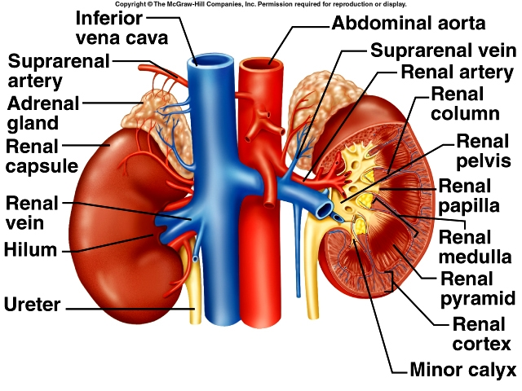

Slide 3
Functions of the kidney
Kidneys make up 1 % of body mass, but receive about 25% of cardiac output.
Kidney has 3 major functions:
1. Filtration of blood
Removes metabolic wastes from the body, esp. those containing nitrogen

Slide 4
2. Regulation:
Blood volume and composition
Electrolytes
Blood pH and blood pressure
3. Production of hormones as erythropoitin

Slide 5
Acute Renal Failure

Slide 6
Definition
Sudden and usually reversible loss of renal function, which develops over days or weeks.
It usually accompanied by a reduction in urine volume.

Slide 7
Causes of Acute renal failure
Pre-renal causes:
1- heart failure
2- blood or fluid loss as :
Hemorrhage- diarrhea- burns
3- renal artery occlusion
Pre-renal causes lead to kidney under-perfusion >> rapidly progressive changes>> acute tubular necrosis.

Slide 8
Causes, continued
Intrinsic Renal causes
1- acute tubular necrosis
Ischemic from prerenal causes.
Bacterial toxins.
Drugs as gentimicin.
2-Glomerular diseases
Primary.
Secondary : Systemic lupus.
3- interstitial diseases.
analgesic nephropathy

Slide 9
Post- renal causes:
-Stones
Tumors
Prostatic enlargment

Slide 10
Clinical assessment
There may be marked hypotension with signs of poor peripheral perfusion as cold sweaty hands.
Postural hypotension
The cause of decreased renal perfusion may be obvious as hemmorhage or burnes .
But in some cases, the cause may be concealed as GIT bleeding, fracture femur.

Slide 11
Uremic features as nausea, anorexia, and vomiting followed by drowsiness, confusion, muscle twitches, fits and coma.
Tachypnea due to acidosis or pulmonary edema .
Pulmonary edema from excessive fluid intake relative to urine output.
Anemia due to blood loss, hemolysis and decreased erythropoietin production.

Slide 12
Alternation in Urine volume>>> patient is usually oliguric ( Urine volume < 500 ml\day),
Anuria is rare and if present indicates post renal obstruction.
Rise in Urea and creatinine.
Disurbance in electrolytes, fluid and acid base balance
1- hyperkalemia 2- dilutional hyponatremia 3- metabolic acidosis 4- hypocalcemia

Slide 13
Managment
Establish and correct cause of acute renal failure.
If hypovolemia is present , restore blood volume as rapidely as possible ( with blood, plasma or isotonic saline).
Monitoring of central venous pressure to assess the rate of fluid administration.

Slide 14
Correction of hyperkalemia ( serum K > 6mmol\L) by:
1- I.V calcium gluconate.
2-Inhaled B2 agonist as salbutamol.
3-I.V glucose and insulin
4-Ion- exchange
5- dialysis

Slide 15
Correction of metabolic acidosis
1- correction of blood volume will correct acidosis
2- Sodium Bicarbonate IV
Dialysis in patients with pulmonary edema and anuria to remove excess fluids.
Protien restriction to decrease urea and creatinine
Control of infections.

Slide 16
Chronic Renal Failure

Slide 17
Definition
Irreversible deterioration of renal function which develops over a period of years.
Initially , it is manifest only as a biochemical abnormalities then loss of excretory, metabolic and endocrine functions of the kidney leads to the clinical symptoms and signs of renal failure>>> Uremia.

Slide 18
Aetiology
As polycystic kidney | Congenital and inherited
 | Renal artery stenosis
 | Hypertension
 | Glomerular diseases
As analgesic nephropathy | Interstitial diseases
 | Diabetes Mellitus
As systemic lupus | Collagen vascular diseases
Renal stones | Obstructive

Slide 19
Clinical manifestation
May be discovered during routine investigation as raised blood level of urea and creatinine.
The patient often has hypertension, anemia.
Nocturia ( frequent micturation at night).
Tiredness and dyspnea due to anemia.
Anorexia, nausea, vomiting and GIT bleeding.
Itching and hiccough.
Muscle twitches, general bone pains.
Parasthesia, numbness with reduced sensation due to neuropathy.
Easy bruising and bleeding tendency.

Slide 20
Complications of chronic renal failure

Slide 21
Anaemia :
Aetiology >>> Decrease erythropoitin production from kidney.
Treatment>>>recombinant human erythropoitin.
Fluid and electrolyte disturbnce:
Leads to fluid retention , lower limb edema and episodic pulmonary edema.
Treatment >>> decrease sodium intake - loop diuretics

Slide 22
Cardiovascular complications:
-coronary artery disease ( angina and infarction)
-pericardial effusion and constrictive pericarditis.
-hypercholesterolemia.
Treatment>>> control of hypertension- statin therapy to decrease hypercholesterolemia.

Slide 23
Metabolic bone diseases:
-osteomalacia and osteoporosis>>> generalized bone aches, fractures.
Treatment>>> calcium supplement – dialysis
Decreased immunity with increased susceptibility for infection.

Slide 24
Renal replacement therapy
It is the treatment of choice of end stage chronic renal failure.
Renal transplant
Dialysis
- hemodialysis
- peritonael dialysis

Slide 25
Renal transplant

Slide 26
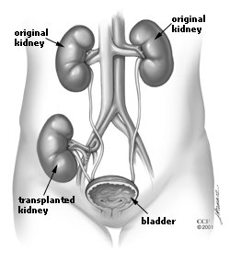

Slide 27
Indications of dialysis
Acidosis
Electrolytes disturbances (hyperkalemia)
Overload
Uremia

Slide 28
Vascular access for dialysis
AV fistula.
Tunneled catheter.

Slide 29
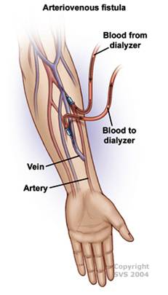
Arteriovenous Fistula
Notes:
Anatasmosis
Thrill - bypasses the capillaries, blood flows rapidly through the fistula
Steal syndrome: blood entering the limb is drawn into the fistula and returned to the general circulation without entering the limb's capillaries. This results in cold extremities of that limb, cramping pains, and, if severe, tissue damage; vasculature that supplies the rest of the limb is poor4
Lowest rate of risks

Slide 30
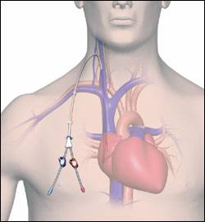
Tunneled Catheter
Notes:
provokes an inflammatory reaction in the vein wall. This results in scarring and narrowing of the vein, often to the point of occlusion

Slide 31
