Slide 1
Care of Newborn Under Radiant Warmer
Prepared by
Hossam Mahran

Slide 2


Slide 3



Discussion Rules

Slide 4
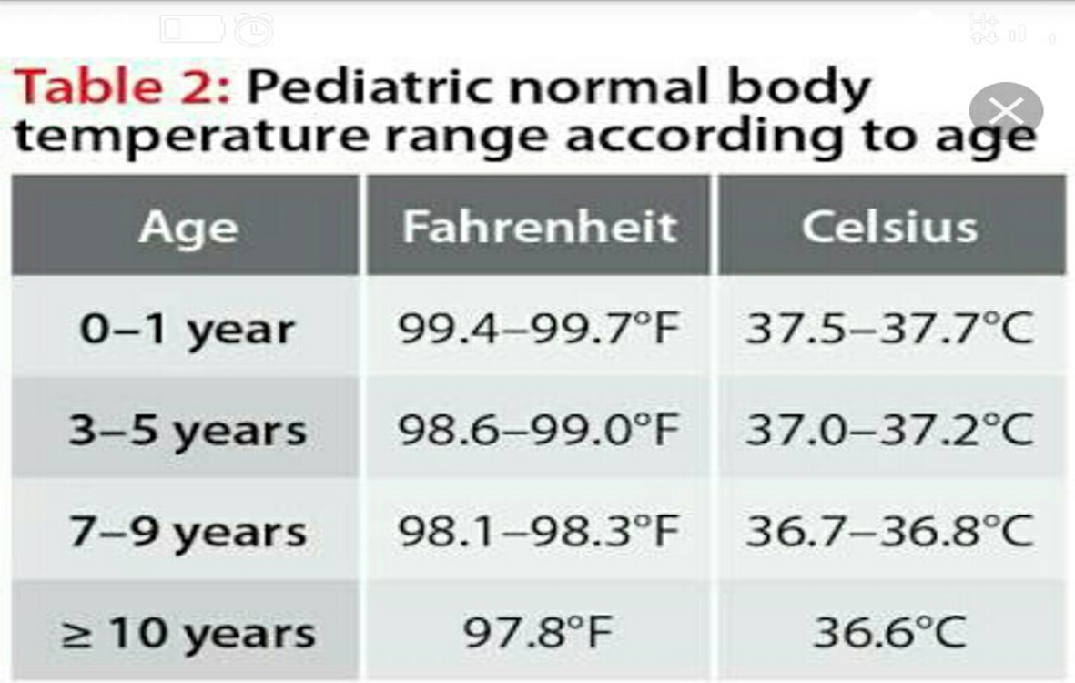

Slide 5
Introduction
Radiant warmer is the device used to maintain the temperature of the baby and to prevent hypothermia. Prepare a bed at least 30 minutes before the baby arrives in the nursery to ensure the baby is received in a warm, Comfortable environment.

Slide 6
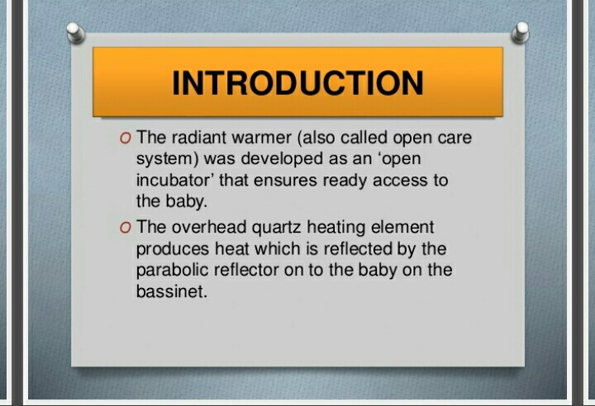

Slide 7
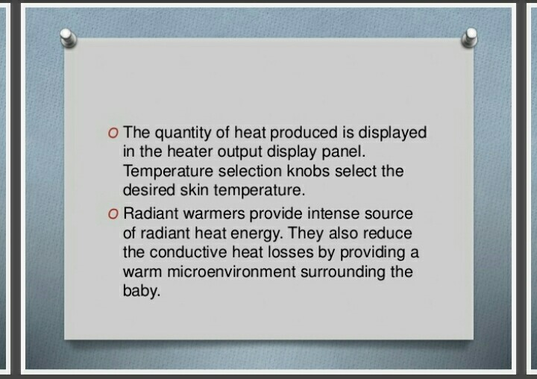

Slide 8
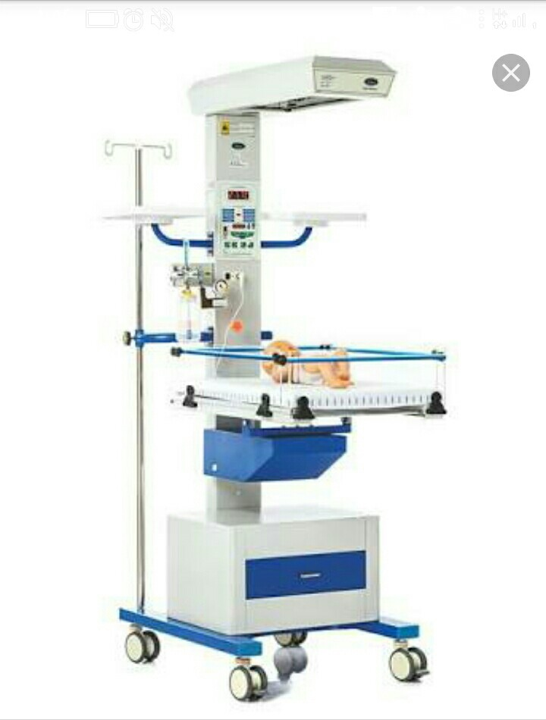
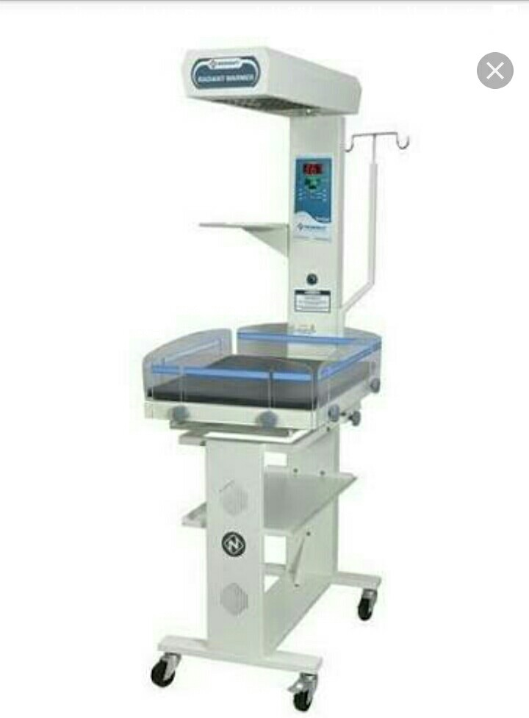

Slide 9
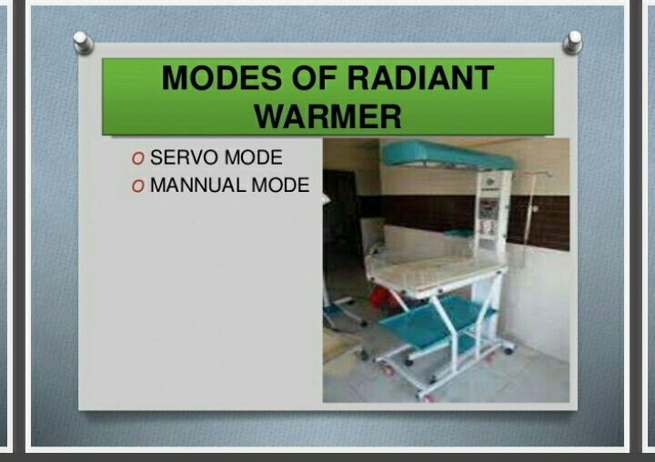

Slide 10
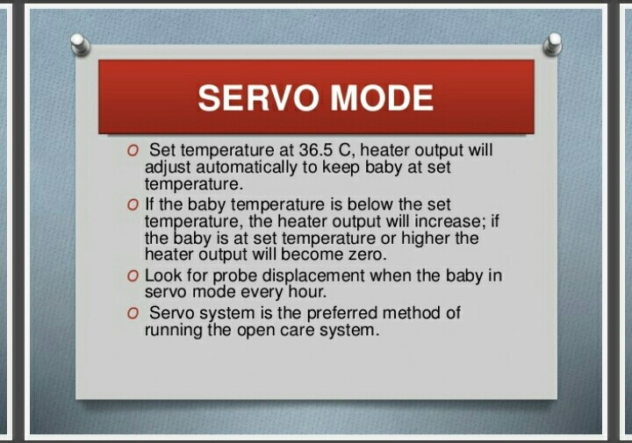

Slide 11
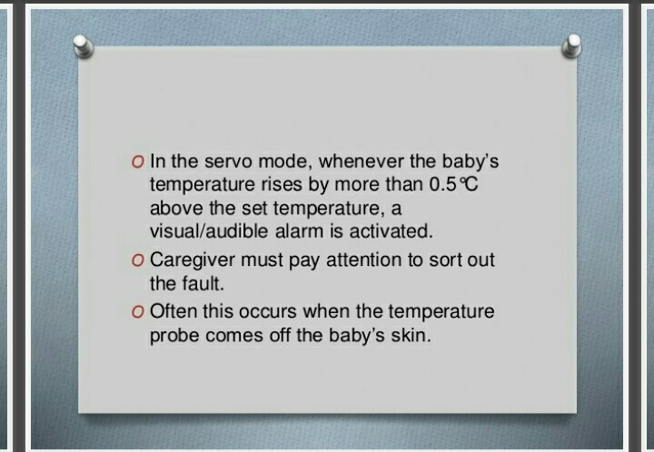

Slide 12
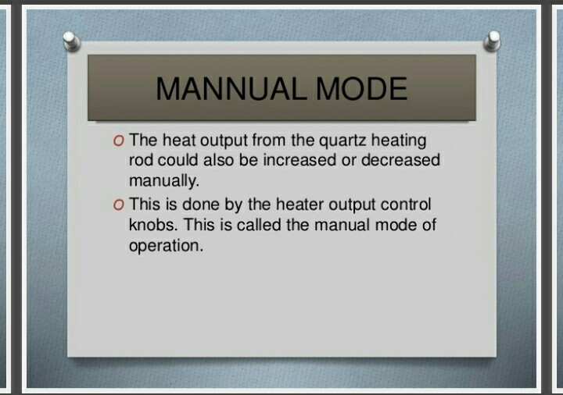

Slide 13
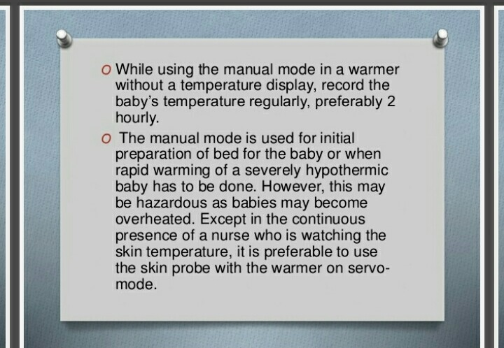

Slide 14
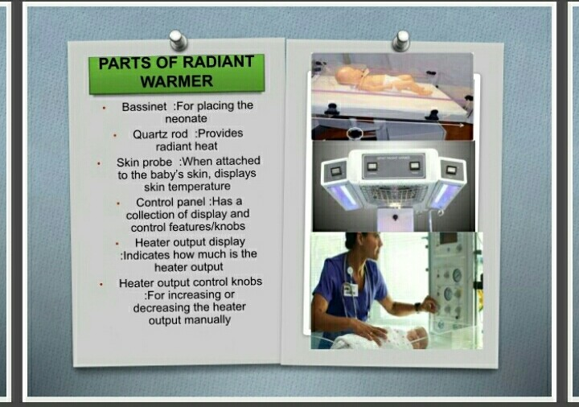

Slide 15
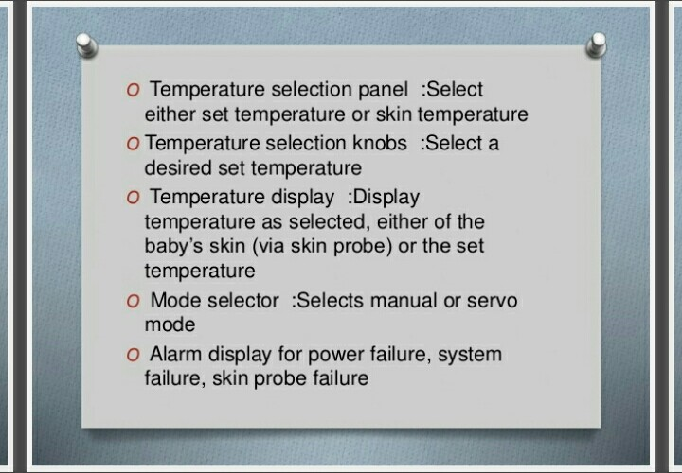

Slide 16
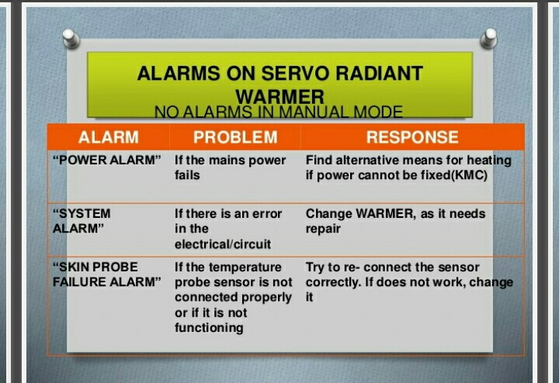

Slide 17
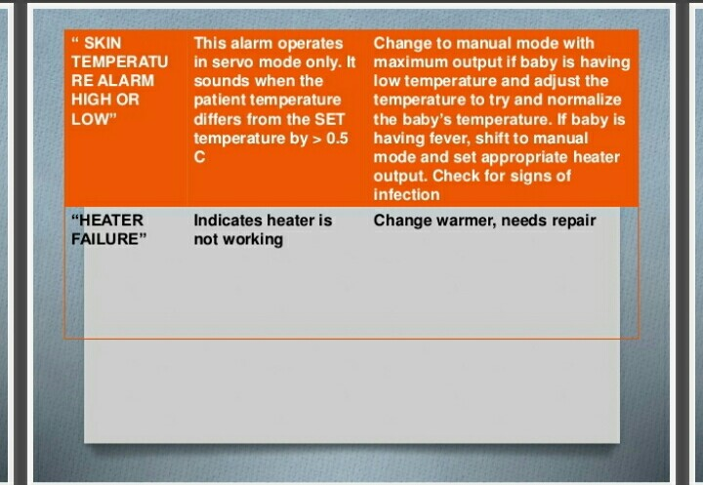

Slide 18
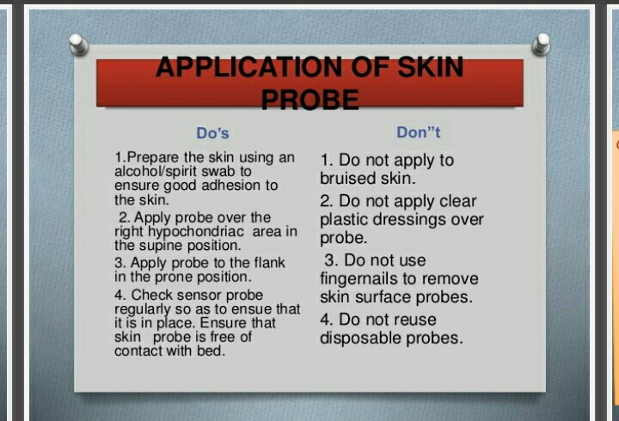

Slide 19
Procedure
Getting ready
1 – Wash hand
2 – Wear the gloves
3 – Prepare the equipment
4 - Explain the procedure to the mother
During the procedure
5 - Clean the radiant warmer/ incubator properly before use.
6 - Switch on the main electrical supply.
7 - Put the baby sheet on the bed. Arrange all necessary items near the bed.

Slide 20
Cont.,
8 - Put the radiant warmer on the manual mode with 100% heater output so that the temperature of all items likely to come in contact with the baby, are warm.
9- Once for radiant warmer is ready. Switch to skin mode with desired setting.
10 -Read temperature on display.
Abdominal skin temperature should be 95.9% to 97.7 F ( 35.5o to 36.5o)

Slide 21
Cont.,
11-Tape the probe onto the infant's abdomen b/w the umbilicus and xiphoid process in supine position and groin area in prone position.
12 -Note the length of time of the radiant waves.
13- Maintain the fluid and electrolyte balance with 30% extra fluid.
14 - Place only one baby under each radiant warmer.
15-Check the temperature of the warmer and of the room every hour and adjust the temperature setting accordingly. Record the heater output in each shift (every 6 hours).
16 - Move the baby with the mother as soon as the baby no longer requires frequent procedures and treatment.

Slide 22
Cont.,
After procedure
17 – Wash hand
18 – Put the enfant in comfortable position
19 – Record and report any abnormality

Slide 23
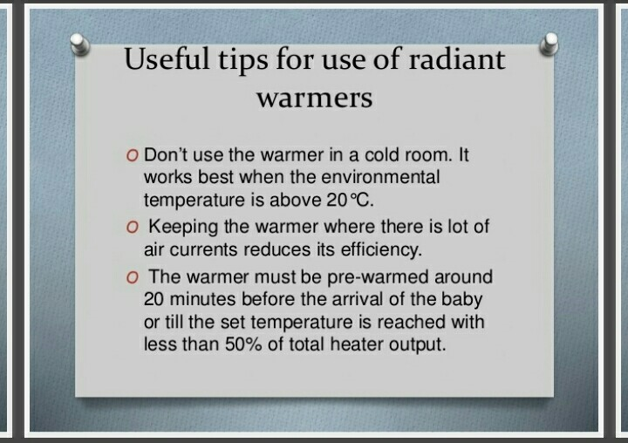

Slide 24
For Disinfection
1- For daily cleaning of front panel use damp cloth soaked in mild detergent.
2- Do not use spirit or other chemicals.
3- Bassinet, cot should be disinfected daily using soap/ detergent solution or disinfection solution

Slide 25


