Slide 1

REPAIR

Slide 2
Definition: the replacement of damaged cells by new healthy ones

Slide 3
Factors affecting repair:
1- Local Factors:
Severity of tissue damage.
Type of damaged cells: Labile, stable or permanent cells.
Blood supply: Poor blood supply and ischemia delays repair
Infection and presence of foreign bodies delay repair.

Slide 4
2- General factors:
Age:
Protein deficiency:
Vitamin deficiency: Vitamin C deficiency Vitamin D deficiency causes failure of calcification of osteoid tissue.
Zinc deficiency: Zinc is necessary for collagen synthesis.
Glucocorticoids and cytotoxic drugs: Delay repair.

Slide 5
Types of Repair:
Regeneration.
Healing by fibrosis

Slide 6
Healing by regeneration:
Definition: The replacement of damaged cells by new cells of the same kind. This is done by proliferation of the surrounding living cells.
Cells are classified according to their abilities to regenerate into three groups

Slide 7
1- Continuously dividing (labile) cells:
cells of skin and mucous membranes
Continously devide throughout life

Slide 8
2- Quiescent “stable cells”:
They do not continuously divide but divide when stimulated
Liver and kidney

Slide 9
3- Permanent cells:
Do not regenerate after injury
Heart and brain

Slide 10
Examples for healing by regeneration:
Regeneration of epidermis of the skin
Regeneration of liver cells:
Repair of bone fracture

Slide 11
The stages of bone healing are
Hematoma formation: Some vessels of bone and soft tissue are torn off, leading to the formation of hematoma
The hematoma is invaded by capillary loops and mesenchymal cells and soft granulation tissue formed is called “soft callus

Slide 12
Formation of provisional callus: The soft callus which become harder and is called “provisional callus”. Complete formation of the provisional callus takes about 3-4 weeks.
  Formation of woven bone: The osteoid starts to be formed, undergoes calcification and this is called woven bone formation.
  Formation of cartilage: The cartilage is formed, undergoes calcification, degenerates and the woven bone is removed.

Slide 13
Formation of lamellar bone: The area gets invaded by blood vessels and osteoid is formed in which collagen bundles are arranged in orderly lamellar fashion, calcifies to form lamellar bone.
Remodeling: The external and internal callus are removed. The remodeling process is directed by the muscle and weight bearing stresses imposed on the bone.

Slide 14
For bony union to occur adequate immobilization is needed
1- Hematoma formation
2- Formation of soft fibrocollagenous callus
3- B0ny callus formation
4- Bone remodelling occur

Slide 15
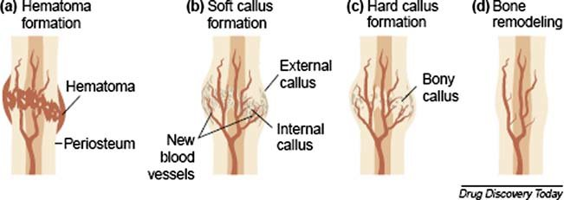

Slide 16
Failure of bony union may occur due to:
Faulty immobilization
Infection at the site of fracture
Impairment of the blood supply
Interposition of soft tissue between the bony ends
Nutritional disturbance of the body and old age.

Slide 17
II- Healing by fibrosis
Replacement of damaged tissue by fibrous tissue.
This is formed in the healing processes of inflammation, wounds, thrombus and infarct.

Slide 18
Mechanism:
Damaged area is invaded by granulation tissue from the surrounding living tissue.
Granulation tissue is moist, insensitive to touch, bleeds easily, and has a red granular surface.
The resulting fibrous tissue is avascular and called scar.

Slide 19
Healing of wounds
Primary union of wounds (healing by first intention):
Occurs in a clean incised wound with minimal tissue destruction, and when the edges are approximated e.g. surgical wounds.
Blood is clotted between the wound edges and on the surface.
The incision causes mild acute inflammation in the edges of the wound.

Slide 20
The basal cell layer of the epidermis on both edges of the wound proliferates across the clot to meet in the center.
Then, they divide to form the whole thickness of the epidermis
The gap of the wound under the new epithelium is filled by granulation tissue.

Slide 21
Primary wound healing

Slide 22
Secondary union of wounds (healing by second intention):
Occurs in healing of gaping wounds, septic wounds or abscesses.
The gap of the wound is filled by blood clots, necrotic debris or pus.
The epidermal cells at the margins proliferate across the blood clot but they do not cover the wound until the gap is filled with granulation tissue.

Slide 23
The gap gets filled from below upward and from the sides by granulation tissue
The basal cell layer around proliferates to cover the formed granulation tissue

Slide 24
Secondary wound healing

Slide 25
Complications of wound healing
Chronic ulcer: loss of continuity of the surface epithelium of the skin
Sinus: blind ended tract between the depth of a wound or abscess cavity and skin surface
Fistula: A tract between the abscess cavity and a hollow organ or between two hollow organs
Keloid:Large scar projecting on the surfaceIt is due to overdone repair

Slide 26
5) Contracture: A scar on a flexure may interfere with movement.
6) Implantation (epidermoid) cyst: Epithelial cells trapped in the wound during healing may proliferate and form an epidermoid cyst.
(7) Sqamous cell carcinoma: It is rarely develop in a scar.

Slide 27
Stem cells

