Slide 1
Pressure Ulcer

Slide 2



Rules

Slide 3
Learning objectives:
At the end of this lecture the student will be able to:
Define Pressure ulcer
Determine normal skin anatomy
Recognize age related change effect on skin
List Risk factors of pressure ulcer
List Most common sites of pressure ulcer
Mention Stages& symptoms of pressure ulcer
Identify management and Prevention of pressure ulcer

Slide 4
Introduction
Pressure ulcers remain a frequently occurring problem in health care. Hospital patients are often particularly vulnerable because of restricted mobility and poor health. Pressure ulcers are caused by pressure and shearing forces They cause pain and discomfort to the affected patients . In addition, the treatment of pressure ulcers is associated with considerable costs for society as well as for the patient. Therefore, it is important to prevent these ulcers.

Slide 5
Normal skin anatomy
The skin is made up of three layers: the epidermis, dermis and fatty tissues.
The epidermis is thin, tough outer layer. This layer has no blood vessels and renew it self about every month.
The dermis is thick, inner layer that attaches to tissue beneath. The dermis give skin strength and flexibility. The dermis contain blood vessels, hair follicles, oil glands, sweat glands, and nerve endings.
Underneath the dermis are fatty tissues, muscle and bone.

Slide 6
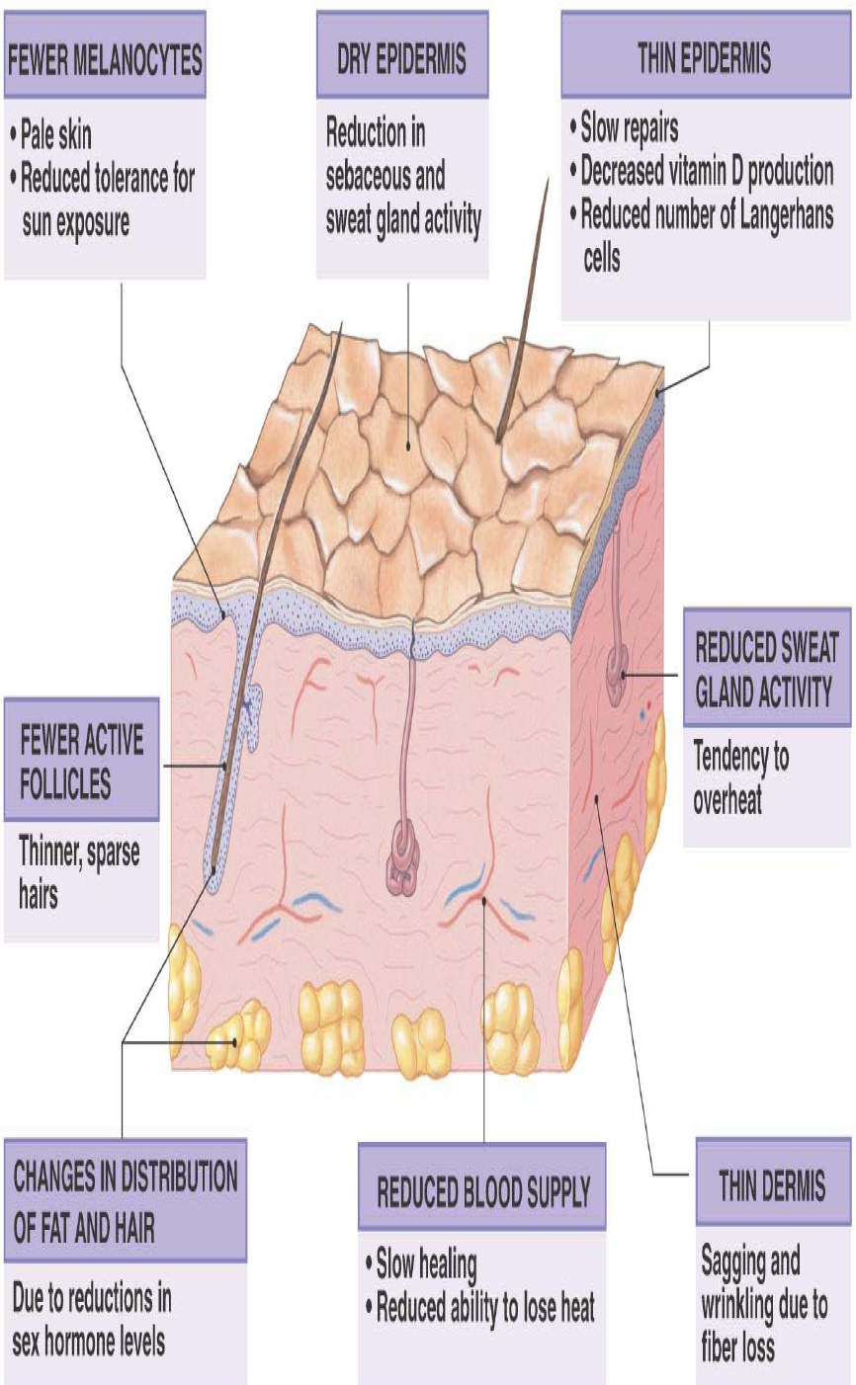
Age related change effect on skin.

Slide 7
Age related change effect on skin(cont.,)
Results | Physiologic changes.
Increase pallor.. | Decrease vascular of dermis.
Decrease hair color (graying). | Decrease amount of melanin
Increase dry skin.- - Decrease perspiration | Decrease sebaceous and sweat gland function.
Increase susceptibility to trauma. | Decrease thickness of epidermis.
Increased incidence of brown spots (senile lentigo). | Increased localized pigmentation
Increased purple patches (senile purpura). | Increase capillary fragility

Slide 8
Definition of Pressure ulcer:-
Localized areas of tissue necrosis that developed when soft tissue is compressed between a bony prominence and an external surface for a prolonged period of time.
An area of unrelieved pressure that result in damage to the underlying tissues and the development of skin lesion.
Other commonly used terms include decubitus ulcer, bed sores, and pressure ulcer.

Slide 9
Risk factors of pressure ulcer:-
♣Reduced mobility
♣ Vascular damage
♣ Sensory impairment
♣ Reduced consciousness
♣ Over 65 years old
♣ Malnourished/dehydrated

Slide 10
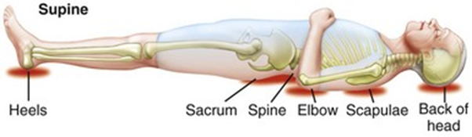
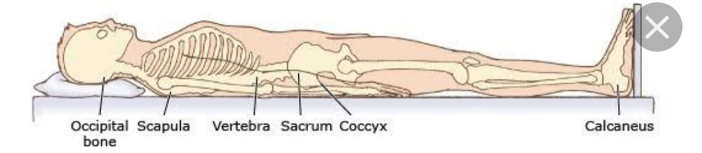
Most common sites of pressure ulcer:-
1) For patient in the supine position include occiput ,scapula,elbow,spinous process,sacrum,posterior calf, and heels.

Slide 11
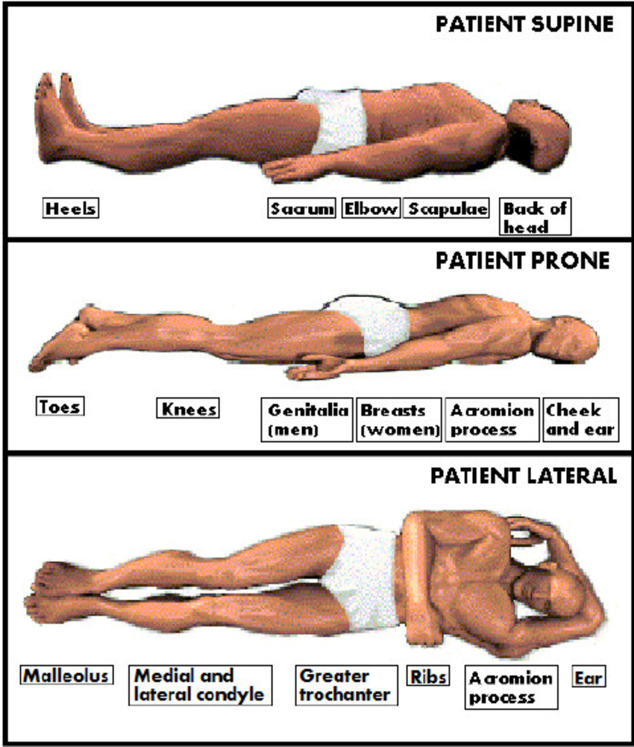
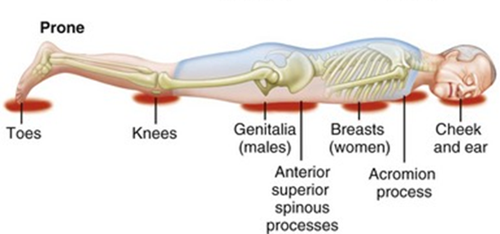
2) For patient in prone position include cheek, ear, acromion process, anterior chest, iliac crest, thigh, knees, and dorsum of feet and ankle.

Slide 12
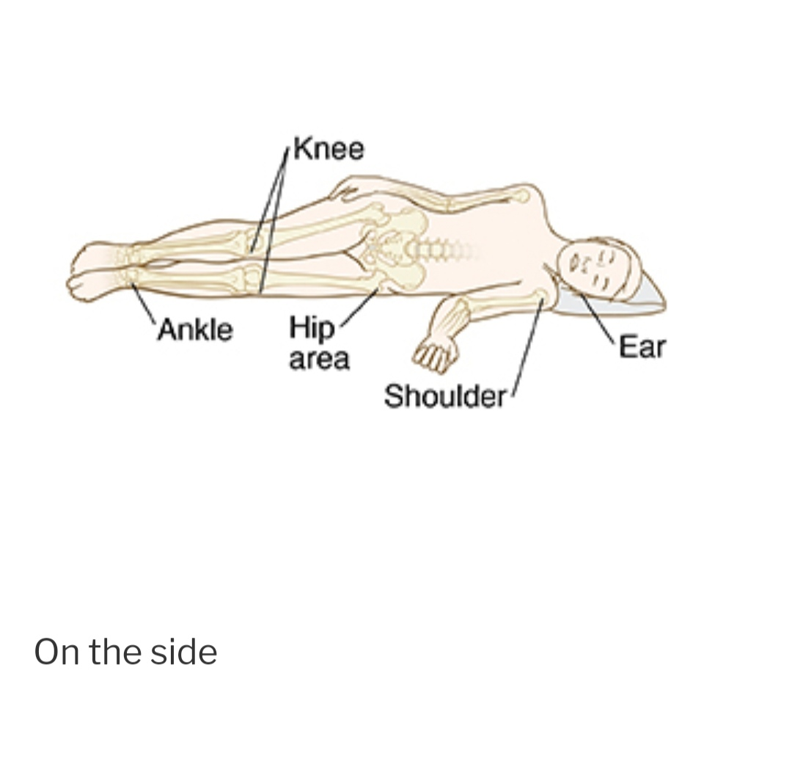
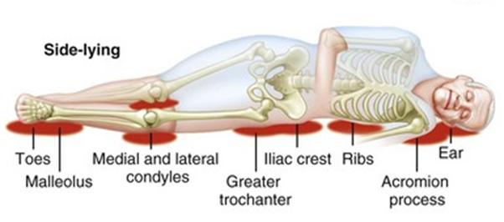
3) In lateral position, the ear and side of head ,acromion process, greater trochanter, medial and lateral surfaces of the knee.

Slide 13
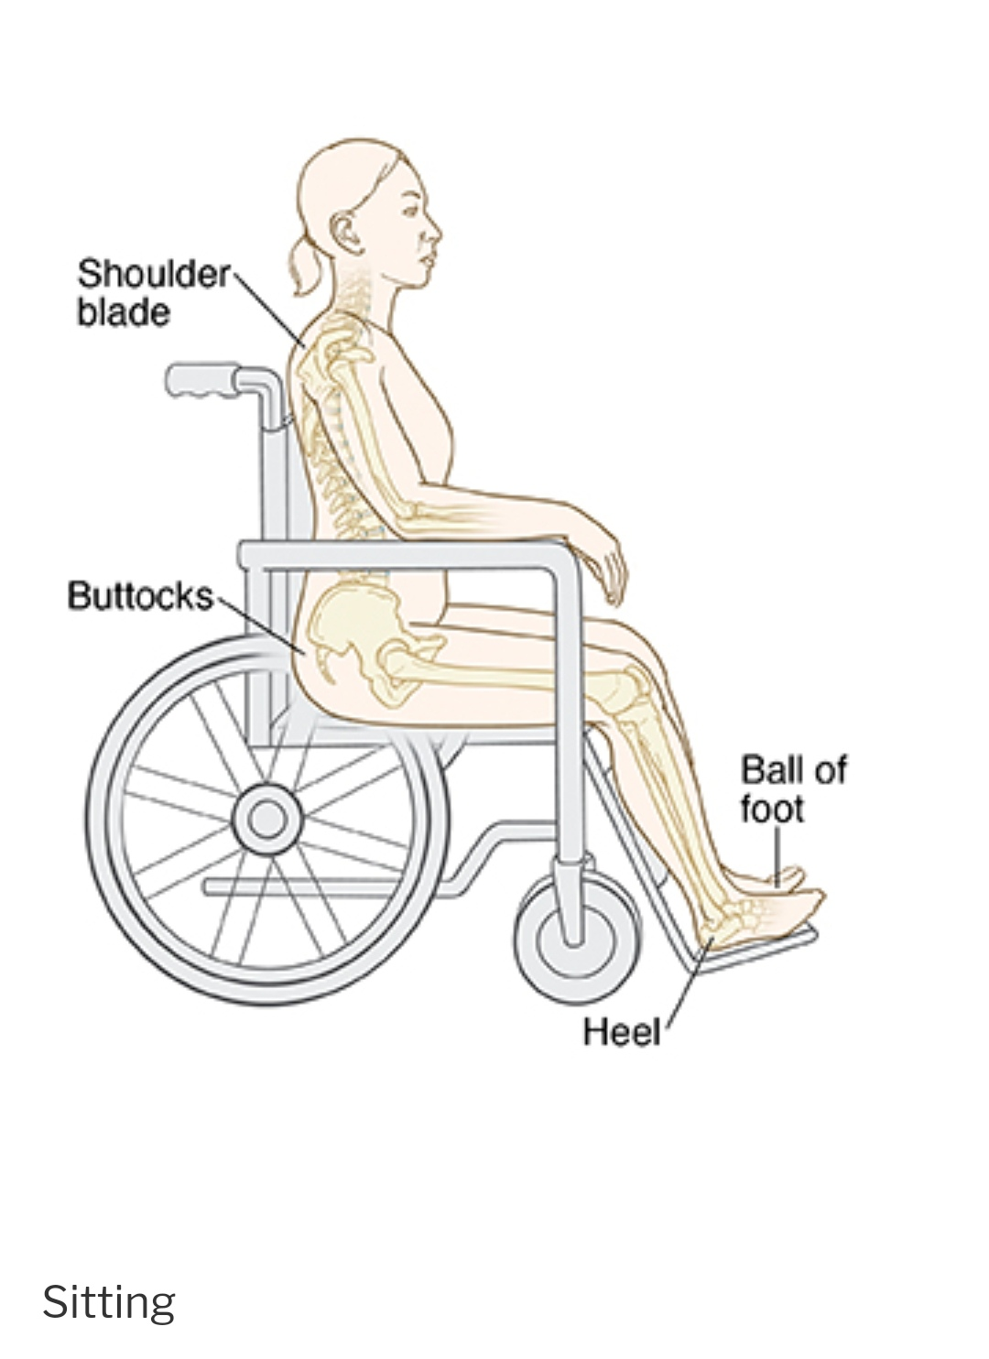
4) In the sitting position, the scapula, sacrum , coccyx, popliteal, heels , and planter surfaces of foot.

Slide 14
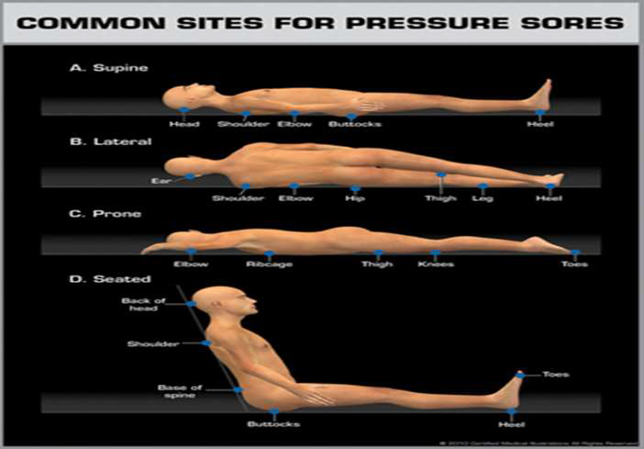

Slide 15
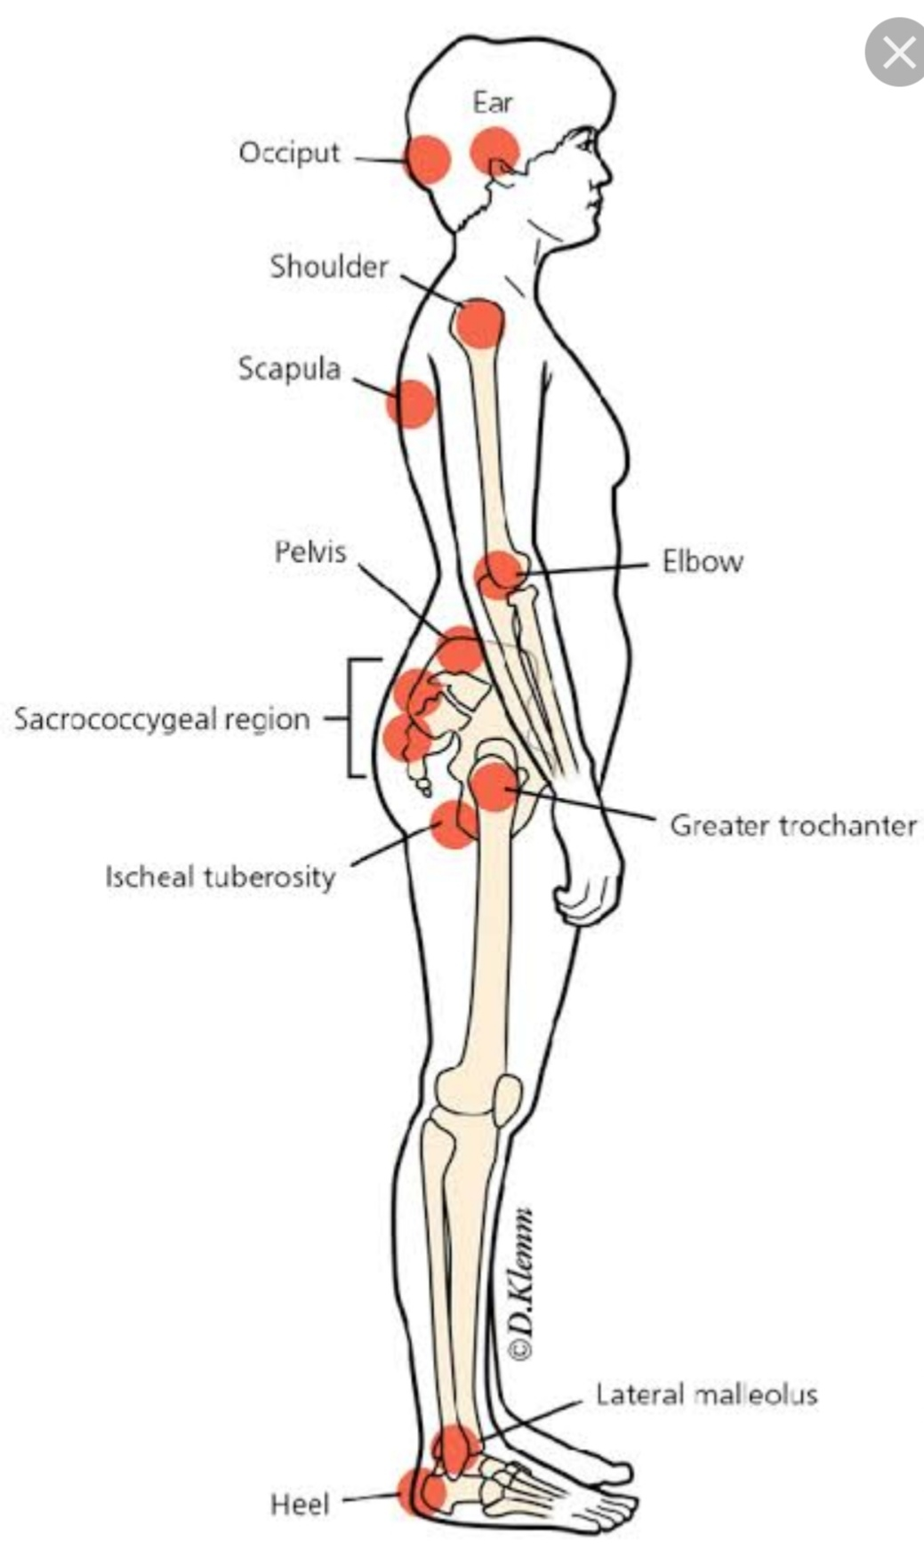

Slide 16
Stages / Classification Of Bedsores
Pressure ulcer classified According to extent of skin damage into four stages:
1. Stage I
2. Stage II
3. Stage III
4. Stage IV

Slide 17
Stages& symptoms of pressure ulcer:-
Stage I:.
Non –blanching erythema of intact skin.
May be painful if sensory innervation is intact and feel warmer or cooler than the skin around it.
The skin is not broken, involves only the epidermal layer of skin.

Slide 18
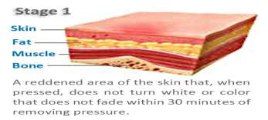
Stage I

Slide 19
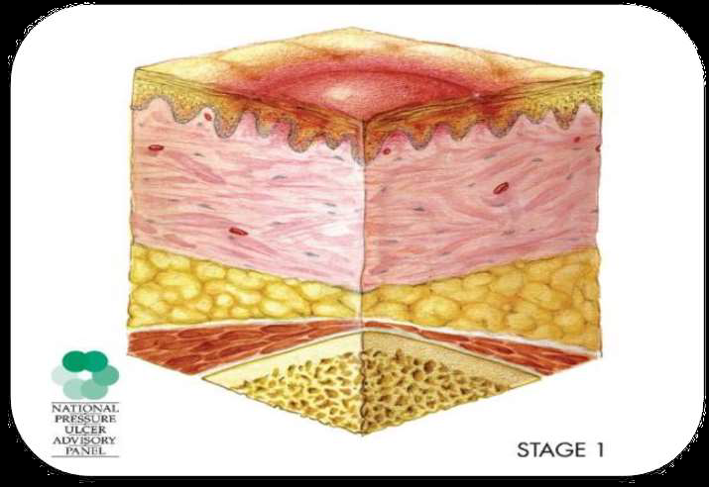
Stage I

Slide 20
Stage II:
Partial-thickness skin loss involving epidermis and or dermis.
The ulcer is superficial and present as blisters or abrasion.
The area around the sore may be red and irritated.

Slide 21
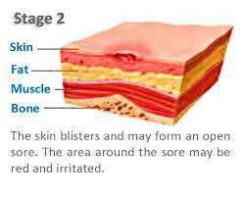
Stage II

Slide 22
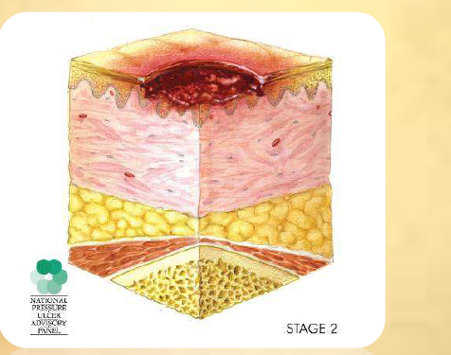
Stage II

Slide 23
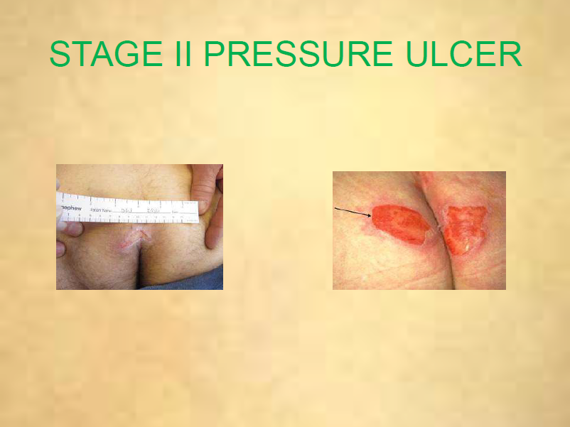

Slide 24
Stage III:
Full-thickness skin loss involving damage or necrosis to subcutaneous tissues which may extend to, but not to through underlying fascia.
The ulcer present as deep crater .

Slide 25
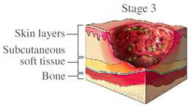
Stage III

Slide 26
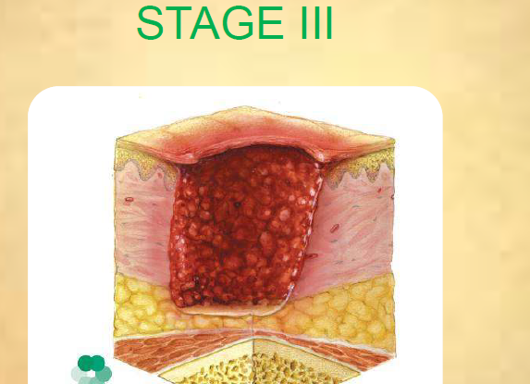

Slide 27
Stage IV:
Full-thickness skin loss with extensive destruction, tissue necrosis, or damage to muscle, bone, or supporting structures(tendon, joint capsule).

Slide 28
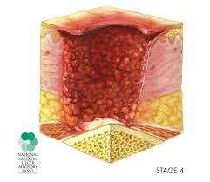

Slide 29
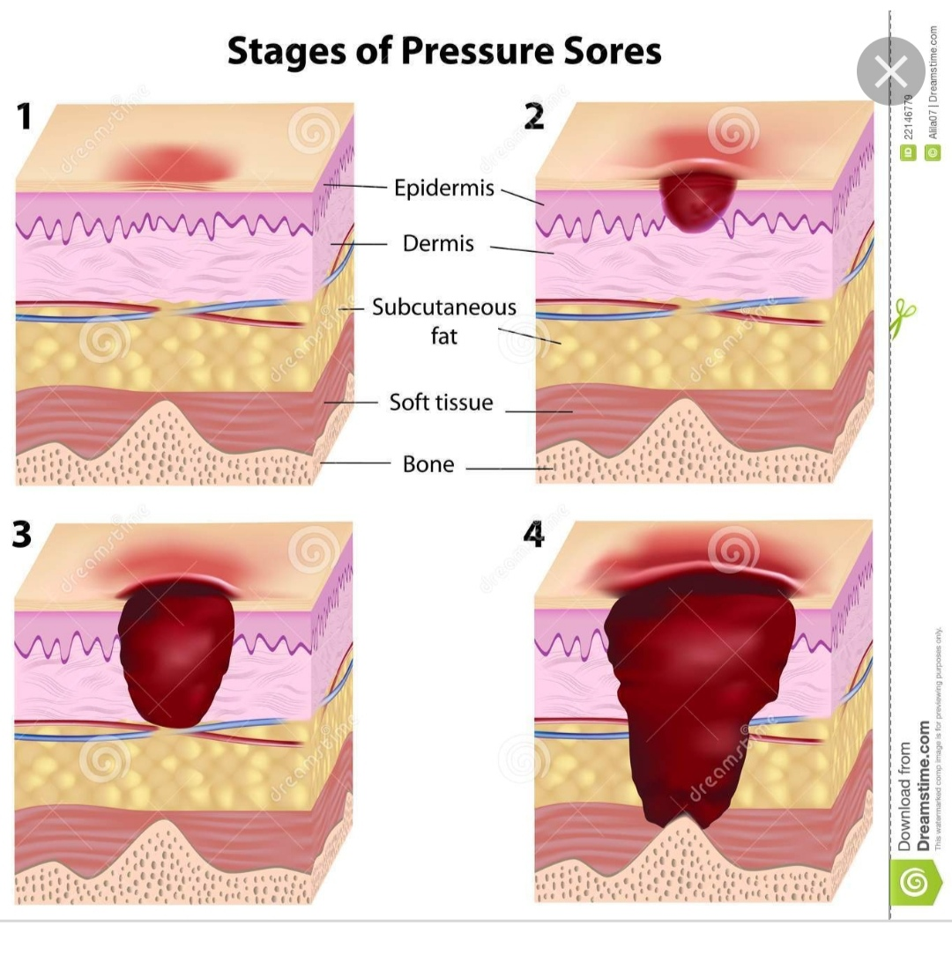

Slide 30
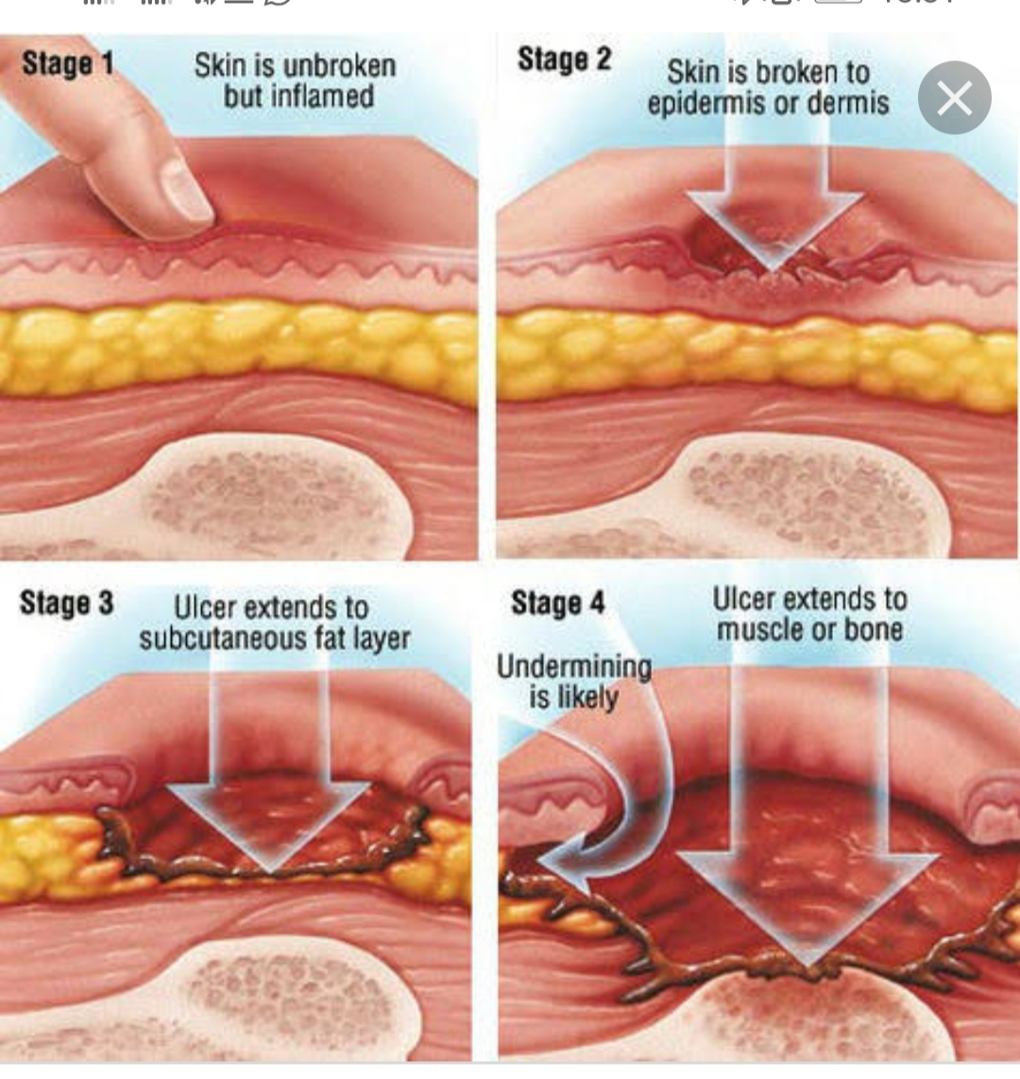

Slide 31
Prevention of pressure ulcer:-
Check you for pressure sores every day.
Take the following steps to prevent pressure ulcers:
Change position at least every 2 hours to relieve pressure.
Inspect the skin at least daily and document assessment results.
Use items that can help reduce pressure -- pillows, sheepskin, foam padding, and powders from medical supply stores.

Slide 32
Avoid massage over bony prominences
Identify and correct factors compromising protein/ calorie intake and consider nutritional supplementation/support for nutritionally compromised persons.
Eat well-balanced meals .
Drink plenty of water (8 to 10 cups) every day.
Exercise daily, including ROM.
Keep the skin dry and clean.

Slide 33
After urinating or having a bowel movement, clean the area and dry it well. A doctor can recommend creams to help protect the skin.

Slide 34
Equipment’s for prevention of pressure ulcer:-
Pillows
Rolled up blanket or towels
Specialty beds if ordered by physician or qualified practitioner
Heal and elbow protectors

Slide 35
Procedure for Management of pressure ulcer:-
1-Hand washing.
2-Prepare equipment.
3-Explain procedure to the patient.
4-Maintain body mechanics.
5-Check the health care provider order for specific positioning of patient and dressing change instructions.

Slide 36
6-Provide for patient privacy and apply gloves.
7-Adjust the bed and lower the side rail nearest you.
8-Asses patient skin over all pressure points such as sacrum-feet-heels-elbows-back of head.
9-Change patient position every 2 hours.
10-Provide skin care if area soiled or sweaty but do not massage pressure points

Slide 37
11-Use support devices such as special beds-pillows-towels-blankets-and heel protectors to decrease progression of ulcer.
12-Perform dressing change to a pressure ulcer.
13-Return side rail to the upright position and lower the bed.
14-Remove gloves and wash your hands.
15-Return the bed to the lowest position and elevate the head of the bed 30 to 45 degrees.

Slide 38
Post procedure:-
Return the bed to lowest position & elevate head of the bed 30:45 degrees.
Assist pt. back into the bed and pull side rails.
Rearrange equipment .
Hand washing.

Slide 39
Expected outcome:-
Comfort pt.
Maintain skin intact.
Limit pressure on body prominences.
Increases mobility.
Demonstrates improved tissue perfusion.
Avoid friction and shear.
Maintain clean, dry skin.

Slide 40
Documentation:-
Report and record the steps of procedure.
Report pt.'s response during the procedure.
Record any assessment such as the patient physical status , vital signs, status of ulcer.

Slide 41


