Slide 1
Incubator care

Slide 2
Introduction:
The term incubation has derived from a Latin word ‗Incubare‘ that means ―lie on. Incubation is the process of providing an environment to keep them worm and suitable for their development as birds sit on their egg to hatch them.
The first infant incubator was devised and used in 1880 when Dr. Jamier, a Parisian obstetrician got the idea from zoo-keeper who had built one to rear poultry. His successor prof. Pierre bud in realized t h e new born babies take time to accustom to the external environment specially if they one premature and low birth weight. As they are on risk to develop hypoxia, hypothermia and other many associated adverse conditions, need special care and attention.

Slide 3
Definition of incubator:
An infant Incubator is an apparatus used to care the premature, low birth weight and very sick babies in thermo -neutral environment.
An infant Incubator provides a closed, controlled environment that warms an infant by circulating heated air over the skin .The heated air is then absorbed into the body by tissue conduction and blood convection.

Slide 4
Purposes/uses/Functions:
♠ To maintain temperature.
♠ To provide humidity.
♠ To administer oxygen.
♠ For observation of baby.
♠ To prevent infection
Types of Incubator:
1- Portable
2- Standard.

Slide 5
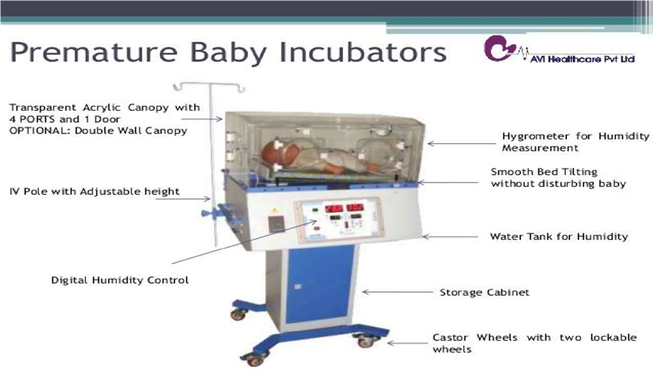
Parts of Incubator: Each part of an incubator has an important job, and throughout the years technology has improved the way they operate.

Slide 6

1-Hood: Single walked rectangular hood. The hood has a large door to aid in placing/ removing b a b y f r o m incubator. There are 4 elbow-operated parts for better access during small procedures, inlet for IV tubes, etc
2-The canopy is a clear, acrylic covering that protects the baby from the outside world and harmful germs that may infect the child. It also makes the perfect warm and oxygenated environment for a baby that's similar to a mother's womb.

Slide 7
3-Control panel: Heater blower and electronics.
Lower unit consists of; control box, touch sensor, front panel with display

Slide 8
4-Humidity percentage
Air is circulated by centrifugal blower, fresh air enters, through air filters located at the end of incubator, fresh air is mixed with circulated air from incubator canopy and passed over heater and humidifier. Temperature inside incubator is maintained by a sensor placed on hood. Thus, heated airflow maintains surrounding of infant at desired temperature.

Slide 9
5-Fan: is used for disinfection and fumigation.
6-Heater: is adjustable and helps maintain an infant's core body temperature. The temperature is always monitored through a temperature controller. Once set, the heater regulates itself just as a thermostat does on a home heating unit.
7- Air Distributors: Air distributors distribute air evenly to ensure equal temperature throughout the incubator. This prevents spaces of cold or stale air.

Slide 10
8-Filters: Filters clean the air before it is pulled into the incubator, preventing harmful particles from entering the incubator and possibly infecting the infant's lungs.
9-Hygrometer: This part of the incubator measures the amount of humidity inside the incubator. It's also responsible for breathing warm and humidified air into the baby's lungs through endotracheal tubes that run from the baby's nostril into the lungs.
This device provides comfort and support for a baby's lungs to fully develop.

Slide 11
10- The INCU incubator analyzer (outside attachable device) is designed to test and perform preventative maintenance on infant incubators and radiant warmers while simultaneously measuring airflow, relative humidity, sound.
11-Inlets: Inlets allow the administration of oxygen, medications and IV fluids.
12-Port Holes: allow nurses and caretakers to handle the baby without contaminating the infant's environment. Port holes are holes sealed with rubber gloves that you must insert your hands into in order have limited and contamination-free access to the inside of the incubator.

Slide 12
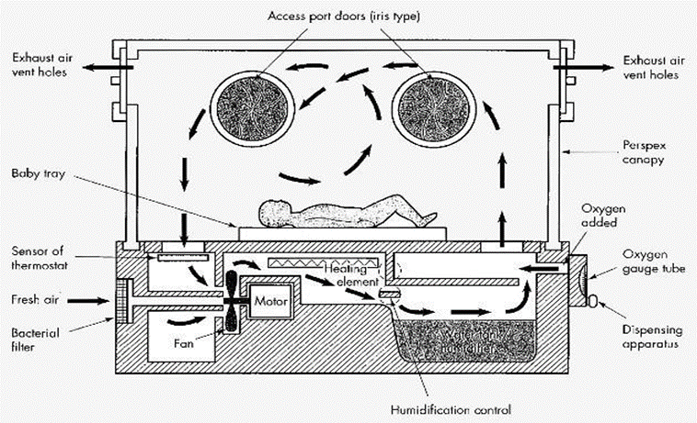

Slide 13
1-Nursing Care of child in incubator

Slide 14
Procedure
Getting ready
1 – Wash hand
2 – Wear the gloves
3 – Prepare the equipment
4 - Explain the procedure to the Mother
During the procedure
1 - Clean incubator with soap and water and disinfect with 20% antiseptic solution.
1-Nursing care of Child in Incubator:

Slide 15
2 - Switch on incubator and adjust temperature to 36°c
3 - Keep infant in incubator after pre warming the incubator for 15 minutes.
4 – Do not place any clothes on baby except on baby diaper.
5- C h e c k temperature of newborn every hour.
6 - Maintain flow chart to record temperature, heart rate, respiration and oxygen saturation.
7 - Change humidifier water every day.
8 - Give care for baby by introducing hand through port holes.
9 - Wearing of child from incubator is important. Keep port holes open for sometimes. Then take baby out and keep warm.

Slide 16
10 – Do not drag/move/pull incubator when b a b y is in the incubator . Avoid noise in the unit.
After procedure
1 – Wash hand
2 – Put the infant in comfortable Position
3 – Record and report any Abnormality

Slide 17
2-Incubator care Procedure (Daily &Terminal)

Slide 18
Preparation of incubator:
1.Wash hands
2. Cover the mattress with a sheet and tuck it under the sides
3. Make sure that the porthole of the clean incubator is remained close
4. Fill the humidity reservoir with distilled water only till the level indicated by a black line
5. Attach the incubator plug to electricity ( wall socket )& switch it on
6. Turn the temperature control dial between 28 –32 °c
7. Connect a tube between O₂ inlet and oxygen source
8. Set prescribed O₂ flow between 20% – 40%
9. Adjust humidity knob between 55%-65%

Slide 19
10. Keep incubator away from sunlight or warm radiant
Daily care of incubator :
1. Wash hand
2. Replenish humidity tank up to the black line with distillated water.
3. Wipe down the inside wall with disinfectant ( Savlon ) or according to hospital policy while changing sheet and having infant on scale
4. Wipe the outside wall every 8 hours with disinfectant ( Savlon )
5. Wipe plastic cover mattress with disinfectant
6. Change bed sheet daily and whenever needed
7. Monitor O₂ flow rate and concentration as prescribed

Slide 20
8. Check that temperature is between 28-32°c
9. Check that humidity is between 55-65%
10. Replace incubator every 7 days. ( Date of replacement should be indicated clearly on incubator
11. Wash hands following completion of procedure
Terminal care of incubator :
1. Wash hands before initiating procedure
2. Switch electricity off from incubator and wall socket
3. Invert humidity tank to drain and dry it .
4. Remove all detachable parts

Slide 21
5. Wash it with hot soapy water , rinse and dry
6. Inspect the mattress cover carefully for signs of tear or loss of impermeability
7. Wash mattress with soap and water & dry it well
8. Wash the floor of incubator with water ,and dry it
9. Expose the whole unit to adequate fresh air and sunshine
10. Change the air filters according to manufacturer instructions.
11. If disinfection‘s required , wipe the inside and outside wall , floor and mattress of the incubator with a dilute hypo- chloride solution but Should be reined off
12. If the incubator has integral humidifier ( can‘t be removed ) to disinfect it , raise the temperature of water at least 70 °c for 10 minutes
13. If the humidifier is removable , detach it and send it to autoclave

Slide 22
After the procedure(Terminal care): -Wash hands -Documentation: date of disinfection ,name of personnel who has performed care on a tape and place it on the outer surface of incubator

Slide 23


