Slide 1

INFLAMMATION

Slide 2
Definition: Inflammation is a reaction of living, vascularized tissues to injury.
It represents a protective response aiming at localization and removal of the irritant, and also initiating the healing process for the tissue.

Slide 3
Inflammation is designated by adding the suffix “itis” to the English, Latin or Greek name of the organ affected e.g tonsillitis, appendicitis, gastritis …etc.
Inflammation is not a synonym for infection.

Slide 4
Causes of inflammation:
Infectious agents (living irritants): bacteria, viruses, fungi, & parasites
Physical agents: excessive heat, cold, radiation
Chemical agents: acids, alkali, poisons, drugs
Mechanical injury: trauma (either blunt or penetrating), foreign bodies
Immunological injury: hypersensitivity, autoimmunity

Slide 5
Types of inflammation:
1- Acute inflammation
2- Chronic inflammation
3- Subacute Inflammation

Slide 6
Acute inflammation:
Caused by an irritant of short duration of action.
The tissue response is rapid and of sudden onset.
Inflammation lasts for days to weeks and is characterized by the presence of fluid exudate and polymorphonuclear leucocytes (PML)

Slide 7
Chronic inflammation
Caused by an irritant of long duration of action.
The tissue response is slow and of gradual onset.
Inflammation lasts for weeks to months, and is characterized by the presence of macrophages, plasma cells, lymphocytes and fibrosis

Slide 8
Subacute Inflammation
Grades of inflammation between acute and chronic inflammation

Slide 9
Acute inflammation
Acute inflammatory reaction consists of:
Local tissue damage.
Local vascular reactions.
Local reaction of tissue histiocytes

Slide 10
Local changes occurs at the site of injury
→local tissue damage includes necrosis and degeneration of some cells→release of chemical mediators→inflammatory response.
It includes:
Vascular phase: →formation of inflammatory fluid exudate
Cellular phase:→formation of inflammatory cellular exudate

Slide 11
1-Local tissue damage where the central cells are dead (necrosis), surrounded by degenerated cells that liberate chemical mediators.
2-Local vascular changes:
Transient vasoconstriction.
Dilation of the blood vessels due to the direct effect of the chemical mediator (histamine) and local axon reflex→↑blood flow to the site of injury→hyperemia →redness, hotness, tenderness, oedema or swelling and loss of function (cardinal signs of inflammation).

Slide 12
INFLAMMATOY FLUID EXUDATE
Formation of inflammatory fluid exudate due to:
1-↑vascular permeability due to
( endothelial contraction, retraction or damage).
2-↑capillary hydrostatic pressure due to vasodilation and ↑blood flow.
3-↑osmotic pressure of the interstitial tissue (due to tissue necrosis).

Slide 13
FUNCTION OF THE FLUID EXUDATE:
1-Dilute the toxins, chemical poison and enzymes at the site of inflammation so ↓its effect
2-Brings AB, and chemical mediators from the blood to the site of injury.

Slide 14
FATE OF INFLAMMATORY FLUID EXUDATE:
drained by lymphatic to the regional lymph node

Slide 15
INFLAMMATORY CELLULAR EXUDATE
Chemotaxis: is the directed movement of the polymorphes towards the site of injury by the effect of chemotactic factors (bacterial products, complements,
Phagocytosis: it is the process of recognition and engulfing of the bacterial parts by polymorphes

Slide 16
It occurred by coating the bacteria by opsonin (immunoglobuline and complements factors).
Phagocytic cells recognized the opsonized bacteria and engulf it by the pseudopodia and formation of phagosome that fused with lysosomal granules leads to release of the proteolytic enzymes ( powerful bacetricidal effect)( formation of reactive oxygen species as oxygen peroxide and superoxide) that degrade the bacterial particles.

Slide 17
Phagocytosis in acute inflammation carried by:
Microphages: These are the PML
Macrophages: derived from blood monocytes and tissue histeocytes

Slide 18
Cardinal signs and symptoms of acute inflammation
Redness:
Hotness: caused by arteriolar dilatation and increased blood flow.
Swelling: caused by accumulation of inflammatory fluid and cellular exudate.
Pain: caused by:
(a) Irritation of the nerve endings by chemical mediators
(b) Pressure of the inflammatory exudate on the sensory nerves.
Loss of function:

Slide 19
Course of acute inflammation
Resolution:
Fibrosis:
Abscess Formation:
Progression and spread
Chronicity

Slide 20
Types of acute inflammation
I. Suppurative inflammation: | II. Non suppurative inflammation:
Localized inflammation: abscess furuncle carbuncle Diffuse inflammation: Cellulitis | Catarrhal inflammation. Membranous inflammation. Sero-fibrinous inflammation. Fibrinous inflammation. Serous inflammation. Hemorrhagic inflammation. Necrotizing inflammation. Allergic inflammation.

Slide 21
Suppurative inflammation (Pyogenic or Septic)
Definition: acute sever inflammation characterized by pus formation, caused by staph aureus, strept hemolyticus, gonococci and pneumococci.
Staph infection → tissue necrosis→ dead neutrophils (pus cells)→ release of proteolytic enzymes→ liquefactive necrosis →Pus formation
Cause:
Composition of pus

Slide 22
Types of suppurative inflammation
Localized: abscess, carbuncle, furuncle
Diffuse: cellulitis, appendicitis, peritonitis.

Slide 23
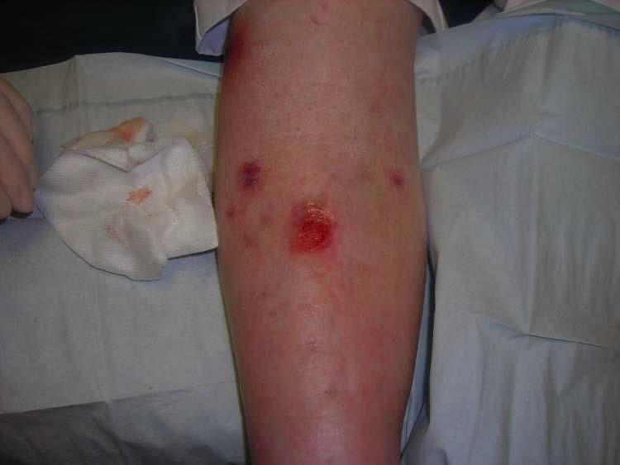
Examples for suppurative inflammation
Abscess
A localized suppurative inflammation caused by staph result in a small cavity filled with pus.
The common site is the subcutaneous tissue but it can occurred in any site.

Slide 24
Pathology of an abscess
  Central necrotic core gradually diminishes in size by liquefaction of its margin until it disappears.
  Mid-zone containing pus known as abscess cavity.
_ Pe ripheral zone of inflamed tissue called pyogenic membrane

Slide 25
Complications:
1-Lymphatic spread of infection causes lymphangitis and lymphadenitis.
2-Blood spread of bacteria and its toxins causes bacteremia, septicemia or toxemia.
4-Inadequate drainage and treatment changes the abscess to a chronic one.
5-Complications of healing in the form of chronic ulcer, sinus, fistula and keloid.

Slide 26
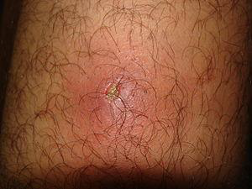
Furuncle: a small abscess related to hair follicles. Common at the face and the neck.

Slide 27
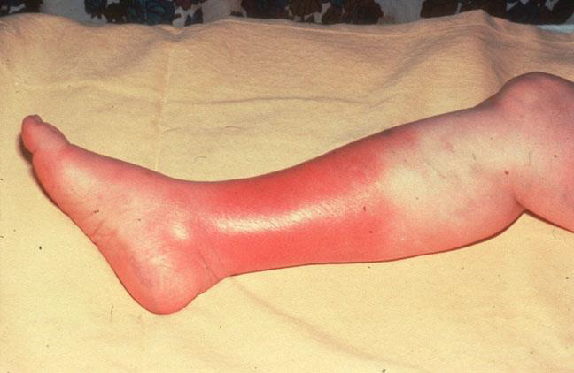
Cellulitis
Acute diffuse suppurative inflammation
Cause:Streptococcus hemolyticus
Sites:Loose connective tissue as subcutaneous tissue, fascial planes, areolar tissue of the orbit, pelvis, scrotum and wall of the appendix
Pathology

Slide 28
The basic pathological changes are similar to those of abscess with the following differences:
Failure of localization because of absence of fibrin.
Necrosis is extensive.
Pus formation is slow.
Pus is thin in consistency and may contain many red cells i.e. sanguinous

Slide 29
Complications:
Acute lymphangitis and lymphadenitis.
Septic thrombophlebitis causing pyemia.
Septicemia.

Slide 30
Non suppurative inflammation
Catarrhal inflammation: Mild acute non suppurative inflammation of the mucous membranes characterized by excess mucus secretion e.g. catarrhal rhinitis, bronchitis, appendicitis ... etc.
Membranous inflammation: Severe acute non suppurative inflammation characterized by the formation of a pseudo-membrane on the affected surface e.g. diphtheria and bacillary dysentery.
Sero-fibrinous inflammation: Acute non suppurative inflammation characterized by the formation of excess fluid exudate rich in fibrinogen e.g. inflammation in serous sacs (pleura, pericardium and peritoneum).

Slide 31
Fibrinous inflammation: Acute non suppurative inflammation characterized by an exudate rich in fibrinogen e.g. lobar pneumonia.
Serous inflammation: Acute non suppurative inflammation characterized by excess serous exudate. Example: mild buns show epidermal vesicles full of serous fluid
Hemorrhagic inflammation: Acute non suppurative inflammation characterized by cellular exudate rich in RBCs e.g. smallpox and hemolytic strept. infection.

Slide 32
Necrotizing inflammation: Acute non suppurative inflammation characterized by marked tissue necrosis e.g. cancrum oris and Vincent-angina.
Allergic inflammation: bronchial asthma

Slide 33


Slide 34
Chronic Inflammation
The irritant is mild and has a prolonged action.
It may follow acute inflammation or starts as slowly progressing chronic disease as in tuberculosis and syphilis.
The tissue response is gradual and prolonged.
Tissue necrosis is progressive

Slide 35
Chronic inflammatory cells
( macrophages,lymphocytes and plasma cells)

Slide 36
Macrophages
derived from blood monocytes and tissue histiocytes.
Macrophages have the following functions:
1-Phagocytosis of bacteria as tubercle bacilli and lepra bacilli.
2-Formation of giant cells.
3-Secrete proteases as collagenase and elastase, chemotactic factors

Slide 37
Chronic inflammation can be divided into:
Chronic nonspecific that followed acute inflammationin all tissues.
Chronic specific or granulomatous disease

Slide 38
 | Acute inflammation | Chronic inflammation
Irritant Onset Duration Inflammatory cells Vascular changes Blood vessels Fluid exudates Toxemia Fibrosis Types Fate | Mild, moderate or severe Sudden Short (days-weeks) PML, pus cells and macrophages Marked Thin dilated congested capillaries Present Acute toxemia Absent or mild Suppurative Non suppurative Resolution or chronicity | Mild irritant Gradual Long (weeks-months) Lymphocytes, plasma cells, macrophages and giant cells Mild Thick walled arteries and arterioles (end arteritis) Scanty or absent Chronic toxemia Marked Non specific Specific Fibrosis and its complications

Slide 39
Granulomas
Definition
Granuloma is a chronic specific inflammation characterized by focal accumulation of a large number of macrophages together with lymphocytes, plasma cells, giant cells and fibroblasts

Slide 40
Types:
Infective granuloma:
Bacterial: e.g. tuberculosis, leprosy and syphilis.
Parasitic: e.g. bilharziasis and leishmaniasis.
Fungal: e.g. madura foot.

Slide 41
. Non infective granuloma (foreign body granuloma):
A-Silicosis and asbestosis.
B-Foreign body granuloma formed around pieces of wood or glass, catgut and talc powder.

Slide 42
Granuloma of unknown cause:
Sarcoidosis
Regional enteritis; Crohn’s disease

