Slide 1
INFECTIOUS DISEASES
By
Dr. Ghada Ahmed Asker
Pathology Department

Slide 2
Toxaemia
Definition: circulation of bacterial toxins in the blood, toxins may be:
Exotoxins from gram +ve bacteria as diphtheria bacilli, cholera
Endotoxins from bodies of dead gram –ve bacteria as thoid bacilli

Slide 3
Bacteremia
Definition: transient presence of small number of bacteria in the blood stream
Septicemia
Definition: large number of virulent bacteria and its toxins circulate and multiplies in the blood

Slide 4
Pyemia
Definition: circulation of septic emboli lead to development of multiple small abscesses (pyemic abscesses) in one or more organs

Slide 5
TUBERCULOSIS
Definition: a chronic granulomatous inflammation caused by mycobacterium tuberculosis
Mode of infection:
1- Inhalation
2- Ingestion
3- Skin inoculation

Slide 6
Types of T.B infection
1- Primary
2-Secondary

Slide 7
Primary TB
Definition: infection by TB bacilli for the first time
Sites: lung, tonsils, intestine and skin
Characterized by primary complex:
1- Ghons focus
2- TB lymphangitis
3- TB lymphadenitis

Slide 8
Secondary TB
Occur in previously sensitized host
Mode of infection:
Endogenous from reactivation of a dormant primary lesion
Exogenous when TB bacilli enter the body for the second time

Slide 9
PULMONARY TUBERCULOSIS
Primary pulmonary TB
Is characterized by:
1- Occur in previously unexposed patient
2- Occurs mainly in children
3- Infection is by inhalation
4- Infection is usually subpleural
5- With the primary complex

Slide 10
Fate of primary pulmonary complex
1- Healing by fibrosis
2- Spread which may be:
- Direct spread
- Blood spread
- Bronchial spread

Slide 11
Secondary pulmonary tuberculosis
Is characterized by:
1- Occur in previously sensitized patient
2- Occurs mainly in adult
3- Infection is by:
- reactivation of dormant primary lesion
- exogenous re-infection
4- Localized to the apex of the lung with cavitations

Slide 12
Course of the disease
1- Regression: healing by fibrosis when small number of bacilli and high immunity
2- Progression:
- If moderate number of bacilli and moderate immunity lead to Chronic fibrocaseous pulmonary tuberculosis
- If large number of bacilli and low immunity lead to Acute tuberculous bronchpeumonia

Slide 13
Complication of pulmonary tuberculosis
1- Hemoptysis
2- Rupture of cavity in the pleural sac
3- Spread of infection
4- Right sided heart failure
5- Secondary amyloidosis
6- Infected sputum may cause TB of larynx, tonsil or tongue
7- Swallowing infected sputum causes intestinal TB

Slide 14
BILHARZIASIS (Shistosomiasis)
Definition: chronic granulomatous disease caused by Schistosoma infection

Slide 15
Bilharziasis of the urinary bladder
Is characterized by pathological lesions including:
1- Sandy patches
2- Bilharzial polyps
3- Bilharzial ulcers
4- Hyperplasia
5- Bruns nests

Slide 16
6- Cystitis cystica
7- Cystitis glandularis
8- Squamous metaplasia and leukoplakia
9- Dysplasia and carcinoma in situ

Slide 17
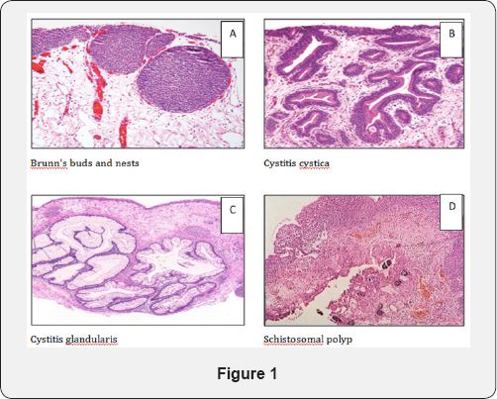

Slide 18
Complication of bilharzial cystitis
1- Hematuria
2- Secondary bacterial infection causing:
- stones - Fistula
3- Bladder neck obstruction by fibrosis leading to:
- Hypertrophy and dilatation of the bladder
- Bilateral hydroureter and bilateral hydronephrosis

Slide 19
4- Chronic renal failure
5- Carcinoma of the urinary bladder

Slide 20
Thank you

