Slide 1
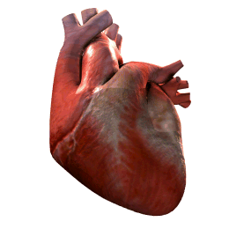
Ischemic Heart Disease
(IHD – coronary Heart Disease)
By
Ahmed Elsharawy
lecturer of internal medicine and cardiology
Sohag faculty of medicine

Slide 2
objectives:
At the end of this session the trainee will be able to
be able to discuss the burden of IHD.
describe essential elements in history taking & examination
develop a differential diagnosis of chest pain.
describe appropriate diagnostic testing for chest pain.
discuss modifiable & non modifiable risk factors for cardiac disease.
describe the use of investigation in the evaluation of a patient with chest pain.
appropriatly use of specialty referral.

Slide 3

The VERY Basics
Function of coronary arteries: delivery of oxygenated blood to the heart muscle (myocardium)
How-to-draw-cartoons-online.com

Slide 4
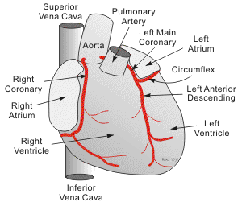
Cvphysiology.com

Slide 5
CORONARY ARTERY DISEASE
A narrowing of the coronary arteries that prevents adequate blood supply to the heart muscle is called coronary artery disease. Usually caused by atherosclerosis, it may progress to the point where the heart muscle is damaged due to lack of blood supply. Such damage may result in infarction, arrhythmias, and heart failure.

Slide 6
CORONARY ATHEROSCLEROSIS
CORONARY ATHEROSCLEROSIS is the abnormal accumulation of lipid or fatty substances or fatty atheroma(plaque) in the lumen of coronary artery

Slide 7
ACUTE CORONARY SYNDROME(ACS)
ACS is a term used to define potential complications of CAD.This syndrome includes;
Unstable angina
Myocardial infartion(ST segment elevation)
Myocardial infarction(non ST segment elevation)

Slide 8
RISK FACTORS
Modifiable
Non Modifiable

Slide 9
MODIFIABLE
Dyslipidemia
Cigarette smoking, tobacco use
Hypertension
Diabetes mellitus
Lack of estrogen in women
Obesity
Sedentary lifestyle and/or lack of exercise
Psychosocial stress

Slide 10
NON MODIFIABLE
Family history of CAD
increasing age
Gender(male)
Race(non white populations)

Slide 11
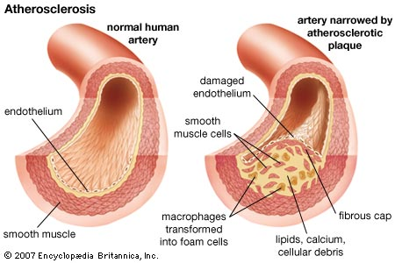
Pathophysiology of CAD

Slide 12
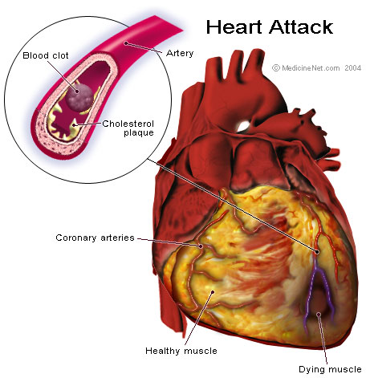
Plaque

Slide 13
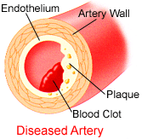
A Narrowing or obstruction of the coronary arteries resulting from atherosclerosis. An accumulation of fatty plaques made of lipids in the arteries
Causes a decrease perfusion of myocardial tissue and inadequate myocardial oxygen supply

Slide 14
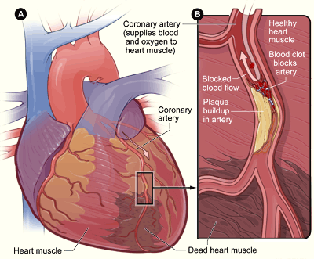
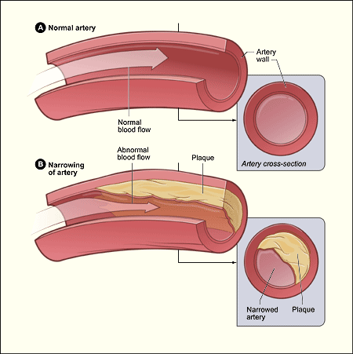
Atherosclerosis

Slide 15
Any tests that might help in diagnosis?
History and Examination
ECG
Cardiac Enzymes
Chest x-ray.
Echocardiography

Slide 16
History taking in CAD
Patient characteristics (Name, age, sex,occupation)
Pain (duration, location, intensity,nature,aggravating factors
Associated symptoms (Dyspnea, syncope….etc)
Past history (HTN,DM,COPD..ETC)
Family history (coronary artery disease ,pneumothorax)
Drug history (antiangina,anti diabetic..etc)
Life style (Diet, exercise, alcohol, smoking )
Psychosocial (anxiety, stress )

Slide 17
What characteristics of the chest pain might make you more concerned for cardiac chest pain?
Location
Associated Symptoms
Quality
Chronology
Onset
Duration
Intensity
Exacerbating
Relieving
Situation

Slide 18
ANGINA PECTORIS
Angina pectoris is a clinical syndrome usually characterised by paroxysms of pain or pressure of anterior lobe.the cause is usually insufficient blood flow

Slide 19
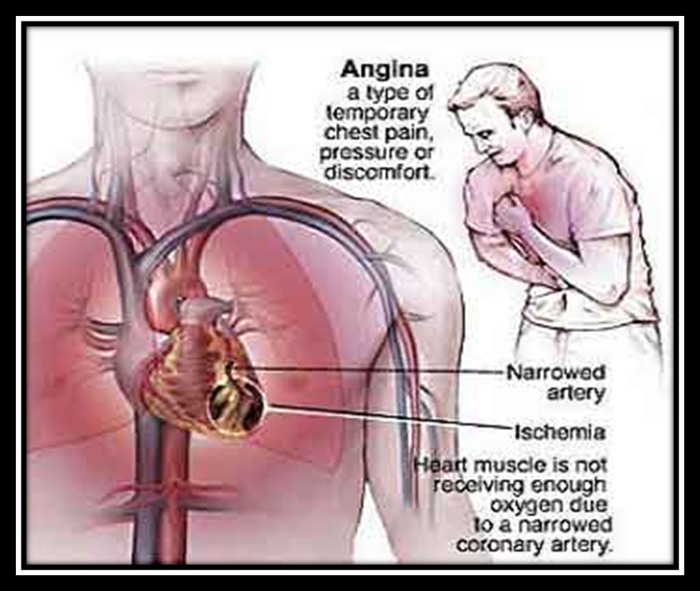

Slide 20
TYPES
Stable angina
Predictable consistent pain that occurs in exertion and is relieved by rest
Unstable angina
Also called preinfarction angina
Symptoms occur frequently and last longer than stable angina
Pain may occur at rest

Slide 21
Variant angina
Also called prinzmentals angina.
Pain at rest with reversible ST segment elevation thought to be caused by coronary artery vasospasm

Slide 22
Silent ischemia
Objective evidence of ischemia (such as electrocardiographic changes with a stress test) but patient report no symptoms

Slide 23
ANGINA PAIN FEATURES
Squeezing burning tightening aching across chest usually starting behing breast bone.
The often spread to neck,jaw arms, shoulders,throat,back,or even teeth
Attack of stable angina last for 1 – 5 minutes

Slide 24
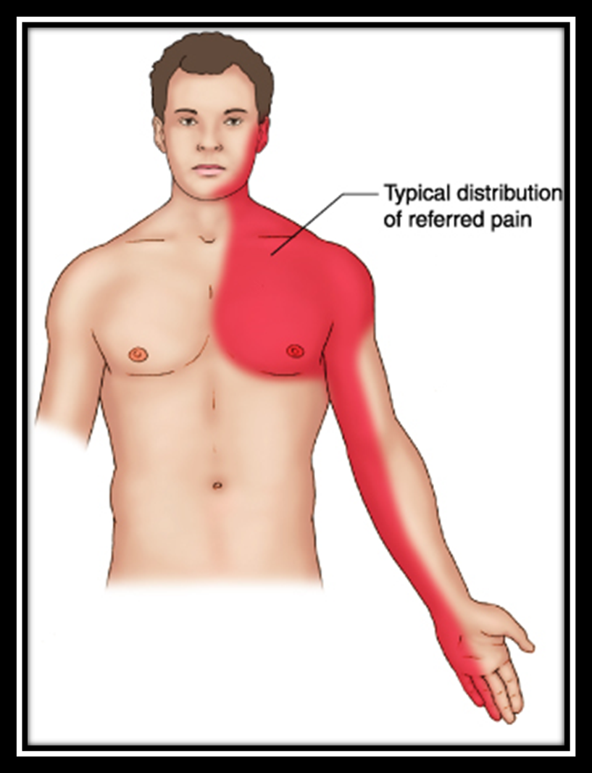

Slide 25
What would be the differential diagnosis for chest pain?

Slide 26
Life threatening Causes | Non-life threatening Causes
Cardiovascular(16%): Myocardial infarct. Angina. Thoracic aortic dissection. Pulmonary (5%): Pulmonary embolus. Pulmonary infarction. Tension pneumothorax. Pneumonia. Pleurisy. | Chest wall (33%): Trauma Fracture Costo-chondritis. Musculoskeletal. Gastrointistinal(20%): Esophageal spasm Esophagitis. Gall bladder disease. Peptic ulcer disease. pancreatitis Psychatric (9%): Anxiety. Spinal dysfunction: Cervical disease. Infections (rare): Herpes Zoster.
..

Slide 27
Physical Examination
General Examination
  patient status: stable,notstable,inpain or not in pain.
  Vital signs.
  Obese or overweight.
  Skin appearance.
Cardiovascular &respiratory system examination
  BP, Pulse rate, JVP.
  Chest :apex beat deviation, crepitations, decrease breath sounds.
  Heart : 1st & 2nd heart sounds, gallop, friction rub.
  Abdomen: tenderness, guadring….

Slide 28
Any exam findings that might help distinguish cardiac from non cardiac chest pain?
General Appearance
  may suggest seriousness of symptoms.
Vital signs
  marked difference in blood pressure between arms suggests aortic dissection
Palpate the chest wall
  Hyperesthesia may be due to herpes zoster
Complete cardiac examination
  pericardial rub
  Ischemia may result in MI murmur, S4 or S3
Determine if breath sounds are symmetric and if wheezes, crackles or evidence of consolidation

Slide 29
Cont…
ECG
    ST elevation of > 1mm or new Q in 2 leads
      Sensitivity 45%
    Above + ST depression or T-wave inversion
      Sensitivity 79%
      False positive rate = 17%
    20% of patients having an MI will have a normal ECG initally

Slide 30
Cont…
Cardiac enzymes:
Troponin, CK, myoglobin
  88-90% sensitive at 4-6 hours
  95-100% sensitive 8-12 hours
Source: Am Heart J 1998 Aug;136(2):237-44

Slide 31
Initial Approach
ABC assessment
100% Oxygen
Aspirine
Nitroglycerine
IV access
Morphine
Monitoring
ECG quickly
Notes:
MONA
Morphine
Oxygen
Nitroglycerine
Aspirine

Slide 32
Important Points
The likelihood of acute coronary syndrome (low, intermediate, high) should be determined in all patients who present with chest pain.
A 12-lead ECG should be obtained within 10 minutes of presentation in patients with ongoing chest pain.
Cardiac markers (troponin T, troponin I, and/or creatine kinase-MB isoenzyme of creatine kinase) should be measured in any patient who has chest pain consistent with acute coronary syndrome.
http://www.aafp.org/afp/20050701/119.html

Slide 33
Nursing Assessment
1. Gather information about all facets of the patients activities, especially those that precede and precipitate attacks of anginal pain.
2. Assess the risk factors in the patient history and modifications possible to reduce risk.
3. If chest discomfort is present at the time of the interview, further collection of data is delayed until pain and dysrhythmias are resolved.
4. A complete physical assessment is performed. The patient is questioned regarding nausea, vomiting, diaphoresis, dizziness, weakness, and palpitations.

Slide 34
Nursing Interventions
1. The nurse must teach the patients the link between symptoms and activity and the need to avoid activities known to cause angina, such as sudden exertion, exposure to cold, and emotional excitement.
2. Medications used in the treatment of angina include nitrates, beta-blockers, calcium channel blockers, and platelet antiaggregants. Administer cardiac medication as prescribed and be alert for adverse side effects, particularly their effect on blood pressure. Teach the patient the symptoms to be aware of and what measures to take.

Slide 35
Nursing Interventions
3. Encourage the patient to remain on bedrest in order to decrease cardiac workload and oxygen consumption.
4. Administer oxygen therapy as prescribed.
5. Evaluate vital signs hourly to determine the hemodynamic effect of the drugs and the client’s tissue perfusion.
6. Nursing care should be planned so that minimal time is spent away from the bedside due to the high level of patient anxiety, as well as the unstable condition of the patient.

Slide 36
Nursing Interventions
7. patients with unstable angina are at high risk for myocardial infarction (MI) and sudden death. The nurse watches for development of heart failure and dysrhythmias.
8. Relieving pain is the top priority for the patients with an acute MI, and medication therapy is administered to accomplish this goal.
9. Maintain patent IV for administration of fluids and vasodilators and anticoagulant therapy (Nitroglycerin and heparin). They relieve pain and they aid in minimizing permanent injury to the myocardium.
10. Prepare for possible emergency heart catheterization or CABG.

Slide 37
Treatment of CAD
Life style modification:-
Medical treatment- managing the patient’s medications to help alleviate symptoms
Percutaneous Coronary Intervention (PCI)- used in various situations, from single lesions to complex, high-risk multi vessel disease
Notes:
So, what are the options for a patient with significant CAD?

Slide 38
Lifestyle changes:
Lifestyle changes that may be useful in coronary disease include:
  Weight control
  Smoking cessation
  Exercise
  Healthy diet

Slide 39
Drug Therapy
Antiplatelets aggregation.
Nitrates.
Calcium Channel Blocker
Beta-blockers.
Anti dyslipidemic therapy.

Slide 40
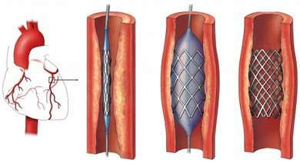
PCI PROCEDURAL REFINEMENTS: STENTS
Expandable metal mesh tubes that buttresses the dilated segment, limit restenosis.
Drug eluting stents: further reduce cellular proliferation in response to the injury of dilatation.

Slide 41
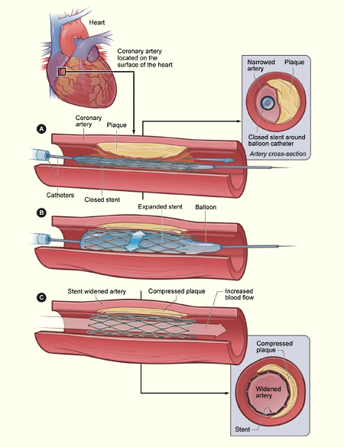
Nhlbi.nih.gov

Slide 42
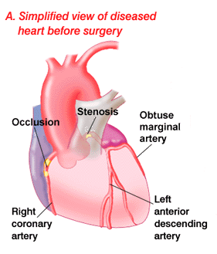
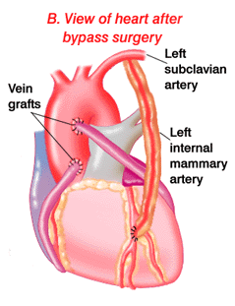
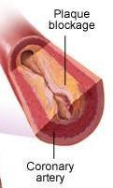
CORONARY ARTERY BYPASS GRAFTING (CABG)

Slide 43


