Slide 1
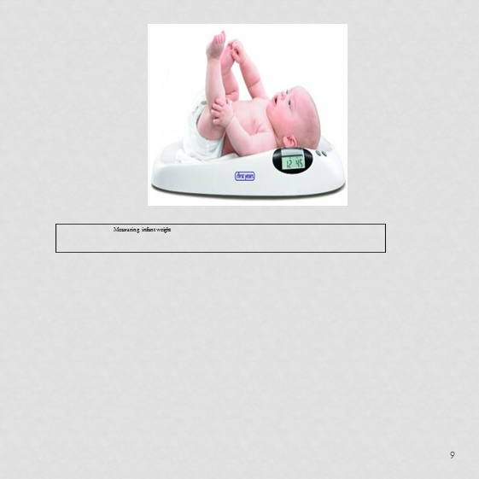
Growth Monitoring

Slide 2
Out lines
Definition
Types of growth
Normal pace of growth
Factors affecting growth
Growth monitoring
Importance of growth monitoring
Requirements for success of growth monitoring
Methods of growth monitoring
Assessment of growth
Egyptian growth charts

Slide 3
Definition
Growth — an increase in the number and size of cells as they divide and synthesize new proteins; results in increased size and weight of the whole or any of its parts.
Types of growth
I- Physical growth includes:
a- Head circumference b- chest circumference c- Weight
Height or length
Arm circumference

Slide 4
II-Physiological growth includes:
Temperature, pulse, respiration, and blood pressure.
Factors affecting growth and development:
Genetic- Hereditary
Environmental factors
Nutritional factors
Severe psychological stress
Socio-economic class
Chronic diseases

Slide 5
Growth monitoring: - regular assessment of the physical growth of child to detect early growth flattering before the child becomes severely malnourished and undertaken appropriate action.
The normal pace of growth of all children falls into four distinct patterns:
A rapid pace from birth to 2 years.
A slower pace from 2 years to puberty.
A rapid pace from puberty to approximately 15 years of age.
A sharp decline from 16 years to approximately 24 years, when full adult size is reached.

Slide 6
Importance of growth monitoring
1.Diagnosis and intervention of malnutrition and take appropriate actions.
2. Growth flattering can be detected in a child early before any observable sign and symptoms of malnutrition become evident.
3. Using monitoring results for family education about normal growth.

Slide 7
Requirement for the success of growth monitoring:
1-The availability of appropriate scale. 2-Availability of growth charts.
The cooperation of mother.
The availability of a well-trained health care team who can use
growth
chart correctly, counsel with mothers efficiently and carry out follow-up activities promptly.

Slide 8
Methods of growth monitoring:
1- Anthropometric measurements: height or length, circumference, chest circumference and arm circumference.
weight,
head
Anthropometric data can explain growth patterns, help establish nutrition care goals, and evaluate health care services, to be useful, these measurements must be taken accurately using reliable equipment and correct measuring techniques.

Slide 9
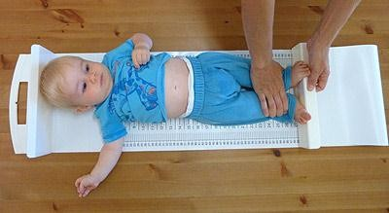


Slide 10
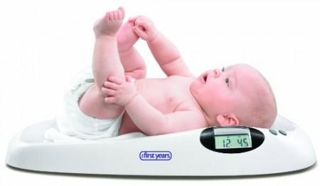

Measuring infant weight

Slide 11

Measuring chest circumference

Slide 12
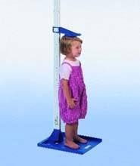


Slide 13
2- Growth chart:
The growth charts have been revised to include the body mass index-for- age (BMI-for-age) charts, 3rd and 97th smoothing percentiles for all charts, and the 85th percentile for the weight-for-stature and BMI-for- age chart.
The weight –for- age percentile distributions are now continuous between the infant and the older child at 24 to 36 months.
The length-for-age to stature-for-age and the weight-for-length to weight- for-stature curves are parallel in the overlapping ages of 24 to 36 months.

Slide 14
Weight-for-Stature
Weight-for-stature charts continue to be included as optional tools for children aged 2-5 years. The period from 24 to 36 months is considered transitional. Health care providers may measure recumbent length (supine) or stature (standing height).
Stature-for-Age
The stature-for-age (or length) index is useful to assess linear growth for
shortness or tallness. Short stature, or stunting, is defined as stature-for-age less than the 5th percentile. Reasons for short stature should be evaluated. Short stature may be because of inadequate intake of key nutrients.

Slide 15
Weigh t-for-Age
Weight-for-age is used in early infancy to monitor weight and in older children to monitor weight-for-Length. It is not used to assess weight status but rather to monitor changes in health or nutritional status.
Weight for Length
Weight-for-Length (or stature) is not dependent on age and assesses weight status in infants and young children. A child whose weight-for-Length exceeds the 95th percentile is considered overweight. Similarly, a child whose weight-for length is less than the 5th percentile is considered underweight.

Slide 16
Head Circumference-for-Age
Head circumference-for-age is a critical measure for infants younger than 36 months; it reflects brain size and may identify hydrocephalus or microcephaly (i.e., which indicates the need for neurologic evaluation). Developmental problems are a concern for those with head circumference indices that are less than the 5th percentile or more than the 90th percentiles Serial data for anthropometric indices arc particularly useful in assessing growth and development in children with special conditions

Slide 17
Assessment of Growth:
By measuring certain aspects of growth and comparing them to
anthropometric charts. These anthropometric charts are made by plotting the percentiles of growth parameters for general population. A curve should be plotted and followed up for each baby, for Wt, Ht, etc.
These curves are called growth curves. Follow up of these curves is an early and easy predictor for any deviation from normal growth patterns.
Weight, height, and head circumference are parameters that are used to monitor growth. They should be measured at regular intervals during childhood.

Slide 18
(I) The weight there is 5 - 10% loss of body weight in the first 3-4 days, regained back by 10 days age. The weight of the average term newborn is approximately 7 to 8 pounds, (3.2-3.6 kg). Male infants are usually slightly heavier than female infants. Usually, the birth weight doubles by 6 months of age and triples by 1 year of age. Between 2 and 3 years of age, the weight quadruples. Slow, steady weight gain during childhood is followed by a growth spurt during adolescence.
Weight = Age in years x 2 + 8 (kg).

Slide 19
(II) The average newborn is approximately 20 inches (50 cm) long, with an average increase of approximately1 inch (2.5 cm) per month for the first 6 months, followed by an increase of approximately ½ inch per month for the remainder of the first year. The child gains 3 inches per year from age 1 through 7 years, then 2 inches (5 cm) per year from age 8 through 15 years. Boys generally add more height during adolescence than do girls.
Height = Age in years x 5 + 80 (cm).

Slide 20
Head circumference indicates brain growth. The normal occipital- frontal circumference of the term newborn head is 33-35 cm. Average head growth occurs according to the following pattern: 10 cm during the first year; 2.5 cm during the second year; ½ inch (1.2 cm) per year from 3 to 5 years; and ½ inch per 5 years until puberty. The average adult head circumference is approximately 53 cm.
Dentition, the eruption of teeth, also follows a sequential pattern. Primary dentition usually begins at approximately 6 to 8 months. Most children have 21 teeth by 12 years. Permanent teeth, 32 in all, eruption beginning at approximately age 6 years, accompanied by the loss of primary teeth.

Slide 21
Eruption of Milk Teeth: At 6 mo. | 20 teeth: Lower central incisors 2
7 mo. | Upper central incisors 2 | 2
8 mo. | Lower lateral incisors 2 | 2
9 mo. 1 y. | Upper lateral incisors 2 First molars 4 | 2
1.5 y. | Canines 4
2 y. | Second molars 4

Slide 22
32 teeth
Eruption of Permanent Teeth:
At 6 y. | 1st molar | 4
7 y . | Central incisors | 4
8 y. | Lateral incisors | 4
9 y. | Canines | 4
l0 y. | 1st Premolars | 4
11 y. | 2nd Premolars | 4
12 y. | 2nd molars | 4
17-22y. | 3rd molars

Slide 23
Delayed eruption of teeth may be due to rickets, under nutrition, malnutrition, cretinism or mongolism

Slide 24
Fontanels
Anterior Fontanels:
At birth
At 6 mo.
At 12 mo.
At 18 mo.
4 - 5 cm.
3 cm.
1.5 cm.
Close.
Posterior Fontanels: Closed at birth or soon after (2months).

Slide 25
Egyptian growth charts 1-Boys charts
25

Slide 26
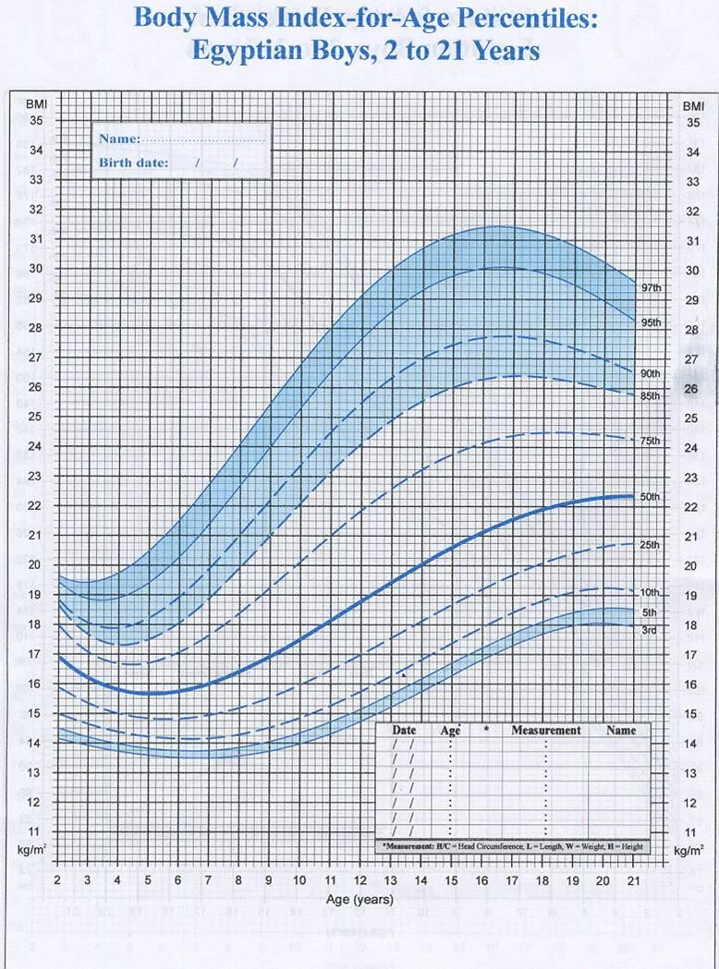
26

Slide 27
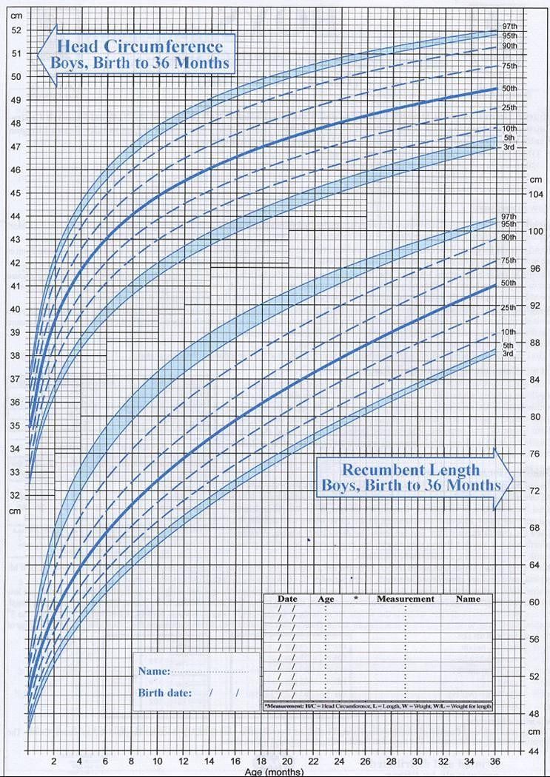
27

Slide 28
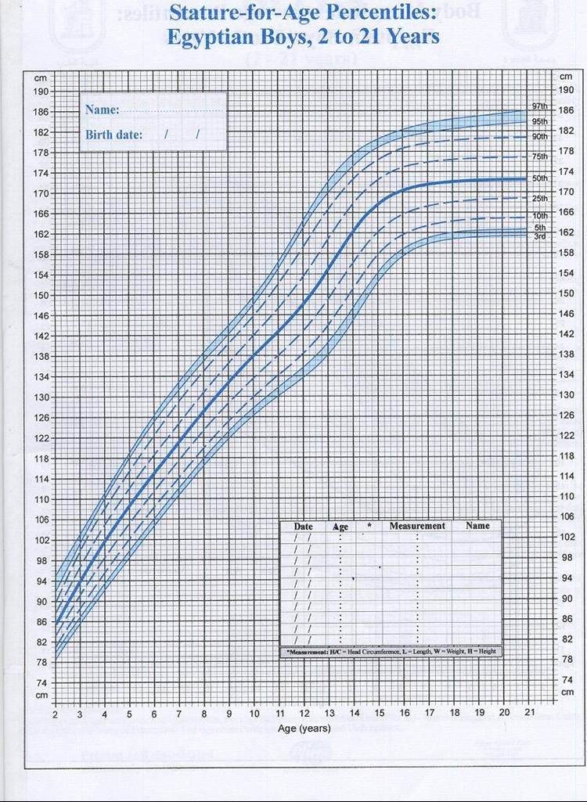
28

Slide 29
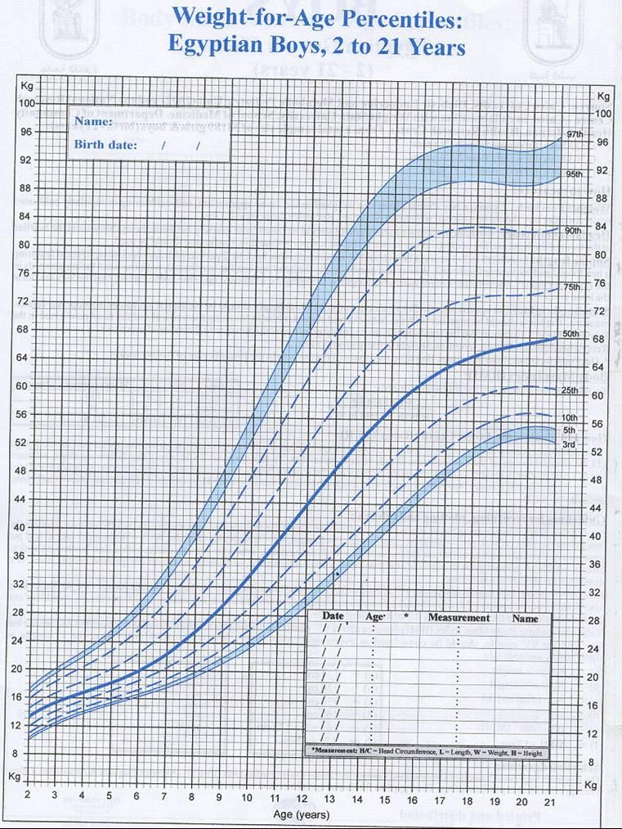
29

Slide 30
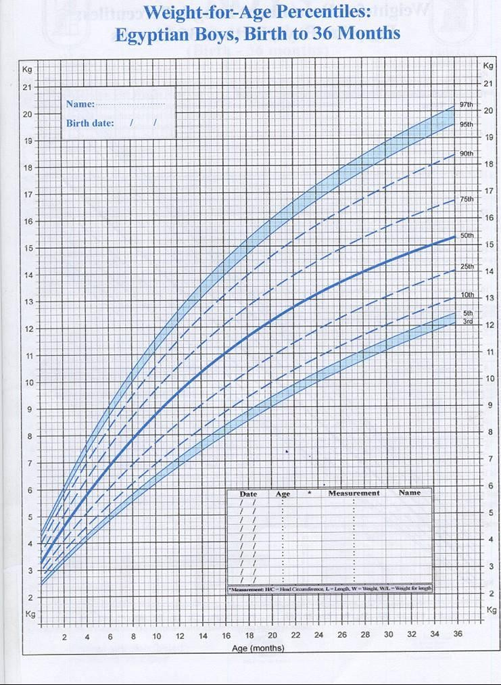
30

Slide 31
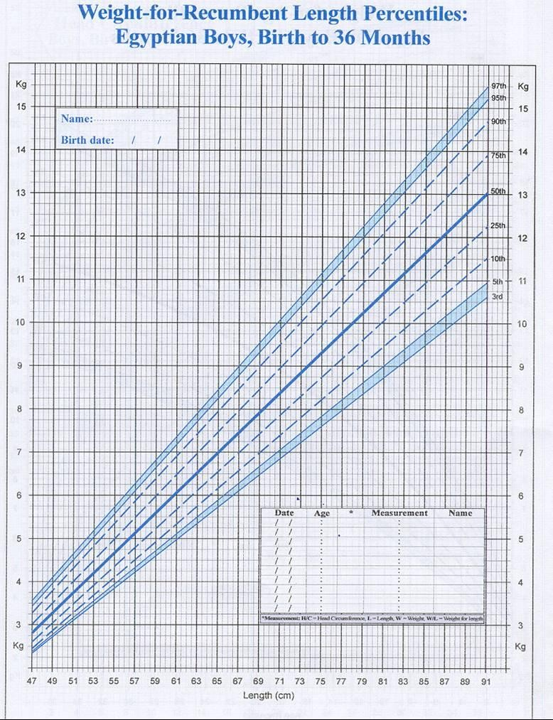
31

Slide 32
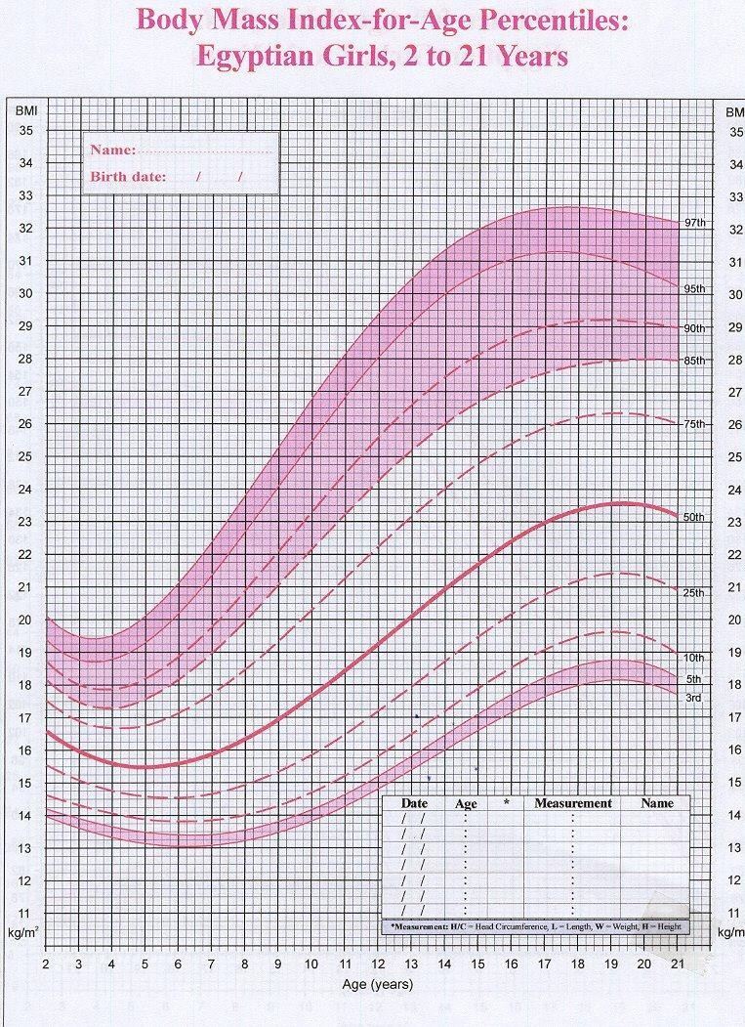
2-GIRLS CHARTS
32

Slide 33
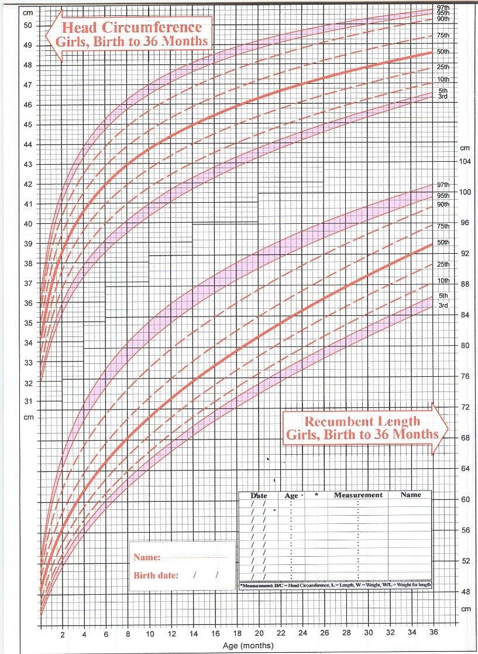
33

Slide 34
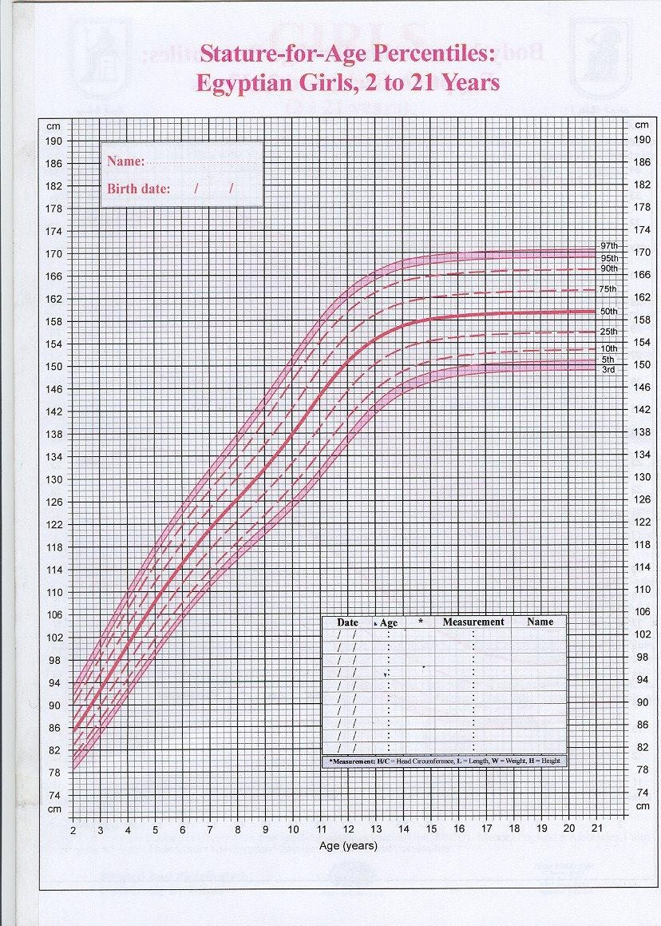
34

Slide 35
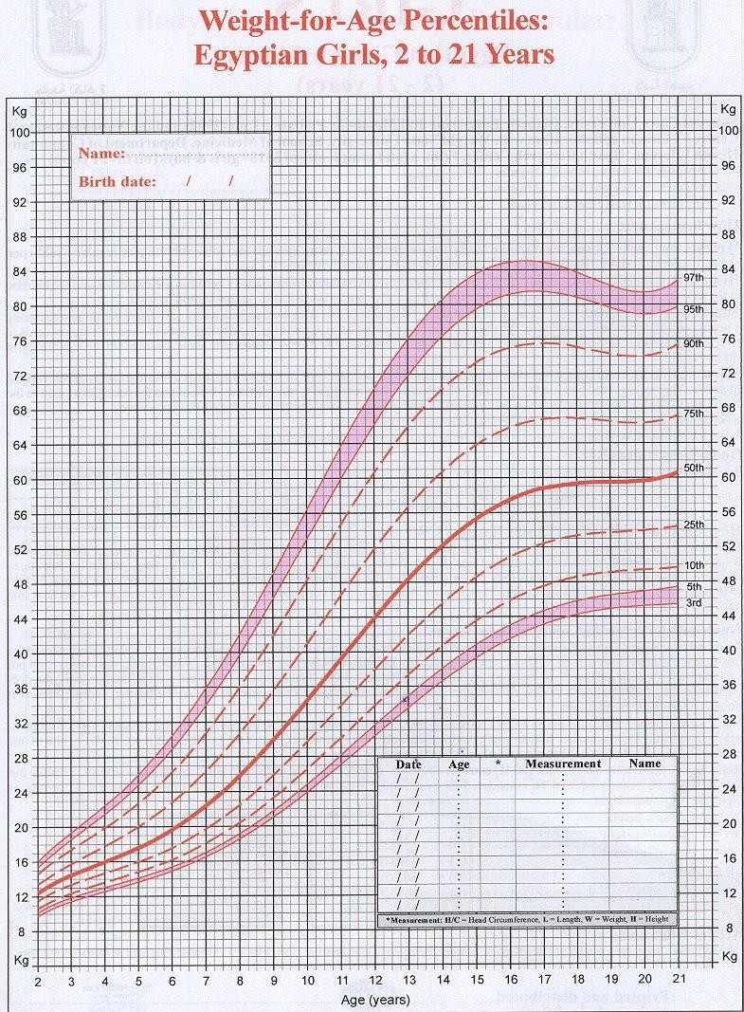
35

Slide 36
36

Slide 37
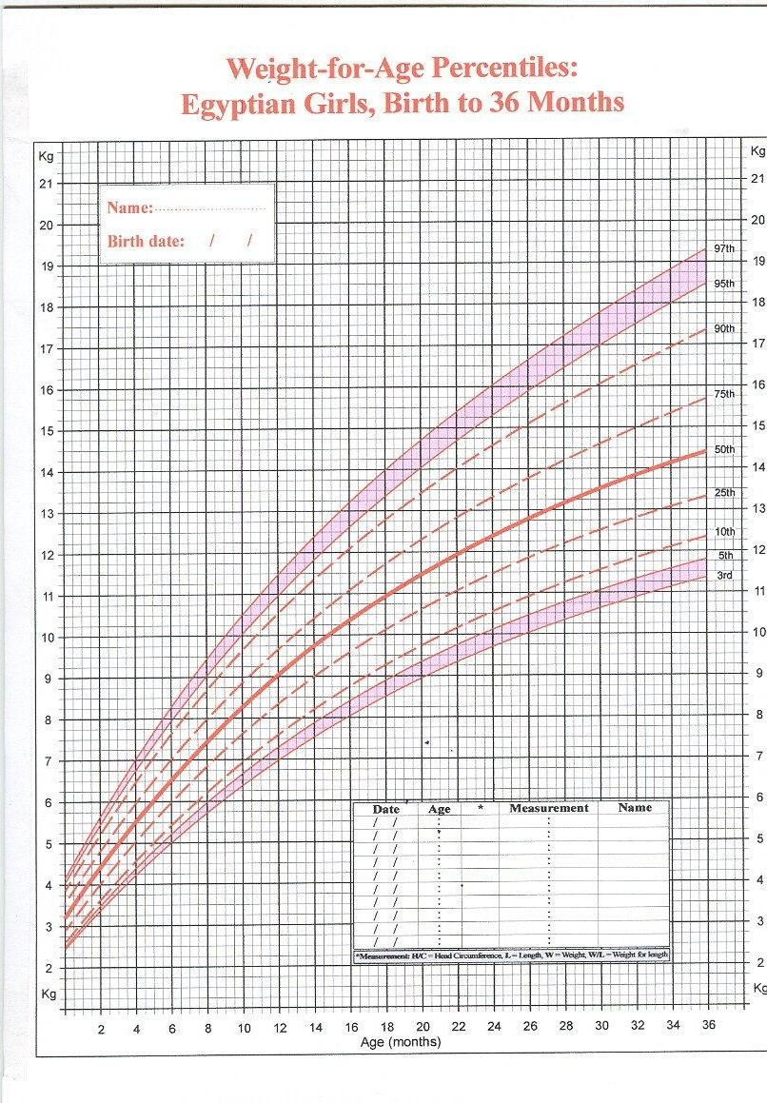
37

Slide 38
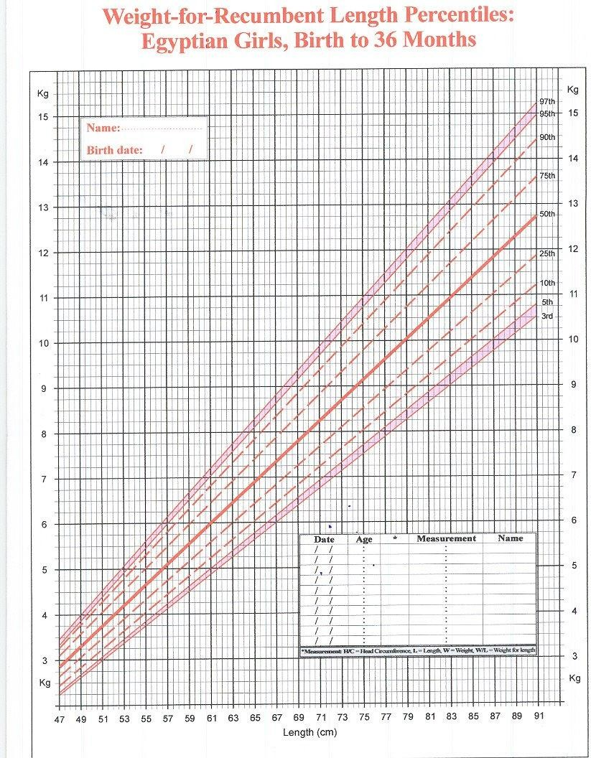
38

