Slide 1
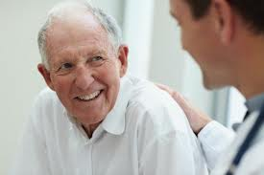
GERIATRIC HEALTH

Slide 2
Contents:
The concept and importance
Etiology of the increased problem
Geriatric health hazards
Geriatric health program

Slide 3
The concept and importance‎:
Geriatric health means health of the elderly (the aged, aging persons) who form ‎a vulnerable group that needs special care.
The world's population of people 60 years of age and older has doubled since 1980 and is forecast to reach 2 billion by 2050.
It is difficult to give the definite onset to aging, and the starting point of ‎geriatric age. Age of 60 years is determined by WHO.

Slide 4
Etiology of the increased problem‎
The declining death rate and rising life expectancy
The variety of morbidity hazards: (disease, accidents and disability).
‎
The social change of modernization and crowded, busy urban life: ‎‎‎

Slide 5
Etiology of the increased problem
The aging process: It is associated with a variety of hazards, due to ‎progressive impairment of physiological functioning, and appearance of ‎pathological changes and their sequelae. ‎

Slide 6
Geriatric health hazards
Morbidity hazards: physical, mental and social. ‎
Mortality hazards. ‎

Slide 7
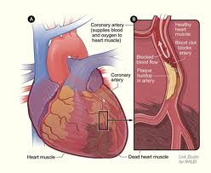
I- Morbidity
A♥- Diseases: ‎
  1- Cardiovascular disease:‎
    Atherosclerosis and its sequelae. ‎
    Ischemic heat disease. ‎
    Hypertension. ‎
    Varicose veins. ‎

Slide 8
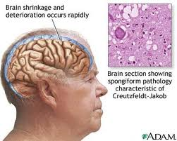
2- Disease of nervous system:‎
Cerebro-vascular disease: thrombosis, embolism, and impaired cerebral blood ‎flow. ‎
Involvement of sensory and motor nerves: neuritis, muscle paralysis, defective ‎sphincter control. ‎
Dementia and psychoneuroses. ‎

Slide 9
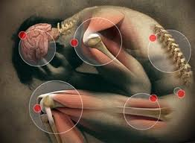
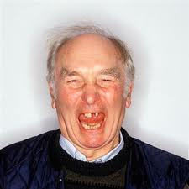
‎3-Bone and joint disease: Osteoarthritis, back and joint aches, osteoporosis. ‎
4- Problems of teeth and gums: are troublesome and interfere with proper ‎feeding.‎

Slide 10
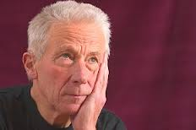
5-Malnourishment and deficiency:
‎ Many factors contribute to this:‎
  ‎anorexia, dental disease and missing teeth, ‎
  ‎impaired digestion, absorption and metabolism, ‎
  indirect socioeconomic factor of low income and living alone where no body ‎cares for their food.‎

Slide 11
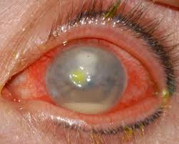
6-Disorders of special senses:‎
‎Presbyousis hearing impairment with aging, usually bilateral, symmetrical, ‎senso-neural. ‎
Senile macular degeneration and cataract. ‎
Decreased speech discrimination, due to presbycusis. ‎

Slide 12
7-Respiratory disease: Chronic bronchitis, emphysema. ‎
‎8- Other diseases: e.g. - Diabetes mellitus. - Neoplasm. -Urinary incontinence.‎

Slide 13
B♥- Accidents: e.g. fracture neck femur. ‎
‎ C♥- Disability:‎
  Pathological conditions of aging may interfere with normal physical activities ‎and / or mental and psychological behavior.
  ‎
  They may be associated with a varying degree of disability that may be so mild ‎and hardly noticed, up to complete disability or crippling. ‎

Slide 14
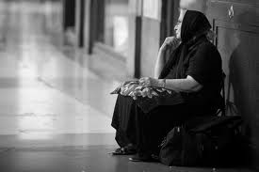
D♥- Miscellaneous:
Loneliness and isolation. ‎
Retirement (loss of employment, income and state). ‎
Bereavement (loss of husband, wife or peers).‎

Slide 15
II- Mortality
Age-specific mortality of the aged is quite high. The leading causes, by priority ‎are:‎
  Cardiovascular disease: (75% of total deaths). ‎
  ‎Cerebrovascular disease: (15% of total deaths).‎
  ‎Others: e.g. respiratory disease. ‎

Slide 16
Geriatric health program

Slide 17
Component of the program:
Adequate nutrition
Social welfare
Socioeconomic promotion
Health education
Health Appraisal

Slide 18
Objectives:‎
‎1- Maintenance of health‎
‎2- Preventing, if possible
‎3- Control of health hazards
‎4- Rehabilitation and management of disability

Slide 19
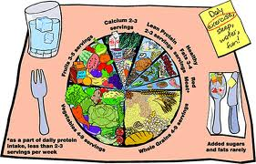
Adequate nutrition
Nutrition education of the elderly and family, for:
  Adequate diet (quality and quantity of food)
  Providing sufficient residue food to prevent constipation.
  Milk (or / and cheese), vegetables and fruits (or fruit juice) must be regularly taken in adequate amount.
Dietary supplementation: To compensate for deficient diet, especially with feeding problems and restrictions of diet therapy

Slide 20
Adequate nutrition
Supplementary foods: a variety of “geriatric foods” are available in powder or liquid form, to provide readily digestible and assimilated nutrient (s).
Supplementary medicines.
Management of anorexia and other pathological conditions: which may contribute to nutritional deficiency.

Slide 21

Socioeconomic promotion:
a- Income: a satisfactory income is necessary for those having independent life.
b- Housing: the aged who may live alone under poor housing & social conditions can be referred to a geriatric home.

Slide 22
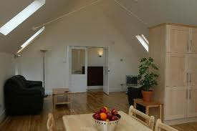
Social welfare
a- Living accommodation:
  With his family.
  In geriatric home.
  In special sanatorium (with disability or chronic disease).

Slide 23
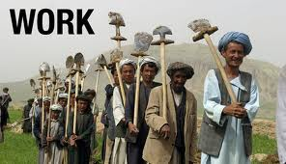
Social welfare
b-Work or activity:
  According to his health status and social circumstances the aged can perform a suitable manual or intellectual activity.
  Enrolment of the aged in some work consumes time and breaks monotony of life.
  Work also leads to self-dependence, and also provides income.

Slide 24
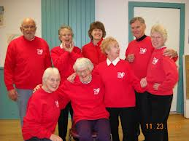
Social welfare
c- Establishment of geriatric clubs: Where the aged pass leisure time, perform suitable exercise or game and physical training, and share in social activities.

Slide 25

Health education
lays stress on healthful lifestyle:
  Adequate diet, and feeding system.
  Rest and sleep (how many hours).
  Exercise and open air walk, if possible.
  Avoiding smoking and alcohol.
  Healthy personal habits.

Slide 26
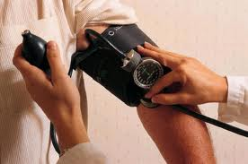
Health Appraisal
a- Periodic Medical check-up: for early case finding and management of disease.
b- Screening tests: can be carried out regularly for particular pathological conditions e.g. are screening for glaucoma and malignancy.
c- Survey studies: They are needed in developing countries, to measure the magnitude of the geriatric problem, and the causes of geriatric morbidity.

Slide 27
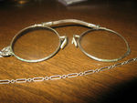
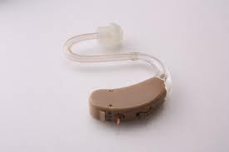
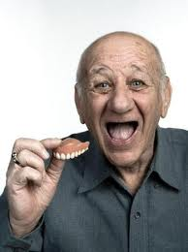
Health Appraisal
d- Clinical service:
  The aged have the right in clinical service, on national or insurance basis, for diagnosis and a management of disease, including first aid and emergency service.
  Appliances are also provided:
    Walking stacks, hearing aids, spectacles (glasses), dentures.
  For those who cannot visit the clinic, home visits for medical care are necessary.

Slide 28


Thank You

