Slide 1
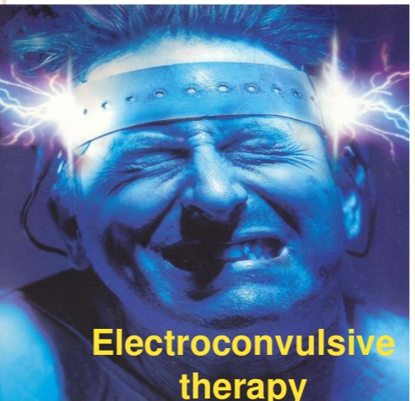


Slide 2
Electro convulsive therapy (ECT) is an important non pharmacological intervention that is effective treatment for patients suffering from certain neuropsychiatry disorders.

Slide 3
Definition:
ECT involves the passage of a brief electrical current through the brain to induce a generalized central nervous system seizure under general anesthesia and muscle relaxant.
Another definition:
ECT is a somatic treatment in which a grandmal seizure is artificially induced by passing an electric current through the brain.
The electrical stimulus is applied usually 70 – 110 ml volts for 0.1 – 0.5 second.

Slide 4
ECT is used if you:
severe, life-threatening depression
have not responded to medication or talking treatments
have found it helpful in the past and have asked to receive it again

Slide 5
Types of ECT:
1- Unilateral 2- Bilateral 3- Bifrontal

Slide 6
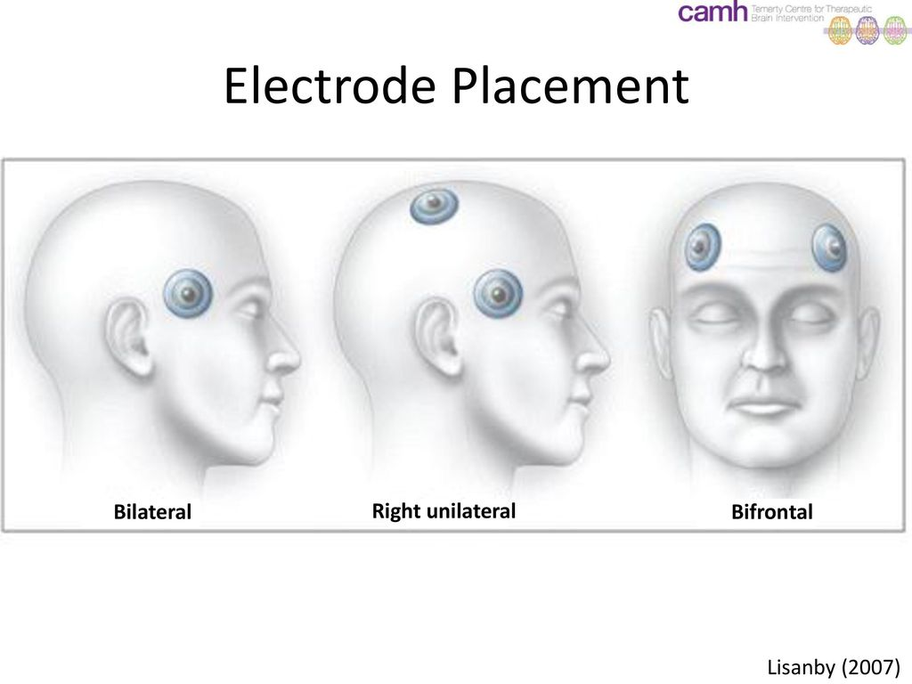

Slide 7
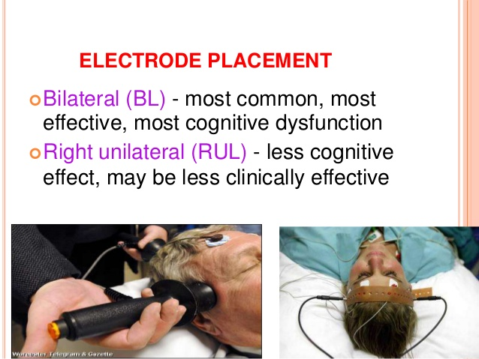

Slide 8
Number of ECT:
Number of ECT is giving according to patient's condition.
For affective disorders (mania and depression) 6 to 12 ECT.
For schizophrenia 20 to 30 ECT

Slide 9
Indications of ECT:
Major depression
Mania
Schizophrenia
Obsessive compulsive disorder & ECT has anticonvulsant effects, so it used to treat patients with epilepsy.

Slide 10
Contraindications of ECT:
Brain tumor, increase intracranial pressure

Slide 11
Pulmonary disease
Liver disease.
Hemorrhage.

