Slide 1
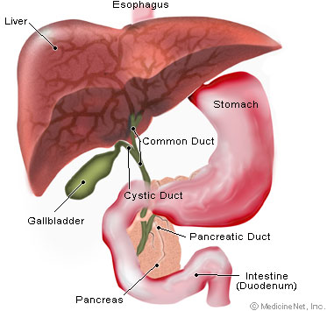
Basic Diabetes Mellitus Pathology and Diagnosis Coding
Ahmed Elsharawy
Assistant Lecturer of medicine and cardiology
Sohag University
http://www.medicinenet.com/diabetes_mellitus/article.htm

Slide 2
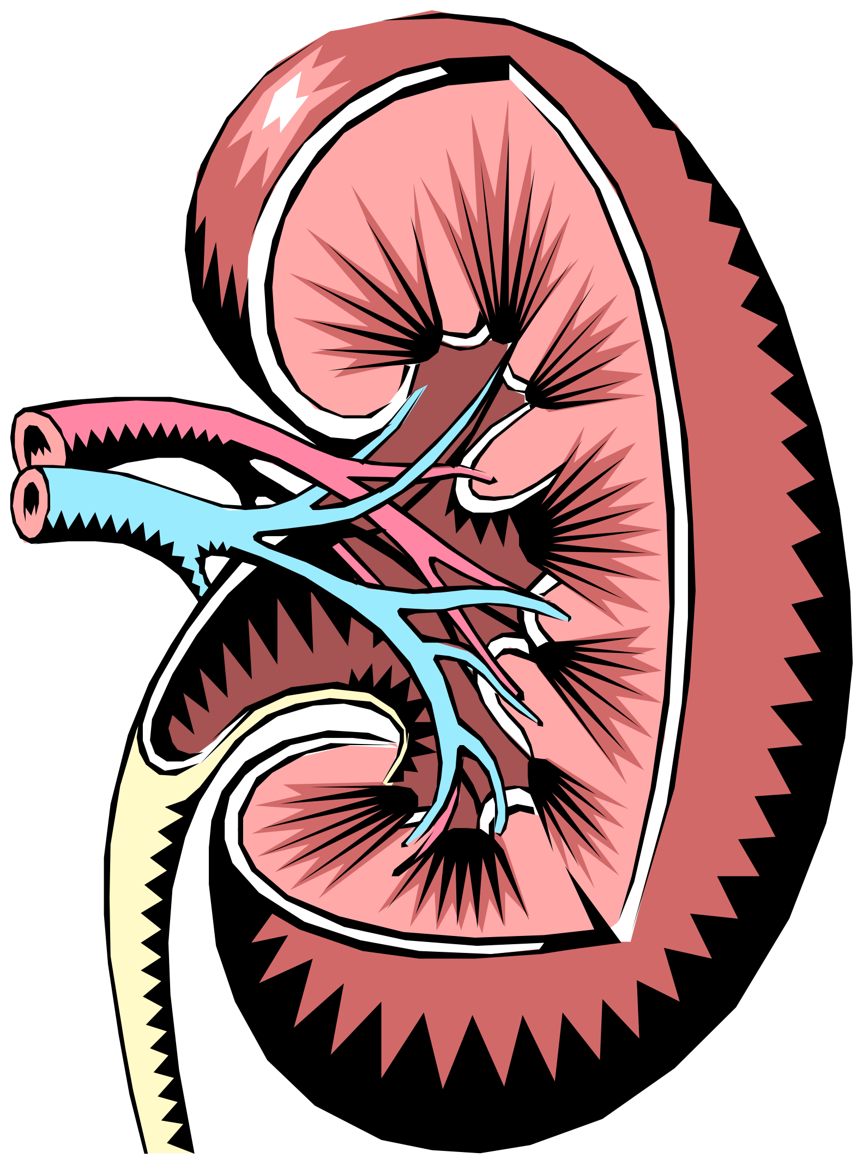

Anatomy of Diabetes
Diabetes Mellitus
1st described in 1552 BC
Mellitus = Honey
Urine smells sweet
Food Metabolism disorder
Pancreas
Insulin hormone
Polydipsia, Polyuria,
Polyphagia
3rd leading cause of DEATH in US (7th in 1996)
DM costs $98 BILLION annually in US
Diabetes Insipidus
1761 –Scots carried to NA
Insipidus = tasteless
Urine has no odor
Water Metabolism disorder
Kidney (NDI)
Pituitary (CDI)
Polydipsia, Polyuria
Much rarer
3/100,000

Slide 3
Pancreas
Accessory organ of Digestive System
compound gland, has endocrine and exocrine functions
Responds to hormones
when food enters the duodenum, secretin & pancreozymin are released into the bloodstream
Functions³
the pancreatic cells produce & release large amounts of water, bicarbonate, and digestive enzymes, which flow into the intestine (exocrines).
Islets (or islands) of Langerhans - secrete insulin and glucagon, which control sugar storage in the body. Insulin stimulates cells to remove sugar from the bloodstream and use it. Glucagon releases stored sugar and increases the blood sugar level, acting as a control mechanism whenever the body produces too much insulin. They are both secreted directly into the bloodstream (endocrines).

Slide 4
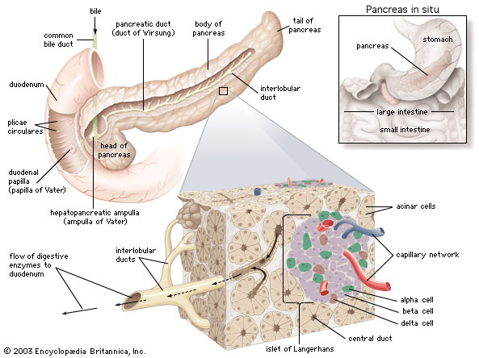
Pancreas Anatomy

Slide 5
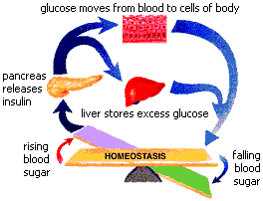
Normal glucose control
Source: http://cascadevalley.org/resources/news/fw04-3.php

Slide 6
DM Definition
“A group of metabolic diseases characterized by high blood sugar (glucose) levels, which result from defects in insulin secretion, or action, or both.”¹
“A chronic disorder of carbohydrate, fat, and protein metabolism caused by inadequate production of insulin by the pancreas OR faulty utilization of insulin by the cells”² of the body.

Slide 7
Etiology of DM
When blood glucose rises (after eating) insulin is released
Insulin helps the cells take in glucose and convert it to energy.
Extra fat tissue can make your body resistant to the action of insulin, but exercise helps insulin work well.
DM occurs when insulin is absent, insufficient, or not used properly.

Slide 8

Types of DM
Pre-Diabetes
Type 1 (about 10% of patients, 1 million in US)
Type 2 (about 90% of patients)
Gestational DM (GDM)
Neonatal DM
Secondary DM
Wolfram syndrome
Autosomal recessive
Type 1 DM, DI, Optic atrophy, Deafness, Ataxia, Peripheral neuropathy

Slide 9
Pre-Diabetes
At least 54 million U.S. adults had pre-diabetes in 2002.
Most people with pre-diabetes develop Type 2 DM within 10 years
Unless lose 5 to 7 % of body weight—about 10/15 pounds for someone who weighs 200 lbs.
Pre-diabetes also creates a higher risk of heart disease.
Also documented as impaired fasting glucose (IFG = 100 – 126 mg/dl) or impaired glucose tolerance (IGT)

Slide 10
Risk Factors for Pre-Diabetes
Genes are partly responsible
Too much fat interferes with muscles' ability to use insulin.
Lack of exercise further reduces muscles' ability to use insulin.
Metabolic Syndrome (Insulin Resistance Syndrome, formerly Syndrome X).

Slide 11
Metabolic Syndrome
Insulin Resistance Syndrome, (formerly Syndrome X). Any 3 of the following
excess weight around the waist (central obesity – apple vs pear) (40+ inches - males, 35+ inches –females),
low HDL (good) cholesterol levels, (<40 mg/dL – males, <50 – females)
high levels of triglycerides (150 mg/dL +)
high blood pressure (130/85),
high fasting blood glucose (110mg/dL +)

Slide 12
Type 1 DM
Previously IDDM, juvenile onset, ketone-prone
Autoimmune disease
Immune system attacks beta cells in pancreas, which can’t make insulin
Causes include
Genetic (white, northern European heritage)
Viral infections (mumps, Coxsackie)
Environmental toxins? (cow’s milk/wheat in early diet?) rat poison (pyriminil)
Insulin tx required for survival

Slide 13
Type 1 DM
Usually occurs in young (<30), lean people
Older patients can get Type 1
LADA – Latent Autoimmune Diabetes in Adults
Slow, progressive form of Type 1 DM

Slide 14
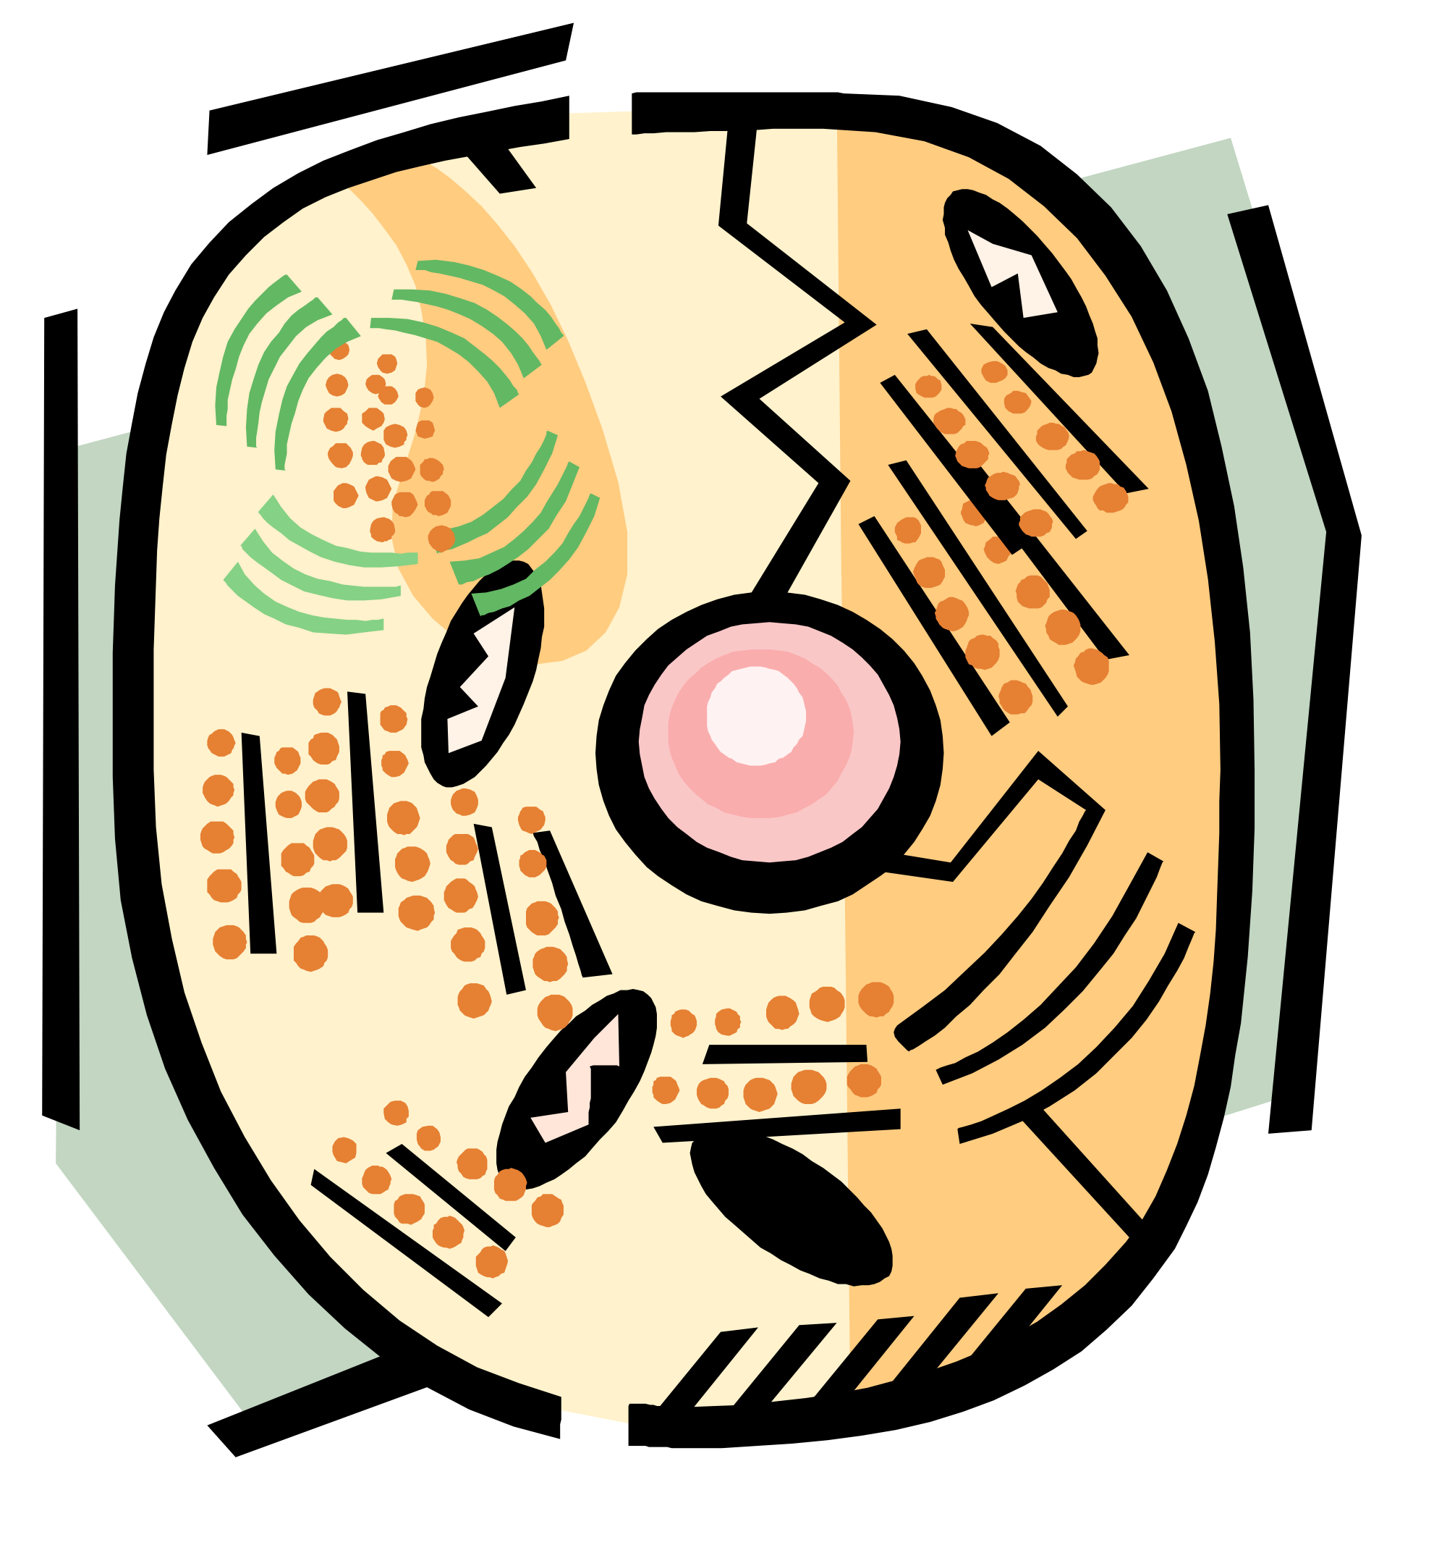

Type 2 DM
Previously - NIDDM, adult-onset DM (AODM), maturity onset, ketosis resistant, non-ketosis prone
Patients produce inadequate insulin, even if more than normal amounts, because of
Insulin resistance
Cells of body are insensitive to insulin
Especially muscle and fat cells
Steady Decline in insulin production
Glucogenesis by liver continues even though glucose is elevated
Recent studies show 15 to 45 % of all children with DM have Type 2 DM.

Slide 15

Risk Factors for Type 2 DM
Obesity in adults and children
Chance of DM doubles with every 20% increase over desirable body weight.
The CDC predicts if the current rate of obesity continues, one-third of the children born in 2000 will develop DM.
up to 85% of children with Type 2 DM are obese.
Obese diabetics are also insulin resistant.

Slide 16
Risk Factors for Type 2 DM
Obesity and insulin resistance
Research indicates
Fat cells produce fatty acids and secrete proteins that interfere with secretion and action of insulin
Obesity is most important controllable risk factor
High saturated fats, refined carbs, sedentary lifestyle

Slide 17


Other Risk Factors for Type 2 DM
Genetics - 45%-80% of diabetics have at least one parent with DM or a hx of DM over several generations.
Race - more common among African-Americans, Mexican-Americans, and American Indians.
Sex - Girls are nearly twice as likely as boys to develop type 2 DM. This is due to a greater insulin resistance.
Puberty - Most cases of DM in children are diagnosed between the ages of 12-16. During puberty there is increased resistance to insulin action, resulting in hyperinsulinemia. Growth hormone, which increases slightly in puberty, also has anti-insulin effects.
Age – prevalence increases with years of age
Prior gestational diabetes

Slide 18


Gestational DM
Pregnancy-related hormone changes can elevate glucose in genetically-predisposed
Usually resolves after birth
25-50% of GDM women will get Type 2 DM
Require insulin during pregnancy
Remain overweight after birth
Risk factors
Family hx of DM, Obesity, 25+ yo

Slide 19

Neonatal DM
Rare metabolic disorder (1 of every 300,000-400,000 newborns)
Autosomal dominant genetic disorder
Within first 3 -6 months of life
Hyperglycemia combined with low insulin levels
Two groups
Transient NDM (50-60% of cases)
Permanent NDM

Slide 20

Secondary DM
Caused by another medical condition
Pancreas affected
Chronic pancreatitis (alcohol, other toxins)
Trauma
Surgical removal results in DM Type 1
Hormonal disturbances
Acromegaly (excessive growth hormone)
Cushing syndrome (excessive cortisol)
Medications may cause DM/worsen control
Corticosteroids, diuretics, beta blockers, some anti-psychotics (schizophrenia)
Tx of HIV/AIDS (Pentam)
Tx of cancer - Asparaginase (Elspar)

Slide 21



Signs and Symptoms of DM
Hyperglycemia
Cells deprived of fuel
Metabolize fats & protein
Ketone bodies as waste in blood (ketosis)
Ketonuria
Acidosis
Dehydration
N&V
Fruity breath odor
Yeast infections
Bladder & Skin infections
Coma
Polyuria
Polyphagia
Polydipsia
Weight loss
Fatigue
Pruritis (genital area)
Blurred vision
GDM – may be symptomless!

Slide 22
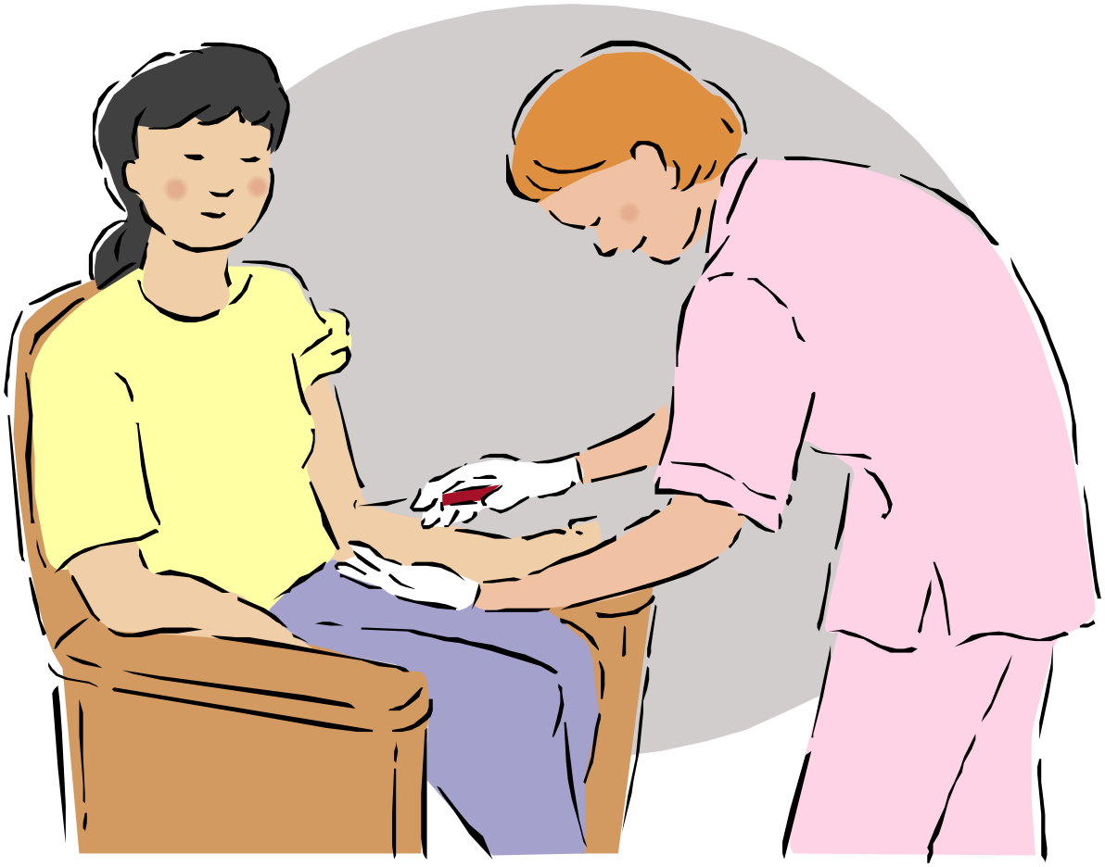
Diagnosis of DM
Patient Hx
2 + tests on different days
Fasting Glucose
Presence in urine
Glucose
Acetone
Insulin level in blood
Eye exam to check for diabetic retinopathy

Slide 23
Glucose Testing
GTT Results
GTT (Glucose Tolerance Test)
Urine tests should be negative for presence of glucose
2 hour postprandial
Usually after lunch
65-139 mg/dl
Random – 200+ = DM
Time | Normal
Fasting* (preferred) | 70-100 mg/dl
30 minutes | 100-140
1 hour | 120-170
2 hours | 70-120
3 hours | 70-120
* Fasting = 8 hours minimum

Slide 24
Complications vs Manifestations
Complication – “a secondary disease or condition that develops in the course of a primary disease or condition and arises either as a result of it or from independent causes”
Manifestation – “a perceptible, outward, or visible expression (as of a disease or abnormal condition)”
Source: MedlinePlus dictionary

Slide 25
Acute Manifestations
Diabetic ketoacidosis (DKA)
usually Type 1 DM
Hyperosmolarity
usually Type 2
Hypoglycemia

Slide 26
Diabetic Ketoacidosis
Ketones in blood turn blood acidic
S&S/Finding
– N&V, abdominal pain
Glycourea, hyperglycemia, acidosis, low plasma bicarbonate
Progresses rapidly to shock, coma, death
Also caused by infection, stress, trauma, meds (corticosteroids)

Slide 27
Hyperosmolarity
Hyperosmolarity – the blood has a high concentration of sodium, glucose, and other molecules that normally attract water into the bloodstream.
When kidneys are conserving water (dehydration), glucose can’t leave body in urine, causing higher glucose in blood, which increases need for fluids, etc.
Causes include: infection, meds that lower glucose tolerance or increase fluid loss, inability to control glucose, stress (AMI, stroke, etc).
S&S: weakness, thirst, nausea, lethargy, confusion, convulsions, speech impairment, dysfunctional movement, loss of feeling, coma
Coma (higher risk of death than DKA)
NKHHC Nonketontic hyperglycemic hyperosmolar coma
HONK - hyperosmolar non-ketontic coma

Slide 28
Hypoglycemia
Abnormally low blood glucose
Too much meds/insulin (Insulin reaction)
Missed meal
Excessive exercise
CNS S&S – dizzy, confused, weak, tremors
Blood glucose = < 65 mg/dl
Can progress to coma, seizures, brain death
<40 mg/dl

Slide 29
Chronic Manifestations
Caused by blood vessel disease
Microvascular
Eyes, Kidneys, Nerves
Macrovascular
Heart
DM accelerates arterio/atherosclerosis
ASCVD can result in (angina, MI), stroke, claudication, BUT are NOT direct DM complications
Periodontal disease
untreated also makes control of DM more difficult

Slide 30

Eye Complications
Diabetic Retinopathy
Clinically significant macula edema
Vitreous hemorrhage
Retinal detachment
Proliferative vitreoretinopthy
Neovascular glaucoma
Diabetic cataract

Slide 31
Eye complications
Diabetic Retinopathy
DM for at least 5 years
Small blood vessels leak protein/blood
Also causes microaneurysms/neovasularization (brittle)
Progresses to retinal scarring and detachment (impaired vision, blindness)
50% of patients have this after 10 years
80% of patients have this after 15 years

Slide 32
Diabetic Retinopathy
Nonproliferative (Background)
Microaneurysms and intraretinal hemorrhages
Proliferative
More extensive hemorrhages
Neovascularization
Disease progresses from mild to moderate to severe diabetic nonproliferative, then to proliferative
Diabetic macular edema can occur at any stage

Slide 33
Eye
Cataracts and Glaucoma more common in Diabetics
When glucose varies, lens of eye shrinks and swells, causing blurry vision
Blood glucose should be controlled before new eye prescription

Slide 34
Kidney Complications
Diabetic nephropathy
1st, small blood vessel disease causes leakage of protein in urine
2nd, kidneys lose ability to clean/filter blood
3rd, need for dialysis / transplant
Progression slows significantly with control of HBP and high blood glucose

Slide 35
Renal manifestations
Diabetic renal failure
Diabetic uremia
Diabetic glomerulonephrosis with renal failure
Diabetic nephropathy with chronic renal failure

Slide 36
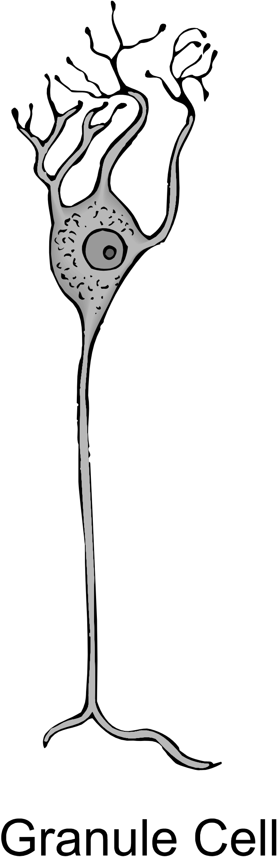
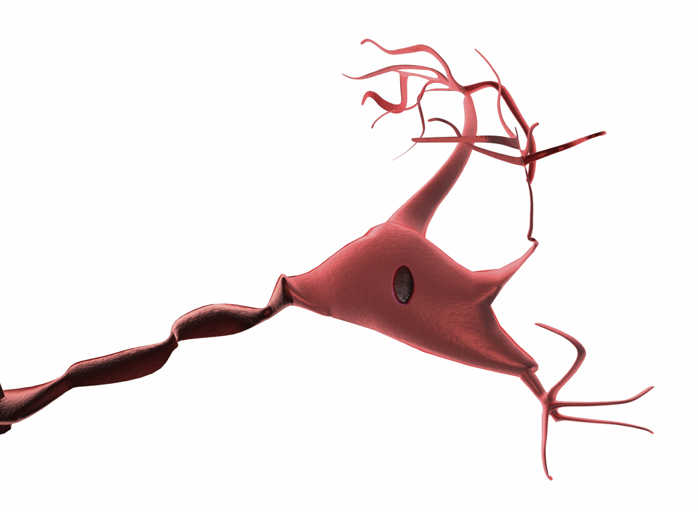
Nerve complications
Diabetic neuropathy
Caused by ischemia
Symptoms
Numbness, burning, aching of feet/lower ext.
Lack of awareness of injuries
Combined with poor blood flow, can lead to serious infections, ulcers, gangrene

Slide 37
Nerve Complications
Erectile Dysfunction
Also caused by poor blood flow due to DM
Gastroparesis – Stomach and intestines nerves affected
ineffective contractions, delayed emptying of stomach
Nausea
Weight loss
Diarrhea

Slide 38
Prevention of Type 2 DM
Diabetes Prevention Program (DPP)
3,234 Americans
IGT
Diet and Exercise
Lost 5-7% of weight
Exercised 30 minutes/day
Reduced risk of DM Type 2 by 58%
Metformin (Glucophage) reduced risk by 31%

Slide 39
Tx of DM
Intense control of blood glucose (not too low)
Decreases complications
Nephropathy
Neuropathy
Retinopathy
Macrovascular conditions
FG – 70-120 mg/dl
<160 after meals
A1c level near normal
Decrease insulin demand (diet, exercise, drugs)
Increase insulin supply (insulin, other meds)

Slide 40
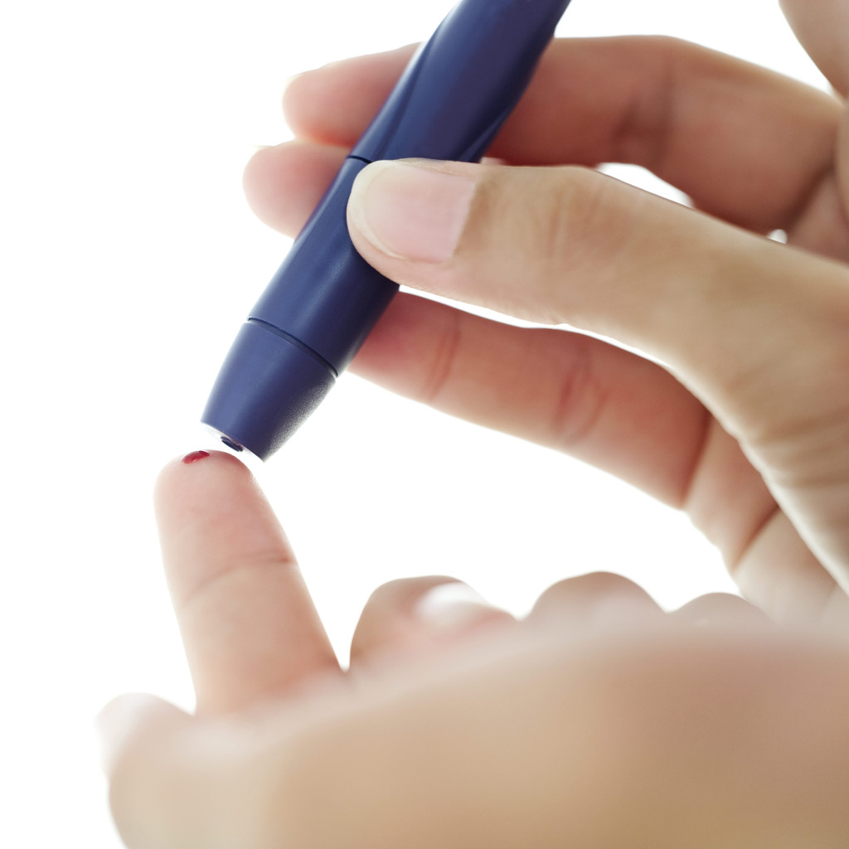
Monitoring Glucose Levels
Patient self-testing
Hemoglobin A1c
Indicates how much glucose sticks to a red blood cell over its life of 3 months
Gives an overview of pt’s glucose control
Normal = 4 – 5.9%, <5%
Well controlled DM patients = < 6.5 – 7%
Mean blood glucose = 145 -170
Poorly controlled DM patients = 8%+
Mean blood glucose = 205 +

Slide 41
A1c
10% decrease of microvascular disease for every 1% reduction of A1c
37% decrease for Type 2 DM
24% decrease of macrovascular disease for every 1% reduction of A1c
14% decrease of MI for every 1% decrease of A1c in Type 2 DM
21% decrease of Death for every 1% decrease ofA1c in Type 2 DM

Slide 42

Medications for type 1 DM
Insulin
1977 human insulin gene cloned
Human insulin now used
Insulin administration
Pre-filled pens
Insulin pumps
Reservoir, pump, computer
About size of pager
Continuous delivery
Used w/ implantable glucose sensors
Newest sensors communicate directly w/insulin pump
Inhaled insulin Exubera
Smokers can’t use
Not sold anymore (not accepted by pts/drs
Intranasal, Transderm
Disappointing results
Pancreas transplants
Whole pancreas (1995 – 8,000)
Islet cells
Why can’t insulin be taken in pill form?

Slide 43

Medications for type 2 DM
Meds designed to
Increase insulin output of pancreas
Sulfonyureas
Meglitinides (Prandin, Starlix)
Decrease glucose release by liver
Biguanides (metformin (Glucophage)
Increase target cells’ sensitivity to insulin
Thiazolidinediones (Rezulin – off market now)
(Actos, Avandia)
Decrease absorption of carbs (intestines)
Enzyme inhibitor (alpha glucosidase inhibitor (Precose))
Slow emptying of stomach
Byetta

Slide 44
Meds for type 2 DM
New meds that affect glycemic control
Pramlintide (Symlin)
Used with insulin in Type 1 and 2 diabetics
Exenatide (Byetta) – incretin mimetic
These are injected
DPP-IV inhibitors
DPP IV is an enzyme that breaks down GLP-1
Januvia (pill)
Combination meds
Glucovance (glyburide/metformin
Avandmet (rosiglitazone/metformin)
Metaglip (glipizide/metformin)
Pioglitazone/metformin (Actosplusmet

