Slide 1


Slide 2
Diabetes Mellitus

Slide 3
Definition
Diabetes is a disease which causes the body to insufficiently use glucose (sugar).
Insulin is a hormone that the pancreas produces to move glucose around the body.

Slide 4
In diabetes, the pancreas does not make enough, or cannot properly use insulin.
This condition can lead to the body having too little (hypoglycemia) or too much sugar (Hyperglycemia) in the blood.

Slide 5
Types of diabetes mellitus
Type 1 insulin dependent diabetes mellitus(IDDM) or juvenile onset diabetes mellitus
In this type, the pancreas is rendered incapable of making insulin. This usually develops in childhood. Patients require daily insulin injections because their bodies produce little or no insulin.

Slide 6
Type 2 (non-insulin dependent diabetes mellitus(NIDDM) or adult onset of diabetes mellitus(AODM), patient can still produce insulin, but inadequately for their body's needs.
N.B. Both type 1 and type 2 diabetic patients can experience an imbalance in the concentrations of sugar and insulin in their blood, resulting in either:
Hypoglycemia - too little sugar in the blood
Hyperglycemia - too much sugar in the blood

Slide 7
The different between type I and type II D.M

Slide 8
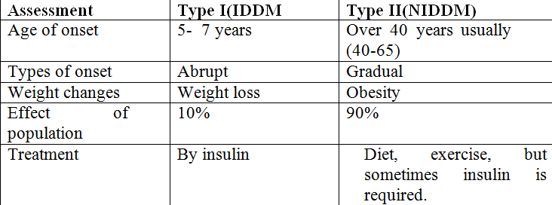

Slide 9
Gestational diabetes
Diabetes can temporary during pregnancy. It is usually resolves once the baby is born. However, 25%- 50% of women with gestational diabetes will eventually develop type II diabetes later in life.

Slide 10
Secondary diabetes
Secondary diabetes refers to elevated blood sugar levels from another medical condition such as chronic pancreatitis, trauma, or surgical removal of pancreas.

Slide 11
Differentiate between first aid of hypoglycemic coma and hyperglycemic coma.
Hypoglycemic coma
Onset: is rapid
Sign and symptoms:
Confused, disorientation, sweating, anxiety, headache, tired

Slide 12
First aid
If the patient is conscious,
orientated and able to swallow
Glucose 10-20 gm is given by mouth. Either in liquid form or 3-4 teaspoons of sugar dissolved in water.
Reassess blood glucose after 10 minutes.
If blood glucose has not risen
to at least 5.0 m mol./ l
Repeat treatment up to three times.

Slide 13
If blood glucose remains less than 4.0mmol/L after 30-45 minutes or 3 cycles, contact a doctor.
Once blood glucose is above 4.0mmol/L and the patient has recovered.

Slide 14
Give a long acting carbohydrate of the patient’s choice, such as
Two biscuits
One slice of bread/toast
200-300ml glass of milk (not soya)
Normal meal if due (must contain carbohydrate).

Slide 15
If the patient is unconscious or unable to swallow:
Arrange immediate transfer to hospital
Do not administer anything by mouth. ……WHY ??/??

Slide 16
Hyperglycemia
DKA
Onset: it is gradual
Signs and symptoms
Blurred vision, fatigue, nausea, vomiting, confusion, (polyphagia, polyuria, polydipsia), lethargy, and acetone breathing.

Slide 17
First aid
Administer the required diabetic medication immediately.
Give the patient some sugar free fluid.
Monitor the patient’s breathing rate, pulse rate and the level of responsiveness.
Immediately call physician.

Slide 18
Diagnosis:
*Clinical manifestations (Diabetes alert).
* Urinalysis. This looks for sugar in urine.
* Fasting plasma glucose test. This test measures the sugar level in your blood. You'll have to stop eating and drinking for at least 8 hours before this test.

Slide 19
* Random (non- fasting) plasma glucose test. This test also measures the amount of sugar in your blood, but you don't have to stop eating or drinking before the test.
* Oral glucose tolerance test. For this test, you'll fast for at least 8 hours, and then drink a sugary beverage.

Slide 20
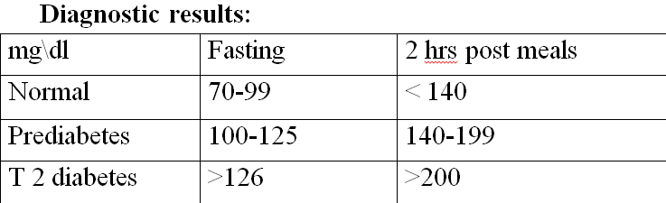

Slide 21
Health education:
  Bathing
Bath daily & dry well
Cleaning inguinal area, axilla, perineum especially important as yeast & fungal infection tend to occur.
  Skin care
Inspect the skin for cuts, rash, abrasions, cyst or and treat boils promptly.

Slide 22
  Foot care
Wash and dry the feet well each day and use water moisturizer to prevent dry skin and cracking.
Wear cotton or wool socks and avoid elastic socks, because they impair circulation
Avoid walking bare foot and wear shoes at all time to protect the feet from injury.
Avoid fitted shoes to prevent occur blisters & sores.
Check up for frown top nails corns

Slide 23
  Dental care
The teeth should be brush at least twice a day
The patient should see the dentist every six months
  Nutrition
Reduce carbohydrate intake as raise blood sugar level, fats. Proteins have minimal effect on glucose level.
Avoid simple sugar
Fat & salts restricted

Slide 24
Increase Vit. B & A, and fiber intake
Avoid tea & coffee
Eating small diet in several times
Taking medication before eating
Increase fruited intake

Slide 25
  Exercise
  is important for diabetic patient
Control weight
Decrease blood pressure
Decrease Stress
Improve carbohydrate metabolism
  Medication:
  Inject insulin at 90 angle into subcutaneous tissue where it is slowly absorbed.

Slide 26
  Follow up of care
Blood test for hyper lipidemia
Provide emotional support
  Identification card: it includes name, address, telephone no. and diagnosis
  Protection against infection
Through immunization against : communicable disease, cystitis , subcutaneous nodules, vulvitis

Slide 27
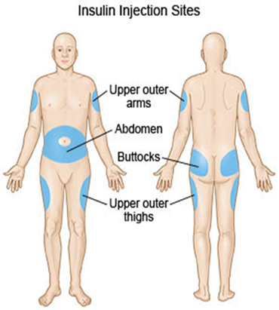
Sites of injecting insulin

Slide 28
complications of sc injection
***lipodystrophy at injection sites
Atrophy of subcutaneous fatty tissue leading to disfiguring excavations and depressed areas may rarely occur at the site of injection.

Slide 29
Procedure:(blood glucose test)
Wash your hands.
Put a lancet into the lancet device so that it’s ready to go.
Place a new test strip into the meter.
Prick your finger with the lancet in the protective lancing device.
Carefully place the subsequent drop of blood onto the test strip and wait for the results.

Slide 30


Slide 31
Hypertension
Outline:
- Definition.
- types of hypertension :
Classification of hypertension -
Complications of hypertension.-
Health education for hypertension. Measuring BP by sphygmomanometers

Slide 32
-
Sites for measuring BP.-
Methods for BP measurement.-
Guide lines for BP measurement.-

Slide 33
Definition:
Blood Pressure: is the force of blood pushing against wall of arteries.
Systolic blood pressure: greatest force exerted when heart is contracted.
Diastolic blood pressure: least force exerted as heart relaxes.
The pulse pressure: difference between systolic and diastolic blood pressure measurement, (30-50 normal).

Slide 34
Abnormalities of BP:
*Hypertension.
Hypotension.
*Postural or orthostatic hypotension it is a ……

Slide 35
Postural or orthostatic hypotension (sudden but temporary drop in blood pressure when rising from reclining position).

Slide 36
Hypertension
*Hypertension is persistent repeated elevation of systolic blood pressure more than 140 mmHg, or diastolic blood pressure more than 90mmHg.

Slide 37
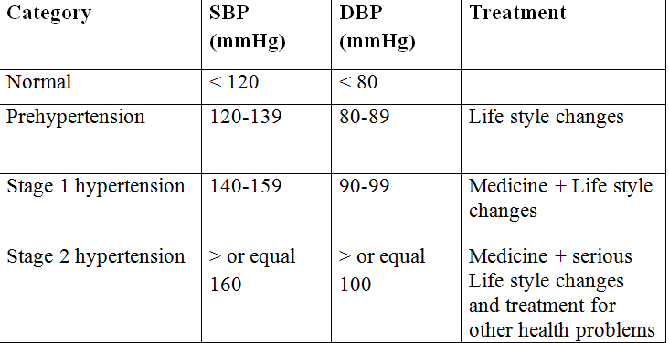

Slide 38
Classification: Blood Pressure
Types of Hypertension:
*primary Hypertension: this type of hypertension is not known. It occurs between ages 25 and 55 years

Slide 39
Secondary Hypertension: :it occurs as a result of other medical problems or medication e.g. kidney or liver diseases, blood or endocrinal diseases .
Malignant Hypertension : it occurs when diastolic blood pressure greater than 110-120 mmHg.

Slide 40
Isolated systolic blood pressure : it is an elevation of the systolic blood pressure above 150mmHg or higher but diastolic BP. less than 90mmHg. It is more common in elderly.
Resistant hypertension: if BP. cannot be reduced below 140\ 190 mmHg, despite a triple drug regime.

Slide 41
Signs &Symptoms of hypertension:
A symptomatic may be for years but it can be silent
Headach , dizziness, blurred vision
Nose bleeds, nausea vomiting
Chest pain , shortness of breath.
Irregular heart beats
Palpation, tinnitus, nervousness.
Being tired at all time, feeling of confusion, and flashing of face, weakness and sudden fall

Slide 42
Health education for hypertension:
Following healthy eating pattern
Reducing salts and sodium intake
Maintaining healthy weight
Being physical active
Limiting alcohol intake
Quitting smoking
Reduce stress.

Slide 43
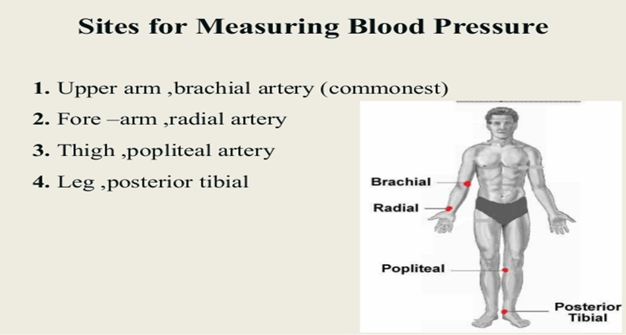

Slide 44
What is the more accurate IBP or NIBP ?

Slide 45
Arterial line , 3 way , normal saline + heparine , dome ,monitor

Slide 46
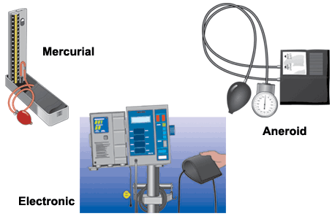

Slide 47
Methods for BP measurement:
1-Auscultatory method: measure systolic &diastolic BP.
Uses: stethoscope &sphygmomanometer.
Types of sphygmomanometers:
1-mercury. 2-aneriod. 3-digital.
*Reading BP by auscultation is considered the gold standard.

Slide 48
2-Palpatory method: measure systolic BP only.
Use only sphygmomanometer.

Slide 49
Guide lines for BP measurement:
In general, blood pressure should be measured:
-Before taking any morning doses of high blood pressure medicine.
-No less than one hour after exercising, smoking, or consuming caffeine.

Slide 50
-Full bladder should be emptied.
-Room temperature, time of day should be recorded.
-Choose the proper cuff size.
-Proper position: supine, seated comfortably, the arm should be relaxed, uncovered, and supported at the level of the heart.

Slide 51
Measuring BP by sphygmomanometers:
Equipment:
Stethoscope, an appropriately sized BP cuff, sphygmomanometer , pen, paper.

Slide 52
Procedure:
-place the BP cuff on the patient's arm.
-palpate the arm at the ante cubical fossa to locate the strongest pulse sounds and place the bell of the stethoscope over the brachial artery at this location.

Slide 53
inflate the BP cuff until there is no sounds through the stethoscope.
-slowly deflate the BP cuff.
-the first occurrence of rhythmic sounds heard as blood begins to flow the artery is the patients systolic pressure.

Slide 54
-continue to listen as the BP cuff pressure drops and the sounds fade. Note the gauge reading when the rhythmic sounds stop. This will be the diastolic reading.

Slide 55


