Slide 1
Child Immunization

Slide 2
Outlines:-
-introduction
-definitions
-Importance of vaccination
-Different types of vaccine
- Routine Immunization Schedule
-Side effect of vaccines

Slide 3
Introduction
Children should be vaccinated to protect them against infectious diseases. Vaccines contain either noninfectious fragments of bacteria or viruses or whole forms of these organisms that have been weakened so that they do not cause disease. Giving a vaccine (usually by injection) stimulates the body's immune system to defend against that disease. Vaccination produces a state of immunity to disease and is thus sometimes termed immunization

Slide 4
Definitions
child immunization
Immunization is the process whereby a person is made immune or resistant to an infectious disease, typically by the administration of a vaccine.
Vaccine
Is suspension of attenuated live or killed micro-organism bacterial or viral administrated to induce immunity and prevent infectious diseases .

Slide 5
Importance of vaccination
Prevention rather than cure
To prevent infectious disease
To prevent handicapping and disabilities
To stimulate the immune system

Slide 6
Different types of vaccine
Type of vaccine | Name of vaccine
Live attenuated vaccine | Measles, Mumps, Rubella(MMR combined vaccine Oral Polio -Sabine vaccine((OPV) BCG against tuberculosis Varicella Rotavirus
Killed or inactivated vaccine | Polio –Salk vaccine((OPV) Hepatitis A_B Pertussis Influenza Pneumococcal Conjugate Meningococcal Conjugate vaccine
Part of organism | Hepatitis B
Toxoid | Diphtheria, Tetanus(DT immunization)

Slide 7
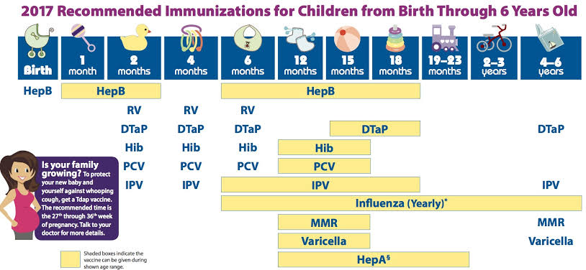
BC Routine Immunization Schedule INFANTS & CHILDREN

Slide 8
Possible reaction of DT aP-HB-IPV-Hib. vaccine:-
Vaccines are very safe.
-Common reactions to the vaccine may include soreness, redness and swelling where the vaccine was given. Some children may have a fever or experience crankiness, restlessness, vomiting, diarrhea, persistent crying or a loss of appetite.

Slide 9
- These reactions are mild and usually last 1 to 2 days
- It is important to stay in the clinic for 15 minutes after getting any vaccine because there is an extremely rare possibility, less than 1 in a million, of a life-threatening allergic reaction called anaphylaxis. This may include hives, difficulty breathing, or swelling of the throat, tongue or lips

Slide 10
Possible reaction of Pneumococcal Conjugate:- *
injection site reactions (pain, soreness, warmth, redness, swelling, tenderness, hard lump),
muscle or joint aches or pain,
fever, chills,
headache,
vomiting, nausea
stiffness of the arm or the leg where the vaccine was injected,
weakness, fatigue
skin rash.

Slide 11
* Common side effects of the rotavirus vaccine:-
Babies who have the vaccine can sometimes become restless and irritable, and some may develop mild diarrhea.

Slide 12
* Common side effects of Meningococcal C Conjugate vaccine:-
Crying - diarrhea
difficulty with moving - drowsiness
irritability -loss of appetite
muscle pain or stiffness - pain in the joints

Slide 13
*Common side effects of MMR vaccine:-
Fever and rash it occurs at 2-3 days after vaccination.
Ng. role: reassure the mother
-Tap compresses, light clothes antipyretic is given

Slide 14
*Common side effects of Varicella vaccine:-
Fever, mild chickenpox-like skin rash,
Runny or stuffy nose,
cough, -Sore throat

Slide 15
*Common side effects of flu shot vaccine:-
- Soreness, redness, and/or swelling from the shot.
-Headache. -Fever.
-Nausea. -Muscle aches

Slide 16
*Common side effects of Hepatitis A vaccine:-
- The hepatitis A vaccine is made from inactive virus and is quite safe. In general, there are very few side effects. The most common potential side effect is soreness at or around the injection site. Other potential side effects include mild headache, loss of appetite among children, and feeling tired.

Slide 17
Thank you

