Slide 1
Vital signs
Prepared by
Hossam Mahran

Slide 2
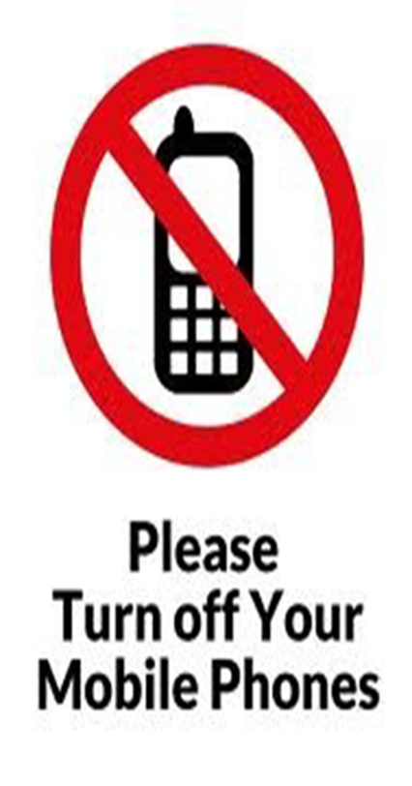


Discussion Rules

Slide 3
Introduction
Vital signs provide clues to the severity of the disease and early signs of complications. These needs to be carefully measured and any deviations are reported and recorded.
Definitions
Temperature, heart rate, respiration and blood pressure are known as vital signs because these are governed by vital organs.

Slide 4
Purposes

Slide 5
Purposes
1- To check any temperature alteration
2- To assess cardiac output
3- To identify abnormalities in the rate, rhythm and volume of the pulse
4- To identify any abnormalities in the rate, rhythm and depth of respiration
5- To monitor patient response to illness and treatment
6- To help in the planning of nursing care

Slide 6
Indications

Slide 7
Indications
1- At the time of admission in the hospital
2- Before and after any surgical procedures
3- Before and after any invasive diagnostic procedures
4- Before and after the administration of certain medications which affects respiratory, cardiovascular and thermoregulatory systems
5- When client is experiencing severe pain and anxiety
6- Patient with cardiac, renal, respiratory diseases or having physical injuries

Slide 8
Normal vital signs in children
Age | Heart rate b/m | Respiratory rate c/m | Systolic blood pressure mmHg | Diastolic blood pressure mmHg
Premature | 120 -170 | 40 -70 | 55 -75 | 35-45
0 -3 months | 100-150 | 35-55 | 65-85 | 45-55
3-6 months | 90-120 | 30-45 | 70-90 | 50-65
6-12 months | 80-120 | 25-40 | 80-100 | 55-65
1-3 years | 70-110 | 20-30 | 90-105 | 55-70
3-6 years | 65-110 | 20-25 | 95-110 | 60-75
6-12 year | 60-95 | 14-22 | 100-120 | 60-75
Over 12 year | 55-85 | 12-18 | 110-135 | 65-85

Slide 9
Equipment needed
Clean tray containing
1- Thermometer in a container lined with soft material containing disinfectant.(digital, rectal, tympanic or temporal)
2- Container lined with soft material containing plain water
3- Clean cotton swabs in a container
4- Paper bag
5- Watch with seconds
6- Stethoscope
7- Blood Pressure Apparatus
8- Soft Tissue

Slide 10
Body Temperature
Definition
It means the degree of warmth or balance maintained between the heats produced (thermogenesis) and heat loss (thermolysis) in the body, compared with a recognized standard. The normal temperature is 37C or 95 F. In order to convert a reading from one scale to the other, the following relation can be used
(F-32)5/9 = C
(C x9/5) +32 = F

Slide 11
Routes for measuring body temperature
1- Oral
2- Axillary
3- Rectal
4- Tympanic

Slide 12
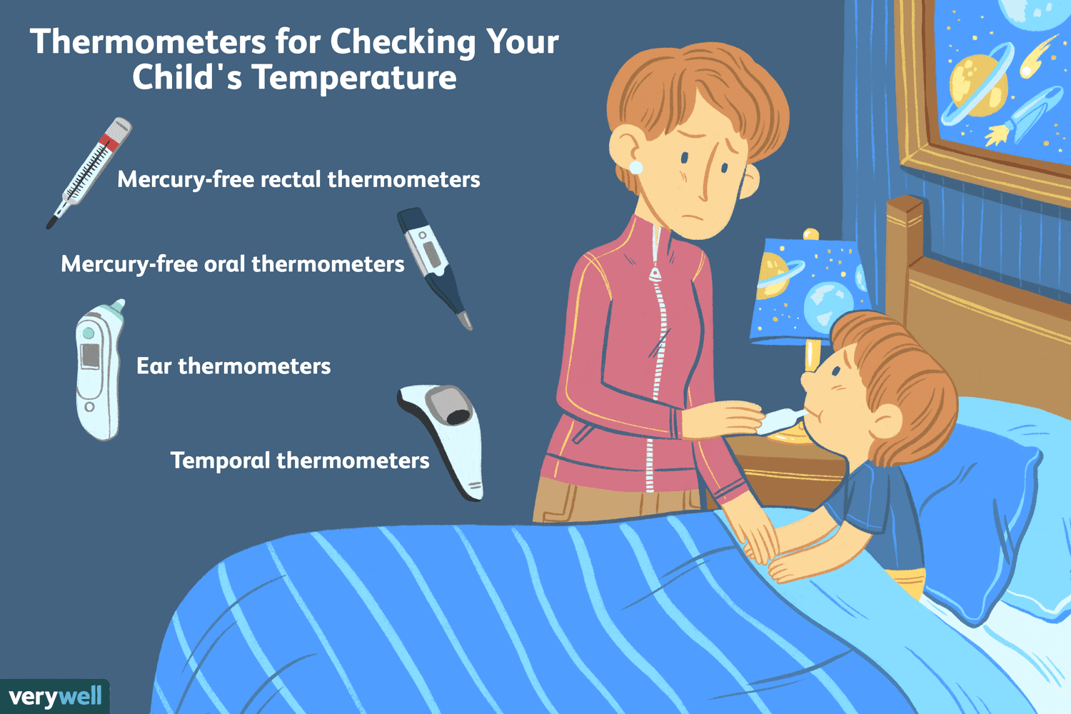

Slide 13
A-Oral Method
Contraindications
1- If patient is extremely nervous, confused, unconscious, hysterical and when they can't follow instructions
2- In patients having convulsions
3- If patients having injuries, inflammations, and operation of the mouth or in patients who breathe by mouth
4- In children under 6 years
5- Immediately after taking hot/cold drinks, chewing gum/betel leaves
6- If patient is receiving oxygen per face mask

Slide 14
Preparation of the articles
Clean tray containing
1- Thermometer in a container lined with soft material containing disinfectant.
2- Container lined with soft material containing plain water
3- Clean cotton swabs in a container
4- Paper bag
5- Watch with seconds

Slide 15
Preparation of the patient and unit
1- Explain the procedure to the patient
2- Tell the patient not to eat or drink 15 minutes prior to the taking of the oral temperature
3- Place the patient in a comfortable position
4- Keep the thermometer tray at the bed side with the necessary articles arranged neatly in it

Slide 16
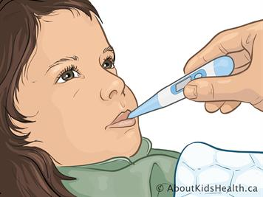

Slide 17
B-Axillary Method
The axillary route is often used for newborn and for children. The axillary temperature is generally 0.5 C lower than the oral temperature.

Slide 18
Preparation of patient and unit
1- Explain the procedure to the child and his parents
2- Place the patient in a comfortable position
3- Dry the axilla
4- Provide privacy
5- Keep the thermometer tray at the bed side with the necessary articles arranged neatly in it

Slide 19
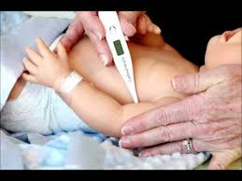

Slide 20
C-Rectal Method
The rectal route should be used only when no other route is possible, due to the potential for rectal perforation and because most children view this as an intrusive procedure. The rectal temperature is 0.5 degree higher than the oral temperature.

Slide 21
Preparation of the articles
A clean tray containing
1- Rectal thermometer in a container containing disinfectant solution
2- Soft tissues
3- Lubricant
4- Disposable gloves
5- Kidney tray/paper bag
6- Watch with second handed

Slide 22
Preparation of the patient and unit
1- Explain the procedure to the patient
2- Place the infant or child prone on a bed or the parent's lap; turn the older child on the side
3- Provide privacy (draw curtain around bed or close room door)
4- Rinse and dry the anal area

Slide 23
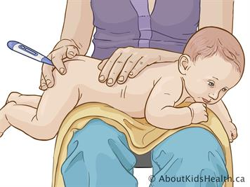

Slide 24
D-Tympanic method
The tympanic route is a convenient and fast method for taking temperatures in infants and children. Infrared technology provides a rapid reading of the temperature of the blood flowing through the carotid artery from the body core.

Slide 25
Preparation
1- Explain procedure to patient
2- Place the infant in a supine on a flat surface. Stabilize the infant's head, and turn the infant's head 90 degree for easy access
3- Position the child on the parent's or assistant's lap with head secured

Slide 26
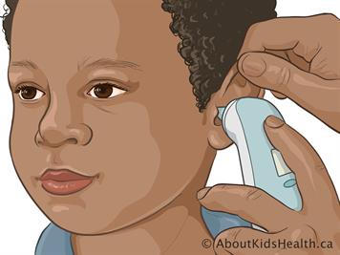

Slide 27
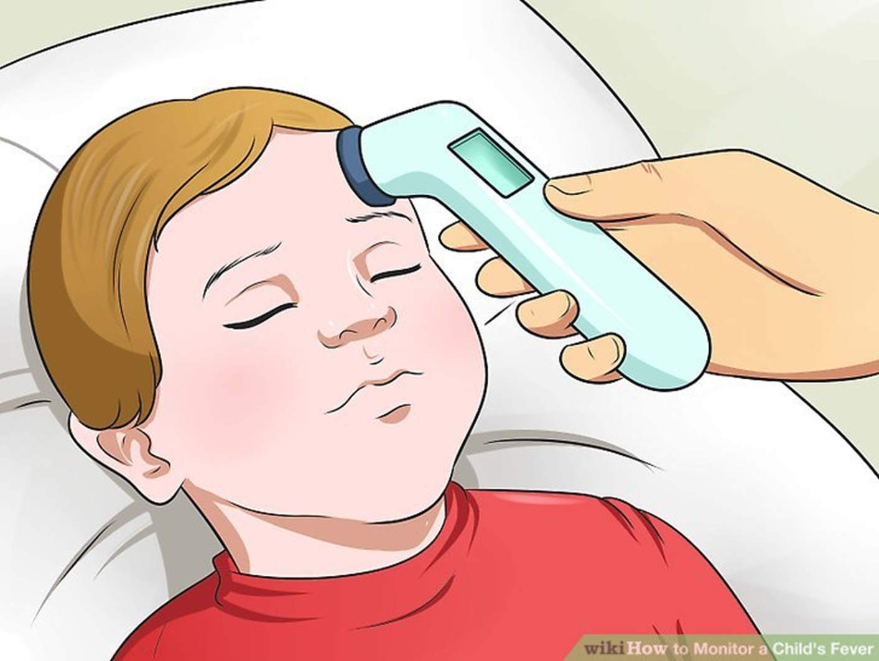
Temporal method

Slide 28
Heart Rate
Definition:
The heart rate is a wave of blood created by contraction of left ventricle of the heart. The rate of pulse is expressed in beats per minute. The apical heart rate is preferred in infants and young children as it is difficult to palpate the pulse in an extremity consistency enough to count the rate. Pulse rates may be palpated in children over 3 years of age. Sites commonly used to palpate heart rate include the brachial, radial, femoral and dorsal pedis.

Slide 29
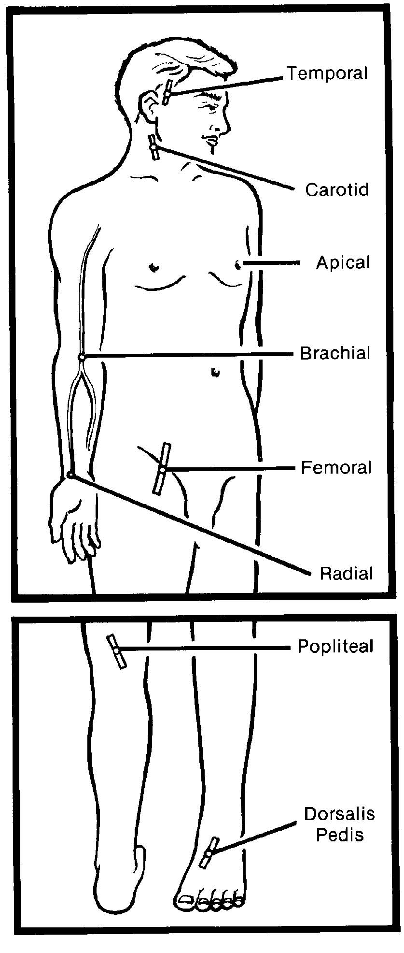

Slide 30
Articles required
Stethoscope .
Watch with second hand .
Alcohol swabs
Preparation
1- Explain the procedure to child and his parents
2- Move clothing away from the anterior chest
3- Give the infant a pacifier or other distraction to get a resting pulse rate
4- Provide privacy
5- Provide a comfortable position
6- Take articles to the bed side

Slide 31
Cont.,
Children (radial pulse) Precautions:
1- Don't apply too much force/pressure over the arteries while taking pulse.
2- Don't use thumb for counting pulse, because there is a pulse in thumb, which the nurse may mistake for patient's pulse.

Slide 32
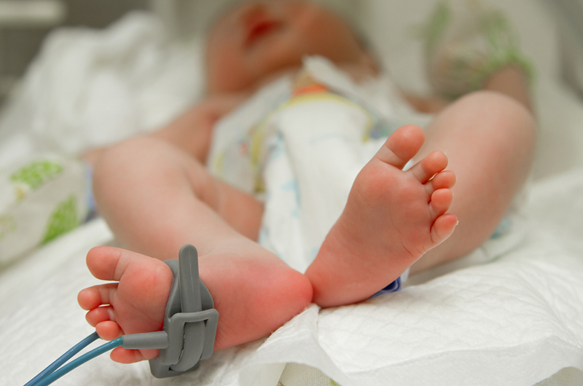

Slide 33
Respiratory Rate
Definition
It is an involuntary process and consists of inspiration, expiration.
Precautions
1- Don't take pulse and respiration immediately after exercise, in emotional stress, during or after a painful treatment in nervous state.
2- Never make conscious that you are counting breathing.

Slide 34
Blood pressure
Definition
The pressure exerted by the blood on the walls of the blood vessels.
Purposes
1- Maintain a baseline measure of arterial pressure.
2- Assess the hemodynamic status of a client.
3- Monitor the response of the circulating systems to various pathological conditions and therapies.

Slide 35
Patient preparation
1- Explain the procedure
2- Instruct to remain quiet during procedure
3- Patient should be in a relaxing or standing position for at least 5-10 minutes prior to taking B.P
4- Permit the child to handle the B.P apparatus prior to using it on him to decrease his fear

Slide 36
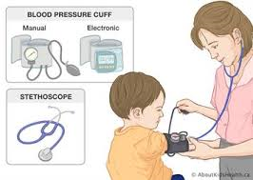

Slide 37



