Slide 1
Assessment of Gestational Age ( New Ballard Score )

Slide 2
Objectives:
At the end of this lecture every student will be able to correctly:
1-Define Assessment of Gestational Age
2-List the purposes of Assessment of Gestational Age
3-Discuss tips for procedure
4-List component of assessment of gestational age
5-Perform the Assessment of Gestational Age
6- Discuss Scoring and maturity rating

Slide 3
Outlines:
1-Definition of Assessment of Gestational Age
2-Purposes of Assessment of Gestational Age
3-Accuracy
4-Tips for procedure
5-Neuromuscular maturity
6-Physical maturity
7-Scoring and maturity rating

Slide 4
Assessment of Gestational Age
( New Ballard Score )

Slide 5
Definition of the New Ballard Score:
The New Ballard Score is a set of procedures developed by Dr. Jeanne L Ballard, to determine Gestational Age through neuromuscular and physical assessment of a newborn infant.

Slide 6
The purpose of the Gestational Age Assessment is to:
1-Compare a given infant against the standardized norms of neonatal growth based on gestational age and identify infants that are preterm, post-term, large or small for gestational age.
2-Verify the obstetrical estimate for gestational age.
3-Observe and treat for possible complications.

Slide 7
Accuracy:
Examination is accurate to ± 2 weeks.
It is best performed at < 12hrs of age if the infant is< 26 weeks' gestation. If the infant is>26 weeks' gestation, there is no optimal age of examination up to 96 hrs.

Slide 8
Tips for Procedure
GA assessment should be unhurried, systematic, and performed when the infant is stable and in a quiet, alert state.
Examination is performed twice by two different examiners to ensure objectivity, and the data are entered on the chart.
Physical maturity is most accurately assessed immediately after birth. If the infant was compromised during labor and delivery or was affected by labor medications, neurological maturity may not be accurately assessed at this time and should therefore be repeated after 24 hrs of age.

Slide 9
If the neurological assessment is not performed, the GA estimate can be based upon a doubling of the physical assessment score.
Assess the infant's physical and neuromuscular maturity and place an (X) in the box on the form which best describes the infant. When a second examination is performed, place a (0) in the appropriate box.

Slide 10
A- Neuromuscular maturity
1- Posture
The infant is placed supine and the examiner waits until the infant settles into a relaxed or preferred posture.
Observe the flexion of the arms and legs.
Compare with the figures on the diagram and place an (X) through the figure most similar.

Slide 11
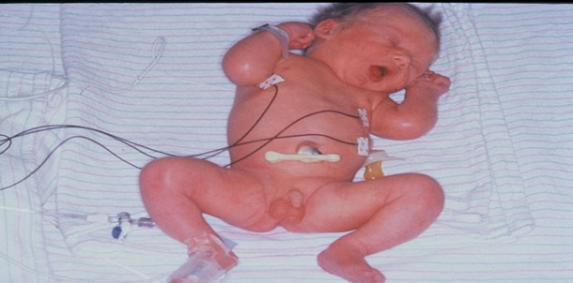

Slide 12

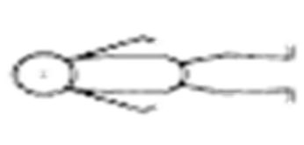
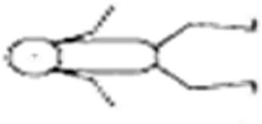


0 |  | The arms and legs are perfectly flat
1 |  | Simple flexion of the knee and thigh joint
2 |  | Medial flexion of the knee, hip, and elbow joints
3 |  | Flexion with spacing or legs, marked flexion of arms
4 |  | Full flexion for arms and legs

Slide 13
2- Square window
Flex the infant's hand at the wrist and observe the angle between the thumb and forearm.
Apply gentle pressure to get as much flexion as possible.
Compare the angle at the thumb with the figures on the diagram and choose the figure most similar.

Slide 14
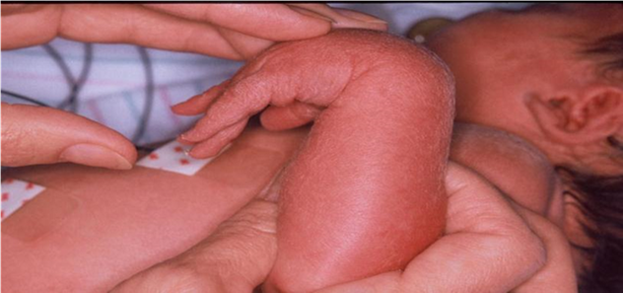

Slide 15






-1 |  | The angle between the base of the thumb and forearm is more than 90 degrees.
0 |  | The angle between the base of the forefinger and the armrest is 90 degrees.
1 |  | The angle between the base of the forefinger and the wrist of the arm is 60 degrees.
2 |  | The angle between the base of the forefinger and the wrist of the arm is 45 degrees.
3 |  | The angle between the base of the forefinger and the wrist of the arm is 30 degrees.
4 |  | The angle between the base of the forefinger and the armrest is zero.

Slide 16
3- Arm recoil
Place the infant in the supine position.
Flex the forearms for 5 seconds; then grasp the hand and fully extend the arm and release.
Observe the infant‘s arm reaction to the release.

Slide 17
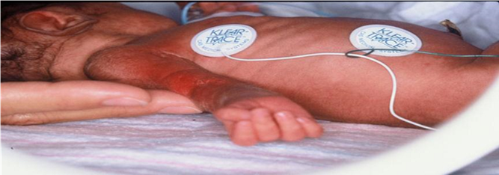

Slide 18





0 |  | The arm is at least 180 degrees
1 |  | A slight flexion of the elbow joint at an angle of 140 - 180 degrees
2 |  | A slight bend at an angle of 110 - 140 degrees
3 |  | Medium flexion at an angle of 90 - 110 degrees
4 |  | Brisk return to full flexion

Slide 19
4- Popliteal angle
With infant lying supine, and with diaper removed and pelvis flat on the examining surface.
Hold the thigh in the knee-chest position with the left index finger and the thumb supporting the knee. Then extend the leg by gentle pressure from the right index finger behind the ankle. • Compare the angle behind the knee or the popliteal angle, with the figures on the diagram

Slide 20
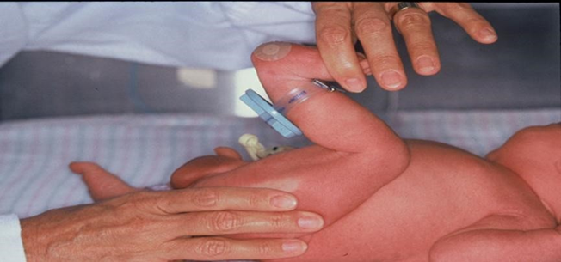

Slide 21







-1 |  | The leg is completely rolled at 180 degrees
0 |  | A slight flexion behind the knee at a 160 degree angle
1 |  | Bend behind the knee at a 140 degree angle
2 |  | A marked bend at an angle of 120 - 130 degrees
3 |  | Medium flexion at an angle of 100 - 110 degrees
4 |  | Flex the knee joint at a 90 ° angle
5 |  | Full flexion of the knee joint at an angle of less than 90 degrees

Slide 22
5- Scarf sign
Place the infant in the supine position.
Hold the infant's hand and draw the arm as far across the neck (like a scarf) to the opposite shoulder as possible.
To perform this maneuver the elbow may need to be lifted across the body, but both shoulders should remain on the examining surface and the head should remain midline.
The point on the chest to which the elbow moves easily prior to significant resistance is noted.
Observe the position of the elbow on the infant's chest and compare it to the figures on the diagram.

Slide 23
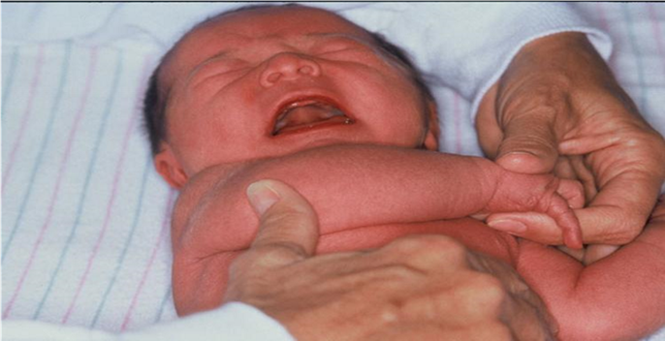

Slide 24






-1 |  | Full scarf at the level of the neck
0 |  | Contralateral axillary line
1 |  | Contralateral nipple line
2 |  | Xyphoid process
3 |  | Ipsilateral nipple line
4 |  | Ipsilateral axillary line

Slide 25
6- Heel-to-ear-maneuver
The infant is placed supine and the flexed lower extremity is brought to rest on the mattress alongside the infant's trunk.
Support the infant's thigh laterally alongside the body with the palm of one hand. Hold the infant's foot between the thumb and index finger of the other hand and draw it to as near the head as possible towards the ipsilateral ear without forcing it. Keep the pelvis flat on the examining surface.
Note the location of the heel where significant resistance is appreciated.

Slide 26
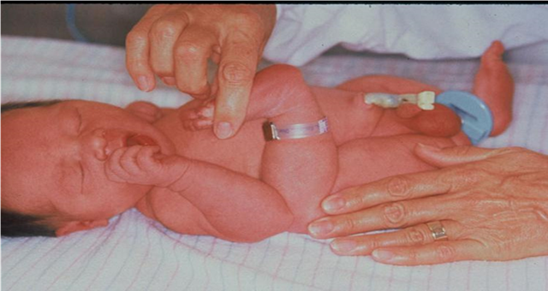

Slide 27






-1 |  | The heel is at or near the ear.
0 |  | The heel is at or near the nose.
1 |  | The heel is at or near the chin level.
2 |  | The heel is at or near the nipple line.
3 |  | The heel is at or near the umbilical area.
4 |  | The heel is at or near the femoral crease.

Slide 28
B- Physical maturity
1- Skin
• Carefully look at the skin and grade according to the diagram.

Slide 29
-1 | Sticky, friable, transparent
0 | Gelatinous, red, translucent
1 | Smooth pink, visible veins
2 | Superficial peeling &/or rash, few veins
3 | Cracking, pale areas, rare veins
4 | Parchment, deep cracking, no vessels
5 | Leathery, cracked, wrinkled

Slide 30
2- Lanugo hair
• Examine on the infant's back; between and over the scapulae.

Slide 31
-1 | None
0 | Sparse
1 | Abundant
2 | Thinning
3 | Bald areas
4 | Mostly bald

Slide 32
3- Plantar surface
Measure foot length from the tip of the great toe to the back of the heel; give a score of (0) if the result is 50 mm and no creases are seen on the plantar surface.
If there are creases, score accordingly.

Slide 33
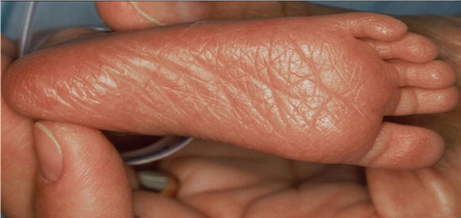

Slide 34
-2 | Heel-toe <40mm
-1 | Heel-toe 40-50mm
0 | Heel-toe >50 mm no crease
1 | Faint red marks
2 | Anterior transverse crease only
3 | Creases ant. 2/3
4 | Creases over entire sole

Slide 35
4- Breast
• The examiner notes the size of the areola and the presence or absence of stippling.
• The examiner then palpates the breast tissue beneath the skin by holding it between thumb and forefinger, estimating its diameter in millimeters, and selects the appropriate square on the score sheet.

Slide 36
-1 | Imperceptible
0 | Barely perceptible
1 | Flat areola no bud
2 | Stippled areola 1-2 mm bud
3 | Raised areola 3-4 mm bud
4 | Full areola 5-10 mm bud

Slide 37
5- Eye and ear
The pinna of the fetal ear changes it configuration and increases in cartilage content as maturation progresses. Assessment includes palpation for cartilage thickness, then folding the pinna forward toward the face and releasing it.
The examiner notes the rapidity with which the folded pinna snaps back away from the face when released, then selects the square that most closely describes the degree of cartilaginous development.

Slide 38
In very premature infants, the pinnae may remain folded when released. In such infants, the examiner notes the state of eyelid development as an additional indicator of fetal maturation. The examiner places thumb and forefinger on the upper and lower lids, gently moving them apart to separate them. The extremely immature infant will have tightly fused eyelids.

Slide 39
-2 | Lids fused tightly
-1 | Lids fused loosely
0 | Lids open pinna flat stays folded
1 | Sl. curved pinna; soft; slow recoil
2 | Well-curved pinna; soft but ready recoil
3 | Formed & firm instant recoil
4 | Thick cartilage ear stiff

Slide 40
Genitals
A-Genitals-Male
The fetal testicles begin their descent from the peritoneal cavity into the scrotal sack at approximately the 30th week of gestation. The left testicle precedes the right and usually enters the scrotum during the 32nd week. Both testicles are usually palpable in the upper to lower inguinal canals by the end of the 33rd to 34th weeks of gestation. Concurrently, the scrotal skin thickens and develops deeper and more numerous rugae.

Slide 41
-1 | Scrotum flat, smooth
0 | Scrotum empty, faint rugae
1 | Testes in upper canal, rare rugae
2 | Testes descending, few rugae
3 | Testes down, good rugae
4 | Testes pendulous, deep rugae

Slide 42
B-Genitals-Female
To examine the infant female, the hips should be only partially abducted, i.e., to approximately 45° from the horizontal with the infant lying supine. Exaggerated abduction may cause the clitoris and labia minora to appear more prominent, whereas adduction may cause the labia majora to cover over them.

Slide 43
-1 | Clitoris prominent & labia flat
0 | Prominent clitoris & small labia minora
1 | Prominent clitoris & enlarging minora
2 | Majora & minora equally prominent
3 | Majora large, minora small
4 | Majora cover clitoris & minora

Slide 44
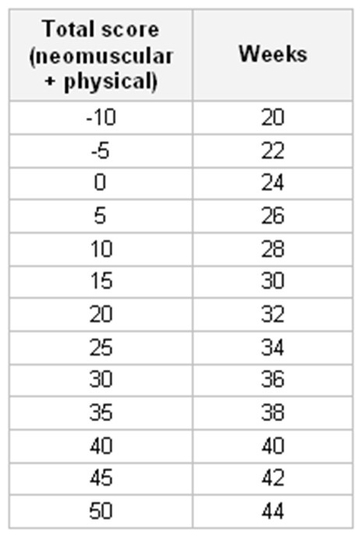

Slide 45
Scoring and maturity rating
After completing the physical and neuromuscular assessment, add up the scores received for each of the checked boxes and record the total scores on the worksheet. If the examination only consisted of a physical assessment; multiply the total score by 2.
Maturity rating: compare the total score obtained from the assessment in the score column to the estimated GA in the weeks‘ column.

Slide 46
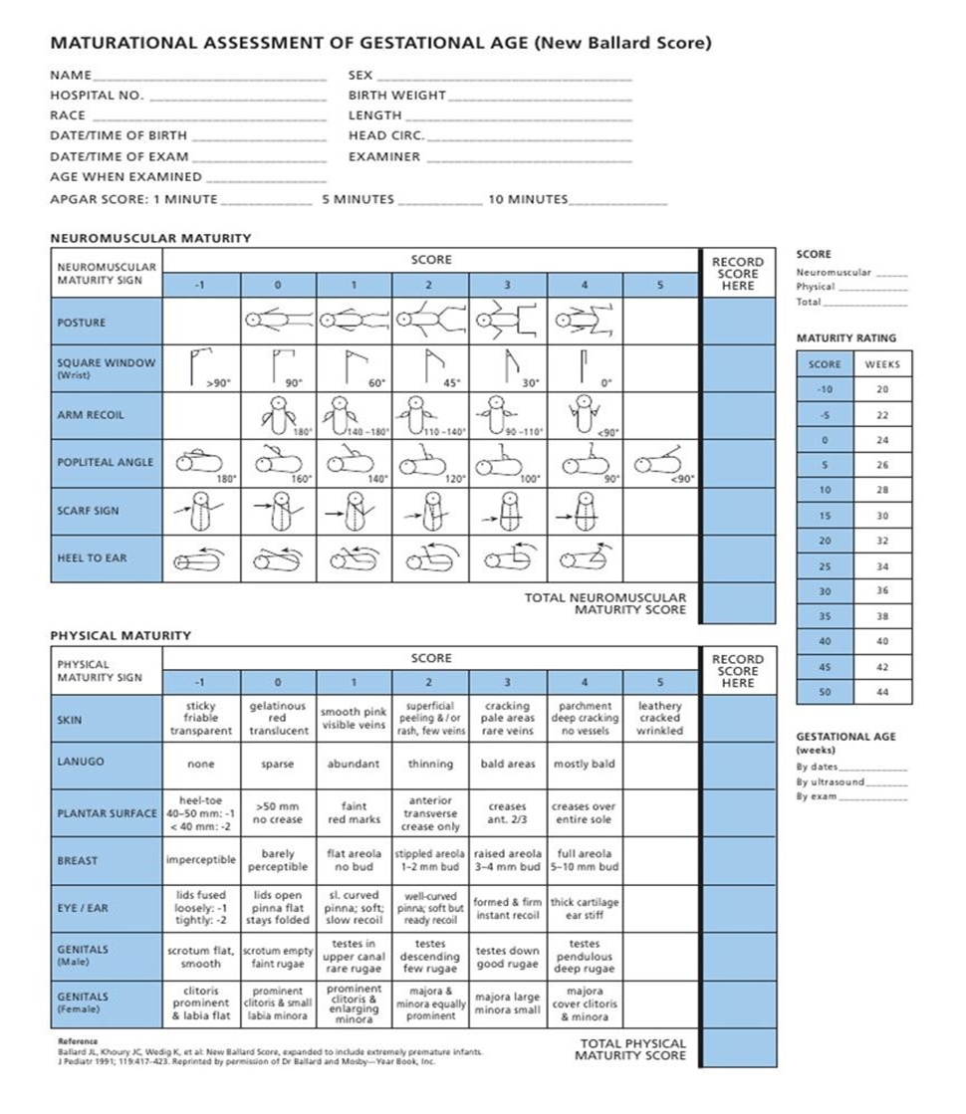

Slide 47
Thank You
Thank You

