Slide 1
Antiseptic solution, Surgical hand washing and Universal precautions
Prepared by
Hossam Mahran

Slide 2



Discussion Rules

Slide 3
Learning objectives
By the end of this lecture the student will be able to:
1-Define the Antiseptic solutions.
2-List uses of antiseptic solution. .
4-Enumerate the most common antiseptics solution.

Slide 4
Introduction
One of the most important aspects of maintaining good health is to combat microorganisms that cause disease and infection, and a good way to do this is through the use of an antiseptic. An antiseptic is a substance applied directly to the affected area that either kills microorganisms or prevents them from growing. There are a variety of antiseptics in common use today that can be classified by their active chemical ingredients

Slide 5
Definition
Chemical substances used in destroying disease causing microorganisms (also called microbiological, pathogens) externally on wounds or (under medical supervision) taken internally to treat infection.

Slide 6
Uses of antiseptic solution:-
1- Decrease bacterial growth on living organisms.
2- Hand washing as skin preparation before invasive procedure, to irrigate wounds.
3- Skin and wound care.

Slide 7
The most common antiseptic solutions
1- Iodophors: Contains iodine in a complex form. This is relatively non irritating and nontoxic. Effective against a broad range of micro organisms. Less irritating to the skin. Recommended for surgical scrub and is the best antiseptic for use in the genital area, vagina, and cervix. Iodophors are effective few minutes after application. Do not dilute them. Popular brand: Betadine.

Slide 8
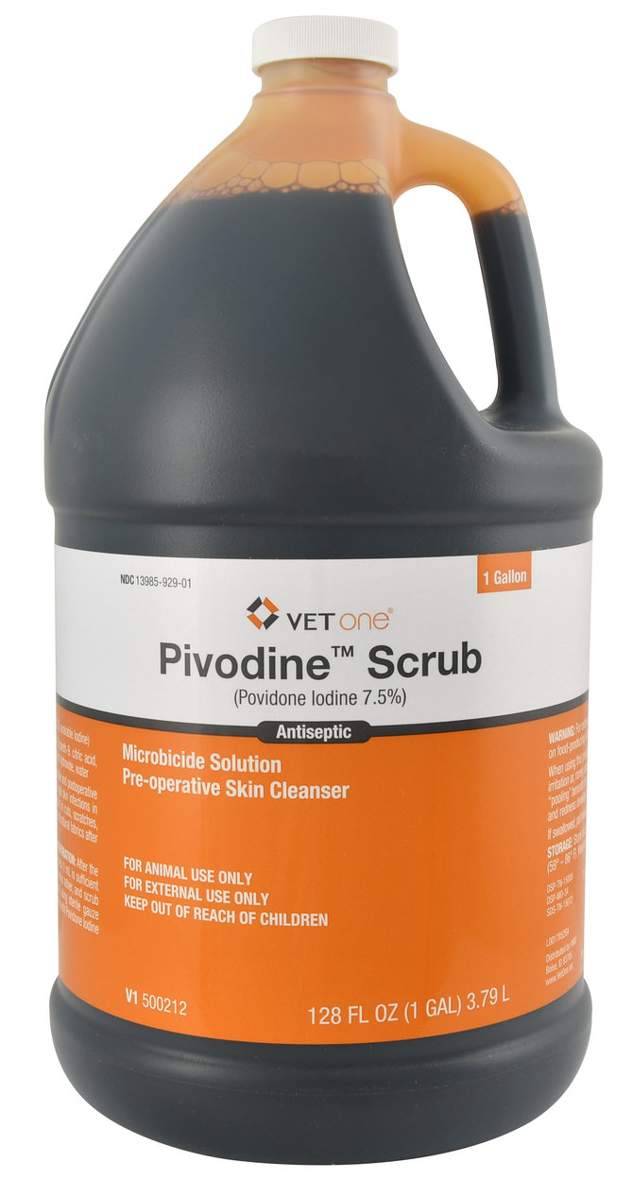
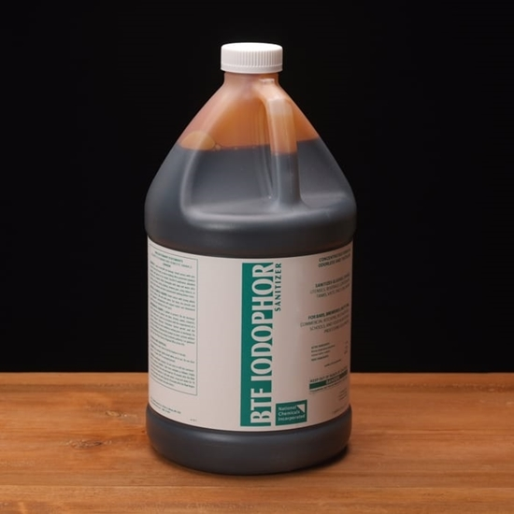
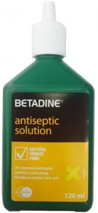

Slide 9
Cont.,
2- Chlorhexidine Gluconate: Useful against a broad range of microorganisms, but the effect is minimum on tuberculosis and fungi. Remains effective for at least 6 hours after being applied. Has a good, persistent effect. If irritation occurs, it can be reduced by hard water, creams, and natural soaps. This is also used for surgical scrub and skin prep, in the genital area, vagina, and cervix.

Slide 10
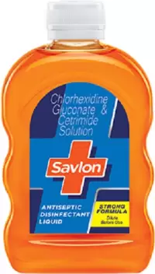
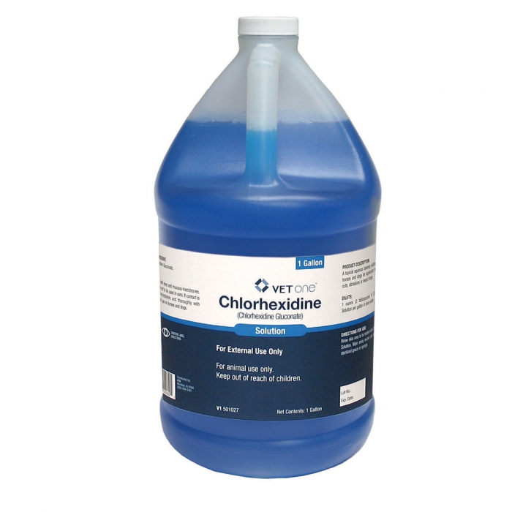
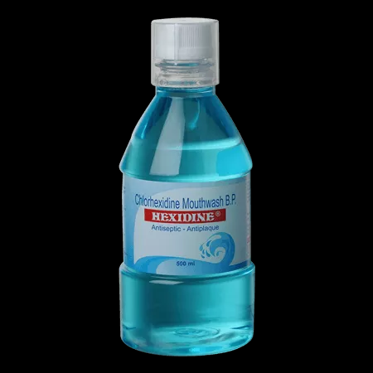
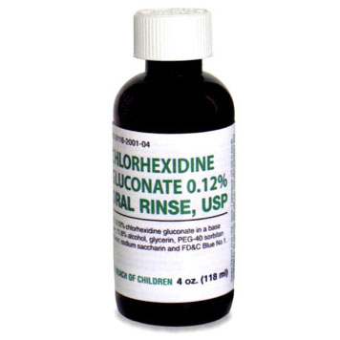

Slide 11
Cont.,
3. Iodine: This is a popular antiseptic used against a broad range of microorganisms. It acts fast but can cause skin irritation. It cannot be used for routine use in surgical scrub or on mucous membranes as it causes irritation. Because of this, when used for pre-procedure skin application, iodine must be allowed to dry and then removed from the skin using alcohol.

Slide 12
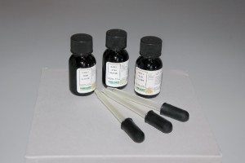
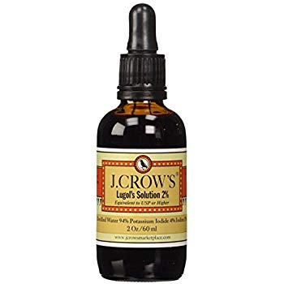

Slide 13
Cont.,
4. Alcohol: This is another popular antiseptic product. Effective against a broad range of microorganisms. It acts fast in killing microorganisms. Has a drying effect on skin and hence not recommended to be used on mucous membranes. Wash the skin before applying it. To be effective, it must dry completely. Alcohol can also be diluted for optimal killing of microorganisms.

Slide 14
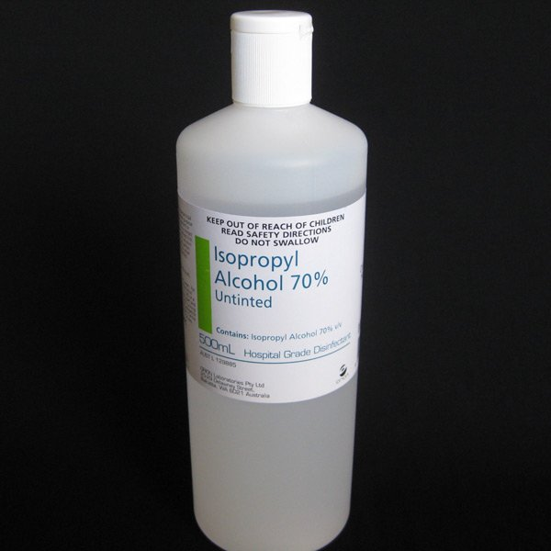
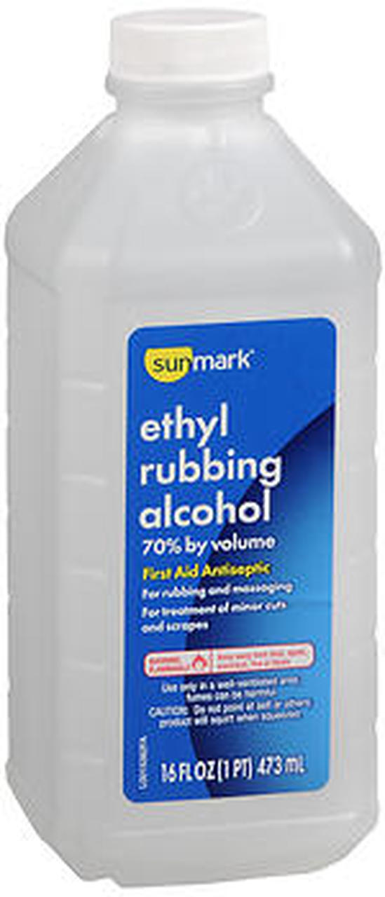

Slide 15
Cont.,
5. PCMX (Para-chloro-meta-xylenol): This is fairly effective against most microorganisms. This antiseptic has a persistent effect over many hours but it is less effective than chlorhexidine and iodophors. Available in both antiseptic and disinfectant preparations. It should not be used on mucous membranes.

Slide 16


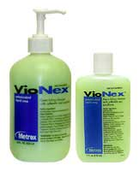

Slide 17
Cont.,
6. Hexachlorophene: Among the other antiseptics, this has the least effectiveness against most microorganisms. Has a good, persistent effect with repeated use. It is toxic to the nervous system. Occasional use cannot reduce the number of microorganisms on hands. If use of this antiseptic is discontinued after long-term use, there are chances of re-growth of bacteria, causing large-scale contamination. Not recommended for use in surgical scrub.

Slide 18
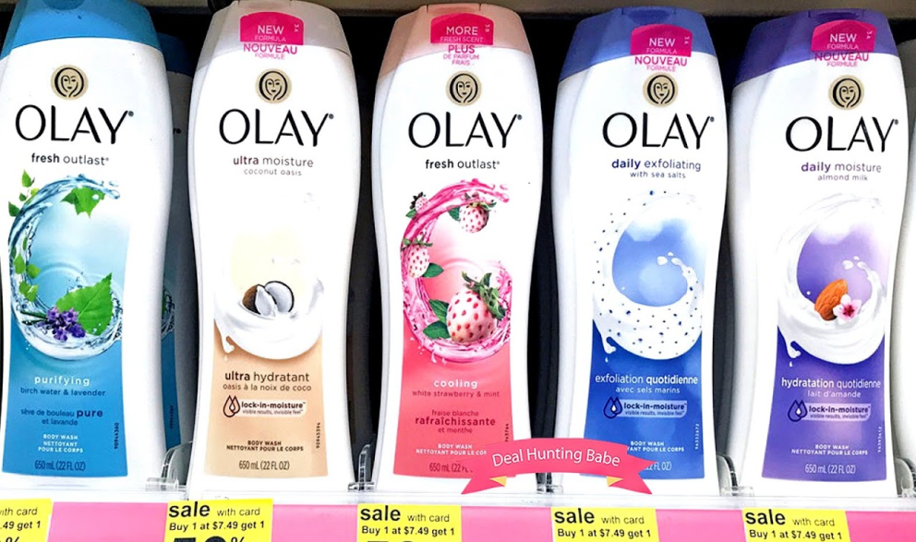
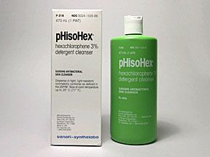
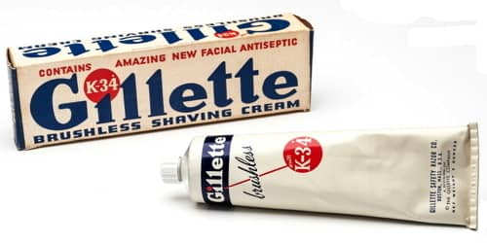

Slide 19
Cont.,
7. Boric acid: Used in suppositories for treating vaginal yeast infections. Can be used in eyewashes, and as an antiviral to reduce the duration of cold sore attacks. Can be applied as creams for burns.
8. Hydrogen peroxide: Used to clean and deodorize wounds and ulcers. Can also be used in household first aid for scrapes, etc.

Slide 20
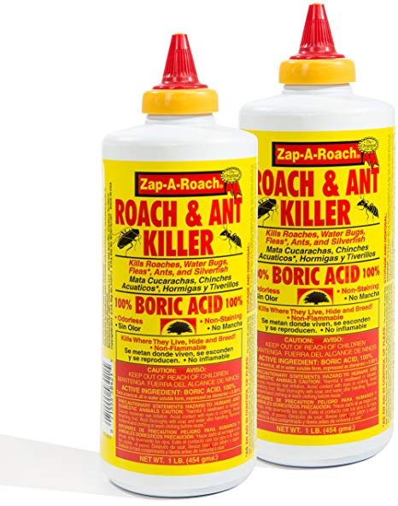
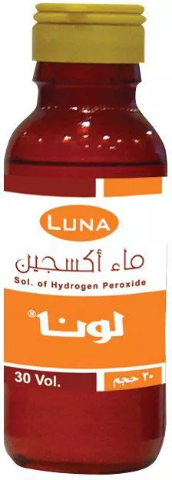

Slide 21
Cont.,
9. Benzalkonium Chloride:This is a mild antiseptic. Comes as a spray and in squirt-bottles. One of the most common antiseptic in over-the-counter first aid preparations.

Slide 22

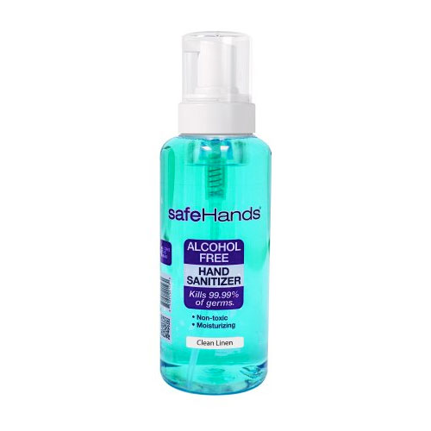
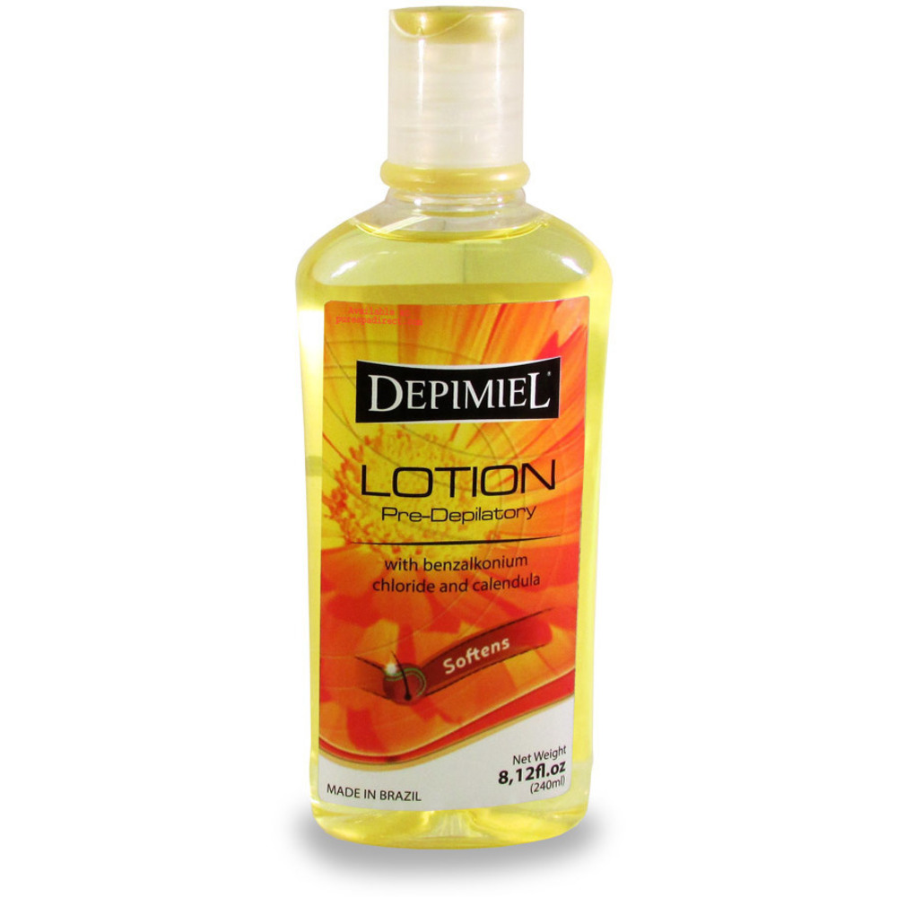

Slide 23
Learning objectives
By the end of this lecture the student will be able to:
1- Define the universal precaution.
2-List purposes of universal precaution.
3-List types of the universal precaution.

Slide 24
Introduction
Standard precautions: are the minimum infection prevention practices that should be used in the care of all patients all of the time. These practices are designed to both protect the healthcare worker and to prevent the healthcare worker from spreading infections among patients.

Slide 25
Definition
Standard Precautions are a set of standard recommendations designed to reduce the risk of transmission of infectious agents from body fluids or environmental surfaces that contain infectious agents.

Slide 26
Purpose
Standard Precautions are the primary method used to prevent the spread of infection. These precautions apply to all contact with all persons.

Slide 27
The Standard Precautions are
Wash hands after contact with blood, body fluids, secretions, excretions, and contaminated objects whether or not gloves are worn.
Wear clean gloves when touching blood, body fluids, secretions, excretions, and contaminated items (i.e. soiled gowns).
Wear a mask, eye protection, or a face shield if sprays of blood, body fluids, secretions, and excretions can be expected.

Slide 28
Cont.,
4. Wear a clean, non-sterile gown if client case is likely to result in splashes or sprays of blood, body fluids, secretions, or excretions. The gown is intended to protect clothing.
5. Handle client care equipment that is soiled with blood, body fluids, secretions, or excretions carefully to prevent the transfer of microorganisms to others and to the environment.

Slide 29
Cont.,
6. Handle, transport, and process linen that is soiled with blood, body fluids, secretions, or excretions in a manner to prevent contamination of clothing and the transfer of microorganisms to others and to the environment.
7. Prevent injuries from used equipment, i.e. scalpels or needles, and place in puncture-resistant containers.

Slide 30
Cont.,
Standard precautions apply to all patients regardless of their diagnosis or presumed infection status, and in the handling of:
Blood
All other body fluids, secretions and excretions (except sweat), regardless of whether they contain visible blood
Non-intact skin
Mucous membranes (mouth and eyes)
Dried blood and other body substances, including saliva.

Slide 31
Types of precautions
1- General precaution (standard precaution).
2- Special consideration.
3- Precaution for invasive procedure.

Slide 32
General precaution (standard precaution)
Protective equipment includes gloves, gowns, masks, and eyewear worn by health care workers to reduce the risk of exposure to potentially infectious materials.
All patients are considered to be possible carriers of infection.
Chang gloves after contact with each patient.
Wash hands and skin surface immediately if contaminated with blood or body fluid.
Clean all equipment before reused to other patient.
Take precaution to prevent injury with sharp instrument.
Know roles and responsibilities for personal safety.

Slide 33
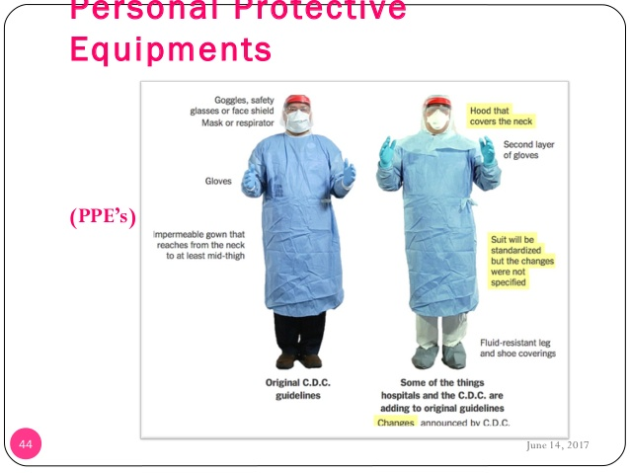
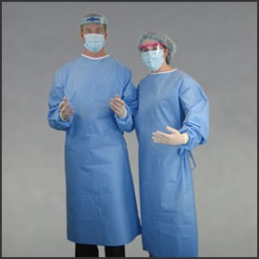

Slide 34
Special consideration
Health workers who have oxidative lesions or dermatitis should avoid all direct care or handling equipment.
Pregnant healthcare workers are greater risk for infection than non pregnant.

Slide 35
Precautions for invasive procedures
All health workers who participate in invasive procedures must routinely use appropriate barrier.
Gloves and surgical masks must be worn for all invasive procedures.
If glove is torn it should be removed and wear another gloves.
Protective eye wears or face mask should be worn for all procedures.

Slide 36
Cont.,
Gowns or aprons should make of materials providing effective barrier during invasive procedures.
All health care workers in a health work place should wear gloves and gown.

Slide 37
How should I clean up blood/body fluids:
Put on disposable gloves
Wipe up blood or body fluids with absorbent paper towels.
Place contaminated paper towels in a new plastic garbage bag.
Clean and rinse area with usual disinfectant.
Wipe the surface with a 1:10 dilution of household bleach in water. This concentration can be achieved by mixing 1 ounce of household bleach with 9 ounces of tap water (1:10 dilution).

Slide 38
Cont.,
Dispose into the same plastic garbage bag: the cloths used to wipe up and your gloves, removing gloves last.
Secure bag with tie.
Dispose of plastic garbage bag as per your department's instructions.
Wash hands.

Slide 39
Surgical Hand Washing

Slide 40
Learning objectives:
By the end of this lecture the student will be able to:
1- Define surgical hand washing
2- List the purposes of surgical hand scrubs.
3- Describe types of surgical hand scrubs.
4- List the safety considerations.
5- Demonstrate the recommended practices for surgical hand washing.

Slide 41
Introduction
Skin is a major source of microorganisms and a major source of contamination in the operating room (OR) setting. Since skin cannot be sterilized, members of the surgical team must wear sterile gloves. The purpose of the surgical hand scrub is to significantly reduce the number of skin bacteria found on the hands and arms of the OR staff.
Studies have shown that skin bacteria rapidly multiply under surgical gloves if hands are not washed with an antimicrobial soap, whereas a surgical hand scrub will inhibit growth of bacteria under gloved hands.

Slide 42
Definition
A surgical hand scrub is performed prior to put on surgical clothing and lasts two to five minutes, depending on the product used and hospital policy.

Slide 43
Purposes
1-To remove as many microorganisms from the hand as possible before sterile procedures.
2- To decrease the risk of infection for high risk groups. (e.g., in the operating room)
Types of surgical hand scrubs
1-Water based surgical hand scrub
2-Alcohol based surgical hand rub

Slide 44
Equipment
1-Surgical scrub item (anti septic solution – scrub brush and nail brush).
2-Protective barrier (over head ,eye wear , mask , over shoes ).
3- Sterile towel

Slide 45
Safety considerations
1. All personnel entering the operating room (OR) or a specific sterile procedure must perform a surgical hand scrub.
2. Hands must be free from rings, watches, and bracelets. Nails should be free from any nail enhancements, artificial extenders, acrylics, wraps, and tips. Nail polish must be free from chips or cracks. Research shows that the amount of bacteria is nine times higher on rings and on the skin beneath the fingernails.

Slide 46
Cont.,
3. All skin on the forearm and hands (including cuticles) should be free from open lesions and breaks in skin integrity. Any allergies to the cleansing products should be reported to the manager.
4. If hands touch anything during cleaning, the entire procedure must be started from the beginning.

Slide 47
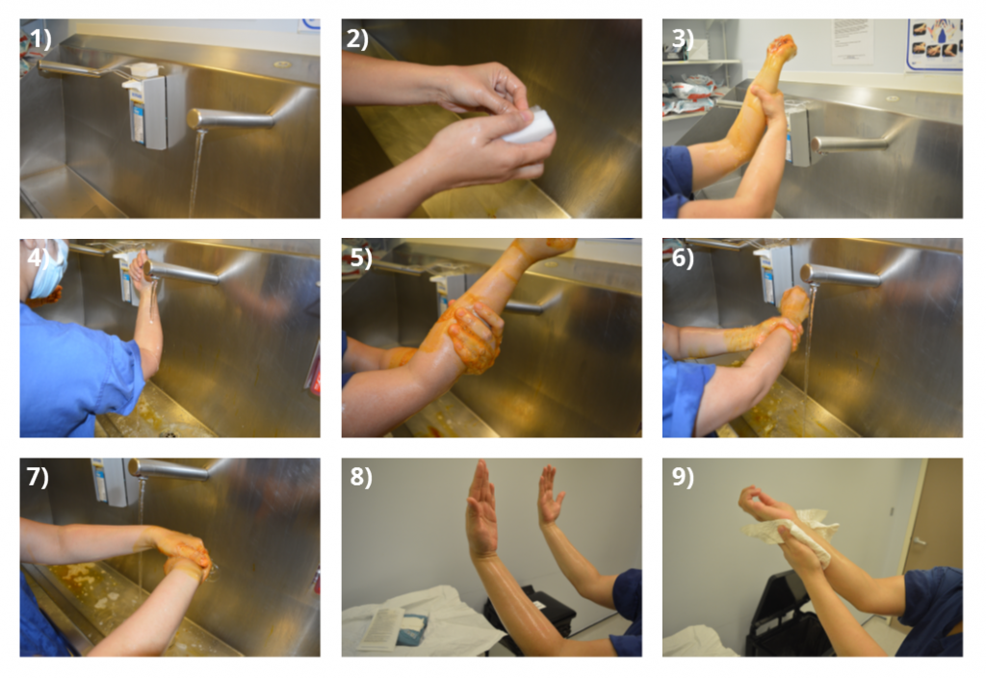

Slide 48


Slide 49



