Slide 1


Slide 2
Blood transfusion

Slide 3
Prepared by
Shimaa Kebary Elsaid
Demonstrator at medical surgical department

Slide 4
Learning objectives;
At the end of this lecture the student will be able to:
• Define Blood transfusion.
• Mention type of blood products.
• List purposes of blood transfusion.
• Discuss indications and Contraindications of blood transfusion.

Slide 5
• Discuss complications of blood transfusion.
• Explain nursing implications before, during and after blood transfusion.
• Apply nursing skills to administer blood transfusion.
• Apply nursing skills to deal with complications of blood transfusion.

Slide 6
Introduction
A variety of medical conditions result in the need for a patient to receive a blood and/or blood product transfusion. The absence of adequate testing increases the possibility of transmitting infectious diseases such as: HIV, Hepatitis viruses, and Syphilis.

Slide 7
Nursing care for these patients is centered on knowledge of the various blood products, thorough pre-assessment skills, and through the
application of accurate infusion parameters. Awareness of the signs and symptoms of early and late transfusion reactions is also key.

Slide 8
Definition
A blood transfusion is the transfer of blood or blood products from one person (donor) into a recipient.

Slide 9
Components of blood:
• Formed elements-Cells:
– Erythrocytes (RBCs)
– Leukocytes (WBCs)
– Thrombocytes (platelets)
• Plasma:
– 90% water
– 10% solutes
– Proteins, clotting factors

Slide 10
Blood products:
• Whole blood
• Packed RBC (PRBC)
• Platelets
• Fresh Frozen Plasma (FFP)
• Gra Cryoprecipitate
• Factor VIII
• Albumin

Slide 11
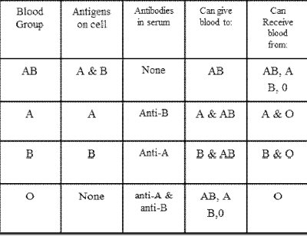

Slide 12
1- Whole blood
Composition:
Red Blood Cells
White Blood Cells
Plasma
Platelets
Hematocrit
Clotting Factors

Slide 13
Purpose:
Volume replacement
Increase oxygen-carrying capacity
Indications:
Significant blood loss (>25% blood lost, i.e. hemorrhage)
Newborn babies with hemolytic disease

Slide 15
2- Packed Red Blood Cells (RBCs)
Composition:
RBCs with little plasma (hematocrit about 75%)
Some platelets and WBCs remain
Purpose:
Increase RBC mass and oxygen-carrying capacity
Assists the body to rid carbon dioxide and other waste products
Indications:
Symptomatic and chronic anemia
Blood loss due to injury or surgery

Slide 16
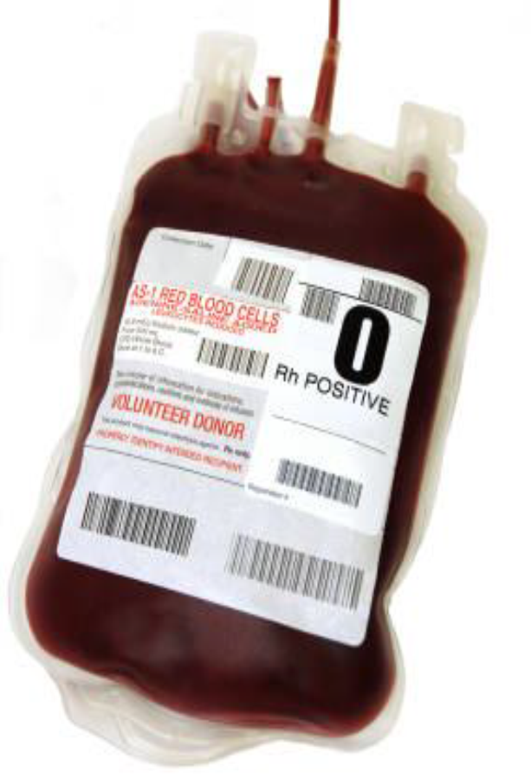

Slide 17
3- Platelets
Composition:
Platelets
Plasma
RBCs
WBCs

Slide 19
Purpose:
Helps to stop bleeding (restore clotting ability)
Essential for coagulation of blood
Indications:
Decreased platelet count
Hemophilia
Thrombocytopenia
Platelet dysfunction (End stage renal disease, DIC)

Slide 20
4- Fresh Frozen Plasma
Composition:
Plasma
All coagulation factors
Purpose:
Increase blood plasma
Replenish clotting factors
Indications:
Bleeding in patients with coagulation factor deficiencies; plasmapheresis
Burn, Liver Failure and Severe Infection

Slide 22
5- Albumin
Composition:
Albumin
Purpose:
Volume expansion leading to increased blood volume
Indications:
Hypoproteinemia
Burns , Shock, Trauma
Surgery and Infections

Slide 23
6- White Blood Cells (WBCs)
Composition:
WBCs or leukocytes suspended in 20% of the plasma
Purpose:
Increase number of WBC’s
Replaces WBC’s that are functioning abnormally

Slide 24
Indications:
Sepsis (not responsive to antibiotics)
Persistent fever
Granulocytopenia

Slide 25
Purposes of blood transfusion
 Restore blood volume
 Replace clotting factors
 Improve oxygen carrying capacity
 Restore blood elements that are depleted
 Prevent complications
 Treat anemia that has failed to respond to other treatments; anemia is a condition where a person has low levels of red blood cells.
 Treat inherited blood disorders, such as thalassemia or sickle cell anemia.

Slide 26
Indications
 Hemorrhaging
 Severe anemia, (causing shortness of breath, dizziness, congestive heart failure)
 Acute blood loss of more than 30 percent of blood volume.
 Surgery
 Cancer
 Gastrointestinal bleeding
 Infection, liver failure or severe burns

Slide 27
Contraindications
 Severe injuries and concussions.
 Hemorrhage and thrombosis of the cerebral vessels.
 Decompensated heart disease.
 In hypertensive disease.
 Acute glomerulonephritis (in the initial phase).

Slide 28
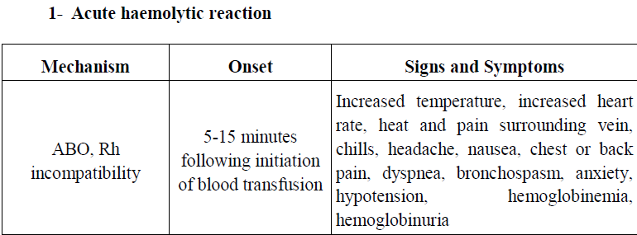
Complications of blood transfusion

Slide 29
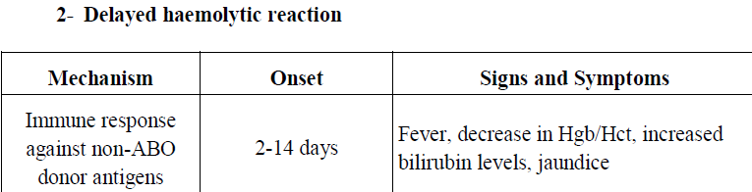

Slide 30
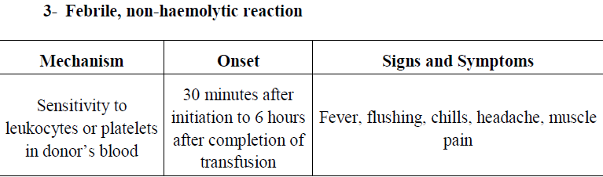

Slide 31
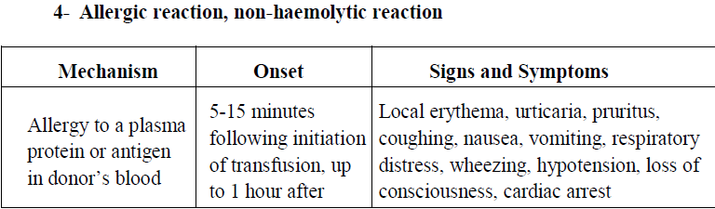

Slide 32
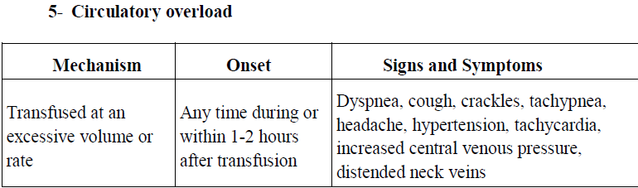

Slide 33
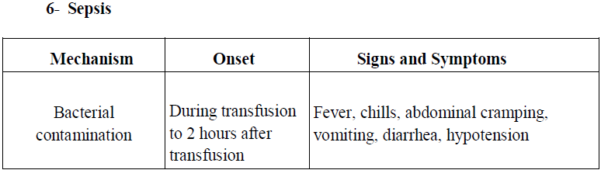

Slide 34
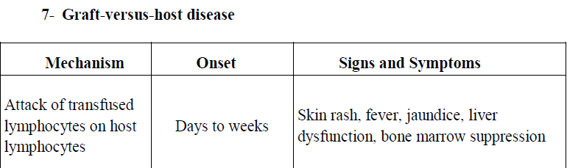

Slide 35
Equipment:
• Blood set
• IV pole
• Gloves
• Blood product
• Saline
• Venipuncture equipment

Slide 36
Nursing Implications before blood transfusion (Preparation):
 Check physician’s Review hospital policy
 Ensure informed and written consent is provided
 Check laboratory values
 Verification procedure occurs with two nurses orders

Slide 37
✓ Compatibility of blood type and Rh factor
✓ Inspect the blood product for discolouration, clots, leaking, or presence of bubbles
✓ Check the unit number on the unit of blood and on the form
✓ Check the expiration date and time on unit of blood
✓ Ask client to state first and last name
✓ Check patient’s identification number on wristband and record
✓ Blood must be initiated within 30 minutes of arrival from lab to floor

Slide 38
Nursing Implications during blood transfusion
 Monitor vital signs closely during the blood transfusion
 Inspect condition of IV site
 Observe for signs and symptoms of a reaction

Slide 39
Nursing Implications after blood transfusion
 Dispose of materials/equipment
 Observe patient for clinical improvements
 Assess the laboratory values for effectiveness of transfusion

Slide 40
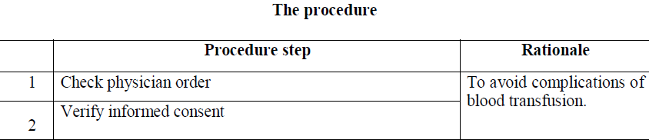

Slide 41
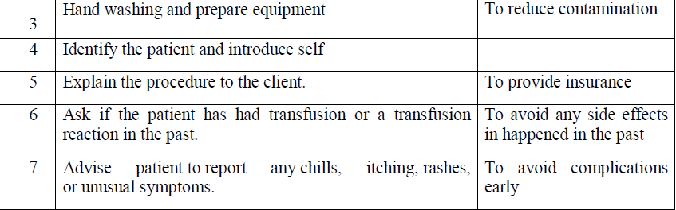

Slide 42
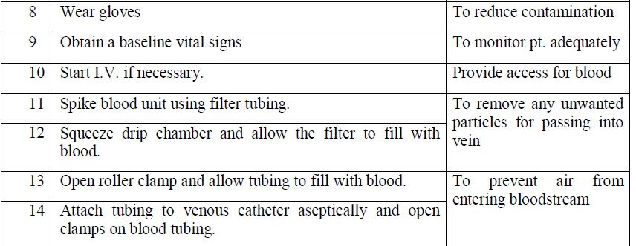

Slide 43
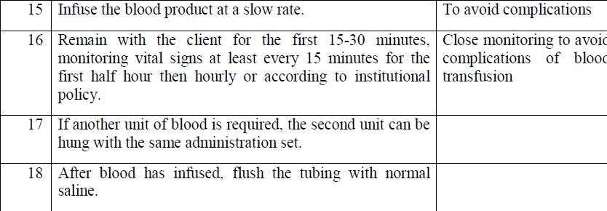

Slide 44
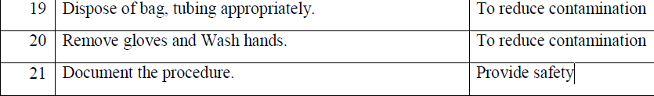

Slide 45
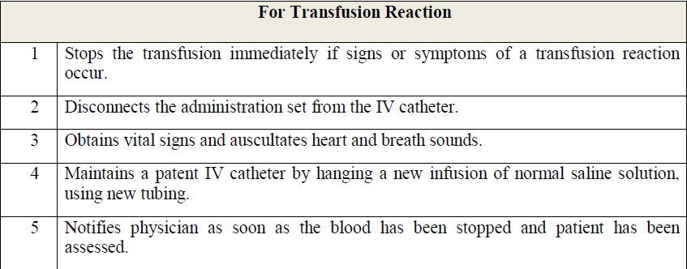

Slide 46
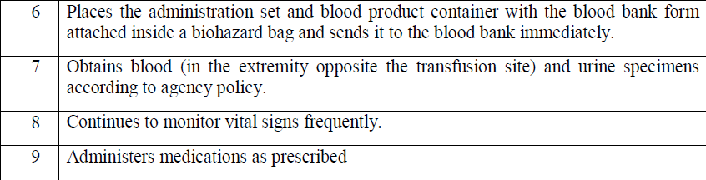

Slide 47


