Slide 1


Slide 2
Suture removal

Slide 3
Prepared by
Shimaa Kebary Elsaid
Demonstrator at medical surgical department

Slide 4
Definition of suture:
Threads of natural, synthetic, or metallic material intended to sew a wound or incision together (i.e., approximate the edges and provide a method for wound closure).

Slide 6
Indication of suturing
• Used to close cuts and wounds in skin (Accidental or intentional).
• Allow the skin to heal naturally when it otherwise may not come together.
• Surgeons use stitches during operations to tie ends of bleeding blood vessels and to close surgical incisions.

Slide 7
Types of sutures
• Absorbable or non-absorbable (Natural or synthetic).

Slide 8
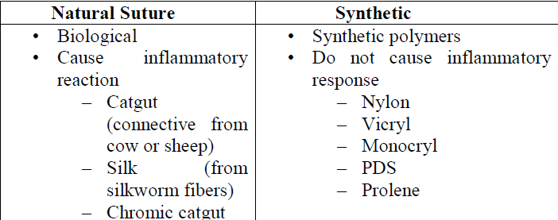

Slide 9
Suture removal
Suture removal is a procedure to take sutures out of skin.
Goal:
Remove skin sutures from a healed wound without damaging newly formed tissue.

Slide 10
Time of suture removal:
depend on:
Shape, size and location of the sutured incision
Absence of inflammation, drainage and infection, patient general condition.
Usually, for sufficient healed wound, sutures are removed 7 to 14 days after insertion.
A suture may consist of only one thread (i.e., monofilament) or several threads (i.e., multifilament) that are frequently twisted or braided.

Slide 11
Equipment
1. Sterile gloves & gloves
2. Sterile dressing
3. Water proof
4. Sterile scissors &sterile forceps
5. Antiseptic cleaning agent
6. Normal saline

Slide 12
Procedure for suture removal:

Slide 13
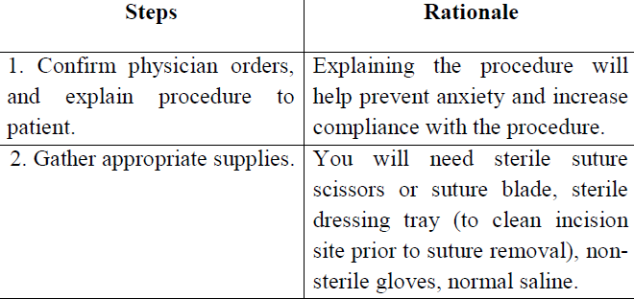

Slide 14
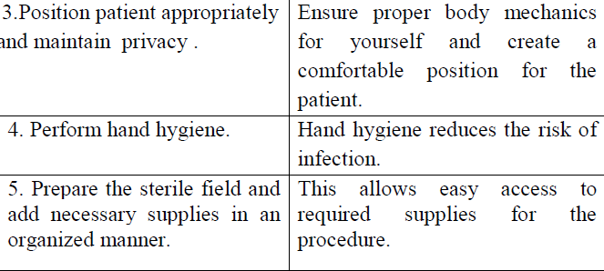

Slide 16
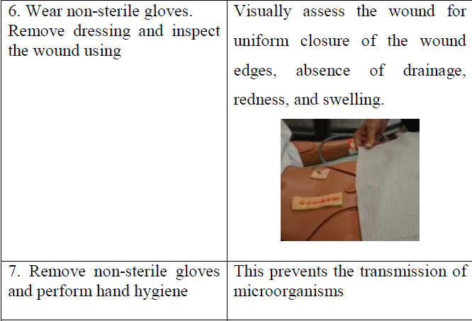

Slide 17
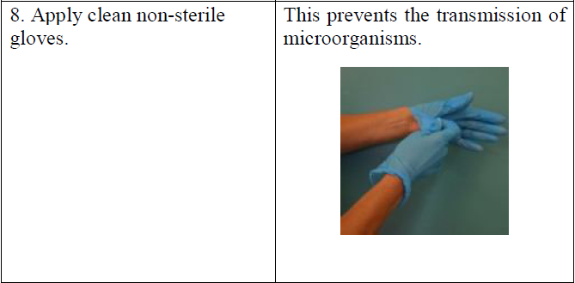

Slide 18
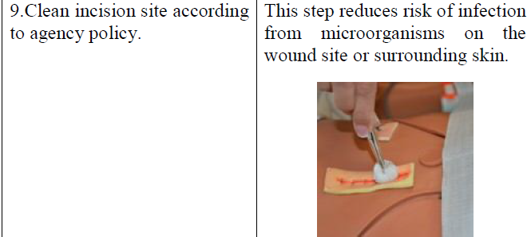

Slide 19
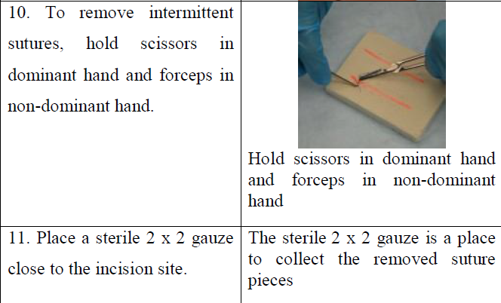

Slide 20
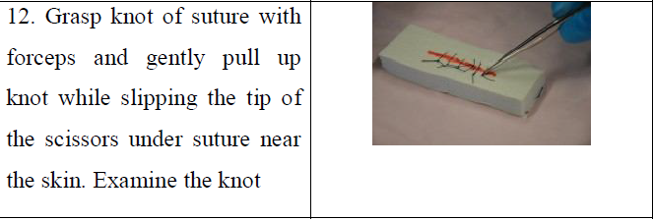

Slide 21
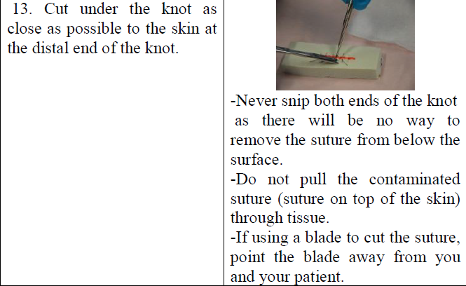

Slide 22
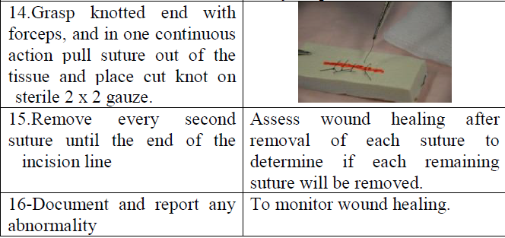

Slide 23
Complications of stitches removing
1. Wound infection:
If signs of infection begin, such as redness, increasing pain, swelling, and fever, contact a doctor immediately.

Slide 24
2. Wound reopening:
If sutures are removed too early, or if excessive force is applied to the wound area, the wound can reopen. The doctor may re stitch the wound or allow the wound to close by itself naturally to lessen the chances of infection.
3. Excessive scarring:
All wounds will form a scar, and it will take months for a scar to completely contract and remodel to its permanent form.

Slide 25
4. Keloid formation:
A keloid is a large, firm mass of scar like tissue. This scarring extends beyond the original wound and tends to be darker than the normal skin.
5. Hypertrophic scars:
Bulky scars can remain within the boundaries of the original wound. These occur mostly around joints.

Slide 26


