Slide 1


Slide 2
Oral drug administration

Slide 3
Prepared by
Shimaa Kebary Elsaid
Demonstrator at medical surgical department

Slide 4
Learning objectives;
At the end of this lecture the student will be able to:
1- Define Oral drug administration.
2-Mention type of oral drug administration.
3-Discuss purpose and contraindication oral drug administration.
4-Perform the steps of oral drug administration

Slide 5
Oral drug administration
Definition
The administration of a tablet, a capsule, a solution or other liquid of medication by mouth.
By adequate amount of water given to lubricate or dissolve the solid medications
or dilute the liquid forms for swallowing.
Oral administration is a part of enteral administration,

Slide 6
which also includes:-
1-Buccal, dissolved inside the cheek
2-Sublabial, dissolved under the lip
3-Sublingual administration, dissolved under the tongue

Slide 7
Purpose
1-The oral route is probably the easiest.
2- Most often used route for administering medications.
3-These medications have the potential to exert both local and systemic effects.
4 -Patients are usually able to take oral medications independently with very few
problems.

Slide 8
Contraindication
1- If a patient is nauseated, is vomiting, has decreased intestinal motility.
2 -NPO (receiving nothing by mouth), cannot swallow.
3-Has a nasogastric tube in place, another route must be used.

Slide 9
Equipment
1-Cup of water, towel.
2- Tray of medication.
3- Medication (table, capsule).
4-Gloves.

Slide 10
The procedure

Slide 11
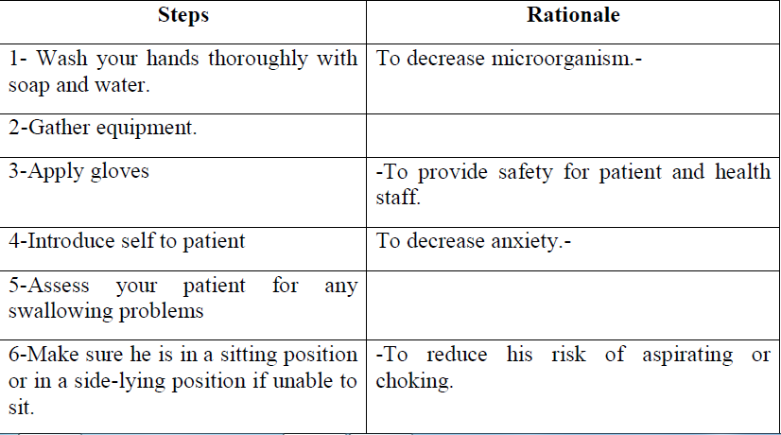

Slide 12
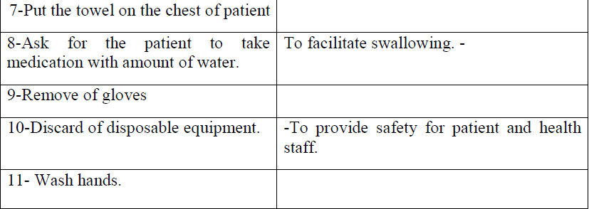

Slide 13
Buccal drug administration
Involves placing a drug between your gums and cheek, where it also dissolves and is absorbed into your blood. Sublingual medications are given under the tongue.

Slide 15
Advantages
1-The medication absorbs quickly.
2- These types of administration can be important during emergencies when you need the drug to work right away, such as during a heart attack.
3-These drugs do not go through the digestive system, so they aren’t metabolized through your liver.

Slide 16
4-This means you may be able to take a lower dose and still get the same results.
5-Drugs that are absorbed under the tongue or between the cheek and gum can be easier to take for people who have problems swallowing pills.

Slide 17
Disadvantages
1-Eating, drinking, or smoking, can affect how the drug is absorbed and how well it works.
2-These forms don’t work for drugs that need to be processed slowly by your system.
3-Any open sores in your mouth can also become irritated by the medication

Slide 18
Eye drug administration
Learning objectives;
At the end of this lecture the student will be able to:
1-Define eye drug administration.
2-Discuss indications of eye drug administration.
3-Describe procedure of eye drug administration.

Slide 19
Eye drug administration
Definition:-
Given into the eye by drops, gel, or ointment. Ophthalmic medications include drops, ointments.

Slide 20
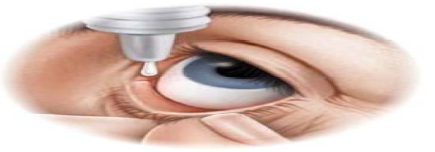

Slide 21
Indications
1-They are often prescribed following cataract removal and to treat such eye
conditions as glaucoma and infections.
2- They are also used to soothe irritated tissue, to dilate or constrict the pupils,
and to provide anesthesia.

Slide 22
Equipment
1-Gauze, gloves, tissue.
2-Medication (drops, ointment).

Slide 23
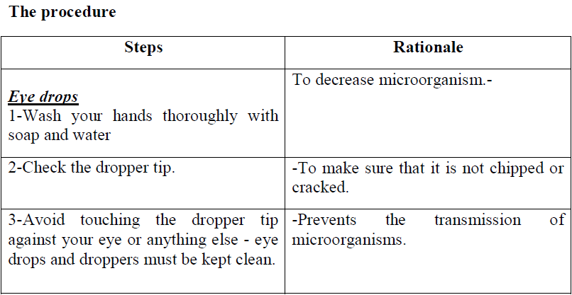

Slide 24
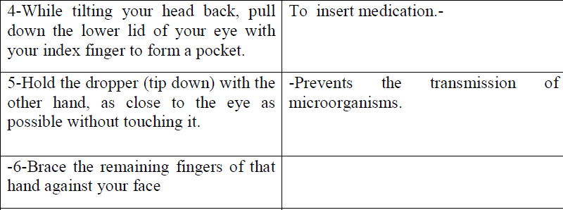

Slide 25
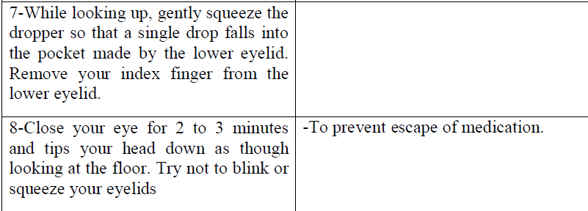

Slide 26
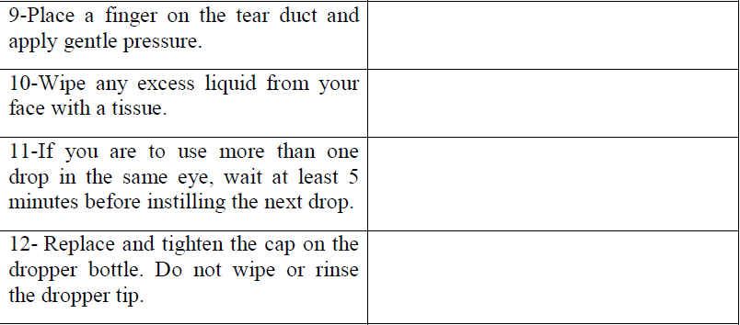

Slide 27
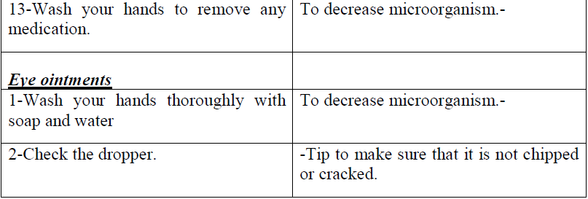

Slide 28
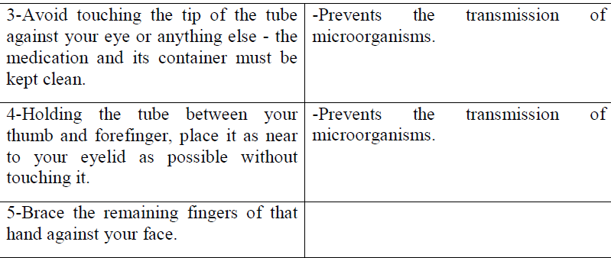

Slide 29
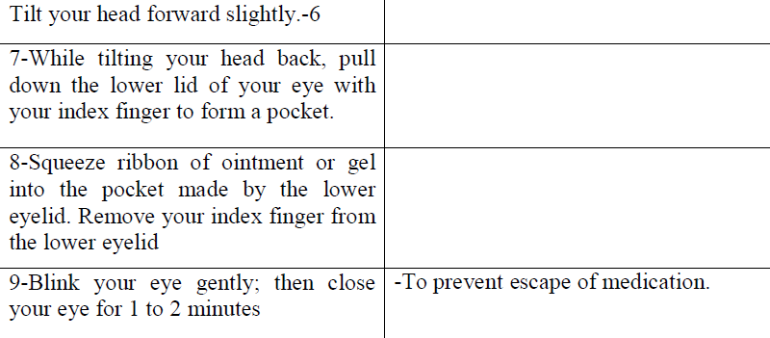

Slide 30
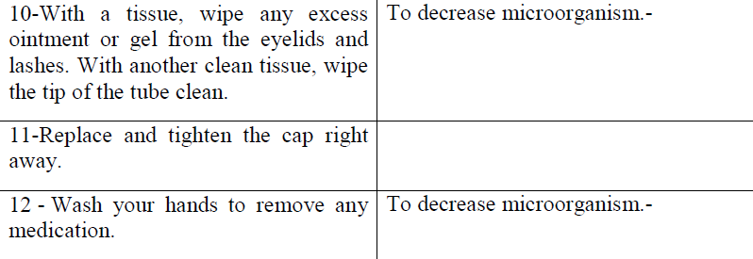

Slide 31
Ear drug administration
Medications instilled into the ear are called otic medications.

Slide 33
Purpose:-
1-They soften wax
2-Relieve pain
3-Treat infection

Slide 34
Equipment
1-Gauze, gloves.
2-Medication (eardrops)

Slide 35
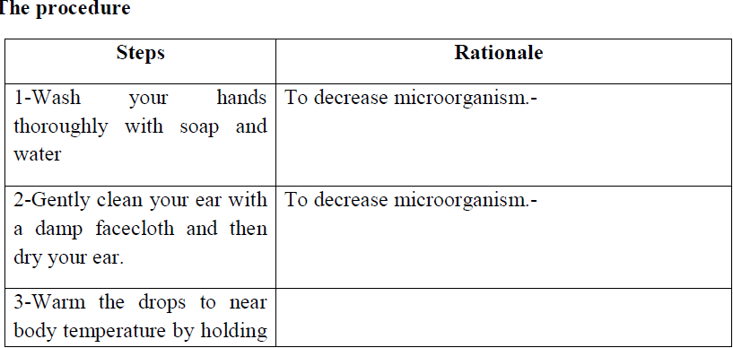

Slide 36
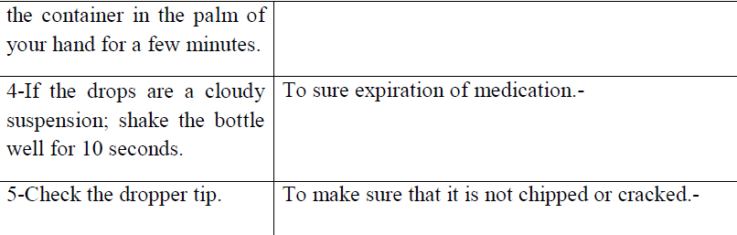

Slide 37
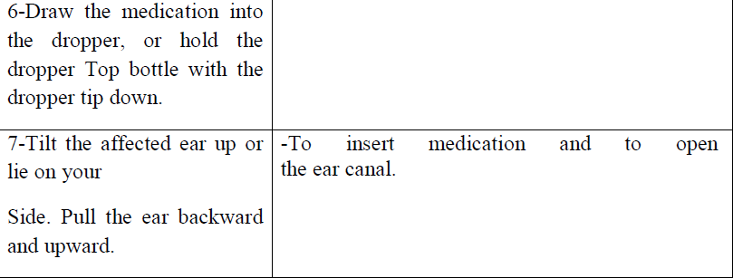

Slide 38
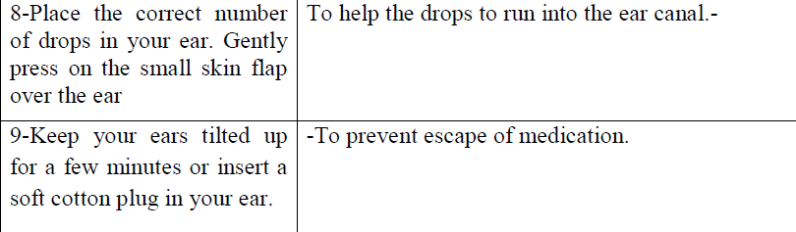

Slide 39
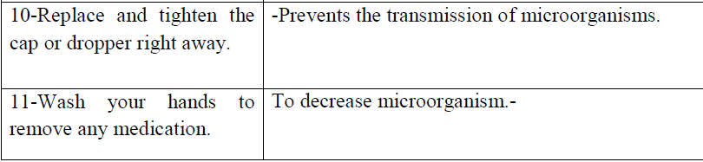

Slide 40
Nasal drug administration
Learning objectives;
At the end of this lecture the student will be able to:
1- Define Nasal drug administration.
2- Discuss purpose of Nasal drug administration.
3- Describe of procedure of Nasal drug administration.

Slide 41
Nasal drug administration
Definition
Is a route of administration in which drug are insufflated through the nose.

Slide 43
Purpose
1-Nasal drops or sprays help relieve sinus congestion.
2-Used to common upper respiratory symptoms.
3-Treat sinus infections.

Slide 44
Equipment
1-Gauze, gloves
2-Medication (drops, spray)

Slide 45
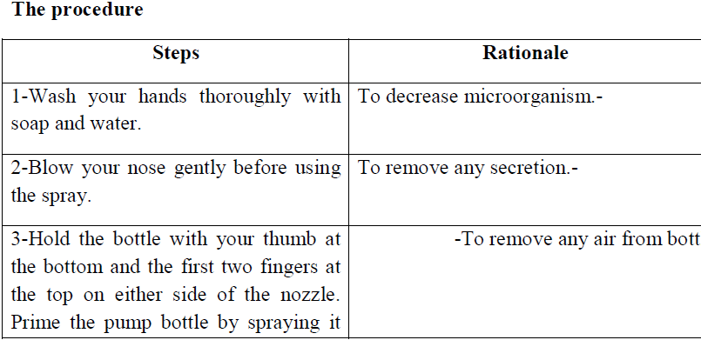

Slide 46
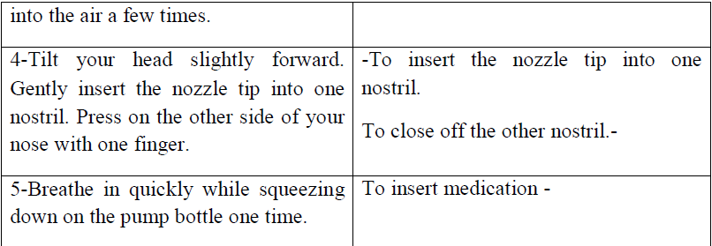

Slide 47
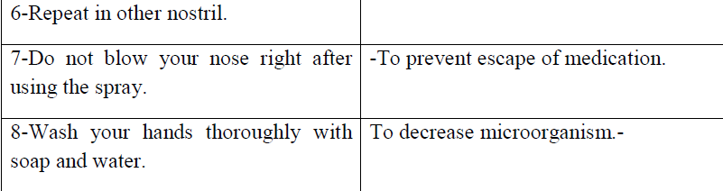

Slide 48
Rectal drug administration
Learning objectives;
At the end of this lecture the student will be able to:
1-Define rectal drug administration.
2- Discuss purpose and Contraindication of rectal drug administration.
3- Describe procedure rectal drug administration.

Slide 49
Rectal drug administration
Definition
Medication inserted into the rectum.

Slide 50
Definition of suppository
A suppository is a solid dosage form that is inserted into the rectum (rectal suppository), vagina (vaginal suppository) or urethra (urethral suppository), where it dissolves or melts and exerts local or systemic effects.
They are used to deliver both systemically and locally acting medications.

Slide 53
Purpose
1-Promote defecation or for their systemic effects for relieving nausea.
2- Providing analgesia.
3- Reducing fever.
4-Treat constipation or hemorrhoids

Slide 54
Contraindication
1-Rectal medications should not be used for patients who have had rectal
surgery.
2-Have active rectal bleeding.

Slide 55
Equipment
1-Gauze, gloves, lubricant (KY gel)
2-Medication (suppositories)

Slide 56
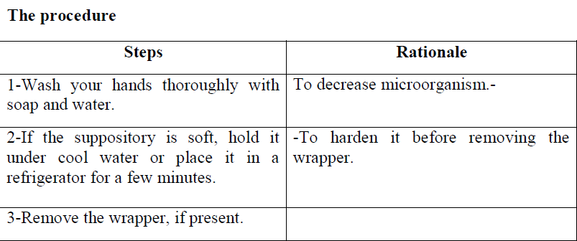

Slide 57
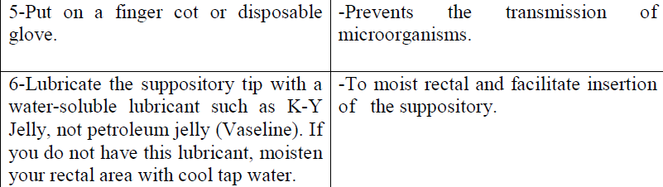

Slide 58
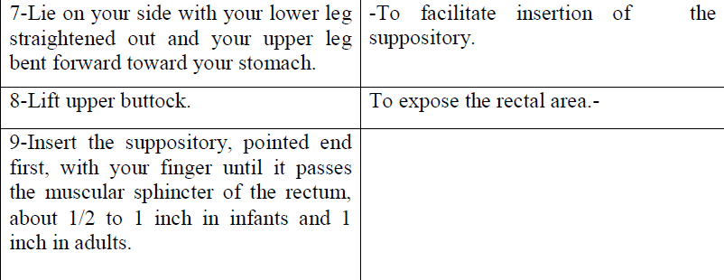

Slide 59
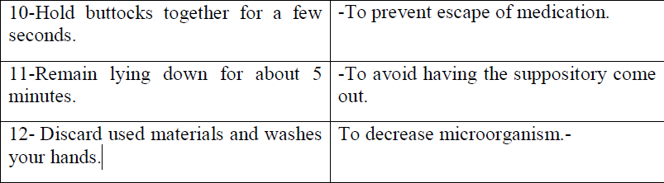

Slide 60


