Slide 1


Slide 2

Hand washing
Prepared by
Asmaa Ragab

Slide 3

introduction
The most important and the most basic technique in preventing and controlling the transmission of infections is hand washing.

Slide 4

Definition
Hand washing is a vigorous, brief rubbing of all surfaces of the hands lathered in soap followed by rinsing under a stream of water. It involves removal of soil, dirt and pathogens by means of friction with soap or detergent and running water.

Slide 5
Purpose
1- Hand washing is a basic technique for infection control
2- To remove soil and transient organisms from the hands and to reduce total microbial counts overtime
3- Prevent transfer of organisms from the environment to the client and from the client to the health care worker

Slide 6
Indications
Contact with any client, especially one with wound drainage, requires thorough hand washing
Before and after client contact
Before performing invasive procedures such as urinary catheterization
After removing gloves

Slide 7
5- After contact with a source of microorganisms like blood or body fluid, mucous membranes, non-intact skin or inanimate object that might be contaminated
6-Before charting or preparing medications
7-Before leaving for a break

Slide 8
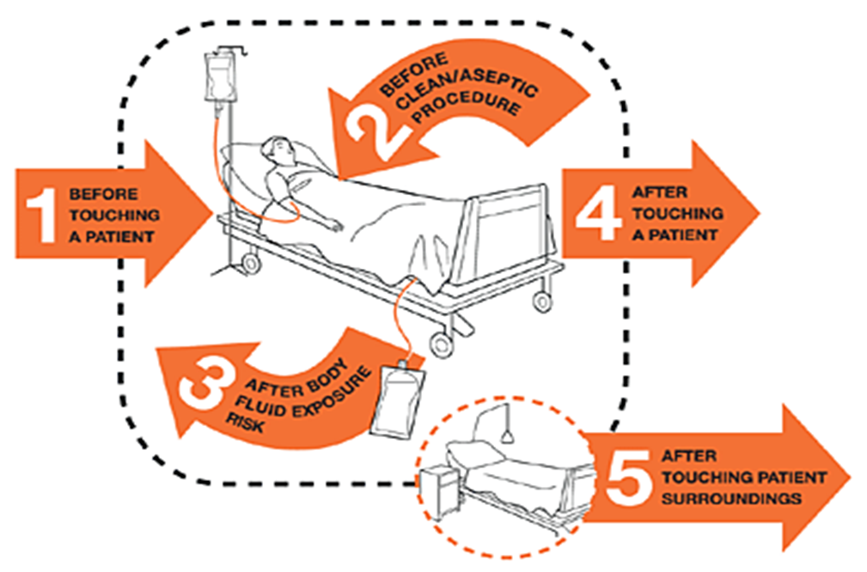

Slide 9
Preparations
Easy to reach sink with warm running water
.Antimicrobial or regular soap
.Towels

Slide 10
Rationale | Steps
Open cuts or wounds can harbor high concentration of microorganisms. | Inspect surface of hands for break or cuticles. | 1
Requires lengthier hand washing | Inspect hands for heavy soiling | 2
Nails should be short and filed because most microbes on hands come from beneath fingernails | Inspect nails for length | 3
Use of antimicrobial soap is encouraged for clients who are immune suppressed | Assess clients risk for or extent of infection | 4
Provides complete access to fingers. Hands and wrists. Wearing of rings increase number of microorganisms on hands. | Push wrist watch and long uniform sleeves above wrist. Avoid wearing rings; if worn, remove during washing | 5

Slide 11
Inside of sink is contaminated area. Reaching over sink increases risk of touching edge, which is contaminated | Stand in front of sink, keeping hands and uniform away from sink surface | 6
 | Turn on water | 7
Microorganisms travel and grow in moisture | Avoid splashing water against uniform | 8
Warm water removes less of the protective oils than hot water | Regulate flow of water so that temperature remains warm. | 9
Water flows from least to most contaminated area, rinsing microorganisms into the sink. | Wet hands and wrists thoroughly under running water. Keep hands and forearms lower than elbows during washing | 10

Slide 12
Use of antiseptic exclusively can be drying to hands and can cause skin irritations. | Apply adequate amount of soap or antiseptic lathering thoroughly | 11
Friction and rubbing mechanically loosen and remove dirt and transient bacteria. Interlacing fingers and thumbs ensure that all surfaces are cleaned | Wash hands for at least15 seconds or more : A. rub hands palm to palm B. rub back of each hand with palm of other hand with fingers interlaced C. rub palm to palm with finger interlaced D. rub with back of fingers to opposing palms with finger interlocked E. rub each thumb clasped in opposite hand washing using a rotational movement F. rub tips of fingers in opposite palm in a circular motion d. rub each wrist | 12

Slide 13
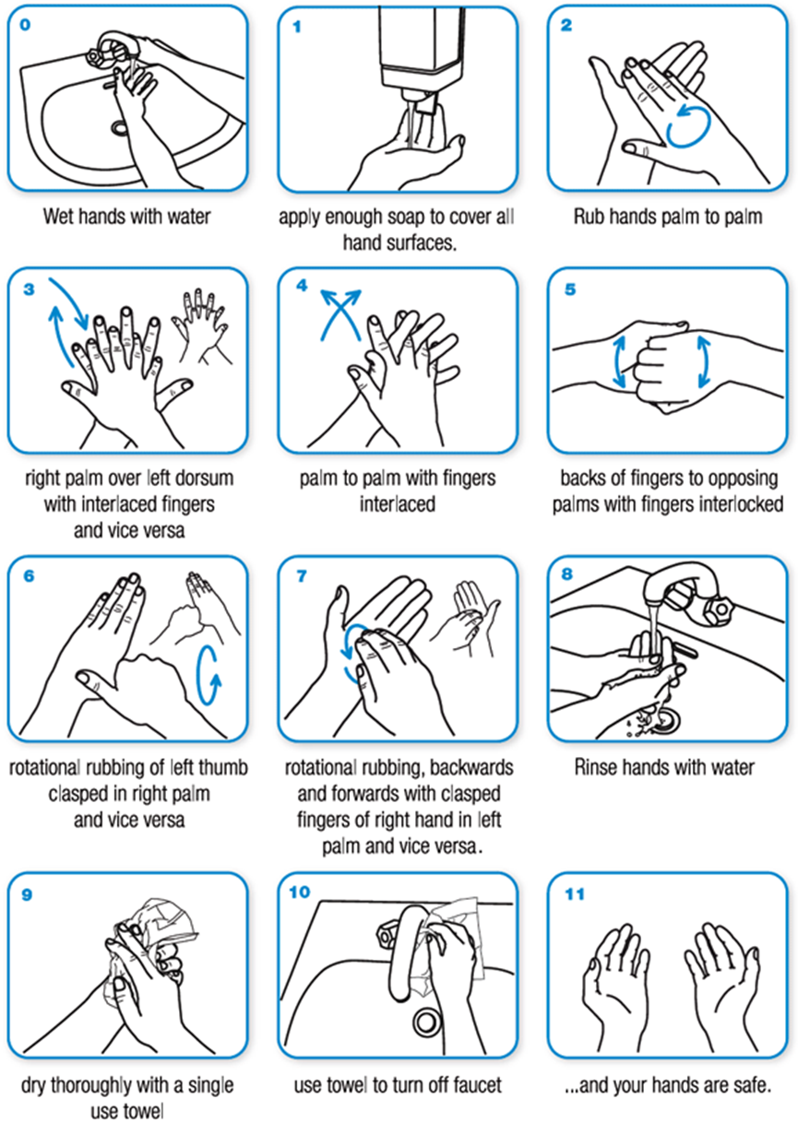

Slide 14
Rinse mechanically washes away dirt and microorganisms | Rinse hands and wrists thoroughly, keeping hands down and elbows up | 13
 | Repeat steps and extend period of washing if hands are heavily soiled | 14
Drying from cleanest to least clean area avoid contamination | Dry hands thoroughly from fingers to wrists and forearm with towels, single use cloth or warm air dryer | 15
Wet towels and handles allow transfer of pathogens | Turn off water with foot or elbow pedals. To turn off hand faucet, use clean, dry paper towel, avoid touching handles with hands. | 16
 | Used paper towels should be disposed of according to the local infection control policy. | 17

Slide 15
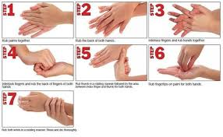

Slide 16

Scrubbing

Slide 17
Definition :
Scrubbing’ or ‘scrub’ is a term used to describe the process of hand and forearm decontamination required by the surgical team prior to commencing any surgical or invasive procedure.

Slide 18
Purpose
To remove dirt and transient microorganisms
To reduce the risk of transmission of microorganisms to patients
To reduce the risk of cross infection among patients
To reduce the risk of transmission of infectious agents to oneself
To prevent iatrogenic infections

Slide 19

Equipment
1 soap /antiseptic detergent
2 running warm water
3 nail brush in antiseptic lotion
4 towels (sterile)
5 mask and overhead

Slide 20
Procedure
Rationale | Steps
To prevent the transmission of pathogens by direct and indirect contact with patients. | After medical hand washing, wear overhead and mask | 1
 | Turn on water using foot/elbow and regulate the flow and temperature of the water. -Open package containing nailbrush lie the brush on the back of the scrub sink still in the opened package. | 2

Slide 21
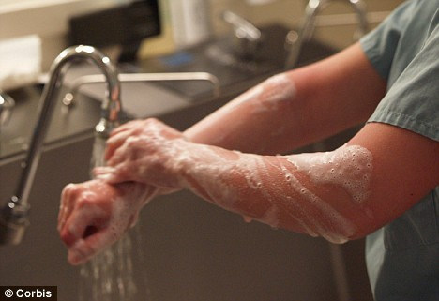
Water flows from fingertips to elbows. Fingertips are considered to be cleaner than the elbows. | Wet hands and arms under running warm water and lather with soap/detergent to 5cm above the elbows(hands need to be raised above the elbows at all time) | 3
 | Use firm circular movements to wash palms, back of hands, wrists, forearm and interdigital spaces of 20-25 seconds | 4
Rinsing removes transient bacteria from hands. | Rinse hands and arms thoroughly under running water | 5
Removes dirt and microorganisms | Clean under nails of both hands with nail pick/nail brush | 6

Slide 22
 | Scrub nails of each hand with 15 strokes using antimicrobial agent | 7
Scrubbing loosens resident bacteria that adhere to skin surfaces | Holding the brush perpendicular scrub palm, each side of thumb and fingers and posterior side of hand with 10 strokes each. | 8
Scrubbing is performed from cleaner area to less clean area. | Scrub from wrist to 5cm above each elbow that is lower arm, upper forearm and antecubital fossa to marginal area above elbows. | 9

Slide 23
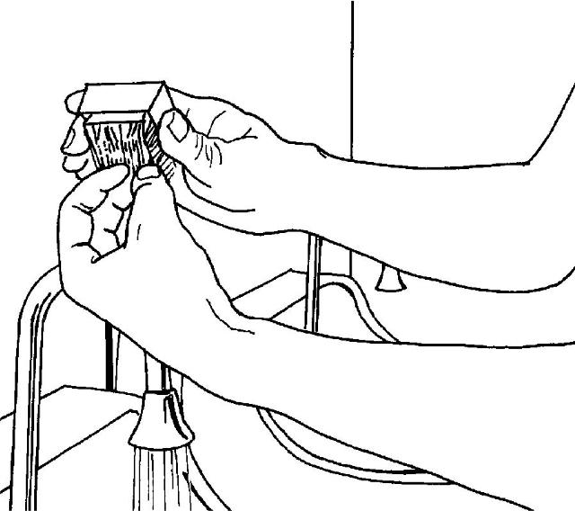
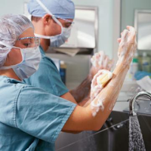
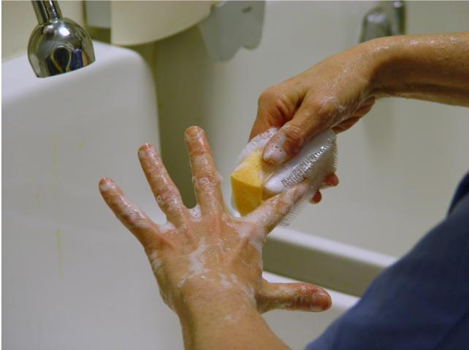

Slide 24
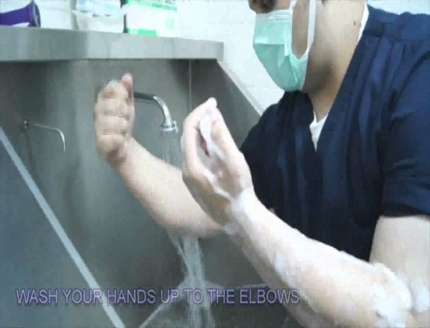
Scrubbing time can be lengthened according to agency policy/ according to the degree of contamination of hands | Entire scrub should last for 3- 5 minutes | 10
 | Discard brush and rinse hands from fingertips to elbows | 11
Tap and sides of sink are considered to be contaminated | Take care not to touch the tap or sides of sink during the procedure | 12

Slide 25
Drying prevents chapping and facilitates donning of gloves | Use a sterile towel to dry one hand moving from fingers to elbows. | 13
 | Repeat drying of the other hand using a different towel. Use one side to dry one hand and reverse side for other hand, if only one towel is available | 14
 | Discard towel. Proceed with sterile gowning | 15

Slide 26

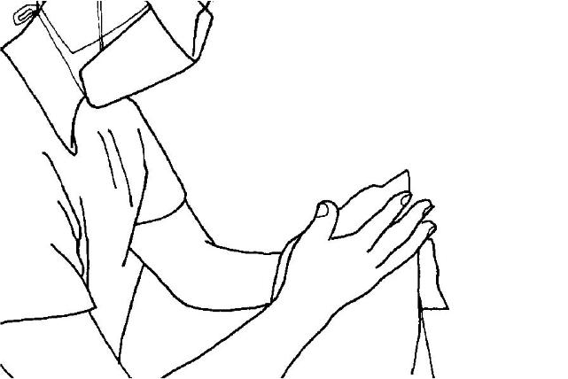
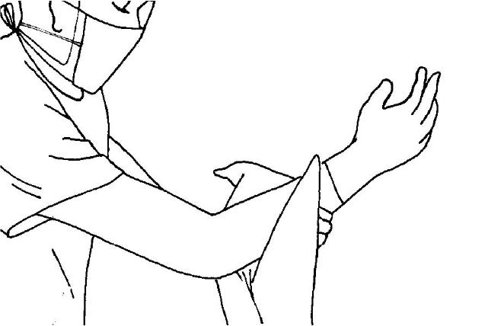
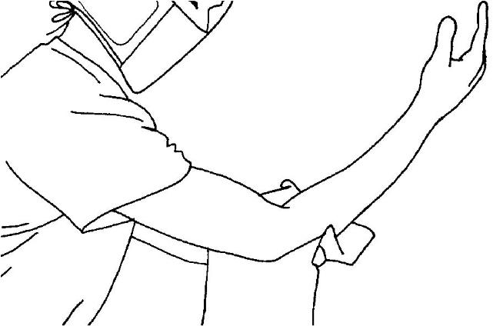

Slide 27

Thank you

