Slide 1
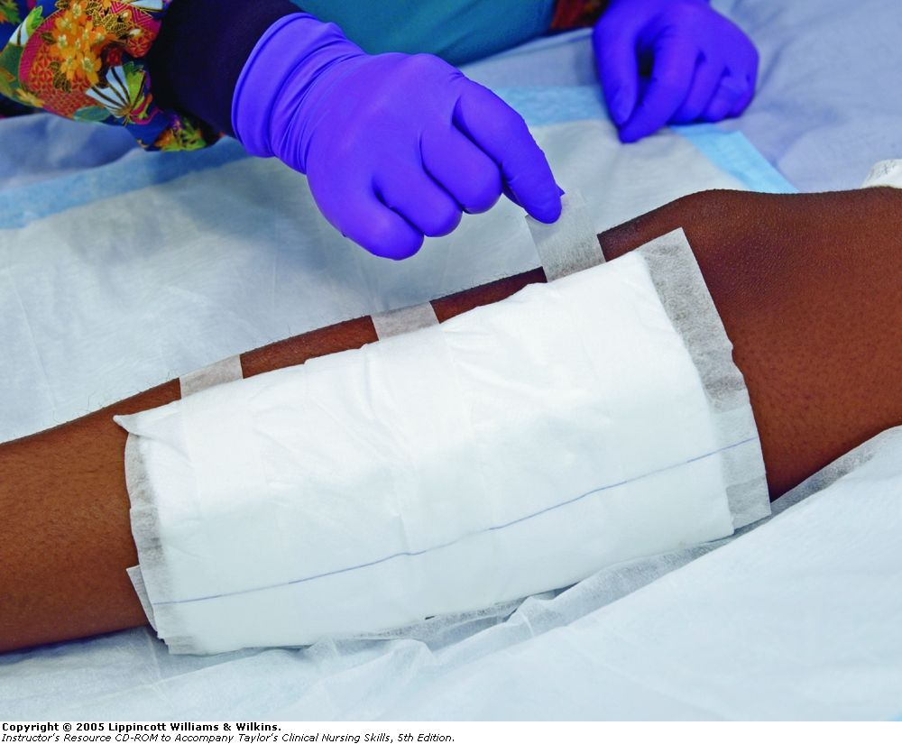
Wound dressing
Prepared by
Asmaa Ragab

Slide 2
Definition:
Process of applying protective sterile covering of gauze of the material to wound and giving necessary care by technique.

Slide 3
Purpose
1- To promote wound healing by primary intention .
2- To prevent infection .
3- To assess the healing process
4- To protect the wound from mechanical trauma .
5- To absorb drainage.
6- To prevent contamination from bodily discharge.

Slide 4
Equipment
-water proof bag .
-Mask .
-Acetone solution to loosen adhesive .
-Clean gloves.
-Sterile gloves .
-Sterile dressing set .
-Additional supplies ( extra gauze dressing , and ointment if ordered .
-Adhesive tape .
Normal saline or antiseptic solution .
Disposable bag
forceps

Slide 5
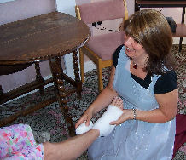
Assessment
1- Client allergies to wound cleaning agents.
2- The appearance and size of the wound .
3- The amount and character of exudates.
4- Client complaints of discomfort.
5- The time of last pain medication.
6- Signs of systemic infection ( e.g. .elevated in body temp , malaise …) .

Slide 6
:procedure
Preparation
Identify patient and introduce your self
-Explain the procedure
Put the client to comfortable position
Maintain privacy
Open sterile field and place all equipment

Slide 7
Performance
1-apply mask .gown .wash hands
2-place clean towel under working area
3-done non sterile gloves
4- Remove adhesive tape and old dressing (Use solvent to loose the tape if required ).

Slide 8
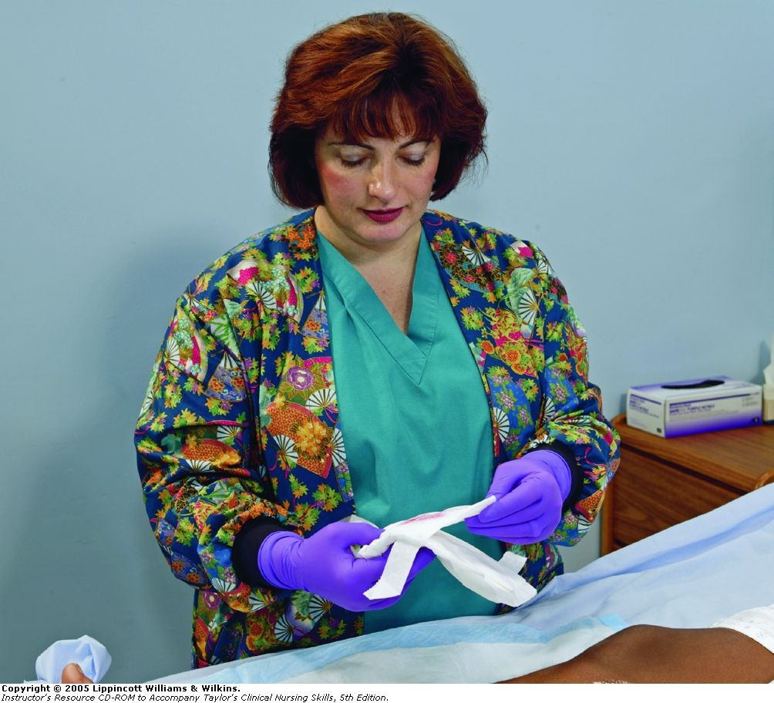
5-Assess the location , type and odor of the wound drainage and signs of infection.
6-Discard the soiled dressing in the bag as before .
7-Remove clean gloves &Wash hands or clean with antiseptic solution .

Slide 9
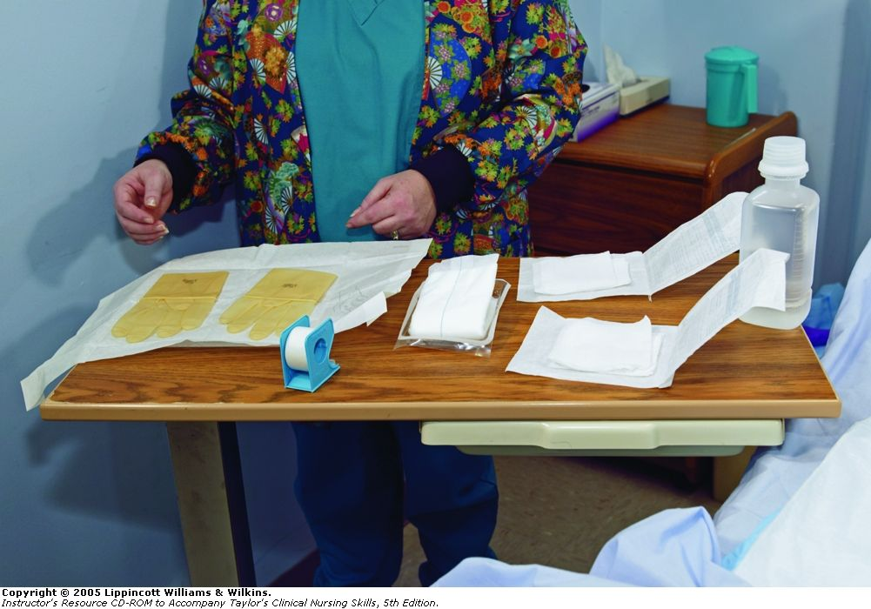
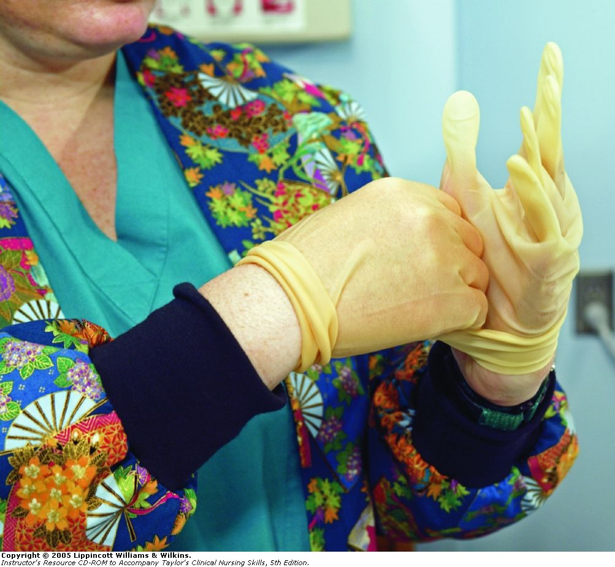
8- Setup sterile supplies .
- Open the sterile dressing set using aseptic technique .
- Place the sterile drape beside the wound .
- Open the sterile cleaning solution pour it over the gauze sponges .
9- Put on sterile gloves .

Slide 10
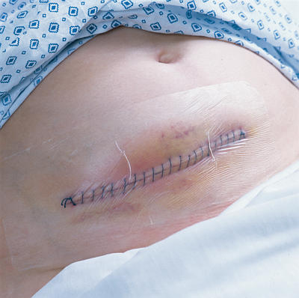
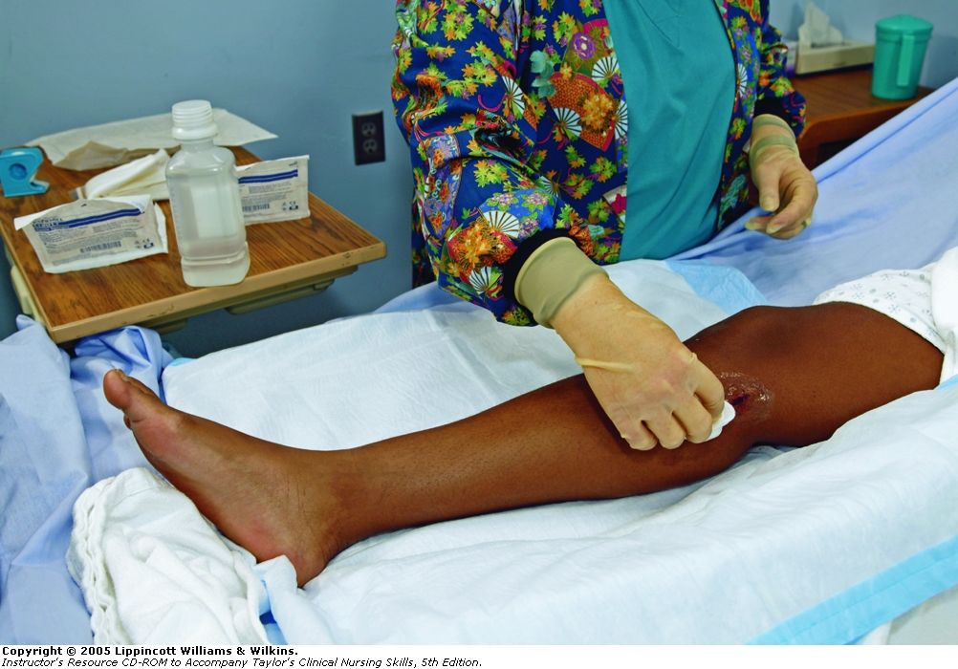
10- Clean the wound
Clean the wound using your gloved hands or forceps and gauze swabs moisture with antieseptic solutions.
Clean from least contaminated to most contaminated area
Use the cleaning method .
Use a separate swab for each stroke and discard each swab after use .

Slide 11
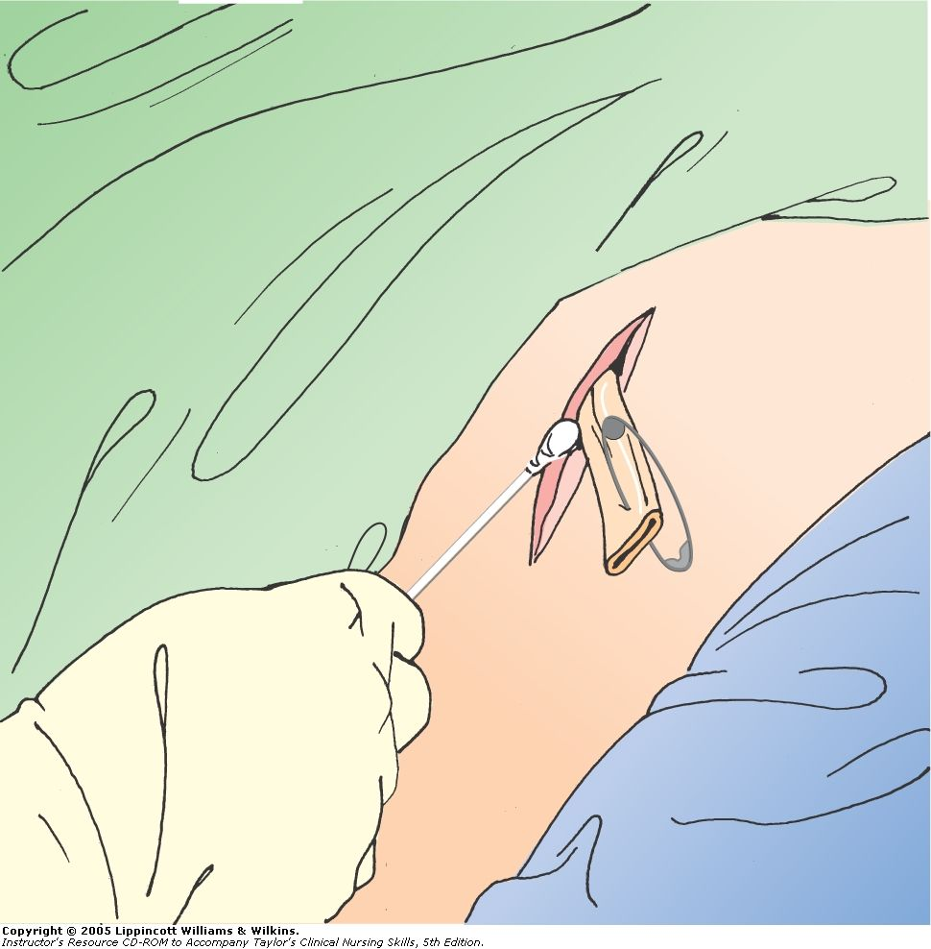
-If drain is present , clean the skin around the drain site by swabbing it half or circle .
-Dry the surrounding skin with gauze swab as required .do not dry wound or incision itself
11- Apply antiseptic ointment
If prescribed

Slide 12
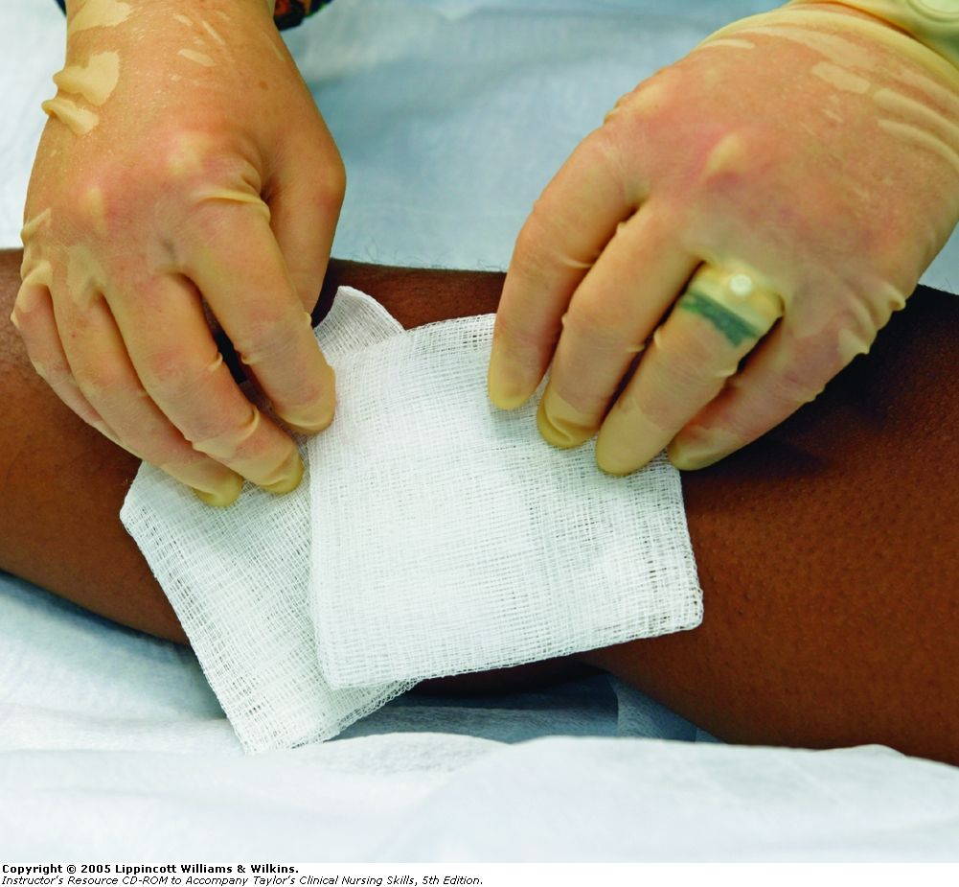
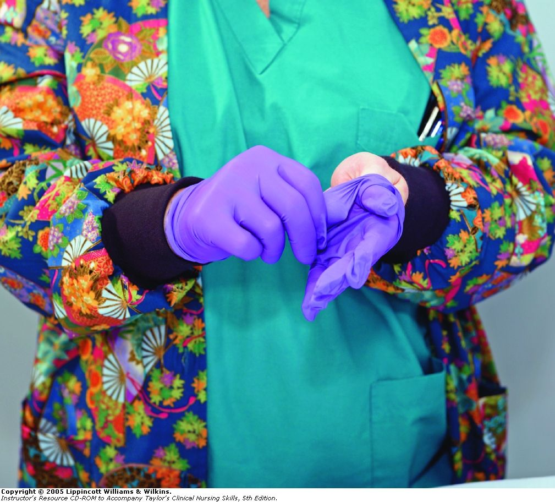
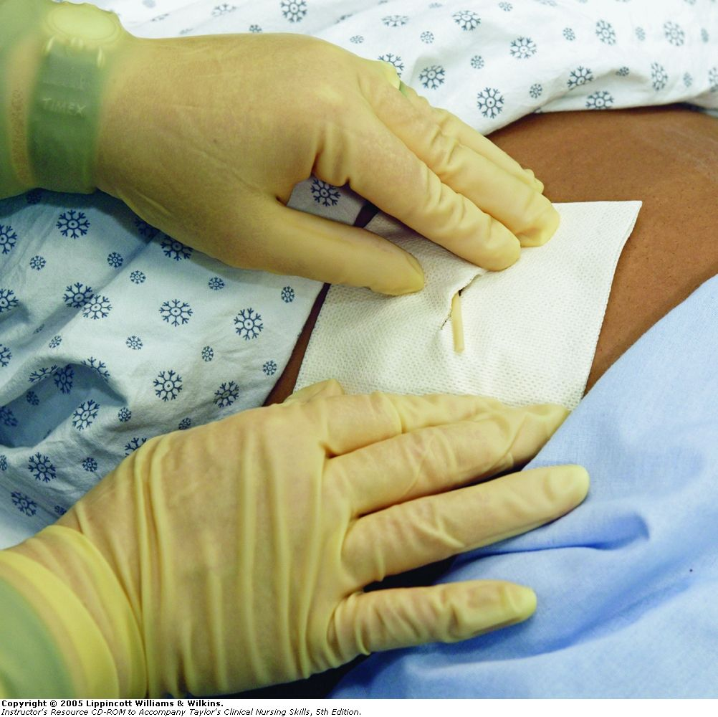
9- Apply dressing to the drain site and incision.
-Apply the sterile dressing one at a time over the drain and incision
Apply second layer if needed
-remove gloves and dispose of them .
-Secure the dressing with tape or tie.
- Wash your hands.
-Document the procedure and all nursing assessment .
Pt in comfortable position

Slide 13
Irrigation wound
Definition:
Washing or flushing out of wound\
Goal :
To clean wound
Equipments:
AS dressing
Sterile irrigating syringe
2 Sterile basin

Slide 14
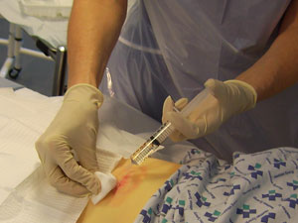
If the wound itself needs cleaning, use a syringe primed with solution in one hand and a gauze swab on the skin below the wound in the other.
Making sure that neither the syringe nor gauze come into contact with the wound, allow the solution to flow into the wound, collecting the solution in the gauze swab held below the wound.or in basin

Slide 15
Pour sterile irrigation(200-500 ml) in
Container
Done sterile gloves
Basin below wound to collect irrigation fluid
Fill syringe ..direct stream of solution into wound
Continue until cleaning
Dry
Apply dressing
Remove gloves
document

