Slide 1


Slide 2

Shock .
BY
Dr Naglaa Gamal eldien
ملحوظه سوف يتم تسجيل المحاضرة صوتيا

Slide 3

Out lines:-
Normal cellular function.
Definition of shock.
Types of shock.
Hypovolemic shock.
Cardiogenic shock.
Circulatory shock.
Neurological shock.
Anaphylactic shock.
Septic shock.

Slide 4
Introduction Normal cellular function.
Adequate blood flow to the tissues and cells requires the three components:
Adequate cardiac pump
effective vasculature circulatory system
sufficient blood volume.
If one component is impaired, perfusion to the tissue is threatened or compromised.

Slide 5
In case of shock
Inadequate blood flow to the tissues results in ******poor delivery of oxygen and nutrients to the cells******** lead to cellular starvation ,cell death, organ dysfunction progressing to organ failure, and eventual death.

Slide 6
Definition of shock.
A condition in which tissue perfusion is inadequate to deliver oxygen and nutrients to support vital organs and cellular function.
Note :-Shock affects all body systems; it may develop rapidly or slowly, depending on the underlying cause.

Slide 7
PATHOPHYSIOLOGY
In shock,
lack adequate oxygen , nutrients and blood supply to cells
cells produce energy through anaerobic metabolism.
The cell swells and the cell membrane becomes more permeable, allowing electrolytes and fluids to seep out of and into the cell.
lead to impaired sodium-potassium pump
damage to cell structures, primarily the mitochondria, are damaged and death of the cell results.

Slide 8
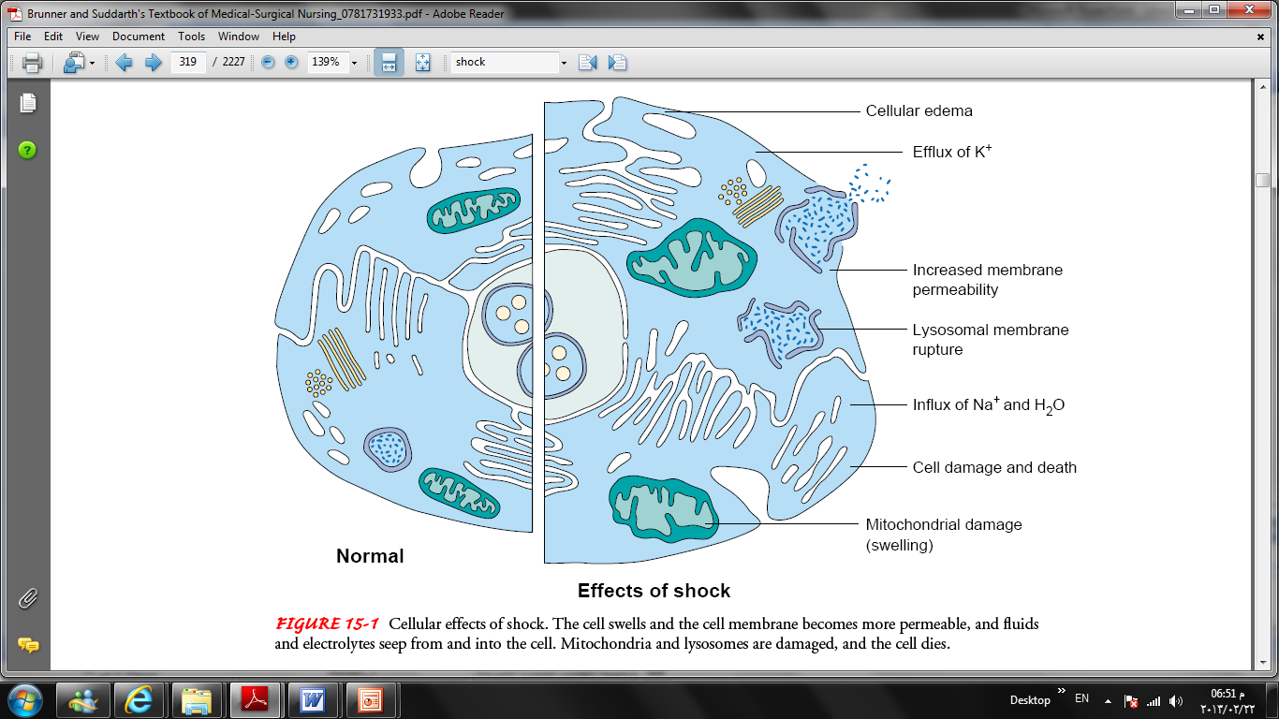

Slide 9
Stages of Shock
Initial stage:
During it, cardiac output (CO) is deceased, and tissue perfusion is threatened.
Notes:
For the most current number of human cases visit the CDC H1N1flu website: http://www.cdc.gov/h1n1flu/investigation.htm.
CDC, along with state and local health agencies, are working together to investigate this situation.
Numbers are updated every at 11:00 AM EDT.

Slide 10
Compensatory stage
In this stage:-
patient’s BP remains within normal limits.
stimulation of the SNS to release of catecholamine's (epinephrine and norepinephrine).
Vasoconstriction, increased HR, and increased contractility of the heart contribute to maintaining adequate CO.

Slide 11
The body shunts blood from organs such as the skin, kidneys, and GIT to the brain and heart.
As a result, patient’s skin is cold and clammy, bowel sounds are hypoactive, and urine output decreases in response to the release of aldosterone and ADH.

Slide 12
Nursing management in compensatory stage
Assessing tissue perfusion:-
observes for changes in level of consciousness,
vital signs (including pulse pressure),
Urinary output, skin, and
laboratory values. (serum sodium and blood glucose levels are elevated in response to the release of aldosterone and catecholamines).
monitor the patient’s hemodynamic status.
assist in identifying and treating the underlying disorder.
administer prescribed fluids and medications,
Reducing anxiety.
Promoting safety

Slide 13
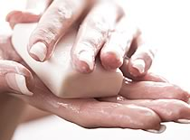
Progressive stage
In this stage, the mechanisms that regulate blood pressure can no longer compensate and the MAP falls. Patients are clinically hypotensive
the cells switch from aerobic to anaerobic metabolism to produce energy, and that causing production of lactic acid.
Increased vascular permeability results in intravascular hypovolemia, tissue edema, and decrease tissue perfusion.
At this time signs of failure in one or more organs may become apparent

Slide 14
Clinical manifestation
As shock progresses, organ systems decompensate.
Cardiovascular:
Ventricular failure
Microvascular thrombosis
Neurologic
Sympathatic nervous organ dysfunction
Cardiac and respiratory depression
Thermoregulatory failure
Coma

Slide 15
Pulmonary
Acute respiratory failure
Acute lung injury
Renal
Acute tubular necrosis
Hematologic
disseminated intravascular coagulation DIC
Gastrointestinal
Gastrointestinal tract failure
Hepatic failure

Slide 16
Irreversible stage
In this stage, shock becomes unresponsive to therapy and is considered irreversible.
As organ system die, MODS occurs.
Death is the final outcome.

Slide 17
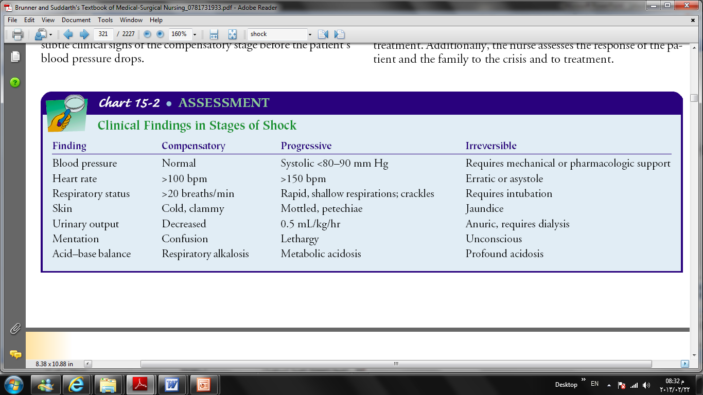

Slide 18
Overall management
Fluid replacement to restore intravascular volume
Vasoactive medications to restore vasomotor tone and improve cardiac function
Nutritional support to address the metabolic requirements that are often dramatically increased in shock.

Slide 19
Fluid replacement
Crystalloids are electrolyte solutions that move freely between the intravascular compartment and the interstitial spaces.
Isotonic crystalloid solutions contain the same concentration of electrolytes as the extracellular fluid. such as 0.9% sodium and lactated Ringer’s solution.
hypertonic crystalloid solution, such as 3% sodium chloride,. It is produce a large osmotic force that pulls fluid from the intracellular space to the extracellular space to achieve a fluid balance.
Complications include excessive serum osmolality, hypernatremia, hypokalemia, and altered thermoregulation.

Slide 20
colloidal solutions as plasma proteins, which are molecules that are too large to pass through capillary membranes.
Colloids expand intravascular volume by exerting oncotic pressure, thereby pulling fluid into the intravascular space.
Examples ; blood and blood component, such as albumin, and pharmaceutical plasma expanders, such as hetastarch, dextran, and mannitol.

Slide 21
Vasoactive medications
as Dopamin
It used to correct the hemodynamic alteration
increase the strength of myocardial contractility, regulate the heart rate, reduce myocardial resistance,

Slide 22
Nutritional support
The patient in shock requires more than 3,000 calories daily.
The release of catecholamines early in the shock continuum causes glycogen stores to be depleted in about 8 to 10 hours.
Nutritional energy requirements are then met by breaking down lean body mass.
Parenteral or enteral nutritional support should be initiated as soon as possible.

Slide 23
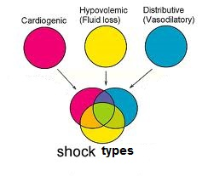
➢Types of shock:-

Slide 24
Hypovolemic shock

Slide 25
Hypovolemic shock
Hypovolemic shock the most common type occurs when there is a reduction in intravascular volume of 15% to 25 which represents a loss of 750 to 1300 mL of blood
characterized by a decreased intravascular volume of body fluid include the intracellular and extracellular volume.

Slide 26
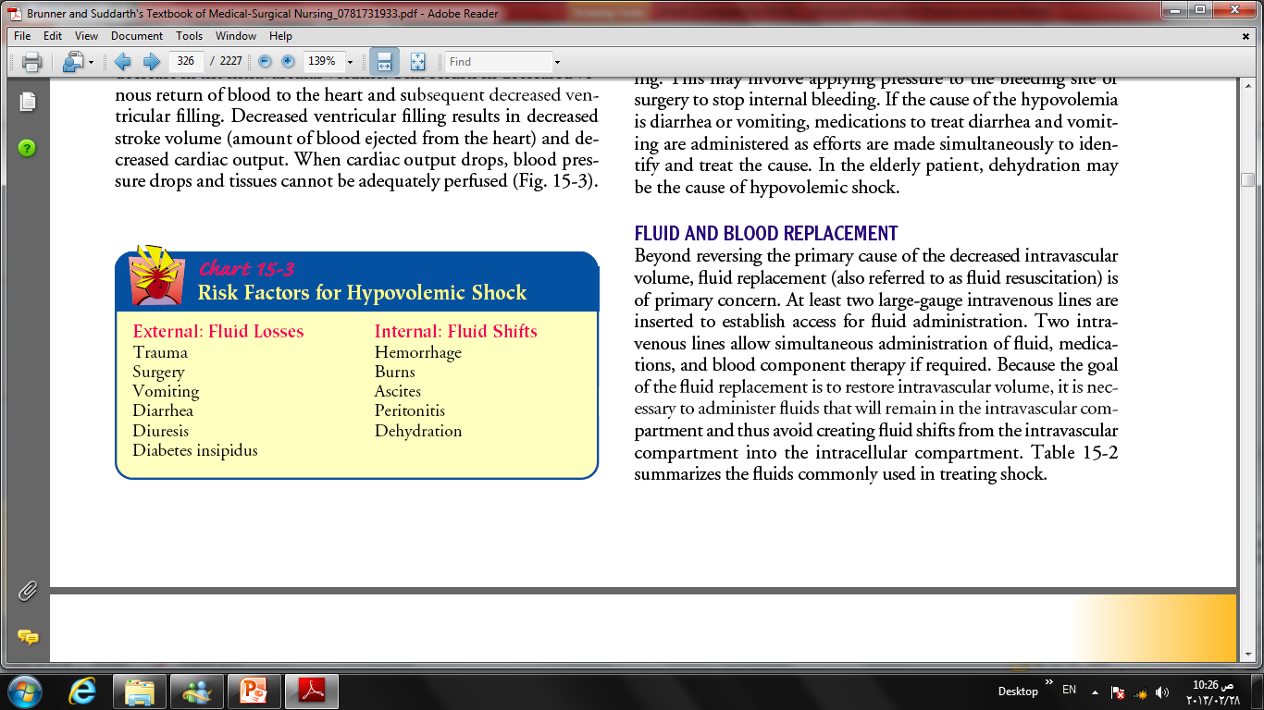

Slide 27
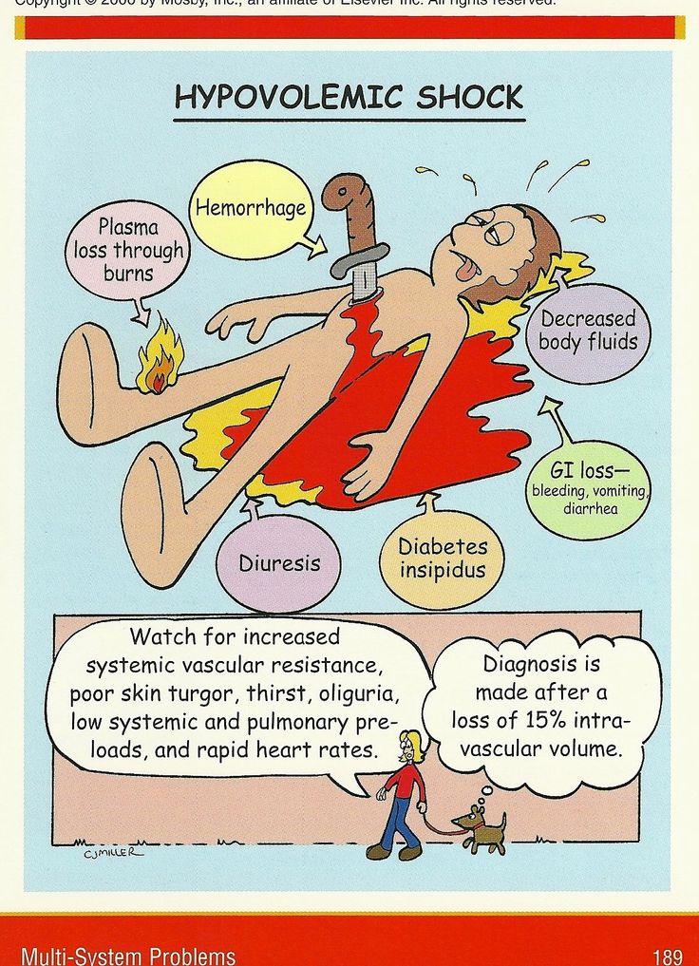

Slide 28
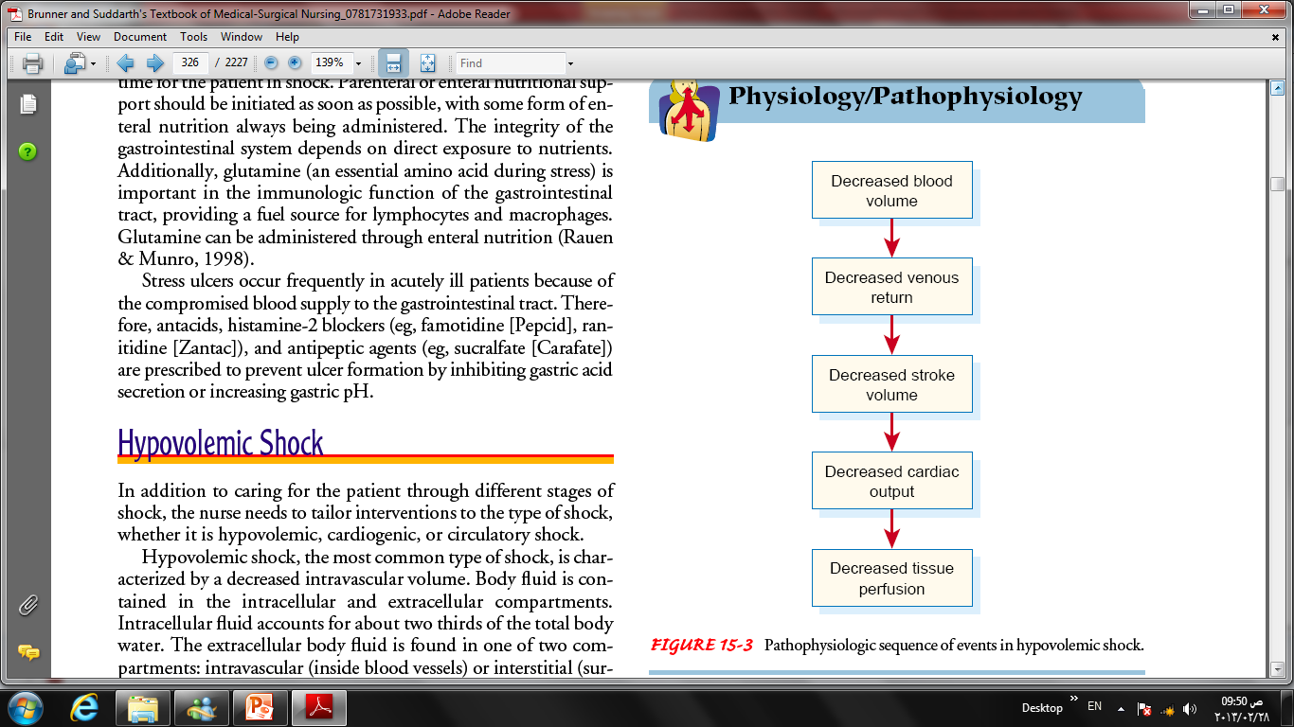

Slide 29

Assessment
1- History
2- Clinical manifestations
3- Laboratory studies

Slide 30
2- Clinical manifestations
Rapid and deep respirations
Cool and clammy skin, with weak and thread pulses , hypothermia
Tachycardia
Hypotension
Decreased urine output
Thirsty
Altered mentation, ranging from lethargy to unresponsiveness

Slide 31
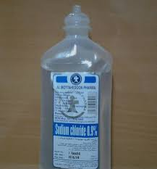
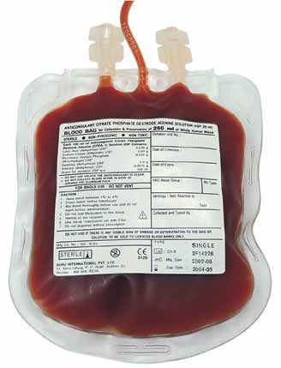
Medical Management
1- Treatment of the Underlying Cause.
2- Fluid and Blood Replacement.

Slide 32
1- Fluid resuscitation:-
Venous access. At least two large cannula
Lactate ringer solution:- An infusion of lactate ringer solution is begun immediately at a rapid rate so that in period of 45 min between 1000-2000 cc is given.
Blood
Colloid solution

Slide 33
2- Pulmonary support:-
Oxygen mask.
ETT and MV is indicated when evidence of respiratory failure.

Slide 34
3- monitoring
Vital signs
A folly catheter check urine output every hour. Optimum output is 0.5-1 ml/kg/h.
Central venous pressure
ECG.
Repeated hematocrit and hemoglobin assessment.
Blood gases

Slide 35
4- positioning:-
5- Pain analgesic
6- Inotropic agents:-
Dopamine and dobutamin are used to improve myocardial contractility while dopamine increase renal blood flow and urine output as well.

Slide 36
Nursing management of hypovolemic shock
large-bore IV catheters are inserted in the antecubital space or central venous system to assist with the rapid infusion of fluids
Frequent documentation of vital signs, hemodynamic monitoring, electrocardiography monitoring, arterial blood gases, serum electrolyte levels, physical and mental status changes), oxygen saturation, urine output, as well as laboratory results and interventions is essential

Slide 37
Care must be Fluid given too rapidly may cause pulmonary congestion and inhibit adequate oxygenation, further compromising oxygen delivery to the tissues.
Fluids should also be warmed during infusion to limit the negative effects of hypothermia.
positioning the patient properly assists fluid redistribution. A modified Trendelenburg position

Slide 38
Complications of hypovolemic shock :-
Complications associated with hypovolemic shock depend on the length of time and severity of the hypotensive crisis. Complications may range from:
Renal damage
Cerebral anoxia
Death.

Slide 39

Cardiogenic Shock

Slide 40
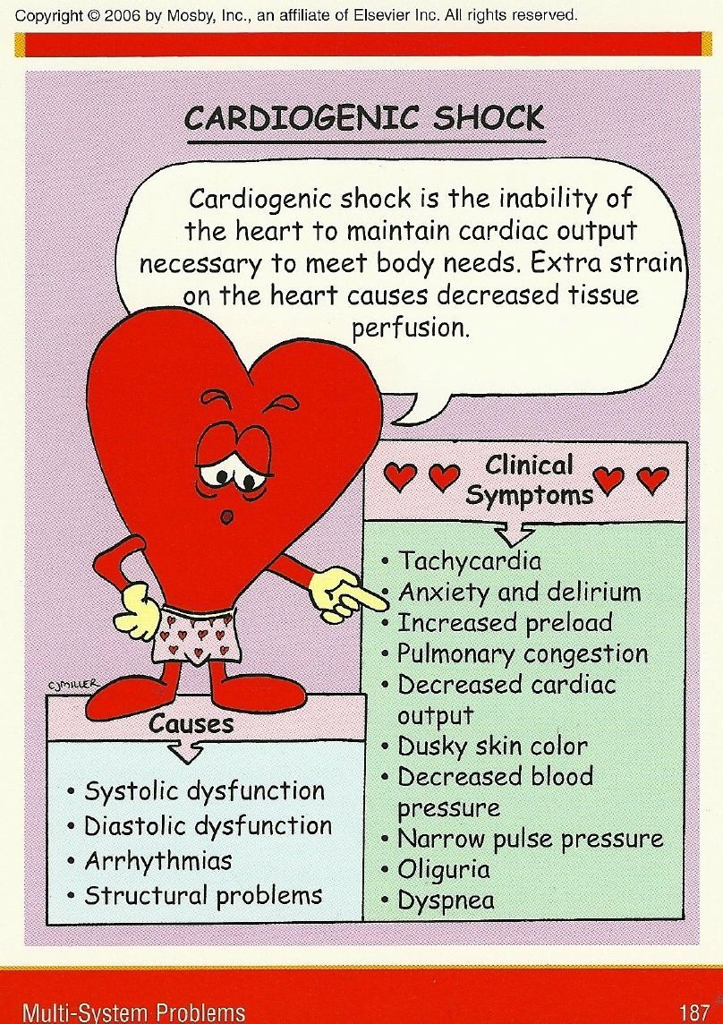

Slide 41
Cardiogenic shock definition :-
inability of the heart's to contract and pump blood and oxygen supply leading to decrease tissue perfusion .

Slide 42

★ Risk Factors of Cardiogenic Shock:-
Increased age (elderly).
Large myocardial infarction.
History of diabetes mellitus.
previous myocardial infarction.

Slide 43
Causes of cardiogenic shock
Acute myocardial infarction (commonest cause).
Sever arrhythmia.
Massive pulmonary embolism.
Cardiac tamponade
High spinal anesthesia.
Myocarditis.

Slide 44
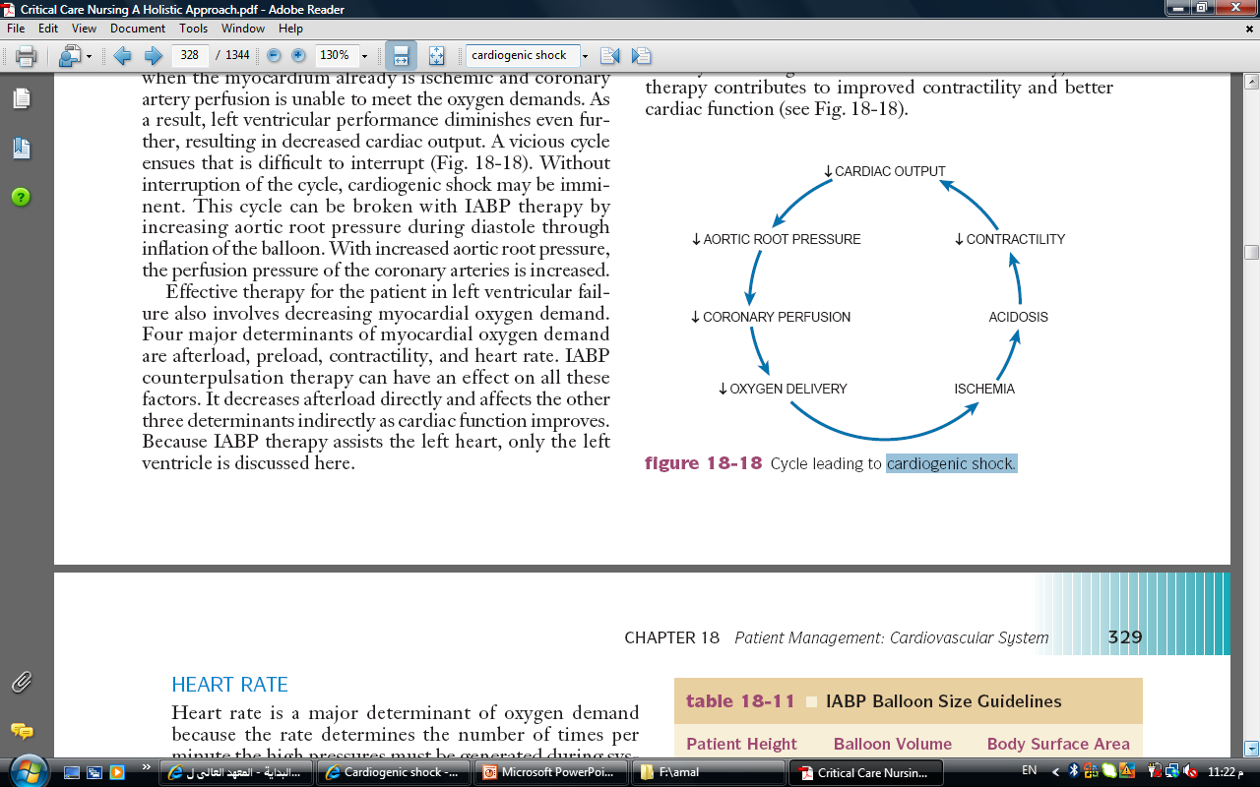
Pathophysiology

Slide 45
Clinical Manifestations
1- Hemodynamic findings
Systolic blood pressure <90mm hg.
Mean arterial pressure <70 mm hg.
Pulmonary artery wedge pressure >18 mm hg.
Noninvasive findings
Thready , rapid pulse.
Narrow pulse pressure.
Distended neck veins.
Arrhythmias.

Slide 46

Chest pain.
Cool, pale, moist skin.
Oliguria.
Decreased mentation.
3- Pulmonary findings
Dyspnea.
Increased respiratory rate.
Inspiratory crackles, possible wheezing.
Arterial blood gases show decreased in PaO2.
Respiratory alkalosis.
4- Radiographic findings
Enlarged heart.
Pulmonary congestion.

Slide 47
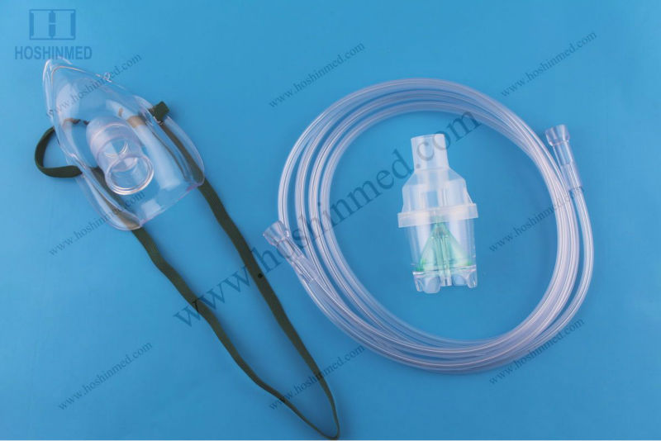
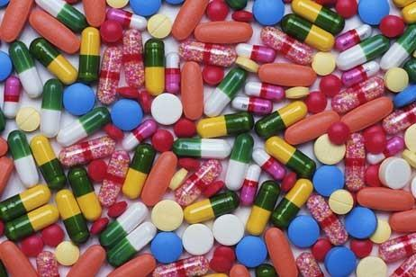
Medical Management:-
1- Correction of Underlying Causes
2- Initiation of First-Line Treatment
✵ Oxygenation:-
Monitoring of oxygen saturation:-
Pain Control:-
Hemodynamic Monitoring:-

Slide 48
Laboratory markers
Fluid Therapy
Pharmacologic Therapy
1- Dobutamine: - Enhances the strength of cardiac contraction, improving stroke volume ejection and overall cardiac output.
2- Nitroglycerin: - IV nitroglycerin in low doses
3- Dopamine.

Slide 49
Nursing Management
1- Monitoring Homodynamic Status
2- Administering medications and intravenous fluids
3- Enhancing Safety and Comfort
reducing anxiety
medication to relieve chest pain
preventing infection.

Slide 50
Circulatory shock
Anaphylactic shock
Neurogenic shock
Septic shock

Slide 51
Anaphylactic shock
Shock due to the severe allergic antigen antibody reaction to substances such as drugs, blood products, or insect or animal venom is called anaphylactic shock.
Food products such as seafood, nuts, ….

Slide 52
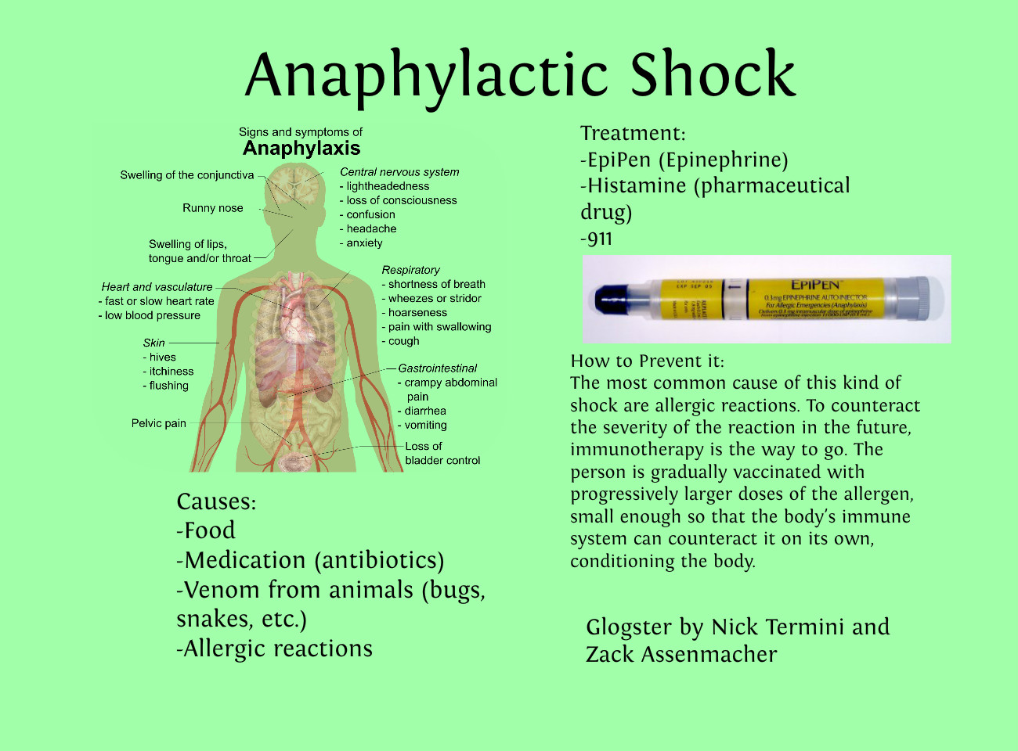

Slide 53
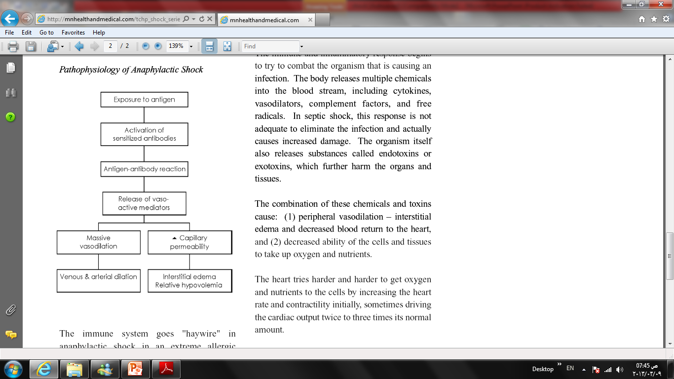

Slide 54
Clinical manifestations
Initially generalized erythema.
Urticarial and pruritus.
Anxiety.
Restlessness.
Dyspnea.
Wheezing.
Chest tightness.
A warm feeling.
Nausea and vomiting.
Angioedema (swelling of the lips, face, neck and throat): this can be life threatening.
Abdominal pain.

Slide 55
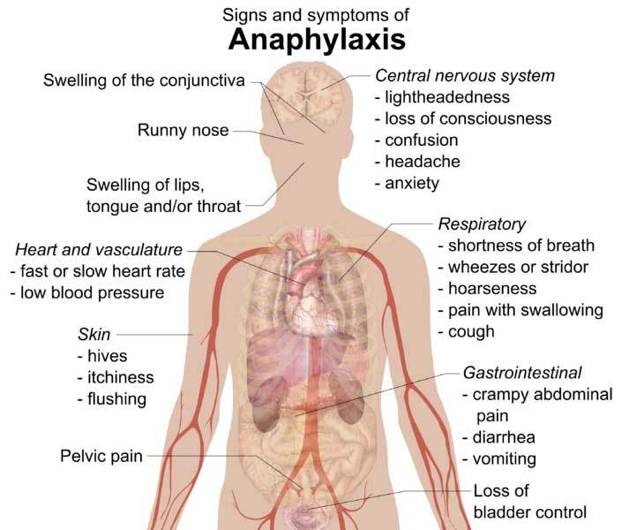

Slide 56
Medical Management
Intravenous crystalloid.
Intravenous hydrocortisone.
Antihistaminic.
ETT may be needed if laryngeal edema and steroid are developed.

Slide 57
Nursing Management
maintaining an adequate airway and monitoring patient response to the antigen.
monitors respirations, heart rate, blood pressure, and level of anxiety, and institutes comfort measures related to the dermatological manifestations.
Patient education

Slide 58
Neurological shock.
vasodilatation occurs as the result of loss balance between parasympathetic and sympathetic stimulation tone leads to decreased tissue perfusion and initiation of the shock response.

Slide 59
Causes of neurogenic shock
Spinal cord injury
Spinal anesthesia
Nervous system damage
depressant action of medications
Emotional stress
Pain
Increase or decrease insulin

Slide 60
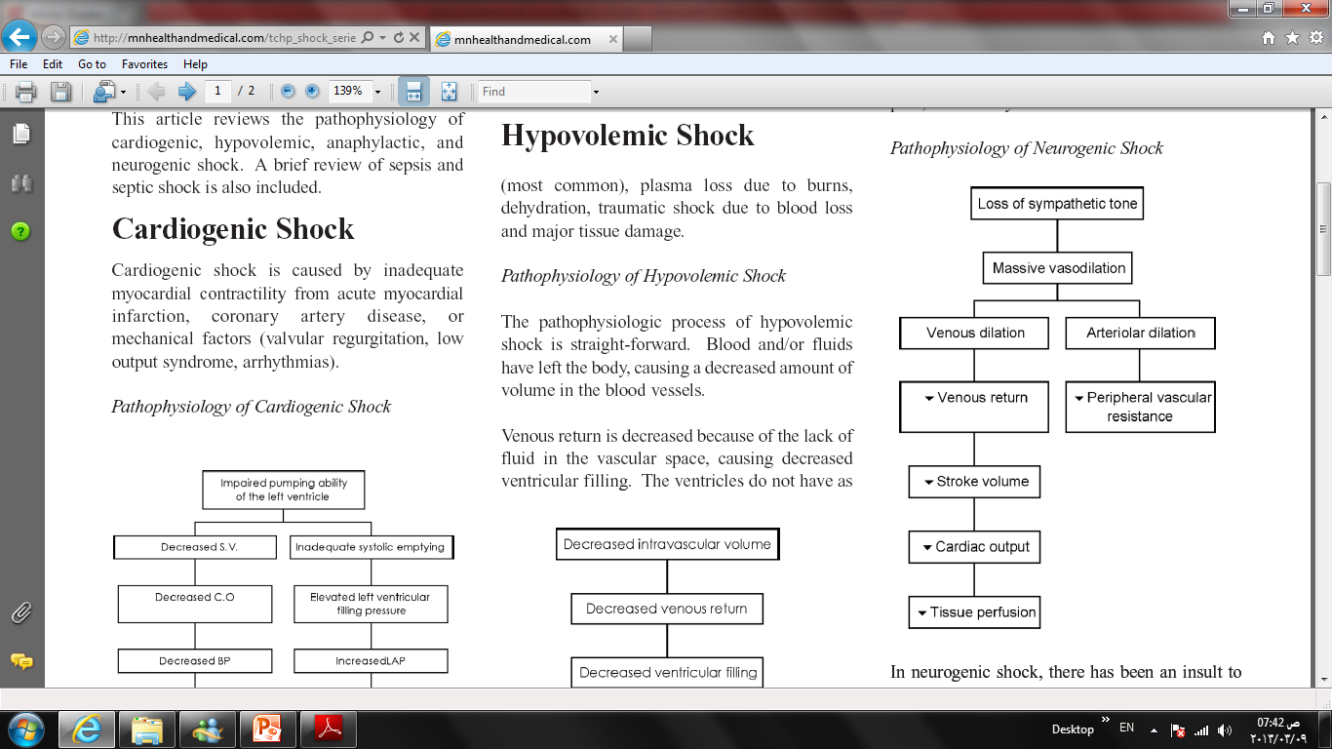

Slide 61
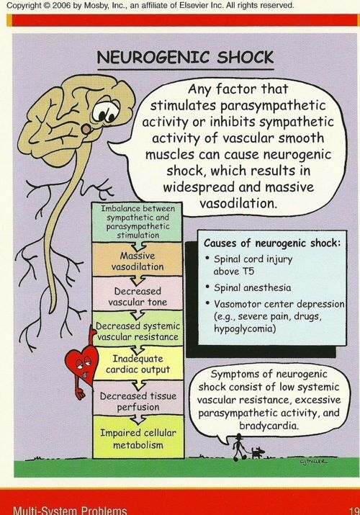

Slide 62
Clinical manifestations
Hypotension
Bradycardia
Warm, dry extremities
Peripheral vasodilatation
Decreased cardiac output (with cervical or high thoracic injury)

Slide 63
Medical management
Goal is to treat or remove cause, prevent cardiovascular instability and promote tissue perfusion.
Treat hypovolemia with carefully fluids resuscitation to prevent overload.
Vasopressors are used as necessary to maintain BP and organ perfusion.
Warming measures to regulate temperature.

Slide 64
Nursing management
Prevention by assessment of risk patients and constant assessment of neurogenic status, immobilization of spinal cord injuries, and elevation of head of bed after spinal anesthesia.
Nursing interventions include; treating hypovolemia, maintaining normothermia, monitoring for dysrhythmias, preventing hypoxia, promoting comfort and emotional support.

Slide 65

Septic shock
is a complex and generalized process that involves all organ systems. Sepsis, severe sepsis, and septic shock represent progressive stages of the same illness.

Slide 66
Septic shock
SIRS: The systemic response to infection. It is manifested by two or more of the following conditions :
■ Temperature >38°C or <36°C
■ Heart rate >90 beats/minute
■ Respiratory rate >20 breaths/minute
■ WBC count >12,000 cells/mm3, <4,000 cells/mm3, or>10% immature forms

Slide 67
Sepsis: Known or suspected infection, plus ≥2 SIRS criteria
Severe Sepsis: Sepsis plus ≥1 organ dysfunction.

Slide 68
Causes of septic shock
The most common causative microorganisms are gram-negative bacteria.
Gram-positive bacterial infections.
viruses and fungi

Slide 69
Risk / Precipitating factors
Host/ intrinsic Factors
■ Extremes of age
■ Malnutrition
■ Coexisting disease
■ alcohol abuse
■ AIDS
■Burn
■ Malignancies
■ diabetes
Treatment-Related/ extrinsic Factors
■ Use of invasive catheters
■ Surgical procedures
■ Traumatic or surgical wounds
■ Invasive diagnostic procedures
■ Drugs (antibiotics, cytotoxic agents, steroids)
Gangrene

Slide 70
Assessment & Diagnosis
Temperature > 38.3
HR > 90 b/min
Altered mental status (confusion or agitation)
Tachypnea (compensated)
Systolic blood pressure < 90 mmHg
Hyperglycemia > 120 ml/dL
WBC count > 12,000 or < 4,000 mm³
Platelet count < 100,000 mm³

Slide 71
Warm peripherals, pink, flushed skin
Oliguria urine output < 0.5 ml/kg/hr
Hypoxia
Crackles
Increased CO and cardiac index
Decreased SVR
Metabolic acidosis
Full bounding pulse
Nausea, vomiting , or diarrhea may occur

Slide 72
Investigation
Blood test; CBC, U&Es, blood suger, coagulation studies, CRP, lactate, ABG, amylase, CK, serology.
Cultures; blood, sputum, urine, throat, wound, drain fluid, stool.
Imaging; CXR, USS, or CT brain, chest , abdomin.

Slide 73
Clinical picture of septic shock
Septic shock has been described as having two phases a hyperdynamic and a 1- hyperdynamic phase (warm)
- Restlessness and confusion.
- Fever above 38oc and chills.
- Tachycardia.
- Tachypnea.
- Patient is flushed with warm dry extremities.
- Oliguria.

Slide 74
2- Hypodynamic phase (cold)
- Systolic Bp <90mmhg.
- Cold clammy skin.
- Tachycardia.
- Tachypnea.
- Oliguria.

Slide 75
Medical management
1- Support of different organs:-
Fluid replacement
Medications.
100% oxygen
Eradication of sepsis
Antibiotic therapy
Prophylaxis against DVT and stress ulceration
monitoring:-as in hypovolaemic shock.

Slide 76
Nursing management
All invasive procedures must be carried out with aseptic technique after careful hand hygiene.
monitor for signs of infection in all patients.
reduce the temperature by administering acetaminophen or applying a hypothermic blanket.

Slide 77
Systemic inflammatory response syndrome
Definition:-
SIRS was to define a clinical response to a nonspecific insult of either infectious or noninfectious origin.

Slide 78
Causes of SIRS
The most common causes of SIRS related to
Infectious disease as follows:
bacterial infection, wound infection (burns, diabetic foot, cholecystitis,)
Noninfectious causes (acute intestinal ischemia, pancreatitis, GUT bleeding, autoimmune diseases, aspiration, cirrhosis).

Slide 79
SIRS stages
Stage I:
Following an insult, local cytokines are produced with the goal of inciting an inflammatory response, thereby promoting wound repair and recruitment of the reticular endothelial system.

Slide 80
 Stage II:
Small quantities of local cytokines are released into circulation to improve the local response. This leads to growth factor stimulation and the recruitment of macrophages and platelets. This acute phase response is typically well controlled by a decrease in the pro inflammatory mediators and by the release of endogenous antagonists. The goal is homeostasis.
Stage III:
If homeostasis is not restored, a significant systemic reaction occurs. The cytokine release leads to destruction rather than protection. A consequence of this is the activation of numerous humeral cascades and the activation of the reticular Endothelial system and subsequent loss of circulatory integrity. This leads to end organ dysfunction.

Slide 81
- Clinical manifestations of SIRS
SIRS is defined as 2 or more of the following variables:
Fever of more than 38°C or less than 36°C
Heart rate of more than 90 beats per minute
Respiratory rate of more than 20 breaths per minute or a PaCO2 level less than 32 mm Hg
Abnormal white blood cell count (>12,000/mL or <4,000/mL or >10% bands).

Slide 82
Signs and symptoms of SIRS – mechanisms involved
1- Fever
2- Hypotension
3- Tachycardia
4- Increased breathing rate and hypocapnia
5- Changes of the leucocytes (WBC count)

Slide 83


Slide 84


