Slide 1


Slide 2
Respiratory diseases
Supervised by:-
Dr./ Fatma Said

Slide 3
prepared by:-
1-Maisara Mohammad Ahmad.
2-Manar El-Sayed Mohammad
3-Manar Khalid Mohammad.
4-Manar Saber Abdel-mabood
5-Sameh Adeeb Zakher. 6-Amr Ahmad Ali.
7-Hoda Mahmoud Mohammad.
8-Gameel Nazmy Lahzy.
9-Hanaa Farghal Mahmoud.
10-Abdel-Azeez Mohammad Husain.
11-Mahmoud Khairy Thabet.
12-Kerolous Atef Nazmy.
13-Mahmoud Abdel-Nasser Mohammad.
14-Mohammad El-Sayed Omran.
15-Mohammad Tawfik Mohammad.
16-Mohammad Ibrahim Abdel-Halim.
17-Gondi Zakka Gondi.

Slide 4
Outlines:-
1-Anatomy & physiology of respiratory system.
2-Definition of respiratory diseases.
3-Types of respiratory diseases.
4-Risk factors of respiratory diseases.
5-Prevention of respiratory diseases.
6-Pneumonia :
a-Definition b-Mechanism
c-Types d-Causes
e-Stages f-Symptoms
g- Risk factors h-Diagnosis
i-Complication j-Treatment
k-prevention
7-Bronchitis:
a-Definition b-Types
c-Causes d-Transmission
e-Risk factors f-Diagnosis
g-Treatment h-Complications
8-Nursing role to patients with respiratory diseases for prevention.

Slide 5
Anatomy &Physiology of respiratory system
-The respiratory system is divided into two main components:-
a)Upper respiratory tract
b)Lower respiratory tract

Slide 6
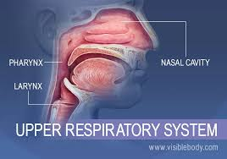
a)Upper respiratory tract:
The structure of the upper respiratory tract are located outside the chest cavity. Composed of the nose, the pharynx, and the larynx.

Slide 7
1-Nasal cavity:
Inside the nose, the sticky mucous membrane lining the nasal cavity traps dust particles, and tiny hairs called cilia help move them to the nose to be sneezed or blown out.

Slide 8
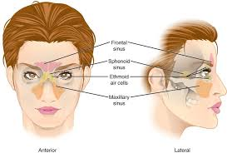
2-Sinuses:
These air-filled spaces along side the nose help make the skull lighter

Slide 9
Paranasal Sinuses
The total function of the paranasal sinuses is unclear. The cavities allow for the increase in the bony structure without adding significant mass. Respiratory mucosa lines the paranasal sinuses. This respiratory mucosa is ciliated and secretes mucus.

Slide 10
1-The ethmoid sinuses
Are found between the orbits. These ethmoidal air cells are divided regionally into anterior, middle and posterior, based on the location of their apertures. The anterior ethmoidal sinus opens into the frontonasal duct. The middle group opens into the ethmoidal bulla or just superior to it. The posterior group opens onto the lateral wall of the superior nasal meatus.

Slide 11
2-The largest of the paranasal sinuses is (The maxillary sinus). There are 2 pyramidal-shaped maxillary sinuses located bilaterally in the maxilla of the face. It fills the bone in its entirety to reduce the mass of the maxilla. The maxillary sinus opens into the center of the semilunar hiatus found in the lateral wall of the middle nasal meatus.

Slide 12
3-The triangular-shaped( frontal sinuses )are found in the frontal bone superior to the orbits. These sinuses vary in size. They open at the lateral wall of the middle meatus which then continues as the semilunar hiatus, which drains the maxillary sinus.

Slide 13
4-Finally, the (sphenoidal sinuses)
Are found in the body of the sphenoid. They open into the posterior wall of the sphenoid-ethmoidal recess.

Slide 14
2-Pharynx:
Both food and air pass through the pharynx before reaching their appropriate destinations. The pharynx also plays a role in speech.
3-Larynx:
The larynx is essential to human speech

Slide 15
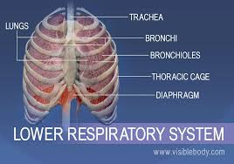
b-Lower respiratory tract:
The structures of the lower respiratory tract are located inside the chest cavity. Composed of the trachea, the lungs, and all segments of the bronchial tree (including the alveoli).

Slide 16
1-Trachea:
Located just below the larynx, the trachea is the main airway to the lungs.
2-Bronchi:
The bronchi branch from the trachea into each lung and create the network of intricate passages that supply the lungs with air.

Slide 17
3-Lungs:
They are form the body’s largest organs. They’re responsible for providing oxygen to capillaries and exhaling carbon dioxide.
4-Diaphragm:
The diaphragm is the main respiratory muscle that contracts and relaxes to allow air into the lungs

Slide 18
Definition of respiratory diseases:
Are pathological conditions that affect the respiratory organs which lead to difficulties in gas exchange , and they range from mild & self limiting such as the common cold ,to life threatening diseases such as bacterial pneumonia , pulmonary embolism , acute ashma and lung cancer .

Slide 19
Types of respiratory diseases:-
A)Upper respiratory tract infection
1-the common cold
2-sinusitis
3-tonsillitis
4-otitis media
5-pharyngitis
6-laryngitis
B)Lower respiratory tract infection
1-Pneumonia
2-Bronchitis
3-Bronchiolitis

Slide 20
Risk factors of respiratory diseases:-
1-Age
2-Gender
3-Smoking
4-Allergies
5-Chest injury
6-Surgery
7-Exposure to chemicals &environmental pollution
8-Family history of infectious diseases

Slide 21
Prevention of respiratory diseases:-
1-Stop and avoid any smoking.
2-Wash your hands
3-Cover your mouth during coughing or sneezing
4-Clean your house
5-Wear a mask
6-Get your vaccines(influenza,pneumonia)

Slide 22
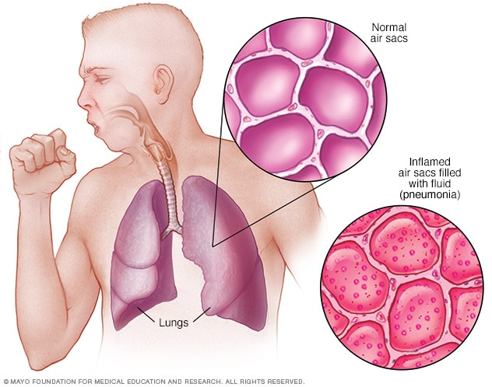
1-Pneumonia

Slide 23
Definition
Is an inflammatory condition of the lung affecting primarily the small air sacs known as alveoli.

Slide 24
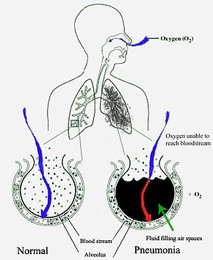
Mechanism of pneumonia:-

Slide 25
Pneumonia frequently starts as an upper respiratory tract infection that moves into the lower respiratory tract. It is a type of pneumonitis (lung inflammation). The normal flora of the upper airway gives protection by competing with pathogens for nutrients. In the lower airways, reflexes of the glottis, actions of complement proteins and immunoglobulins are important for protection. Microaspiration of contaminated secretions can infect the lower airways and cause pneumonia. The virulence of the organism, amount of the organisms to start an infection and body immune response against the infection all determines the progress of pneumonia.

Slide 26
Pneumonia fills the lung's alveoli with fluid, hindering oxygenation. The alveolus on the left is normal, whereas the one on the right is full of fluid from pneumonia.

Slide 27
Types of pneumonia
1-Hospital-acquired pneumonia (HAP):-
Some people catch pneumonia during a hospital stay for another illness. Hospital-acquired pneumonia can be serious because the bacteria causing it may be more resistant to antibiotics and because the people who get it are already sick. People who are on breathing machines (ventilators), often used in intensive care units, are at higher risk of this type of pneumonia.

Slide 28
The person is more likely to get this type if:
1-He is on a breathing machine
2-He can't cough strongly enough to clear his lungs
3-He has a tracheostomy tube to help he breathing
4-His immune system is weak from a disease or treatment

Slide 29
2-Community-acquired pneumonia (CAP):-
- It's occurs somewhere other than a hospital or long-term care facility. Community-acquired pneumonia can be caused by bacteria, viruses, and fungi.

Slide 30
3-Health care-acquired pneumonia
-Health care-acquired pneumonia is a bacterial infection that occurs in people who live in long-term care facilities or who receive care in outpatient clinics, including kidney dialysis centers. Like hospital-acquired pneumonia, health care-acquired pneumonia can be caused by bacteria that are more resistant to antibiotics.

Slide 31
4-Aspiration pneumonia
-Aspiration pneumonia occurs when you inhale food, drink, vomit or saliva into your lungs. Aspiration is more likely if something disturbs your normal gag reflex, such as a brain injury or swallowing problem, or excessive use of alcohol or drugs.

Slide 32
Causes of pneumonia
There are several types of infectious agents that can cause pneumonia.
A-Bacterial pneumonia
The most common cause of bacterial pneumonia is Streptococcal pneumonia

Slide 33
B-Viral pneumonia
Respiratory viruses are often the cause of pneumonia. Some examples include:
1- influenza (flu)
2-respiratory syncytial virus (RSV)
3-rhinoviruses (common cold)
Viral pneumonia is usually milder and can improve in one to three weeks without treatment.

Slide 34
C-Fungal pneumonia
Fungi from soil or bird droppings can cause pneumonia. They most often cause pneumonia in people with weakened immune systems. Examples of fungi that can cause pneumonia include:
1-Pneumocystis jirovecii.
2-Cryptococcus species
3-Histoplasmosis species

Slide 35
Pneumonia stages
Pneumonia may be classified based off the area of the lungs it’s affecting:
1-Bronchopneumonia
Bronchopneumonia can affect areas throughout both of your lungs. It’s often localized close to or around your bronchi. These are the tubes that lead from your windpipe to your lungs.

Slide 36
2-Lobar pneumonia
Lobar pneumonia affects one or more lobes of your lungs. Each lung is composed of lobes, which are defined sections of the lung.
Lobar pneumonia can be further divided into four stages based off how it’s progressed:
1-Congestion.
Lung tissue appears heavy and congested. Fluid filled with infectious organisms has accumulated in the air sacs.

Slide 37
2-Red hepatization.
Red bloods cells and immune cells have entered into the fluid. This makes the lungs appear red and solid in appearance.
3-Gray hepatization. The red blood cells have begun to break down while immune cells remain. The breakdown of red blood cells causes a change in color, from red to gray.
4-Resolution.
Immune cells have begun to clear the infection. A productive cough helps eject remaining fluid from the lungs.

Slide 38
Symptoms of pneumonia
Pneumonia symptoms can be mild to life-threatening. They can include:
1-Coughing that may produce phlegm (mucus)
2-Fever
3-Sweating or chills
4-Shortness of breath that happens while doing normal activities or even while resting
5-Chest pain that’s worse when you breathe or cough
6-Feelings of tiredness or fatigue
7-loss of appetite
8-Nausea or vomiting
9-Headaches

Slide 39
Pneumonia Risk factors
Anyone can get pneumonia, but certain groups do have a higher risk. These groups include:
1-Infants from birth to 2 years old
2-People ages 65 years and older
3-People with weakened immune systems
4-People with certain chronic medical conditions, such as asthma, cystic fibrosis, diabetes, or heart failure

Slide 40
5-people who recently had a respiratory infection, such as a cold or the flu
6-Hospitalized people, particularly if they were on a ventilator
7-people who’ve had a stroke, have problems swallowing, or have a condition that causes immobility
8-people who smoke, use certain types of drugs, or drink excessive amounts of alcohol
9-people who’ve been exposed to lung irritants, such as pollution, fumes, and certain chemicals

Slide 41
Pneumonia Diagnosis
A)Take medical history
B)complete physical examination , your doctor may also order one or more of these tests:
1-Chest X-ray
2-Blood culture
3-Sputum culture.
4-Pulse oximetry
5-CT scan
6-Fluid sample
7-Bronchoscopy

Slide 42
Pneumonia complications
Pneumonia may cause complications, especially in people with weakened immune systems or chronic conditions, such as diabetes.
1-Worsened chronic conditions
If you have certain preexisting health conditions, pneumonia could make them worse. These conditions include congestive heart failure and emphysema. For certain people, pneumonia increases their risk for having a heart attack.

Slide 43
2-Bacteremia
Bacteria from the pneumonia infection may spread to your bloodstream. This can lead to dangerously low blood pressure, septic shock, and in some cases, organ failure.
3-Lung abscesses
These are cavities in the lungs that contain pus. Antibiotics can treat them. Sometimes they may require drainage or surgery to remove the pus.

Slide 44
4-Impaired breathing
You may have trouble getting enough oxygen when you breathe. You may need to use a ventilator.
5-Acute respiratory distress syndrome
This is a severe form of respiratory failure. It’s a medical emergency.

Slide 45
6-Pleural effusion
If your pneumonia isn’t treated, you may develop fluid around your lungs in your pleura, called pleural effusion. The pleura are thin membranes that line the outside of your lungs and the inside of your rib cage. The fluid may become infected and need to be drained.
7-Death :
In some cases, pneumonia can be fatal

Slide 46
Treatment
-Treatment for pneumonia involves curing the infection and preventing complications. People who have community-acquired pneumonia usually can be treated at home with medication. Although most symptoms cure in a few days or weeks, the feeling of tiredness can persist for a month or more.

Slide 47
Specific treatments depend on the type and severity of your pneumonia, your age and your overall health. The options include The following

Slide 48
Antibiotics
Oral antibiotics can treat most cases of bacterial pneumonia. Always take your entire course of antibiotics, even if you begin to feel better. Not doing so can prevent the infection from clearing, and it may be harder to treat in the future.
Antibiotic medications don’t work on viruses. In some cases, your doctor may prescribe an antiviral. However, many cases of viral pneumonia clear on their own with at-home care.
Antifungal medications are used to fight fungal pneumonia. You may have to take this medication for several weeks to clear the infection.

Slide 49
Cough medicine
Your doctor may also recommend cough medicine to calm your cough so you can rest. Keep in mind coughing helps remove fluid from your lungs, so you don’t want to eliminate it entirely.

Slide 50
Fever reducers/pain relievers.
You may take these as needed for fever and discomfort. These include drugs such as aspirin, ibuprofen and acetaminophen .

Slide 51
Hospitalization:-
Adults may need to be hospitalized if:
1-They are older than age 65
2-They are confused about time, people or places
3-Their kidney function has declined
4-Your systolic blood pressure is below 90 millimeters of mercury (mm Hg) or your diastolic blood pressure is 60 mm Hg or below

Slide 52
5-Your breathing is rapid (30 breaths or more a minute)
6-You need breathing assistance
7-Your temperature is below normal
8-Your heart rate is below 50 or above 100
9-You may be admitted to the intensive care unit if you need to be placed on a breathing machine (ventilator) or if your symptoms are severe.

Slide 53
Children may be hospitalized if:
1-They are younger than age 2 months
2-They are lethargic or excessively sleepy
3-They have trouble breathing
4-They have low blood oxygen levels
5-They appear dehydrated

Slide 54
Hospital treatment may include:
1-Intravenous antibiotics injected into a vein
2-Respiratory therapy, which involves delivering specific medications directly into the lungs or teaching you to perform breathing exercises to maximize your oxygenation
3-Oxygen therapy to maintain oxygen levels in your bloodstream (received through a nasal tube, face mask, or ventilator, depending on severity)

Slide 55
Prevention of pneumonia
To help prevent pneumonia:
1-Get vaccinations
2-Make sure children get vaccinations.
3-Practice good hygiene.
4-Don't smoke.
5-Keep your immune system strong.

Slide 56
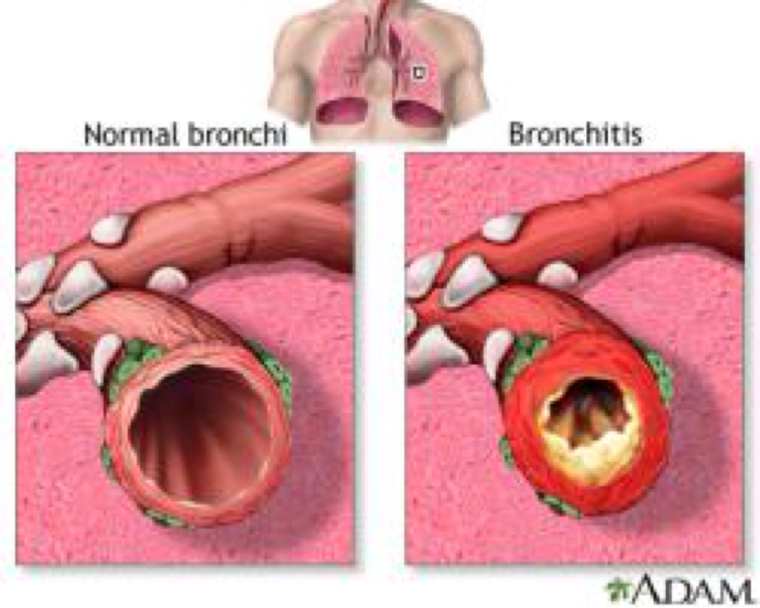
2-Bronchitis

Slide 57
Definition
Is an infection of the main airways of the lungs (bronchi), causing them to become irritated and inflamed.

Slide 58
Types of bronchitis
1-Acute bronchitis
2-Chronic bronchitis

Slide 59
1-Acute bronchitis
Definition:
It’s short-term inflammation of the lungs and airways, usually lasting less than 3 weeks. Acute bronchitis is most common in the elderly, infants, and young children.

Slide 60
-A virus usually causes acute bronchitis, which makes it more likely that a person will develop the condition during the winter months when viral infections are more common. With acute bronchitis, symptoms can be similar to that of a cold or the flu. For this reason, it is often called a "chest cold".

Slide 61
Symptoms of acute bronchitis
1-Cough
2-Chest soreness
3-Headaches
4-Fatigue
5-Muscle aches
6-Sore throat

Slide 62
2-Chronic bronchitis
Chronic bronchitis is one of several conditions also known as chronic obstructive pulmonary disease, or COPD.

Slide 63
With chronic bronchitis, symptoms are more likely to include:
1-Long-term cough with significant mucus and sputum production
2-Ongoing shortness of breath
3-History of COPD
4-History of smoking

Slide 64
As opposed to the acute variation, chronic bronchitis is diagnosed when symptoms:
1-Are ongoing
2-Have lasted at least 3 months within one year
3-Have occurred for 2 consecutive years

Slide 65
Causes of bronchitis:-
A range of different factors may cause acute or chronic bronchitis.
1-Virus and bacteria
Acute bronchitis is usually caused by a viral infection, similar to the viruses that cause colds and flu, which means acute bronchitis may be contagious.Rarely, bacterial infections are a cause.

Slide 66
2-Environmental factors
Some environmental factors can increase the chances of developing acute bronchitis. These conditions cause airway inflammation and make the lungs more prone to infection.

Slide 67
It is best to avoid the following irritants where possible:
1-Air pollution: also known as smog.
2-Strong chemicals: inhaling these can irritate the lungs and airways.
3-Tobacco smoke: a person who smokes increases not only their own chances of developing both acute and chronic bronchitis, but also the risks for those who inhale the secondhand smoke around them.
4-Other environmental factors: other factors hat inflame the airways include dust, smoke, and large fires.

Slide 68
Transmission
The bronchitis virus can be transmitted from person to person when they are close to one another.
A)If a person with bronchitis coughs or sneezes, infected droplets will go into the air and land on surfaces.
B)These infected particles can infect another person and cause bronchitis if they come into contact with the nose or mouth.

Slide 69
Risk Factors
Smoking
Chemical inhalants
Pollution
Urban environment
Hygiene

Slide 70
Diagnosis
a)Labs and Tests
1-Sputum Culture
2-Complete Blood Count
3-Pulse Oximetry
4-Pulmonary Function Testing
5-Arterial Blood Gas
b)Imaging
1-Chest X-Ray
2-Chest CT

Slide 71
Treatment
Most cases of acute bronchitis get better without treatment, usually within two weeks.

Slide 72
Medications
-Because most cases of bronchitis are caused by viral infections, antibiotics aren't effective. However, if your doctor suspects that you have a bacterial infection, he or she may prescribe an antibiotic.

Slide 73
-In some circumstances, your doctor may recommend other medications, including:
-Cough medication. If your cough keeps you from sleeping, you might try cough suppressants at bedtime.
-Other medications. If you have allergies, asthma or chronic obstructive pulmonary disease (COPD), your doctor may recommend an inhaler and other medications to reduce inflammation and open narrowed passages in your lungs.

Slide 74
Lifestyle and home remedies
To help you feel better, you may want to try the following self-care measures:
Avoid lung irritants
1-Don't smoke.
2-Wear a mask when the air is polluted or if you're exposed to irritants, such as paint or household cleaners with strong fumes.

Slide 75
Use a humidifier
-Warm, moist air helps relieve coughs and loosens mucus in your airways. But be sure to clean the humidifier according to the manufacturer's recommendations to avoid the growth of bacteria and fungi in the water container.
Consider a face mask outside
- If cold air aggravates your cough and causes shortness of breath, put on a cold-air face mask before you go outside.

Slide 76
Complications of bronchitis
1-Difficulty breathing, sometimes severe
2-Respiratory failure
3-Pneumonia
4-Enlargement and weakness of right heart
Ventricle of the heart caused by lung disease
6-Pneumothorax (collection of air or gas in lung causing lung collapse).

Slide 77
prevention
1-Drink fluids every one to two hours, unless your doctor has restricted your fluid intake.
2-Rest.
3-Don't smoke. Stay away from all kinds of smoke.
4-Relieve body aches by taking aspirin or acetaminophen.

Slide 78
5-Follow your doctor's instructions on ways to help you clear your mucus.
6-If you have a moist, productive cough (with mucus), note how often you cough, as well as the color and amount of the sputum (mucus). 6-Report this to your doctor.
7-Use a humidifier.
8-Try herbal teas or lemon water with 1-2 tablespoons of honey to provide comfort.

Slide 79
Nursing role in patient with respiratory diseases prevention:-
-Primary prevention of CRDs requires the reduction or avoidance of personal exposure to common risk factors, to be started during pregnancy and childhood.

Slide 80
-Avoidance of direct and indirect exposure to tobacco smoke is of primary importance not only for healthier lungs, but as a preventative measure for the (cardiovascular disease, cancer, and diabetes). Also avoid other risk factors as low birth weight, poor nutrition, acute respiratory infections of early childhood, indoor and outdoor air pollutants, and occupational risk factors.

Slide 81
-Additionally, the population must be fully informed about what constitutes a healthy lifestyle, such as healthy nutritional habits, regular exercise and avoidance of tobacco, airway irritants and allergens.

Slide 82


