Slide 1


Slide 2
Pulmonary Edema
Prepared by
Dr/ Sanaa Saber Mohamed
Critical care nursing

Slide 3
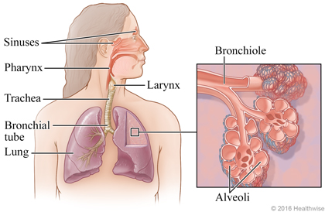

Slide 4
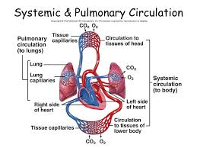

Slide 5
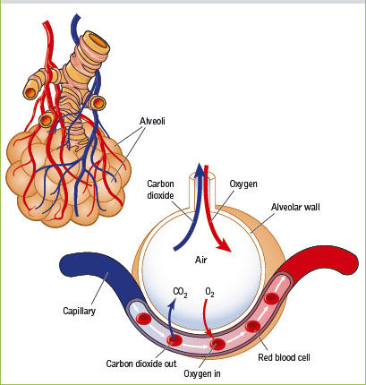

Slide 6
Introduction
Pulmonary edema most commonly occurs as a result of increased micro vascular pressure from abnormal cardiac function. The backup of blood into the pulmonary vasculature resulting from inadequate left ventricular function causes an increased micro vascular pressure, and fluid begins to leak into the interstitial space and the alveoli.

Slide 7
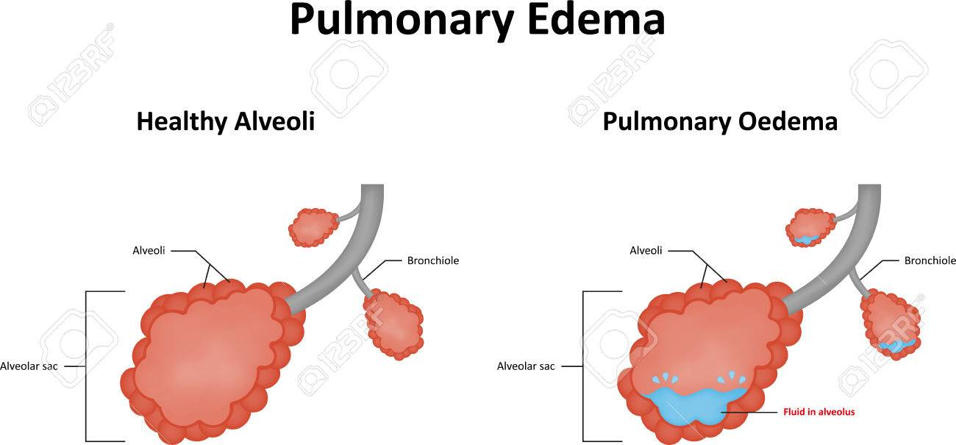
Definition
Pulmonary edema is defined abnormal accumulation of fluid in the lung tissue. The fluid may accumulate in the interstitial spaces or in the alveoli. It is a severe, life threatening condition

Slide 8
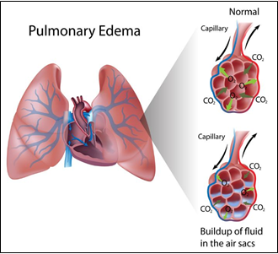
Pathophysiology

Slide 9
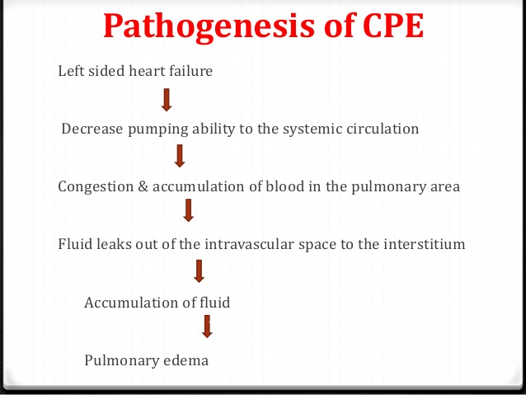

Slide 10
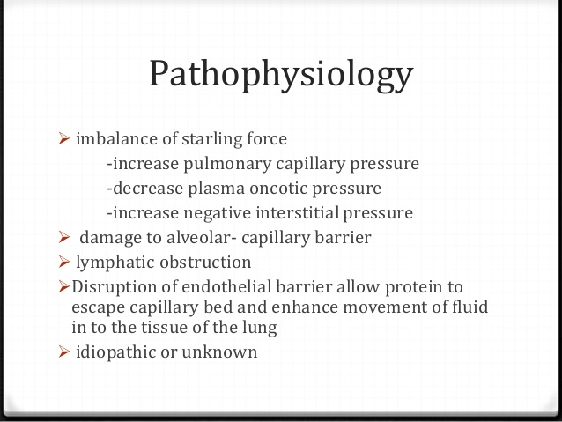

Slide 11
The backup of blood into the pulmonary vasculature resulting from inadequate left ventricular function causes an increased micro vascular pressure, and fluid begins to leak into the interstitial space and the alveoli.

Slide 12
1
Increased hydrostatic pressure in the pulmonary capillaries
  elevated pulmonary venous pressure
  increased left ventricular end-diastolic pressure and left atrial pressure
  edema fluid breaks through the lung epithelium
  flooding the alveoli with protein-poor fluid
  increase in the vascular permeability of the lung
  resulting in an increased flux of fluid and protein into the lung interstitial and air spaces
2
As left atrial pressure rises further (>25 mm Hg)
3
Noncardiogenic pulmonary edema

Slide 13
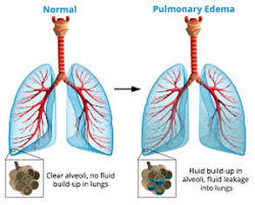

Slide 14
Etiology
1- Cardiogenic pulmonary oedema:
Left ventricular failure as a complication of a myocardial infarction, mitral or aortic valve disease, cardiomyopathy, or other disorders characterized by cardiac dysfunction.
Fluid overload, e.g., from kidney failure or intravenous therapy which may cause dilatation and failure of the left ventricle.

Slide 15
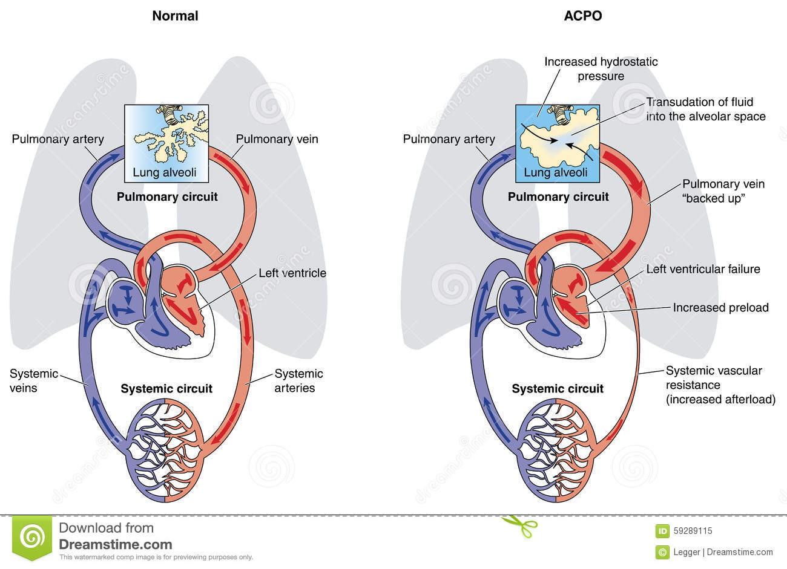

Slide 16
2- Non-cardiogenic
Hypertensive crisis; due to a combination of increased pressures in the right ventricle and pulmonary circulation and also increased systemic vascular resistance and left ventricle contractility increasing the hydrostatic pressure within the pulmonary capillaries leading to extravasation of fluid and edema.
Upper airway obstruction (negative pressure pulmonary edema )
Neurogenic causes (seizures, head trauma, strangulation, and electrocution).

Slide 17
Other causes:
Inhalation of hot or toxic gases
Pulmonary contusion, i.e., high-energy trauma
Aspiration, e.g., gastric fluid
Re-expansion, i.e. post large volume thoracentesis, resolution of pneumothorax, removal of endobronchial obstruction.
Reperfusion injury, i.e. post lung transplantation
Immersion pulmonary edema
Multiple blood transfusions
Severe infection or inflammation, which may be local or systemic.
Heroin overdose (also other narcotics)

Slide 18
Clinical manifestation
Shortness of breath with lying down, causing the patient to sleep with head propped up or using extra pillows
Difficulty in breathing
Wheezing
Feeling of "air hunger" or "drowning"
Grunting or gurgling sounds with breathing
Cough, Anxiety, Restlessness, Excessive sweating
Pale skin, Coughing blood
Decrease in level of awareness,
Rapid breathing and increased heart rate
Crackles in the lungs and abnormal heart sound

Slide 19
Assessment and Diagnostic Findings
Chest X-ray: shows interstitial edema
Echocardiogram to detect valvular disease
Measurement of pulmonary artery wedge pressure by Swan-Ganz catheter (differentiates etiology of pulmonary edema: cardiogenic or altered alveolar-capillary membrane)
Blood cultures in suspected infection: may be positive
Cardiac markers in suspected MI: may be elevated
Arterial blood gas (ABG) analysis: may show hypoxemia and impending respiratory failure

Slide 20

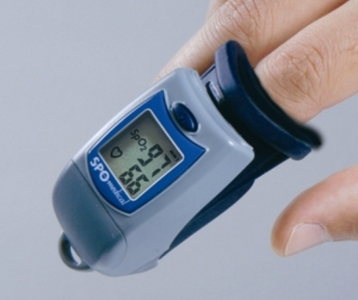
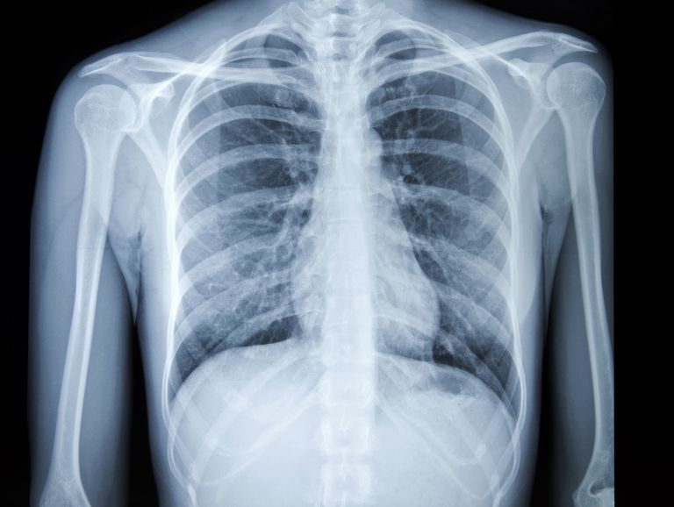
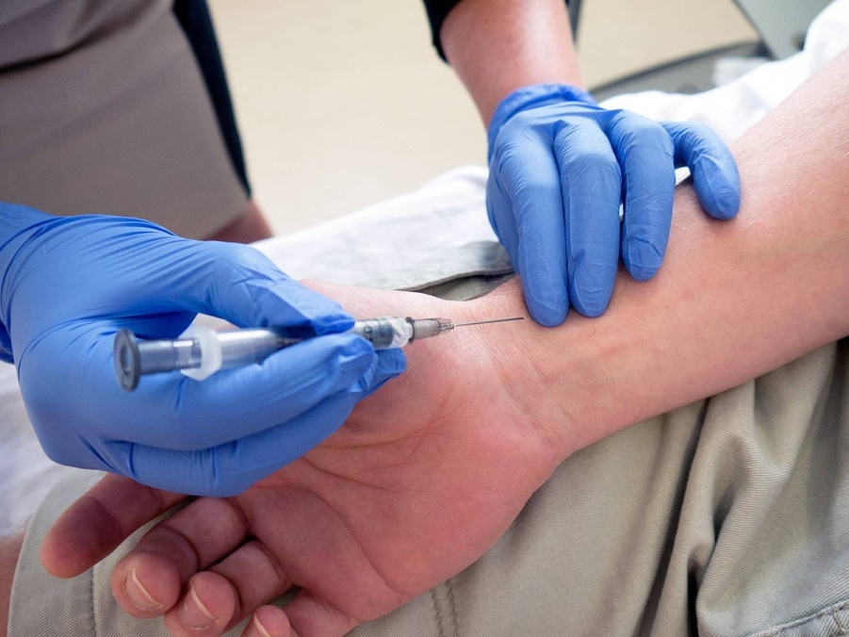

Slide 21
Medical management
Pharmacologic therapy
Oxygen therapy. Is administered to correct the hypoxemia and dyspnea.
Morphine. Morphine is administered to reduce peripheral resistance and venous return so that blood can be redistributed from the pulmonary circulation to other parts of the body.
Diuretic therapy. It is used to increase rate of urine production and removal of excess extracellular fluid from the body.
Other intravenous medications. These include dobutamine, a catecholamine that increases myocardial contractility; amrinone, which dilates the arteries and increases CO; and digitalis, which increases contractility.

Slide 22
Nursing Management
Position the patient to promote circulation
Providing psychological support
Monitoring medications

Slide 23
Nursing Diagnoses:
Impaired Gas Exchange related to excess fluid in the lungs
Nursing Interventions:
Improving Oxygenation
Give oxygen in high concentration: to relieve hypoxia and dyspnea.
Take steps to reduce venous return to the heart.
  Place patient in upright position; head and shoulders up, feet and legs hanging down: to favor pooling of blood in dependent portions of body by gravitational forces; to decrease venous return.

Slide 24
Nursing Diagnoses:
Anxiety related to sensation of suffocation and fear
Nursing Interventions:
Stay with patient and display a confident attitude: the presence of another person is therapeutic, because the acute anxiety of the patient may tend to intensify the severity of patient's condition. (Arterial vasoconstriction diminishes as anxiety is relieved.)
Explain to patient in a calm manner all therapies administered and the reason for their use. Explain to patient importance of wearing oxygen mask. Assure patient that mask will not increase sensation of suffocation.
Inform patient and family of progress toward resolution of pulmonary edema.
Allow time for patient and family to voice concerns and fears

Slide 25
Nursing diagnosis:
Decreased Cardiac Output Related to Alterations of Preload
Nursing Interventions and Rationale
1. Collaborate with physician regarding the administration of oxygen to main­tain a Spo2 >92% to prevent tissue hypoxia.
2. Maintain surveillance for signs of decreased tissue perfusion and acidosis to facilitate the early identification and treatment of complications.
3. Monitor fluid balance and daily weights to facilitate regulation of the patient's fluid balance.

Slide 26
Nursing diagnosis:
Decreased Cardiac Output Related to Alterations in Contractility
Nursing Interventions and Rationale
Collaborate with physician regarding the administration of oxygen to main­tain a Spo2 >92% to prevent tissue hypoxia.
Monitor homodynamic and intake and output.
Ensure electrolytes are optimized. Collaborate with physician regarding the administration of electrolyte replacement therapy to enhance cellular ionic environment.
Collaborate with physician regarding the administration of inotropes to enhance myocardial contractility.
Monitor ST segment continuously to determine changes in myocardial tissue perfusion.

Slide 27
Give morphine in small, titrated intermittent doses (I.V.) as directed.
  Morphine usually is not given if pulmonary edema is caused by stroke or occurs with chronic pulmonary disease or cardiogenic shock.
  Watch for excessive respiratory depression.
  Monitor BP because morphine may intensify hypotension.
  Have morphine antagonist available: naloxone (Narcan).

Slide 28
Give I.V. injections of diuretic.
  Insert an indwelling catheter: large urinary volume will accumulate rapidly.
  Watch for falling BP, increasing heart rate, and decreasing urinary output: Indications that the total circulation is not tolerating diuresis and that hypovolemia may develop.
  Check electrolyte levels because potassium loss may be significant.
  Watch for signs of urinary obstruction in men with prostatic hyperplasia.
Administer vasodilator if patient fails to respond to therapy.
  Monitor by measuring pulmonary artery pressure and CO.

Slide 29


