Slide 1
Essential Newborn care
Prepared by
Asmaa Ragab

Slide 2
Essential Newborn care
Definition :
(ENC) is care that every newborn baby needs regardless of where it is born or its size. ENC should be applied immediately after the baby is born and continued for at least the first 7 days after birth.

Slide 3
Purpose:
Adapt quickly to life outside the uterus.
o Breathe well.
o Be warm
o Initiate breast feeding as early as possible

Slide 4
8 steps for new born care
Drying and wrapping new born (dry surface-sex to mother)
Dry to stimulate breathing
Assess breathing band color
Cut the cord
Prevent heat loss
Give eye care
Give vitamin K
Wight the baby

Slide 5
Remember three cleaning:
Clean hand
Clean surfaces
Clean equipment

Slide 6
Equipment:
o Two clean dry towels
o Cord clamps
o Sterile scissors
o Functional resuscitation equipment
o Vitamin K, syringe
o Alcohol
o Tetracycline eye ointment.

Slide 7
Immediate newborn care
Clamp and cut the cord
Care of the umbilical cord.
Initiating immediate breastfeeding
Maintain the baby’s body temperature/thermal protection
Care of the eyes(while the baby is held by mother)
Administer vitamin K1(while the baby is held by mother)
Identification of the baby
Weigh the baby after the first breast fed
Initial Assessment: Apgar Scoring

Slide 8
Immediate newborn care
1. When the head is delivered, wipe the mouth and nose with gauze.
2. When the baby is fully born, place the baby on a clean, dry towel or blanket on the mother’s abdomen.
3. Note the time of birth and sex of the baby.
4. Wipe the eyes and face and thoroughly dry the baby.
5. Stimulate mildly depressed baby for breathing while drying by rubbing up and down along the baby’s back with warm and clean cloth.

Slide 9
6. Assess the baby’s breathing while drying and stimulating. • If the baby is not crying or breathing well within 30 seconds of birth, clamp and cut the cord and begin resuscitation.(cpr) • If the baby is breathing normally, continue with the other components of essential newborn care.
7. Remove the wet cloth and place the baby skin-to-skin on the mother’s chest.
Cover the baby with a clean, dry cloth including the head. Use a hat if available.

Slide 10
Note : not remove vernix ( creamy whit substance --- skin )----- protect skin .. Prevent infection
Breath less than 30 breath resuscitate (ready equipment)
While draying assess breathing (normal 30-60)

Slide 11
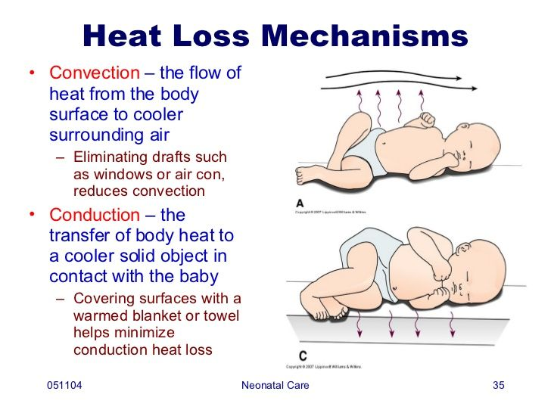

Slide 12
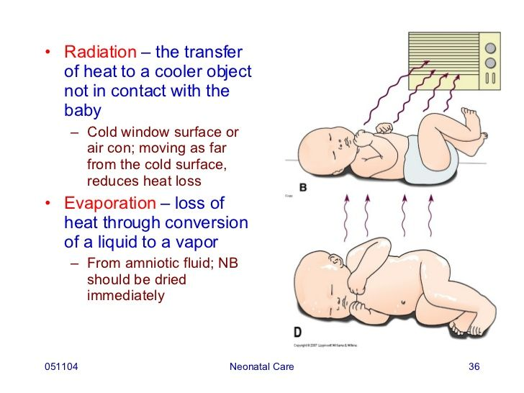

Slide 13
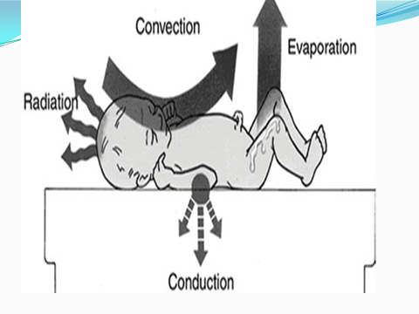

Slide 14
Steps to keep the newborn worm is called the worm chain
worm delivery room
Immediate draying
Skin to skin contact
Breast feeding
Bathing and weighing poet ponded
Appropriate clothing
Mother and baby together
Worm transportation for baby needs referral

Slide 15
Clamp and cut the cord
1. Wait for 2-3 minutes after birth or until the cord ceases to pulsate before clamping and cutting the cord. NOTE: As noted above, clamp and cut the cord soon after drying the baby if he/she is not breathing.
2. Tie the cord two fingers’ length from the baby’s abdomen and make another tie two fingers from the first one. Cut the cord between the two clamps using a sterile scissor.

Slide 16
Initiating immediate breastfeeding
If everything is normal, the mother should immediately start breastfeeding.
Help the mother begin breastfeeding within the first hour of birth.
Help the mother at the first feed. Make sure the baby has a good position, attachment, and is sucking well.
Do not limit the length of time the baby feeds; early and unlimited breast feeding gives the newborn energy to stay warm, nutrition to grow, and antibodies to fight infection.

Slide 17
Maintain the baby’s body temperature/thermal protection
1. Keep the baby warm, ideally by keeping him/her in skin-to-skin contact on the mother’s chest, with the body and head covered by a cloth or hat. If the baby cannot be placed in skin-to-skin contact in case of a Cesarean section or if the mother is ill, wrap the baby well and cover the head.
2. Check the baby’s axillary temperature with a thermometer.

Slide 18
Care of the eyes(while the baby is held by mother)
1. Instill eye drops (tetracycline or erythromycin), one drop in eacheye.When using an ointment, depress the lower eyelid and place a length/strip of the ointment inside the lid from the inner to the outer edge of the eye. Do the same for the other eye.
2. Make sure that the tip of the bottle or the tube does not touch the eye of the baby or other objects.

Slide 19
Administer vitamin K1(while the baby is held by mother)
1. Explain to the mother that an injection will be required to prevent hemorrhage in the baby.
2. Collect all the necessary supplies: disposable syringe (preferably1 mL) with needle, vitamin K, alcohol, pieces of gauze/cotton, preferably sterile.
3. Wipe the injection site with alcohol soaked cotton or gauze.
4. Inject the drug intramuscularly in the antero-lateral part of thethigh: 1 mg for a normal weight baby and 0.5 for a baby weighing less than 1500 grams.
5. Dispose of the needle and syringe in an appropriate and safe manner (in a container for sharp instruments).

Slide 20
Identification of the baby
1. Place an identification band, preferably two-one on the wrist and the other on the ankle of the baby-noting the name of the mother and that of the father (where available), the sex of the baby, and date and time of the delivery.

Slide 21
Weigh the baby after the first breast fed
Delay taking the weight of the baby until he/she is stable and warm and after first breast feeding. (less 1500gm
Decontamination, cleaning, and sterilization
Ensure the proper disposal of waste and decontamination of the equipment and supplies that can be reused.

Slide 22
Initial Assessment: Apgar Scoring
Apgar scoring system is the most frequently used method to assess the newborn’s immediate adjustment to extra-uterine life is the score is based on observation of heart rate, respiratory effort, muscle tone, reflex irritability, and color. Each item is given a score of 0, 1, or 2. Evaluations of all five categories are made 1 and 5 minutes after birth and are repeated every 5 minutes until the infant’s condition stabilizes.

Slide 23
1-Color:
a. Pale or blue = 0
b. Normal color body, but blue extremities (arms and/or legs) = 1
c. Normal color = 2 – completely pink
2- Respiration:
a. Not breathing = 0
b. Weak cry, irregular breathing = 1
c. Strong cry = 2

Slide 24
3- Heart Rate:
a. Absent heartbeat = 0
b. Slow heartbeat (less than 100 beats/minute) = 1
c. Adequate heartbeat (more than 100 beats/minute) = 2
4- Muscle Tone:
a. Limp, flaccid = 0
b. Some flexing or bending = 1
c. Active motion = 2

Slide 25
5- Response to Stimulation (also called Reflex Irritability):
a. No response = 0
b. Grimace (facial expression) = 1
c. Vigorous cry or withdrawal = 2
*Results:
*10 out of 10 is a perfect score. The higher the score, the better the condition
*A score over 7 indicates good condition
*Ascore from (4 -6) moderately depressed and need more extensive clearing airway and supplementary oxygen.
* Ascore from (0 – 3) severely depressed and need immediate CPR

Slide 26
Sign | 0 | 1 | 2
Heart rate | Absent | <100 beats/min | >100 beats/min
Respirations | Absent | Slow, irregular | Good, crying
Muscle tone | Limp | Some flexion | Active motion
Reflex irritability | None | Grimace | Cough, sneeze, cry
Color | Blue or pale | Pink body, blue hands and feet | Completely pink

Slide 27
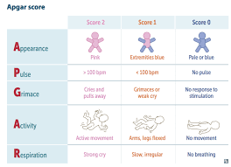

Slide 28
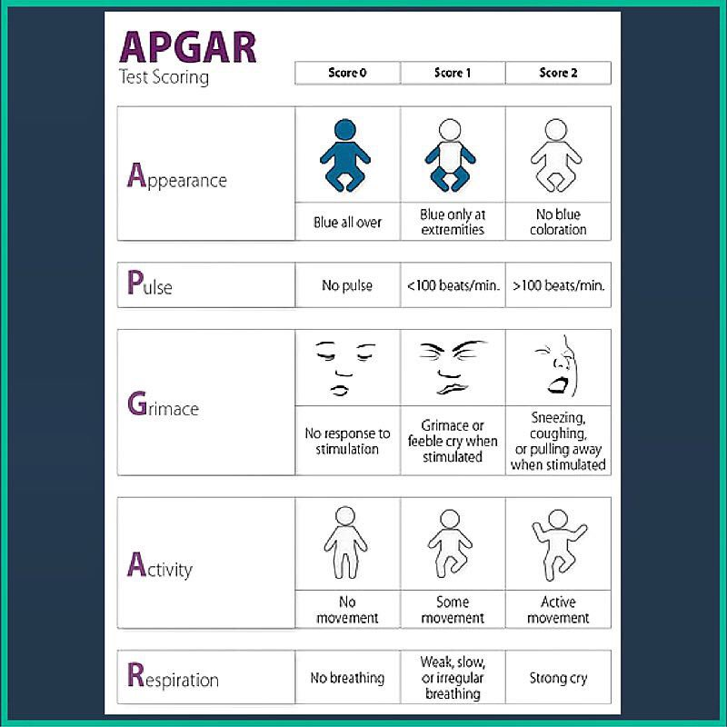

Slide 29
