Slide 1
Nasogastric Tube Insertion
Prepared by :
Asmaa Ragab

Slide 2
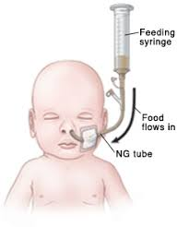

Slide 3
Introduction:
When baby is too sick for well-coordinated sucking, swallowing, esophageal motility and gastric emptying without marked reflux, tube feeding can be used for successful feeding of the baby. Tubes can be passed into the stomach, duodenum or jejunum. Feeding can also be given by continuous infusion.

Slide 4
Definition
This is an alternate method of feeding in which children are fed by a way of tube inserted orally or nasally into the stomach.

Slide 5
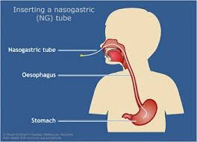

Slide 6
Indications:
The indications for inserting nasogastric tubes are:
♠ Anomalies of throat, esophagus or bowel.
♠ Impaired swallowing capacity, e.g. postoperative cases.
♠ Severe debilitation.
♠ Unconsciousness or respiratory distress.

Slide 7
Inserting Naso gastric Tubes: Articles Required:
The articles required for inserting nasogastric tubes are:
Tube of appropriate size according to the age of the child.
Mackintosh and draw sheet.
Saline or warm water to lubricate the tube.
Stethoscope to check the placement of the tube
- 5ml or 10ml syringe to aspirate the contents.
-A skin friendly tape to secure the tub

Slide 8
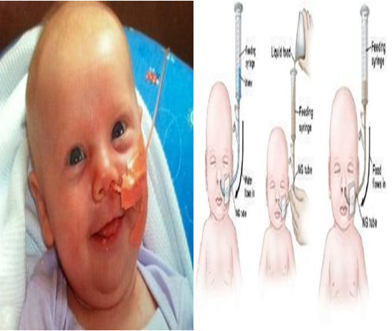

Slide 9
Procedure
Getting ready
1 – Wash hand
2 – Wear the gloves
3 – Prepare the equipment
4 -Explain the procedure to the mother

Slide 10
During the procedure
1 - Assemble the required articles at
the patient's bedside.
2 - Explain the procedure to the child
if possible, or to the care givers.
3 - Give comfortable position to the
client.
4 - Wash hands with soap and water
5 Place the child in supine position
with head slightly hyper flexed.

Slide 11
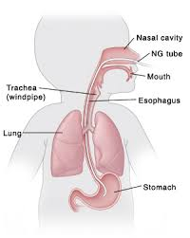

Slide 12
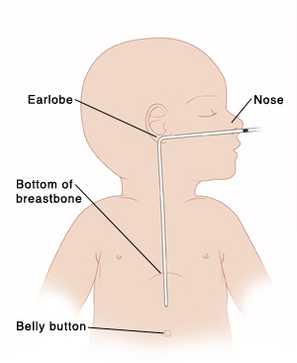
6 - Measure the tube for approximate
Length of insertion (from the nose to the bottom of the ear lobe and then to the end of xiphoid processes) and mark it.

Slide 13
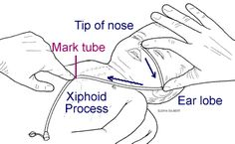

Slide 14
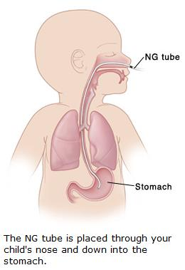
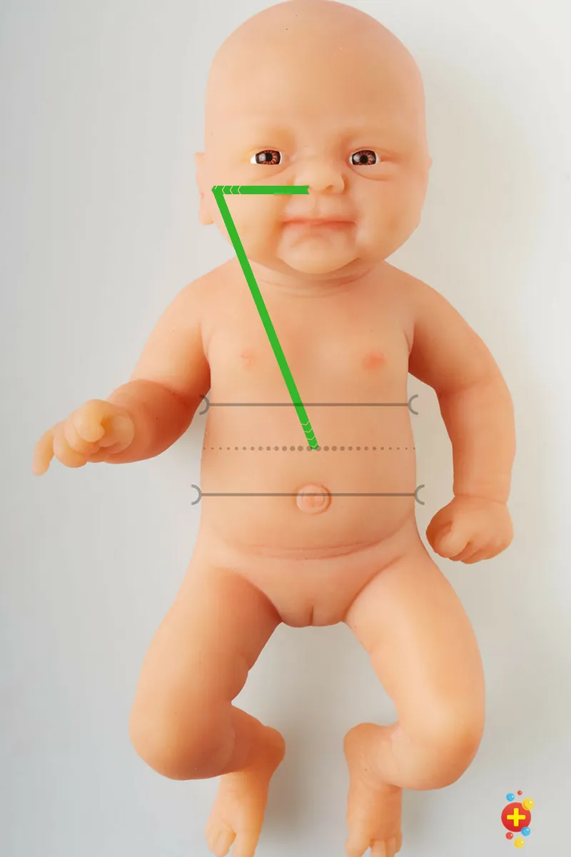

Slide 15
7 - Lubricate the tip of the tube with
saline or water.
8 - Insert the lubricated tube through mouth or nares to the predetermined mark.
9 - When inserting through nasal
route, slip the tube along the base of the nose and direct it back towards the occiput
10 - When entering through the mouth direct the tube towards the back of the throat...

Slide 16
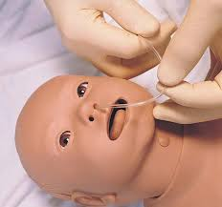

Slide 17
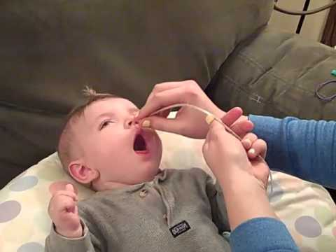

Slide 18
11 - Check the placement of the tube by aspirating the contents or with help of syringe or inject a small amount of air (0.5 – 1 ml in preterm or small infants to 5 ml in larger children) into the tube and listening with stethoscope over stomach..
12 - Secure the tube with the help of tape if in correct position.

Slide 19
After procedure
1-Wash hand
2-Put the infant in comfortable
position
3-Record and report any abnormality

Slide 21
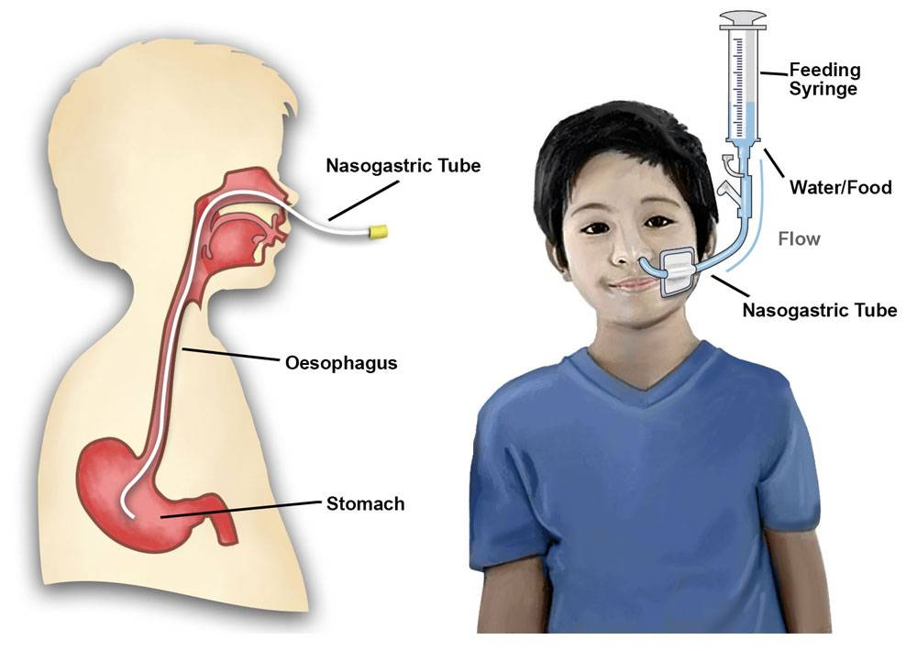

Slide 22


