Slide 1
Integrated Management of Childhood Illness (IMCI)

Slide 2
Introduction
Integrated Management of Childhood Illness (IMCI)
is a systematic approach to children's health which focuses on the whole child. This means focusing not only on curative care but also on prevention of disease. The approach was developed by United Nations Children's
Fund and the World Health Organization in 1995.
It includes both preventive components on the part of families and communities, as well as curative actions to be taken by health workers. It also has an objective to help improve health systems.

Slide 3
Definition
A strategy for reducing mortality and morbidity associated with major causes of childhood illness
OR
is an integrated approach to child health that focuses
On the well-being of the whole child.

Slide 4
components of IMCI
1) Improve of health worker skills.
2) Improve of health systems.
3) Improve of family and community practices in relation to child health.

Slide 5
1) Improving health providers’ skills

Slide 6
1) Improving health providers’ skills
Improving health providers’ skills mostly refers to clinical and communication skills and covers both pre-service education and in-service training, public and private sector.
In-service through:-
Training on adapted standard protocols for case management developed by WHO & UNICEF.
On site follow-up of trained providers after 4-6 weeks.
Supportive supervision.

Slide 7
1) Improving health providers’ skills
Pre-service through-:
-Introduction of IMCI protocol into curricula of medical & nursing schools.
-Improving providers’ skills in areas of:-
✓ Comprehensive assessment irrespective of mother’s complaint according to the protocols.
✓ Proper management & rationalization of drug prescribing particularly antibiotics.
✓ Maximizing home care.
✓ Counseling & giving relevant advice to mothers.
✓ Follow-up of child illness as appropriate.

Slide 8
2) Improving health systems
Improving health systems to deliverIMCI concerns policy, planning and
management, ﬁnancing, organization of work and distribution of tasks at health facilities, human resources, availability of drugs and supplies, referral, monitoring
and health information system, supervision, evaluation and research.

Slide 9
3) Improving family and community practices
✓ Improving family and community practices currently refers to 12 key family and community practices related to child health and development that, if properly promoted and adopted by the targeted communities, would potentially contribute to improving child survival, growth and development .
✓ Aims at initiating, reinforcing & sustaining desired “key family practices” for child survival, growth and development.

Slide 10
Key family practices include:

Slide 11
Key family practices include:
1.Exclusive Breast feeding.
2.Complementary feeding.
3.Micronutrients.
4.Hygiene practices.
5.Vaccination.
6.Malaria use of bed nets.
7.Psychosocial development.
8.Home care for illness.
9.Home treatment for infection
10.Care-seeking
11.Compliance with advice.
12.Antenatal care.

Slide 12
Objectives of IMCI

Slide 13
Objectives of IMCI
The overall objectives of IMCI in is to:-
1-Reduce infant morbidity and mortality in children under five years of age relation to the major killers:-
1-Diarrhoeal diseases.
2-Acute respiratory infections especially Pneumonia.
3-Malaria.
4-Measles.
5-Malnutrition.
2-To promote improved growth and development of children.
3-To educate communities on home management of diseases and on disease prevention.
4-To strengthen health system by ensuring that policies pertaining to child health are in place.

Slide 14
How do we assess children using IMCI strategy?

Slide 15
How do we assess children using IMCI strategy?
✓ Assess the sick young Infant , Age up to 2 Months:-
Name of the infant.
Age.
Weight.
Temperature.
Infant’s problems.
Initial or follow up visit.
Check for possible bacterial infection.
Check for the presence of Jaundice.
Check for diarrhea.
Check for feeding problem or low weight.
Check for immunization.
Assess other problems.

Slide 16
How do we assess children using IMCI strategy?
✓ Assess the sick child, Age 2 months up to 5 years:-
Name of the infant.
Age.
Weight.
Temperature.
Infant’s problems.
Initial or follow up visit.

Slide 17
How do we assess children using IMCI strategy?
✓ Check for general danger signs for all sick children:-
1- Unable to drink or breastfeed.
2-Vomits everything.
3- Has the child had convulsions?
4- Unconscious, lethargic.
5- Is the child convulsing now.

Slide 18
How do we assess children using IMCI strategy?
✓ Assess major four symptoms:-
1-Cough or difficult breathing.
2-Diarrhoea.
3-Fever.
4-Ear problems.
✓ Check for nutrition, immunization, vitamin A supplementation and feeding problems.

Slide 19
The case management process
1- Assessment of the child or young infant.
2- Classification the illness.
3- Identification the treatment.
4-Referral, treatment or counselling of the child's care taker
(depending on the identified classification(s).
5-follow up care.

Slide 20
Steps in Integrated Case Management
The IMCI integrated case management process consists of a number of steps that should be taken by a health-care provider to ensure effective case management.

Slide 21
Steps in Integrated Case Management
STEP 1. ASESS
STEP 2. CLASSIFY
STEP 3. IDENTIFY TREATMENT
STEP 4. TREAT
STEP 5. COUNSEL
STEP 6. FOLLOW-UP

Slide 22
Steps in Integrated Case Management
STEP 1. ASESS
When a child or young infant is brought to a clinic, a health-care provider uses good communication skills to ask the mother about the child's problems and makes an assessment of the child's condition. The health worker checks ﬁrst for general danger signs, which would indicate any life- threatening condition. In young infant the health worker checks for signs of very severe disease and local bacterial infection. Then the health worker asks speciﬁc questions about the most common conditions affecting a child's health. If the answers are positive, he or she examines the child appropriately. An essential part of the assessment is checking the child's nutrition and immunization status. The assessment includes checking the child for other health problems.

Slide 23
Steps in Integrated Case Management
STEP 2. CLASSIFY
Based on the results of the assessment a health-care provider classiﬁes a child's illnesses using a specially developed color-coded triage system. Because many children have more than one condition, each condition is classiﬁed according to whether it requires

Slide 24
Steps in Integrated Case Management
STEP 3. IDENTIFY TREATMENT
After classifying all the conditions present, a health-care provider identiﬁes speciﬁc treatments for the sick child or the sick young infant.
1. If a child requires urgent referral (pink classiﬁcation), essential treatment to be given before referral is identiﬁed.
2. If a child needs speciﬁc treatment (yellow classiﬁcation), a treatment plan is developed, and the drugs to be administered at the clinic are identiﬁed. The content of the advice to be given to the mother is decided on.
3. If no serious conditions have been found (green classiﬁcation), the mother should be correctly advised on the

Slide 25
Steps in Integrated Case Management
STEP 4. TREAT
After identifying appropriate treatment, a health-care provider carries out the necessary procedures relevant to the child's conditions. The health worker:
1. gives pre-referral treatment for sick children being referred;
2. gives the ﬁrst dose of relevant drugs to the children who are in need of speciﬁc treatment, and teaches the mother how to give oral drugs, how to feed and give fluids during illness, and how to treat local infections at home;
3. provides advice on the home management of sick children at home;
4. if needed, asks the mother or other caregiver to return with the child for follow-up on a speciﬁc date.

Slide 26
Steps in Integrated Case Management
STEP 5. COUNSEL
If the follow-up care is indicated the health-care provider teaches the mother when to return to the clinic, the health worker also teaches the mother how to recognize signs indicating that the child should be brought back to the clinic immediately.
When indicated, a health-care provider assesses feeding, including breastfeeding practice, and provides counseling to solve any feeding problems found. This also includes counseling the mother about her own health.

Slide 27
Steps in Integrated Case Management
STEP 6. FOLLOW-UP
Some children need to be seen more than once for a current episode of illness. The IMCI case management process helps to identify those children who require additional follow-up visits. When such children are brought back to the clinic, a health-care provider gives appropriate follow-up care, as indicated in I MCI guidelines, and if necessary, reassess the child for any new problems.

Slide 28
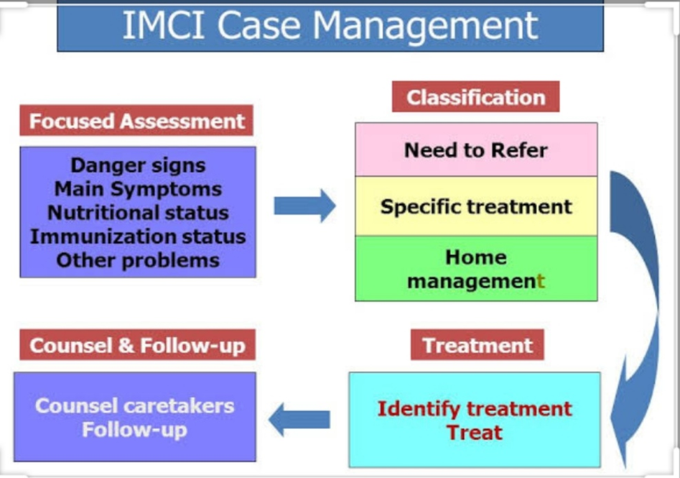
The Integrated Case Management process

Slide 29
Diseases covered by IMCI
1-difficulty breathing
-Difficulty breathing can present in a number of ways. This include nasal flaring, recession of the skin and muscles under and in between the rib cage, and fast breathing.
2-Dehydration
-A dry mouth, little or no tears when crying, decreased number of wet nappies and excessive thirst.
3-head injury
-With a history of head injury (child falling on his head, or being struck on the head) look out for a decreased level of consciousness, vomiting, strange behavior, excessive sleepiness, weakness of any body part.
4-severe infection
-Often the cause of infection is not immediately apparent like in the case of middle ear or urinary tract infections. Be on the lookout for high fevers, refusing to eat or drink anything, rapid pulse and rapid breathing.

Slide 30
Diseases covered by IMCI
5-Diarrhoeal diseases.
6-Malaria.
7-Measles.
8-Malnutrition.

Slide 31
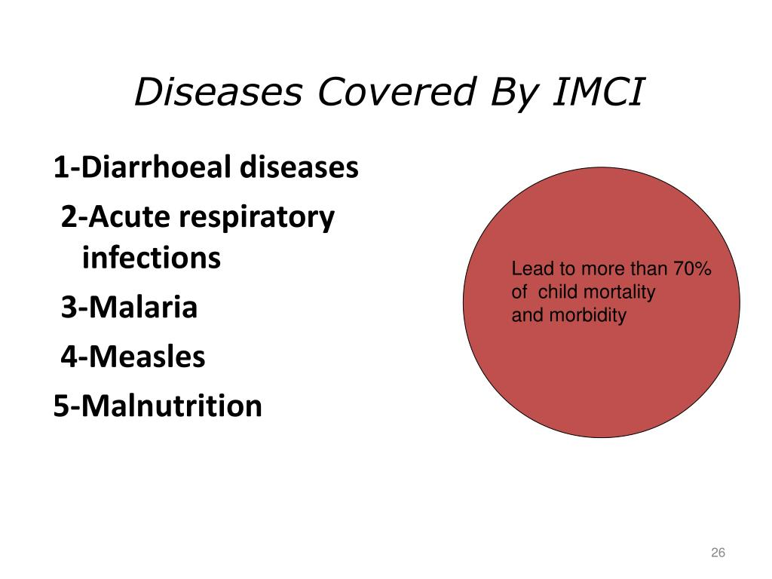
Diseases covered by IMCI

Slide 32
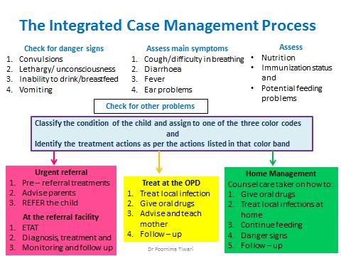

Slide 33
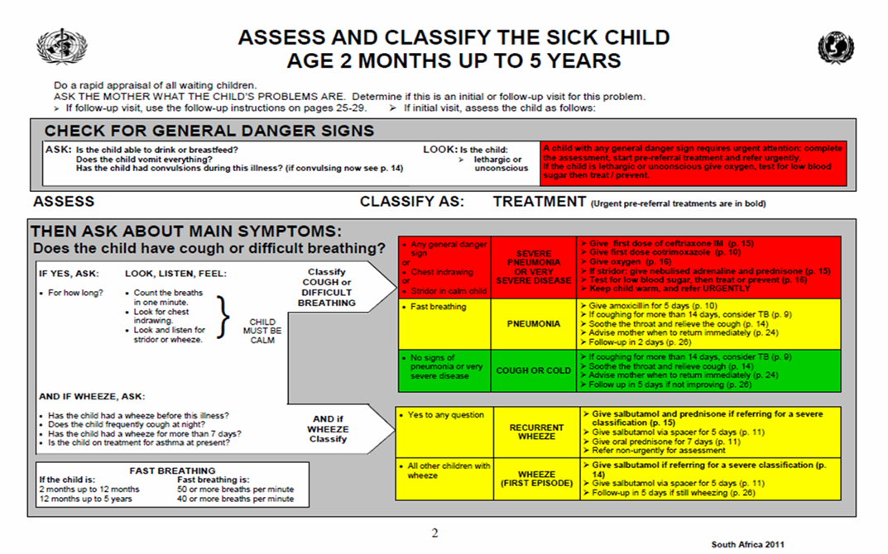

Slide 34


Slide 35
Thank you

