Slide 1
Pulmonary Embolism
Prepared by
Dr/ Sanaa Saber Mohamed
Critical care nursing department

Slide 2
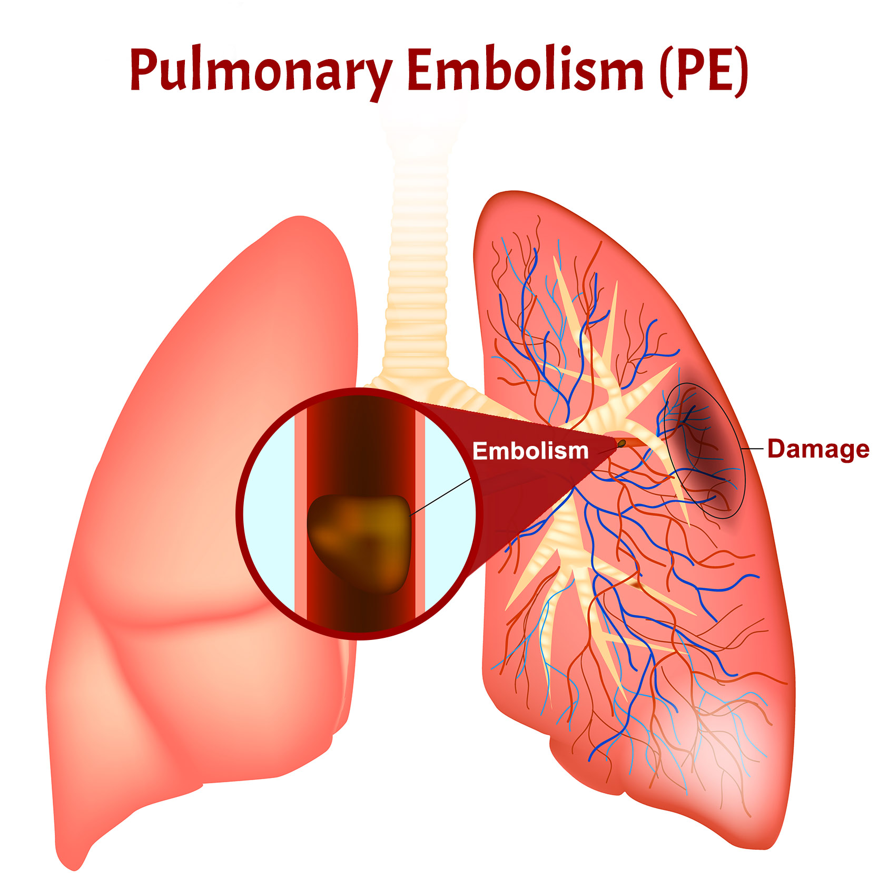

Slide 3
Introduction
Pulmonary embolism occurs when a thrombus, which has broken loose and migrated to the pulmonary arteries, obstructs part of the pulmonary vascular tree. A pulmonary embolism usually results from a deep vein thrombosis (DVT) that has formed in the lower extremities.

Slide 4
Definition:
A pulmonary embolism is a blockage in one of the blood vessels in the lungs. It happens when part, or all, of a blood clot blocks the blood supply to the lungs,
Pulmonary embolism is a clot (thrombotic emboli) or fat, tumors, amniotic fluid, air and foreign bodies (non thrombotic emboli) lodges in the pulmonary arterial (PA) system disrupting the blood flow to a region of the lungs.

Slide 5
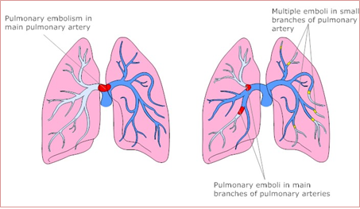

Slide 6
Types of embolism according to cause
Pulmonary embolism: usually formed in the leg (known as a deep vein thrombosis or DVT), lodges in one of the arteries of the lungs.
Brain embolism: If a blood clot travels to the brain, this causes an ischemic stroke or TIA (transient ischemic attack).
Retinal embolism: Small clots can block the smaller blood vessels feeding the retina at the back of the eye. The result is usually sudden blindness in one eye.
Septic embolism: caused by infection in the body reach the bloodstream and block blood vessels.

Slide 7
Amniotic embolism:. In pregnancy, the Amniotic fluid can embolize and reach the mother's lungs, causing pulmonary amniotic embolism.
Air embolism: Scuba divers who rise to the surface too rapidly can generate air embolism, bubbles in the blood that can block arterial blood flow.
Fat embolism: If fat or bone marrow particles are introduced into the blood circulation, they may block blood vessels the way a blood clot or air bubble can.

Slide 8
Risk factors:
Cardiovascular disease, specifically heart failure.
Cancer: especially pancreatic, ovarian and lung cancers.
Surgery: for this reason, medication to prevent clots may be given before and after major surgery such as joint replacement.
Bed rest: when the lower extremities are horizontal for long periods, the flow of venous blood slows and blood can pool in the legs.
Smoking: tobacco leads to blood clot formation.
Obesity : excess weight increases the risk of blood clots
Sedentary lifestyle
Supplemental estrogen.
Pregnancy: the weight of the baby pressing on veins in the pelvis can slow blood return from the legs.

Slide 9
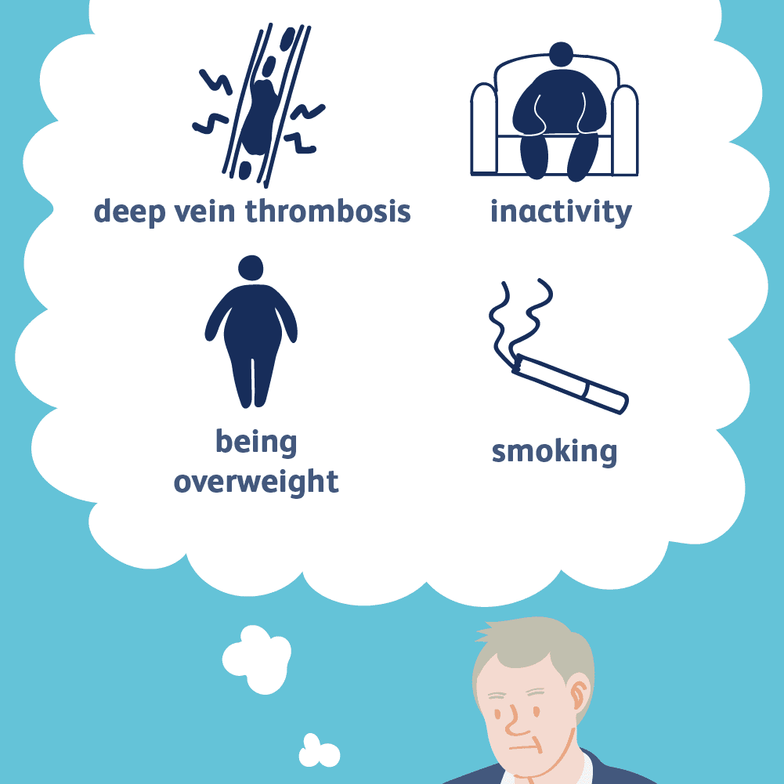

Slide 10
Clinical manifestation of pulmonary embolism
a)_ Small to Moderate Embolus
Chest pain - sharp, stabbing pain that might become worse when breathing
Increased or irregular heartbeat
Dyspnea
Diaphoresis - Wheezing
Dizziness
Difficulty breath - this could occur suddenly, or slowly develop over time
Rapid breathing
Cough - normally a dry cough but sometimes blood, or mucus containing blood may be coughed up.

Slide 11
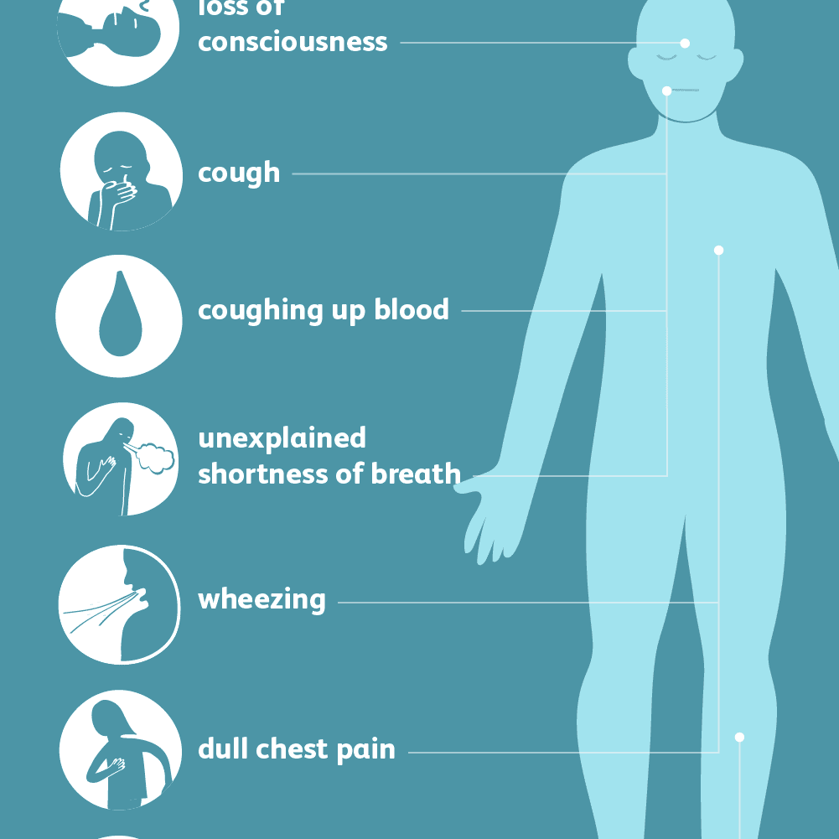
b)- Massive embolus (above manifestation plus the following)
Cyanosis
Restlessness
Anxiety
Confusion
Cool, clammy skin
Decreased urinary output

Slide 12
c)_ Signs of Pulmonary Embolism in Intensive Care Patients
Worsening hypoxemia or hypocapnia in a patient on spontaneous ventilation
Worsening hypoxemia and hypercapnia in a sedate patient on controlled mechanical ventilation
Worsening dyspnea, hypoxemia, and a reduction in PaCO2in a patient with chronic lung disease and known carbon dioxide retention
Unexplained fever
Sudden elevation in pulmonary artery pressure or central venous pressure in a hemodynamically monitored patient.

Slide 13
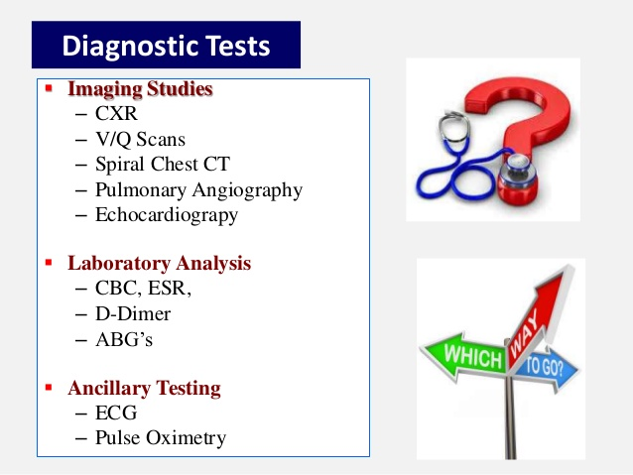
Diagnostic tests of pulmonary embolism
Physical exam.
History for the previous
risk factors
ECG.
Arterial blood gases
Chest X-ray.
Pulmonary angiography.
Doppler ultrasound
(to rule out DVT).

Slide 14
Medical treatment of pulmonary embolism
Anticoagulant therapy with low-dose or adjusted-dose heparin, LMW heparin.
Thrombolytic therapy as streptokinase.
Elastic stoking or intermittent pneumatic leg compression devices.
Surgical intervention (pulmonary embolectomy).

Slide 15
Collaborative management
Administer oxygen therapy, Intubate patient, Initiate mechanical ventilation
Administer medication As bronchodilators, intropic agents , Sedatives, and analgesics
Administer fluids
Position patient to optimize ventilation/perfusion matching
Maintaining surveillance for complications such as ( Bleeding , ARDS)

Slide 16
Nursing care plan
Impaired gas exchanged related to decrease pulmonary perfusion
Acute pain related to transmission and perception of cutaneous, visceral, muscular, or ischemic impulses
Impaired gas exchange related to ventilation /perfusion mismatching
Anxiety related to threat biological, psychologic, and /or social integrity

Slide 17
Patient education for preventing recurrent embolism
Apply elastic stoking.
Elevation of the legs
Active/passive range of motion (ROM) exercises
Adequate hydration
Avoid crossing, dangling of the legs.
Avoid sitting or lying for prolonged periods.
Avoid wearing of constricting clothes.
Do not left the IV lines for prolonged periods.
Do not take aspirin or any drugs without doctor's order.
When traveling, change your position frequent early

Slide 18
Complications of pulmonary embolism
Sudden cardiac death
Obstructive shock
Pulseless electrical activity
Atrial or ventricular arrhythmias
Secondary pulmonary arterial hypertension
Cor pulmonale
Severe hypoxemia
Right-to-left intracranial shunt
Lung infarction
Pleural effusion

Slide 19


