Slide 1
Anemia

Slide 2
Out line:
Introduction.
Def of anemia.
Pathophysiology of anemia.
Normal Range of Anemia
Incidence Of Anemia
Degree of anemia
Risk Factor of anemia
Types of anemia.
General prevention.

Slide 3
Introduction:
Anemia is a condition in which you lack enough healthy red blood cells to carry adequate oxygen to your body's tissues. Having anemia can make you feel tired and weak.
There are many forms of anemia, each with its own cause. Anemia can be temporary or long term, and it can range from mild to severe. See your doctor if you suspect that you have anemia. It can be a warning sign of serious illness.
Treatments for anemia range from taking supplements to undergoing medical procedures.

Slide 4
Def of anemia:
Is a decrease in the total amount of red blood cell (RBCs) or hemoglobin in the blood. A lowered ability of the blood to carry oxygen.
Anemia is a condition in which you lack enough healthy red blood cells to carry adequate oxygen to your body's tissues. Having anemia can make you feel tired and weak.

Slide 5
Pathophysiology:
Anemia generally results from blood loss, decreased red blood cell (RBC) production, poor RBC maturation, or increased RBC destruction. This article reviews the pathophysiology of anemia, with specific emphasis on its physiologic consequences in the surgical patient, and provides a contemporary definition of anemia for use in that context.
Taking a broader, more functional view of anemia paves the way for understanding and appreciating the newer techniques of RBC conservation and transfusion avoidance, as well as of pharmacologic methods available to counter this disorder.

Slide 6
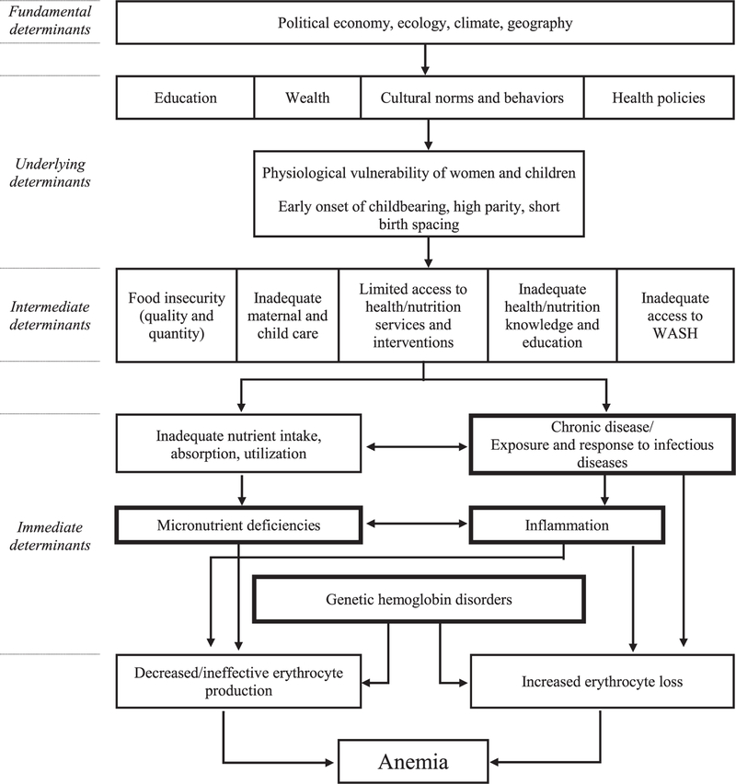

Slide 7
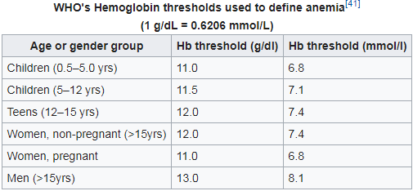
Normal Range of anemia according to WHO
Normal Range of anemia according to WHO

Slide 8
Prevalence of anemia:
Prevalence of anemia among non-pregnant women ( % of women ages 15-49 ) in Egypt was 28.90 as of 2016 .
Its highest value over the past 26 years was 47.40 in 1990 while its lowest value was 28.90 in 2015 .

Slide 9
Degree of Anemia:
Experts identify three main degrees of anemia, which are classified into mild, moderate and severe. Determine at a glance, without the use of laboratory tests, to what degree of anemia is a particular case of the disease is very difficult even for medical professionals. The fact that the main criterion for the degree of anemia is a hemoglobin level and determine its level is possible only on the basis of the analysis of the patient's blood.

Slide 10
1-( Mild )Easy
the first degree of anemia is characterized by insignificant decrease in hemoglobin levels with the following parameters - 100-120 g / L in men and 90 -110 g / l in women. Typically, patients experience no change in its condition. As this type of anemia is recommended diet and consumption of food with high content of iron.
3-( Severe)Heavy
third degree of anemia is already considered dangerous to human life. Hemoglobin level is lowered to 70 g / l or less. Observed irregularities in the cardiovascular system, there is a dilution of the blood, much worse overall health.
2-( Moderate )
In the second, the average degree of anemia, the hemoglobin has a substantial degree of reduction - 70-80 g / l. This state is characterized by the following symptoms of anemia and complaints: headaches, light headedness, etc. In this case, a correction is not enough food, and assigned medications iron supplements.

Slide 11
Risk factors:
A diet lacking in certain vitamins.
Intestinal disorder.
Severe bleeding.
Pregnancy.
Chronic conditions:
For examples, if you have a cancer, kidney or liver failure, or another chronic condition, you may at a risk of anemia.
Family history:
If your family has a history of an inherited anemia , such as sickle cell anemia , you also may be at increased risk of the condition.
Other factors:
Blood diseases and autoimmune disorders, alcoholism, exposure to toxic chemicals, and use of some medications can affect red blood cell production and lead to anemia.

Slide 12
Types of anemia:
Iron Deficiency Anemia.
Aplastic Anemia.
Hemolytic Anemia.
Sickle Cell Anemia.
Pernicious Anemia.
Fava Bean Anemia.

Slide 13
Iron Deficiency Anemia
Def:
Iron deficiency anemia is a common type of anemia — a condition in which blood lacks adequate healthy red blood cells. Red blood cells carry oxygen to the body's tissues

Slide 14
As the name implies, iron deficiency anemia is due to insufficient iron. Without enough iron, your body can't produce enough of a substance in red blood cells that enables them to carry oxygen (hemoglobin). As a result, iron deficiency anemia may leave you tired and short of breath.
Causes:
Inadequate iron intake.
Pregnancy or blood loss due to menstruation.
Internal bleeding.
Inability to absorb iron

Slide 15
Symptoms:
General fatigue.
Weakness.
Pale skin.
Shortness of breath.
Dizziness.
Cold hands and feet.
Fast or irregular heartbeat.
Brittle nails.
Headaches.
Complications:
Rapid or irregular heartbeat.
Pregnancy complications.
Delayed growth in infants and children.

Slide 16
Treatment and health education:
Iron supplements.
Diet:
Diets high that include the following foods can help treat or prevent iron deficiency:
red meat.
Dark green, leafy vegetables such as spinach, Lentils and Soybeans.
Dried fruits such as dried berries, dried apricots and dates.
nuts such as Beans, pulses, nuts and seeds.
Iron-fortified cereals such as Fortified Breakfast Cereals, Fortified Hot Cereals.

Slide 17
Aplastic Anemia
Def:
Aplastic anemia is a condition that occurs when your body stops producing enough new blood cells. Aplastic anemia leaves you feeling fatigued and with a higher risk of infections and uncontrolled bleeding.

Slide 18
Causes:
Radiation and chemotherapy treatments.
Exposure to toxic chemicals.
Use of certain drugs.
Autoimmune disorders.
A viral infection.
Pregnancy.

Slide 19
Symptoms:
Aplastic anemia symptoms may include in addition general symptom:
Frequent or prolonged infections.
Unexplained or easy bruising.
Nosebleeds and bleeding gums.
Prolonged bleeding from cuts.
Skin rash.
Treatment and health education:
Blood transfusions.
Stem cell transplant.
Immune-suppressants.
Bone marrow stimulants.
Antibiotics, antivirals.

Slide 20
Health education:
Resting when you need to. Anemia can cause fatigue and shortness of breath with even mild exertion. Take a break and rest when you need to.
Avoiding contact sports. Because of the risk of bleeding associated with a low platelet count, avoid activities that may result in a cut or fall.
Protecting yourself from germs. You can reduce your risk of infections with frequent hand-washing and by avoiding sick people. If you develop a fever or other indicators of an infection, see your doctor for treatment.
Prevention:
There's generally no prevention for most cases of aplastic anemia. Avoiding exposure to insecticides, herbicides, organic solvents, paint removers and other toxic chemicals may lower your risk of the disease.

Slide 21
3.Hemolytic Anemia:
Def:
Is a condition in which red blood cells are destroyed and removed from the blood stream before their normal life span is up.
Is a condition in which your bone marrow can’t make enough new RBCs to replace the ones that are destroyed too early.

Slide 22
Causes:
Extrinsic hemolytic:
Anemia is also known as autoimmune hemolytic anemia. This type of anemia develops when the spleen traps and destroys healthy red blood cells. It can also come from red blood cell destruction due to:
Infection.
Tumors.
Autoimmune disorders.
Medication side effects.
Leukemia.
Lymphoma.
Intrinsic hemolytic:
Anemia develops when the red blood cells produced by your body are defective. This condition is often inherited, such as in people with sickle cell anemia or thalassemia.

Slide 23
Symptom:
Common signs and symptoms that are seen in patients with hemolytic anemia include in addition general symptom:
Dark urine.
jaundice (yellowing of the skin and the whites of the eyes).
Heart murmur.
Increased heart rate.
Enlarged spleen.
Enlarged liver.

Slide 24
Health education
Avoid any injury
Don’t use medication can causes bleeding as aspirin
Be aware of signs and symptoms of hemolytic anemia
Treatment:
Blood Transfusion.
Intravenous Immunoglobulin (IVIG).
Corticosteroids.
Surgery.

Slide 25
Sickle Cell Anemia:
Sickle cell anemia is an inherited form of anemia a condition in which there aren't enough healthy red blood cells to carry adequate oxygen throughout your body.
Normally, your red blood cells are flexible and round, moving easily through your blood vessels. In sickle cell anemia, the red blood cells become rigid and sticky and are shaped like sickles or crescent moons. These irregularly shaped cells can get stuck in small blood vessels, which can slow or block blood flow and oxygen to parts of the body.

Slide 26
Symptoms:
Episodes of pain.
Painful swelling of hands and feet.
Frequent infections.
Delayed growth.
Vision problems.
Cause:
Genetic.
Treatment
Blood transfusions.
Bone marrow transplant.

Slide 27
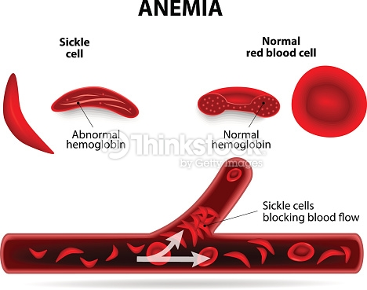
Health education
Get enough oxygen.
Drink plenty of fluids.
Avoid getting over-heated or getting very cold.
Avoid getting infections, and quickly treat infections when you do get them.
See a primary care doctor.
The parent should do premarital tests to detect any genetic abnormality.

Slide 28
5.Pernicious Anemia:
Def:
Pernicious anemia is a decrease in red blood cells that occurs when the intestines cannot properly absorb vitamin B12.
Causes:
Weakened stomach lining (atrophic gastritis).
An autoimmune condition in which the body's immune system attacks the actual intrinsic factor protein or the cells in the lining of your stomach that makes it.

Slide 29
Symptoms:
Desire to eat ice or other non-food things (pica).
Diarrhea or constipation.
Fatigue, lack of energy, or lightheadedness when standing up or with exertion.
Loss of appetite.
Pale skin.
Problems concentrating.
Shortness of breath, mostly during exercise.
Swollen, red tongue or bleeding gums.

Slide 30
Treatment:
Treatment involves a shot of vitamin B12 once a month. People with severely low levels of B12 may need more shots in the beginning.
Some people may also need to take vitamin B12 supplements by mouth.
A certain type of vitamin B12 may be given through the nose.
Health education:
Eating food contain vitamin B12 such as Beef liver, Sardines Tuna, Raw cheese , Eggs and Lamb.
Be aware signs of bleeding.
Avoid food can causes irritation to stomach.

Slide 31
Fava Bean Anemia
Def:
G6PD deficiency is a genetic abnormality that results in an inadequate amount of glucose-6-phosphate dehydrogenase (G6PD) in the blood. This is a very important enzyme, or protein, that regulates various biochemical reactions in the body. G6PD is also responsible for keeping red blood cells healthy so they can function properly and live a normal life span. Without enough of it, red blood cells break down prematurely. This early destruction of red blood cells is known as hemolysis, and it can eventually to hemolytic anemia.
Most people with G6PD deficiency usually don't experience any symptoms. However, some may develop symptoms when they’re exposed to the medication, food, or infection that triggers the early destruction of red blood cells. Once the underlying cause is treated or resolved, symptoms of G6PD deficiency usually disappear within a few weeks

Slide 32
Symptoms:
Rapid heart rate.
Shortness of breath.
Urine that is dark or yellow-orange.
Fever.
Fatigue.
Dizziness.
Paleness.
jaundice, or yellowing of the skin and whites of the eyes.
Causes:
Genetic

Slide 33
Treatment:
Treatment for G6PD deficiency consists of removing the trigger that is causing symptoms. If the condition was triggered by an infection, then the underlying infection is treated accordingly. Any current medications that may be destroying red blood cells are also discontinued. In these cases, most people can recover from the condition on their own.
Once G6PD deficiency has progressed to hemolytic anemia, however, more aggressive treatment may be required. This usually includes oxygen therapy and a blood transfusion to replenish oxygen and red blood cell levels. You will need to stay in the hospital while receiving these treatments, as close monitoring of severe hemolytic anemia is critical for ensuring a full recovery without complications.

Slide 34
Health education:
Avoid condition that causes trigger symptoms.
If symptom occur that should be rest and take oxygen therapy.
Should be aware signs of hemolytic.

Slide 35
General prevention of anemia
Eat a vitamin-rich diet:
Many types of anemia can't be prevented. But iron deficiency anemia and vitamin deficiency anemia's can be avoided by having a diet that includes a variety of vitamins and nutrients, including:
Iron:
Iron-rich foods include beef and other meats, beans, lentils, iron-fortified cereals, dark green leafy vegetables, and dried fruit.
Folate:
This nutrient, and its synthetic form folic acid, can be found in fruits and fruit juices, dark green leafy vegetables, green peas, kidney beans, peanuts, and enriched grain products, such as bread, cereal, pasta and rice.
Vitamin B-12:
Foods rich in vitamin B-12 include meat, dairy products, and fortified cereal and soy products.

Slide 36
Vitamin C:
Foods rich in vitamin C include citrus fruits and juices, peppers, broccoli, tomatoes, melons and strawberries. These items help increase iron absorption.
Consider a multivitamin:
If you're concerned about getting enough vitamins from the food you eat, ask your doctor whether a multivitamin may be right for you.
Consider genetic counseling:
If you have a family history of an inherited anemia, such as sickle cell anemia or thalassemia, talk to your doctor and possibly a genetic counselor about your risk and what risks you may pass on to your children.

Slide 37


