Slide 1
Nutrition for elderly
Dr\ Esteer Ibrahim Ghayth
Lecturer of Gerontological Nursing Department

Slide 2
Out lines:
Introduction
Factors affecting nutritional status
Nutritional daily requirement of elderly
Modified my pyramid for older adult
Supplemental Nutrition
Role of gerontological Nurse for Elderly

Slide 3
I-Introduction
As adults age, many changes impact their eating: losing one’s spouse can take away the socialization surrounding eating; physical decline can interfere with the ability to cook, drive to the grocery store, or carry groceries; and medications and physical, sensory, and cognitive impairments can interfere with both the enjoyment and physical ability to eat.

Slide 4
Factors affecting nutritional status
Age related changes.
Psychosocial factors.
Economic factors.
Cultural factors.

Slide 5
Age related changes:
↓ Taste & smell.
↓ Visual acuity.
Loss of teeth & poor fitting denture.
↓ Gastric secretion→ influence in absorption of B12, folic acid& iron.
Food remains longer time in stomach + ↓ gastric secretion will lead to indigestion &feeling of fullness.

Slide 6
Psychosocial factors:
Depression is common (losses, death, retirement, change of body appearance, impaired vision &poor physical fitness) this will lead to lack of interest in eating& anorexia and ↓ food intake.
Living alone also will lead to lack of incentive to cook &eat.

Slide 7
Low income.
Limited access to food and food choices.
Inadequate facilities to food storage and preparation.
Economic Factors

Slide 8
Cultural factors:
Eating habits may miss certain food group as vegetarians.
Dietary intake
a. Little or no appetite
b. Problems with eating or swallowing
c. Eating fewer than two meals a day
. Limited income may cause restriction in the number of meals eaten per day or dietary quality of meals eaten.

Slide 9
Isolation
a. Older adults who live alone may lose desire to cook because of loneliness.
b. Lack of access to transportation to buy food
Chronic Illness
a. Disability
b. Poor oral health (e.g., cavities, gum disease, and missing teeth, dry mouth, impairs ability to lubricate, masticate, and swallow food
c. Medications e.g. antidepressants, antihypertensive, and bronchodilators can contribute to dry mouth, and alterations in taste and smell

Slide 10
Physiological changes
a. Decrease in lean body mass and redistribution of fat around internal organs lead to decreased caloric requirements
b. Change in taste (from medications, nutrient deficiencies, or taste bud atrophy) can also alter nutritional status
3- Nutritional daily requirement of elderly: As people age, physiologic changes affect the body’s need for calories, protein, and fluid, “with aging, a gradual decline in lean body mass and an increase in body fat occur.

Slide 11
The following is a summary of the daily requirements for healthy older adults

Slide 12
The following is a summary of the daily requirements for healthy older adults
1- Calories requirement:
Caloric requirement diminished by 10% in age 51-75 years and by 20-25% in age more than 75 years.
N.B: Fat yield 9 cal/gram, CHO and protein yield 4 cal/gram, mineral and water yield no calories .
Daily energy intake declined by 1000-1200 for men and by ` 600-800 calories for women after age of 60 years.

Slide 13
Protein requirement:
Protein is essential components for tissue growth. A minimum daily protein intake of 1 gm/kg of body weight is recommended, achieved through 10-20 of daily caloric intake delivered from protein.
This can be changed to be low in a case of renal impairments or to be a high in cases of acute inflammation process.
During infection, stress, trauma protein ↑ to 1.6 or 1.5 g/kg body wt.
Daily allowance requirement of protein: male: 63 g/day & female: 50 g/day.

Slide 14
Fat requirement
Many functions of fats include; temperature regulation, provide reserve source of energy, and facilitate absorption of fat soluble vitamins.
For older adults, the total fat intake should be limited to10-30% of the total energy intake.
Fats are categorized according to their sources, saturated fats are derived from animals and unsaturated fats are derived from vegetables.

Slide 15
Fat requirement
Saturated fats usually associated with accumulation of serum cholesterol and associated with harmful effects such as hyperlipidemia.
For older adults, the consumed fats should be polyunsaturated or monounsaturated fatty acids.

Slide 16
Carbohydrates and fibers:
The essential source of energy and fibers. The adequate intake of CHO helps to maintain normal levels for blood glucose and prevent the breakdown of tissue protein.
CHO provides at least 50% of the total caloric content of the diet.
Importance of fibers for elders: Soluble fibers that found in oats, it has benefit in lowering serum cholesterol level and improves glucose tolerance in diabetic patients.
Insoluble fibers found in most grains and vegetables helpful for maintaining good bowel function and in preventing constipation.

Slide 17
Carbohydrates and fibers:
Also elderly advised to consume food containing complex CHO e.g.( vegetables, grains and fruits) that contains fibers, and nutrients such as minerals and vitamins, than foods containing simple CHO e.g. (table sugar, honey, and candy).
Recommended daily intakes of carbohydrates for Men is 200-300 g/day, for women is 180-230 g/day.
An adequate intake for total fiber is set at 25 g/day for women and 38 g/day for men.

Slide 18
Vitamins and minerals:
Because older adults need fewer calories in addition age related changes affecting GIT, a deficiency of essential minerals or vitamins are likely to occur. In addition pathologic condition and medication used that commonly occur in older adults often cause nutritional deficiencies such as (iron deficiency anemia, deficiency in zinc, calcium, B vitamins, vitamin and E.

Slide 19
Vitamins & mineral requirements:
Calcium:- for mineralization of bone &has a role in blood & cardiac function.
Daily requirement 1200 mg./day if there is no contraindications.
Vitamin D: needed for calcium absorption& metabolism.
Daily requirement: 10-15mcg of Vitamin D.
Exposure 15 minutes/day to sun is enough.

Slide 20
7- Fluids intake:
Older people are at increased risk for dehydration due to age associated decline in thirst sensation, inadequate fluid intake, and excessive fluid loss some medications, such as for high blood pressure or anti-depressants, and diuretic.
It is recommended that older adults consume 1500-2000 ml /day (6-8 glasses) of non-caffeinated fluid daily to maintain adequate hydration status.

Slide 21
Recommended daily intakes for micro nutrients as
Nutrient | Recommended daily intake for 50+ years | Nutrient | Recommended daily intake for 50+ years
Calcium (mg) | 700 | Iron (mg) | 14.8
Vitamin B₆ (mg) | 1.2 | VitaminB₁₂ (μg) | 1.5
Vitamin C (mg) | 40 | VitaminA (mg) | 600
Vitamin D* (μg) | 10 | Sodium(mg) | 1600
* The recommendation for vitamin D only applies for adults over the age of 65 years.

Slide 22
Modified My Pyramid for Older Adults
The Modified My Pyramid for Older Adults, developed by researchers at Tufts University, continues to emphasize nutrient-dense food choices and the importance of fluid balance, but adds additional guidance about forms of foods that could meet the unique needs of older adults.

Slide 23
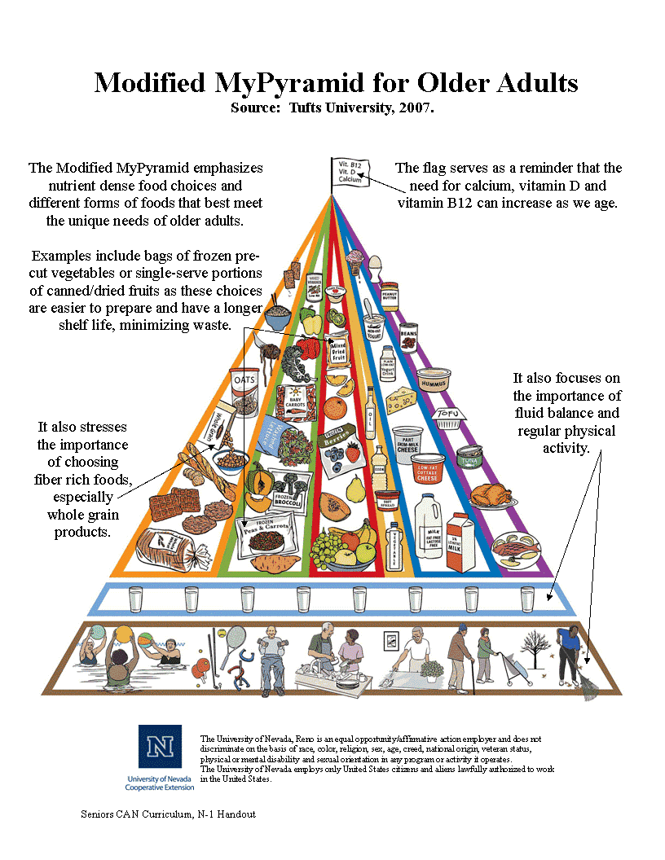

Slide 24
Recommendations from the Modified USDA Food Pyramid for Older Adults
Whole, enriched, and fortified grains and cereals such as brown rice and 100% whole wheat bread
Bright-colored vegetables such as carrots and broccoli
Deep-colored fruit such as berries and melon
Low- and non-fat dairy products such as yogurt and low-lactose milk

Slide 25
Recommendations from the Modified USDA Food Pyramid for Older Adults
Dry beans and nuts, fish, poultry, lean meat and eggs
Liquid vegetable oils and soft spreads low in saturated and trans fat
Fluid intake (water is best, 8 glasses of fluids/ day)
Physical activity such as walking, house work and yard work

Slide 26
5-SUPPLEMENTAL NUTRITION
When older adults begin to show signs of unintentional weight loss, supplemental nutrition may provide a means of increasing intake. There are different types of supplemental nutrition.

Slide 27
Risk factors of elderly abuse:
Socially isolated, lack financial resources.
Lack of resources or access to resources.
Low income.
Social isolation.
Low level of education.
Functional debility.
Cognitive impairment.
Dependence on caregiver for ADLs (Activities of Daily Living).
Psychological disorders.

Slide 28
Snacks
The first simply practice of offering snacks between meals. The researchers concluded that snacks may be a more effective way for increasing intake than increasing amount of food eaten at meal times.

Slide 29
2- Oral Nutrition Supplements (ONS)
Oral nutritional supplements are generally liquid preparations that are high in energy, protein, High-calorie, nutrient-rich supplements and fiber for people who are unable to eat.
There are a variety of supplements, including those created for patients with diabetes, chronic obstructive pulmonary disease, renal disease, and liver disease.
Supplements are not designed to replace meals but should be provided between meals (not within the hour preceding a meal) and at bedtime.

Slide 30
3- Tube Feeding
When swallowing is impaired, tube feeding may seem like a logical step to increase nutrition e.g. Enteral nutrition (NGT- G-tube, J-tube) and Parenteral nutrition (TPN- IV)

Slide 31
6-Role of gerontological Nurse to Promoting Nutrition for Elderly:
Nutritional assessment involves: nutritional history, physical examination, anthropometric measurements, biochemical evaluation, cognitive & mood evaluation.
Health history related to nutrition.
Anthropometric measurement.
Client and family education.
Dietary guideline for old persons.
Eat a variety of food.
Maintain a healthy weight.

Slide 32
6-Role of gerontological Nurse to Promoting Nutrition for Elderly:
Choose a diet low in fat, saturated & cholesterol.
Choose a diet plenty of vegetables, fruits & grain products.
Use sugar & salts in moderate.
Drink 2000-3000cc/daily.
Frequently reassess the patient’s nutritional status so proper nutritional interventions can be administered.

Slide 33
6-Role of gerontological Nurse to Promoting Nutrition for Elderly:
Provide information to elderly caregivers on how to maintain their own nutritional health.
When appropriate, encourage family members to assist with meals.
Obtain a careful weight history and carefully measure weight and height at each visit.
When appropriate, provide instructions on how to increase calories and protein intake.
Refer to community agencies if there are limitations to shopping or preparing foods.

Slide 34
Nutrition Education:
The goal of nutrition education is to help people to eat and enjoy healthy food. These goals can be accomplished through the following steps:
Increase awareness of good nutrition.
Enhance motivation to eat well

Slide 35
Thanks

