Slide 1
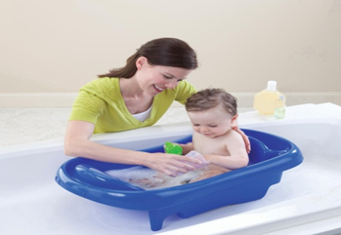
Infant bath

Slide 2
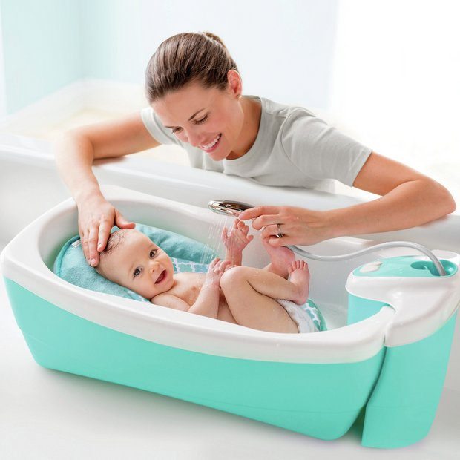

Slide 3
Purposes:
1-To keep skin clean
2-To stimulate circulation
3-To promote comfort
4-To observe the child body

Slide 4
Equipment:
1-Awash basin with warm water (about 38ºC).
2-Clean gloves
3-Washcloth
4-Cottonball
5-Towel(at least two)
6-Babycomb
7-The infant cloths
8-Mild-soap

Slide 5
Procedure
 | Steps
1 | Wash hands
2 | Prepare equipment
3 | Explain procedure to the mother
4 | Close window and doors
5 | Count apical pulse, measure Temperature and respiration before disrupted
6 | Fill the bath basin one-half full of Warm water

Slide 6
7 | Test temperature of water by your Wrist or elbow
8 | Place the rubber sheet on bed
9 | Undress the infant ,and wrap him in Bath towel
10 | Clean the eye using wash cloth with water only from the inner to outer
11 | Wash the infant face with water only then dry
12 | Wash infant's ears and neck giving Particular attention to skin fold of the neck, behind the ears and the external part of the ears

Slide 7
13 | Place the infant again on his back, Wash, rinse and dry each arm and hand ,pay attention to the axilla, dry it thoroughly
14 | Wash, rinse and dry the infant's chest and abdomen. Keep him covered with bath blanket or towel between washing and rinsing
15 | Turn the infant on his stomach or side, wash, rinse and dry the back
16 | Wash, rinse and dry the infant legs And feet, pay attention to areas between the toes
17 | Place the infant on his back ,clean And dry the genital areas from front to back, the rectal area is cleansed

Slide 8
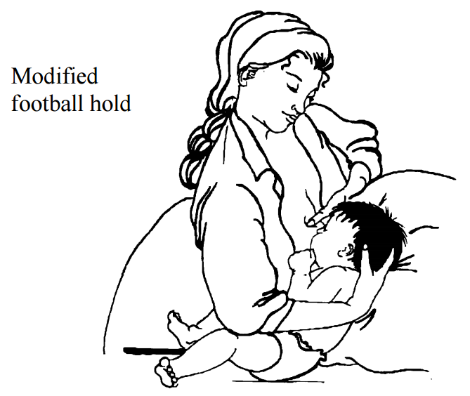
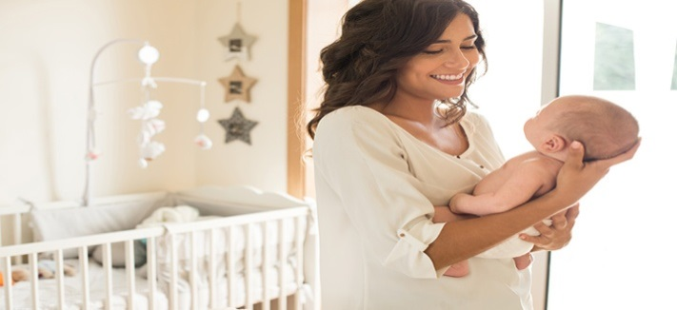
18 | Pick the infant up using football hold position the baby's head over the wash basin .Lather the scalp using mild soap and message the scalp using your fingertips
19 | Rinse and dry the scalp
20 | Dress the infant
21 | Clean the finger nails with, cutting Toe nails,comb the hair

Slide 9


Slide 10
22 | Clean the equipment
23 | Wash hands thoroughly with soap and water, dry with clean and dry cloth | Standard precaution to reduces the Transmission of microorganisms
24 | Record the following: time, Observation ,reaction of infant

