Slide 1

Gynecological instrument
Dr : nehad shwkat

Slide 2
Outlines:
Allis' Forceps • Artery Forceps • Ayre's Spatula • Babcock's Forceps • Cusco's Speculum • Ferguson's speculum • Auvard's speculum • Doyen's Retractor • Right Angle Retractor used for Tubectomy • Episiotomy Scissors • Foleys Catheter • Hegar's Dilator • Kocher's Forceps ( Clamp) • Needle Holder • Ovum Holding Forceps • Pinard's Fetal Stethoscope • Sims' Anterior Vaginal Wall Retractor • Sims' Speculum • Sponge Holder / Sponge holding forceps. • Surgical Blades • Cord Clamp • Umbilical Cord Cutting Scissors • Uterine Curette • Bladder Sound • Vulsellum forceps • Towel Clamp

Slide 3
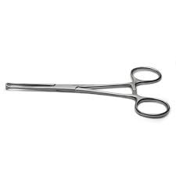
1-Allis' Forceps
This instrument is used for grasping tough structures like Rectus sheath or fascia in operations like tubectomy, LSCS, abdominal hysterectomy

Slide 4
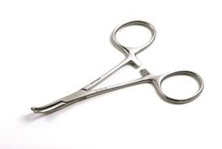
2-Artery Forceps
This is a hemostat. Used for clamping bleeding vessels. It is also used for grasping tissue at the time of operation. ( Opening and closing peritoneum) . It is also used to hold stay sutures. It comes in two shapes straight and curved. Usually straight is used for rough work like stay and curved is used as hemostat.

Slide 5
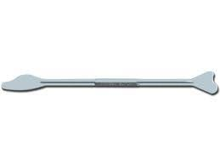
3-Ayre's Spatula
Shape: It's a wooden spatula
Usage:
Used to obtain a specimen from squamocolumnar junction where carcinoma is more likely to occur or to obtain a specimen from vaginal fornices by its reverse end. The patient will be in lithotomy position

Slide 6
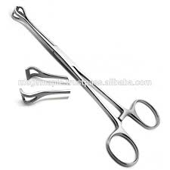
4-Babcock's Forceps
This instrument is used for grasping tubular structures like fallopian tube in tubectomy ureter, appendix etc. The tip is a traumatic as there are no sharp teeth.

Slide 7
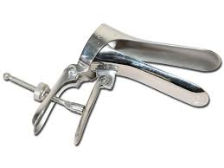
5-Cusco's Speculum
Self-retaining double bladed vaginal speculum.
Usage:
Used in OPD for routine examination.
To separate the anterior and posterior wall of vagina
It is rotated and then opened it into the vagina and the patient in a dorsal position
Because of limited opening only few procedures like taking of Pap smear, Insertion and removal of Copper T can be done.

Slide 8
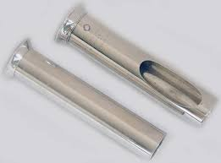
6-Ferguson's speculum
Shape: it is a metal tube with different sizes
Usage: Used to obtain a sterile or uncontaminated smear swab from high vagina (post vaginal wall)
The patient should be in the left lateral position

Slide 9
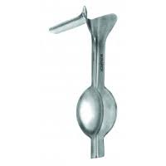
7-Auvard's speculum
Shape: is a weighted vaginal retractor
Usage: it is only used in the operating room when the patient is anesthetized

Slide 10
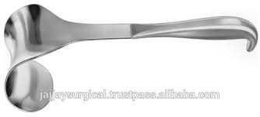
8-Doyen's Retractor
This instrument is used for retracting bladder during abdominal operations like LSCS , abdominal hysterectomy , laparotomy. The smooth edge and the curvature retracts the bladder and protects it during surgery

Slide 11
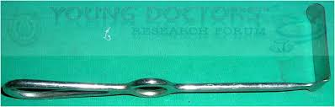
9-Right Angle Retractor used for Tubectomy

Slide 12
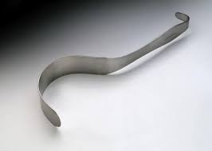
10-Deaver's Retractor for retraction of deep structures.

Slide 13
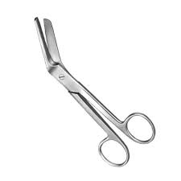
11-Episiotomy Scissors.
This is used for giving episiotomy. Episiotomy is usually given under local anesthesia (1% Xylocain) at the time of crowning of head.. The cut is given medio laterally ( Midline or Lateral episiotomy is usually not given) The episiotomy is sutured in 3 layers with no 0 ( one zero) chromic catgut. The first layer is vagina starting with the apex. The second layer is perineal muscles and the third layer is skin.

Slide 14
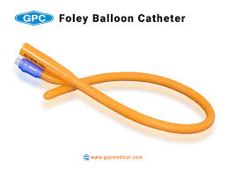
12-Foleys Catheter
This is a self retaining catheter most commonly used for drainage of the urinary bladder after surgery. It is used in operations like Abdominal, Vaginal hysterectomy, repair of Vesico vaginal fistula

Slide 15
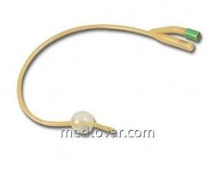
It has a bulb below the tip. This can be inflated by normal saline.
It has two channels. One for inflating bulb and has a valve The other channel is for drainage of urine to which urobag is attached. No 14 or 16 are used in adult.

Slide 16
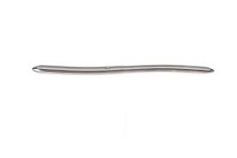
13-Hegar's Dilator
Shape: may be single or double – ended and consist of a set of progressive sizes. One number is written on its base to indicate the diameter in millimeters
Usage:
It is passed through the cervical canal for dilatation of the cervix in procedures like D&C, D& E , Fothergills operation , Hysteroscopy , Cervical Stenosis , Primary dysmenorrhea. It can cause perforation if too much force is used.. Very large dilatation can cause cervical incompetence.
The patient is in lithotomy position

Slide 17
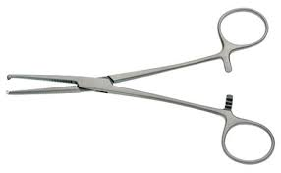
14-Kocher's Forceps (Clamp)
This instrument is used for holding pedicles in hysterectomy. The tips of the blades have teeth so that the tissue does not slip. The blades can either be straight or curved. This instrument is used in hysterectomy to clamp pedicles which are then transfixed. 27 It is also used for salpingectomy in ectopic or oophorectomy in ovarian mass. This can also be used for clamping umbilical cord of new born at the time of delivery or for artificial low rupture of membranes (ARM).

Slide 18
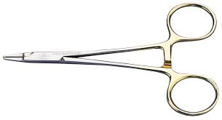
15-Needle Holder
This instrument is used for grasping needle at the time of suturing. The inner surface of tip has serrations and a small grove for firm grasp of the curved needle

Slide 19
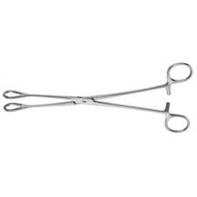
16-Ovum Holding Forceps
Shape: it shape like two spoons
Usage: which grasp the ovum or other tissue from the uterine during surgery for example , This instrument is used for removing the products of conception in inevitable , incomplete abortion. The tip of this instrument is rounded cup like to avoid perforation and to hold large tissue. The patient is in the lithotomy position

Slide 20
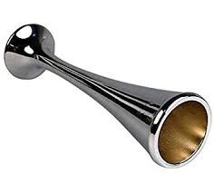
17-Pinard's Fetal Stethoscope
This is used for auscultation of fetal heart. The tapering rim is applied to ear and the other side to mother's abdomen.

Slide 21
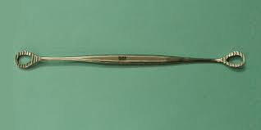
18-Sims' Anterior Vaginal Wall Retractor
This instrument is used with Sim's Speculum Its a long instrument with blunt loops at both the ends making an angle for easy visualization of cervix and vagina. Especially useful in case of cystocele.

Slide 22
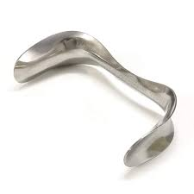
19-Sims' Speculum
Shape: one blade is larger than the other
Usage: It used to expose the posterior vaginal wall and expose the cervix when packing or painting by lubricated and passed it along the posterior vaginal wall.
Use on Gyn OPD for following procedures: Taking Pap Smear , Insertion and removal of Copper T , Colposcopy ,Taking swabs for microscopic examination in suspected infections. Hysterosalpingography (HSG) Use in Gyne Operations : D&C , Cervix Biopsy , Vaginal Hysterectomy , Fothergills Operation, Repair of Vesico vaginal fistula The patient should be in left lateral position

Slide 23
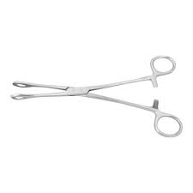
20- Sponge Holder / Sponge holding forceps.
This instrument is used for holding sponge or a gauze piece for painting the area before
operation. This is also used for tissue dissection when used as sponge on holder
This also used for grasping the cervix is obstetrics.. In exploring cervix after forceps
delivery. In LSCS this can be used for clamping the bleeding edges of uterine incision

Slide 24
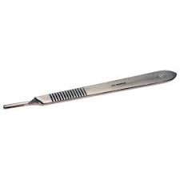
21-Surgical Blades
Blade Handles come in two sizes No 4 for big blades.
No 20 Blade used for Skin Incision in LSCS, Laparotomy etc.

Slide 25
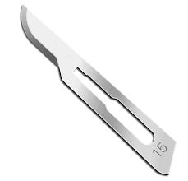
No 15 Blade for fine incision

Slide 26
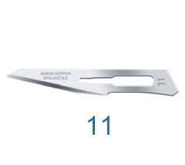
No 11 Blade for Stab Incision like drainage of abscess or putting trocar

Slide 27
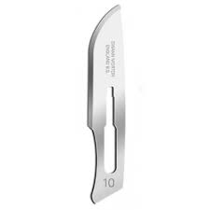
No 10 Blade for small incisions

Slide 28
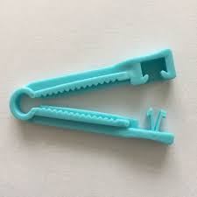
22-Cord Clamp
Used for closed blood vessels of cord after delivery and to prevent bleeding.

Slide 29
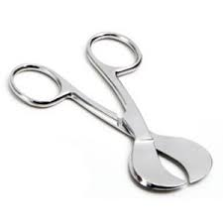
23-Umbilical Cord Cutting Scissors
Used for cutting umbilical cord after delivery.

Slide 30
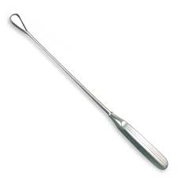
23-Uterine Curette
Shape: The tip comes in two shapes. Sharp and Blunt. Sharp curate is used in gynecologyand blunt in pregnancy check curettage.
Usage:
Use for scraping endometrial cavity to obtain sample for histopathology.
Diagnostic D&C is done commonly for Menorrhagia, Endometrial Carcinoma, Infertility,
Tuberculosis of endometrium . It also has secondary beneficial advantage of reducing the
bleeding in menorrhagia.
The patient is in the lithotomy position

Slide 31
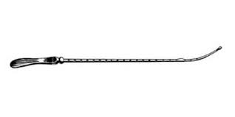
24-Uterine sound
Shape: Its a long instrument with blunt tip (To avoid perforation) About 5 cms from the tip its bend to make angle of 30 degrees. It has marking on it for measurements. (Bladder sound has no markings) The angle helps to negotiate curvature of the uterus (Anteflexion).
Usage: It is used for measuring uterocervical length , length of the cervix (for diagnosing supra vaginal elongation of the cervix). To feel for any pathology inside the cavity like fibroid ( Sub mucus, polyp) Congenital anomalies like septa or bicornuate. Adhesions or synachae. To feel for the misplaced IUCD.
It can create false passage or perforation especially in soft uterus in pregnancy
The patient is in the dorsal position

Slide 32
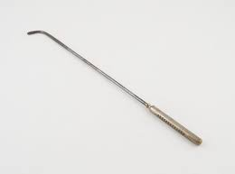
25- Bladder Sound
Shape: It is long instrument with gentle curve ( not angled like uterine sound) and has no markings on it.
Usage: It is used to estimate the size of the bladder and define extension of bladder cystocele and vaginal hysterectomy.
The patient is in the lithotomy position .

Slide 33
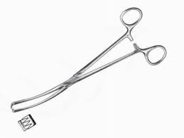
26- Vulsellum forceps
Shape: have large teeth
Usage:
It is used for grasping the cervix and allows traction to be passage of some instrumentthrough the cervical canal during procedure. . The tips of the blades have 3-4 teeth to holdand steady the cervix in procedures like Insertion of IUCD. Cx Biopsy, Fothergillsperation, Vaginal Hysterectomy
Since the teeth are sharp it is not used in pregnancy as it may cause cervical tares andlacerations. Instead sponge holding forceps is used to grasp the cervix.
The patient is in the dorsal position.

Slide 34
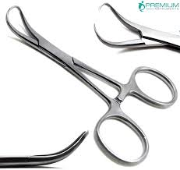
27-Towel Clamp
Adds weight to drapes and towels to ensure they stay in place
Allow exposure of the operative site

