Slide 1
Growth Measurement
Prepared by
Asmaa Ahmed Mahazm
Demonstrator at Community Health
Nursing department

Slide 2
outlines
- Definition of growth
-Types
- Newborn stage
- Infant stage
- Toddler stage
- preschool stage
- School stage
- Adolescence Stage
- procedure

Slide 3
Growth:-
a normal process of increase in size o the whole body or any of its parts as a result of accretion of tissue similar to that originally present.
Types of growth:
1- Physical growth (Ht. Wt., head & chest circumference)
2-Physiological growth (vital signs)

Slide 4

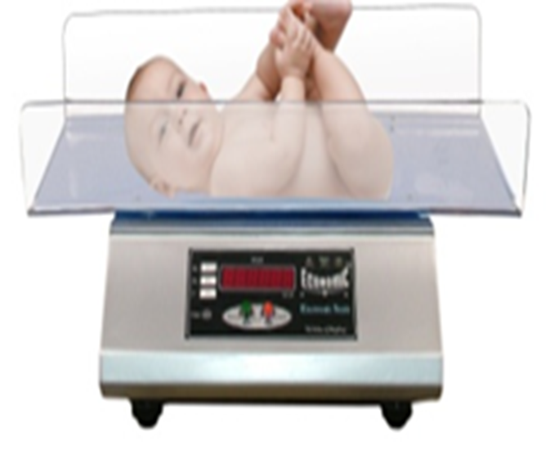
Newborn Stage
Physical growth
1-Weight
Weight = 2.700 – 4 kg

Slide 5
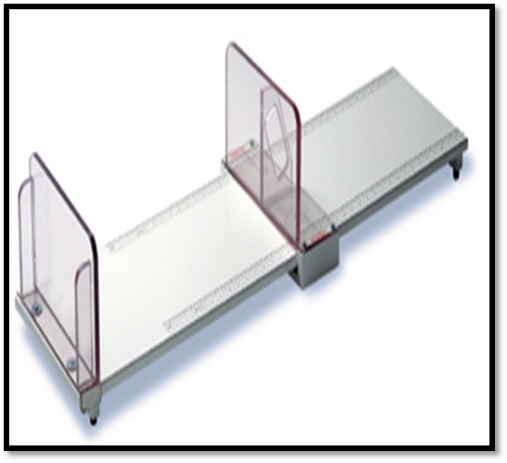
2-Height
Boys average Ht = 50 cm
Girls average Ht = 49 cm

Slide 6
3-Head circumference (33-35 cm)
-Skull has 2 fontanels (anterior & posterior).
4-Chest circumference
- It is 30.5 to 33cm (usually 2–3cm less than head circumference).
Physiological growth
- Temperature (36.3 to37.2°C).
- Pulse (120 to 160 b/min).
- Respiration (35 to 50C/min).

Slide 7
Infant Stage
Physical growth
1- Weight
The infant will double his birth wt by 4-5 months and triple it by 10-12 months of age
- Infants from 3 to 12 months
Weight = Age in months +9
2

Slide 8
2- Height
    - Length increases about 3 cm /month during the 1st 3 months of age,
    - then it increases 2 cm /month at age of 4-6 months.
    - Then, at 7 – 12 months, it increases 1 ½ cm per month.
-During 1–2 years, the child's height increases by 1cm/mont

Slide 9
3- Head circumference
It increases about 2 cm /month during the 1st 3 months,
Then ½ cm/month during the 2nd 9 months of age.
4- Chest circumference
-By the end of the 1st year, it will be equal to head circumference.
Physiological growth
Pulse 110-150 b/min-
Resp. 35 ± 10 c/min -
-Blood pressure 80/50 ± 20/10 mmHg

Slide 10
Toddler Stage
1-Weight:
-The toddler's average weight gain is 1.8 to 2.7 kg/year.
-Formula to calculate normal weight of children over 1 year of age is
Age in years X 2+8 = ….. Kg.

Slide 11
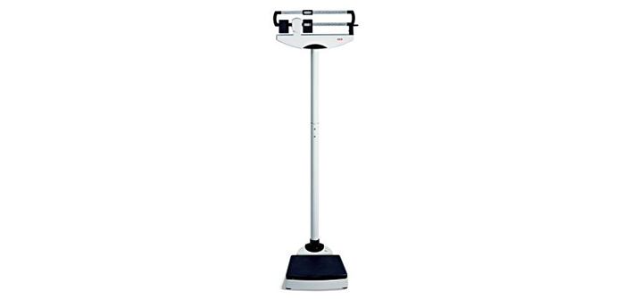


Slide 12
2- Height:
-During 1–2 years, the child's height increases by 1cm/month.
-The toddler's height increases about 10 to 12.5cm/year.
- Formula to calculate normal height:-
Age in years X 5 + 80 = cm.

Slide 13
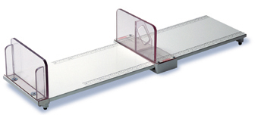
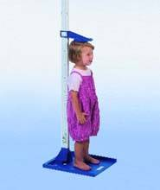

Slide 14
3- Head circumference:-
The head increases 10 cm only from the age of 1 year to adult age.
4- chest circumference continues to increase in size and exceeds head circumference.
* Physiological growth:
- Pulse: 80–130 beats/min (average 110/min)
-Respiration: 20–30C/min.

Slide 15
Preschool Stage
Physical growth:
Weight: *
The preschooler gains approximately 1.8kg/year-
*Height:
- He doubles birth length by 4–5 years of age
Physiological growth:
Pulse: 80–120 beat/min. (average 100/min)*
*Blood Pressure: 100/67+24/25.
Respiration: 20–30C/min*

Slide 16
School Stage
Physical growth:
1- Weight
- School–age child gains about 3.8kg/year-
- Boys tend to gain slightly more weight through 12 year-
- Weight Formula for 7 - 12 yrs
= (age in yrs x 7 )– 5)
2

Slide 17
2- Height:
- The child gains about 5cm/year
-Body proportion during this period: Both boys and girls are long-legged.
Physiological growth:
    Pulse: 90+15 beats/min
    Respiration: 21+3C/min-
    -Blood Pressure: 100/60+16/10.

Slide 18
Adolescence Stage
1- Weight:
Growth spurt begins earlier in girls (10–14 years, while it is (12– 16 in boys).
Males gains 7 to 30kg, while female gains 7 to 25kg
2- Height:
By the age of 13, the adolescent triples his birth length
Males gains 10 to 30cm in height
Females gains less height than males as they gain 5 to 20cm
Growth in height ceases at 16 or 17 years in females and 18 to 20in males.

Slide 19
Physiological growth:
Pulse: Reaches adult value 60–80 beats/min.
Respiration: 16–20C/min.
Blood pressure: 120/80

Slide 20
Growth Chart
A growth chart is used by pediatricians and other health care providers to follow a child's growth over time. ... The height, weight, and head circumference of a child can be compared to the expected parameters of children of the same age and sex to determine whether the child is growing appropriately

Slide 21
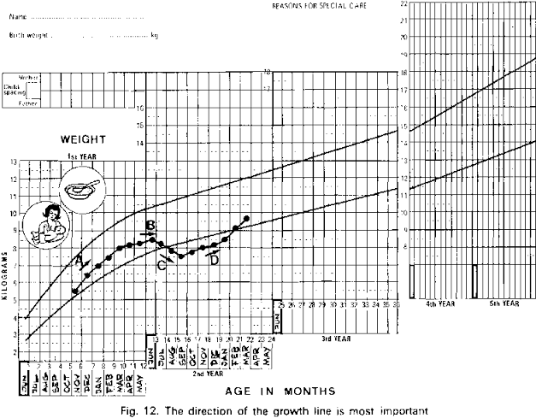
Proto type chart

Slide 22
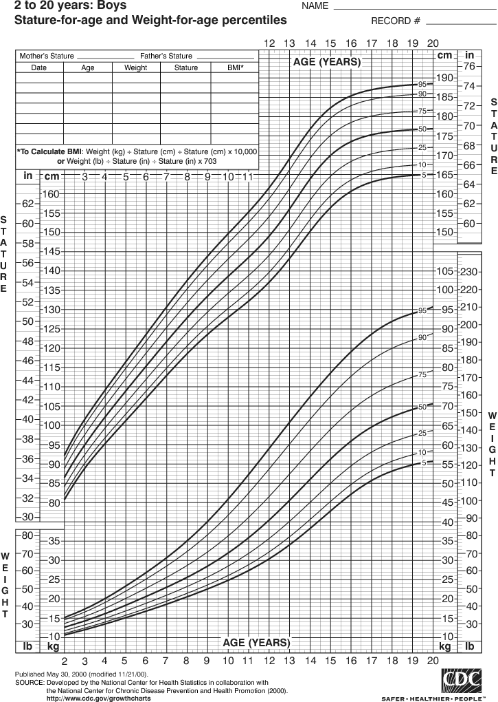
Percentile chart

Slide 23
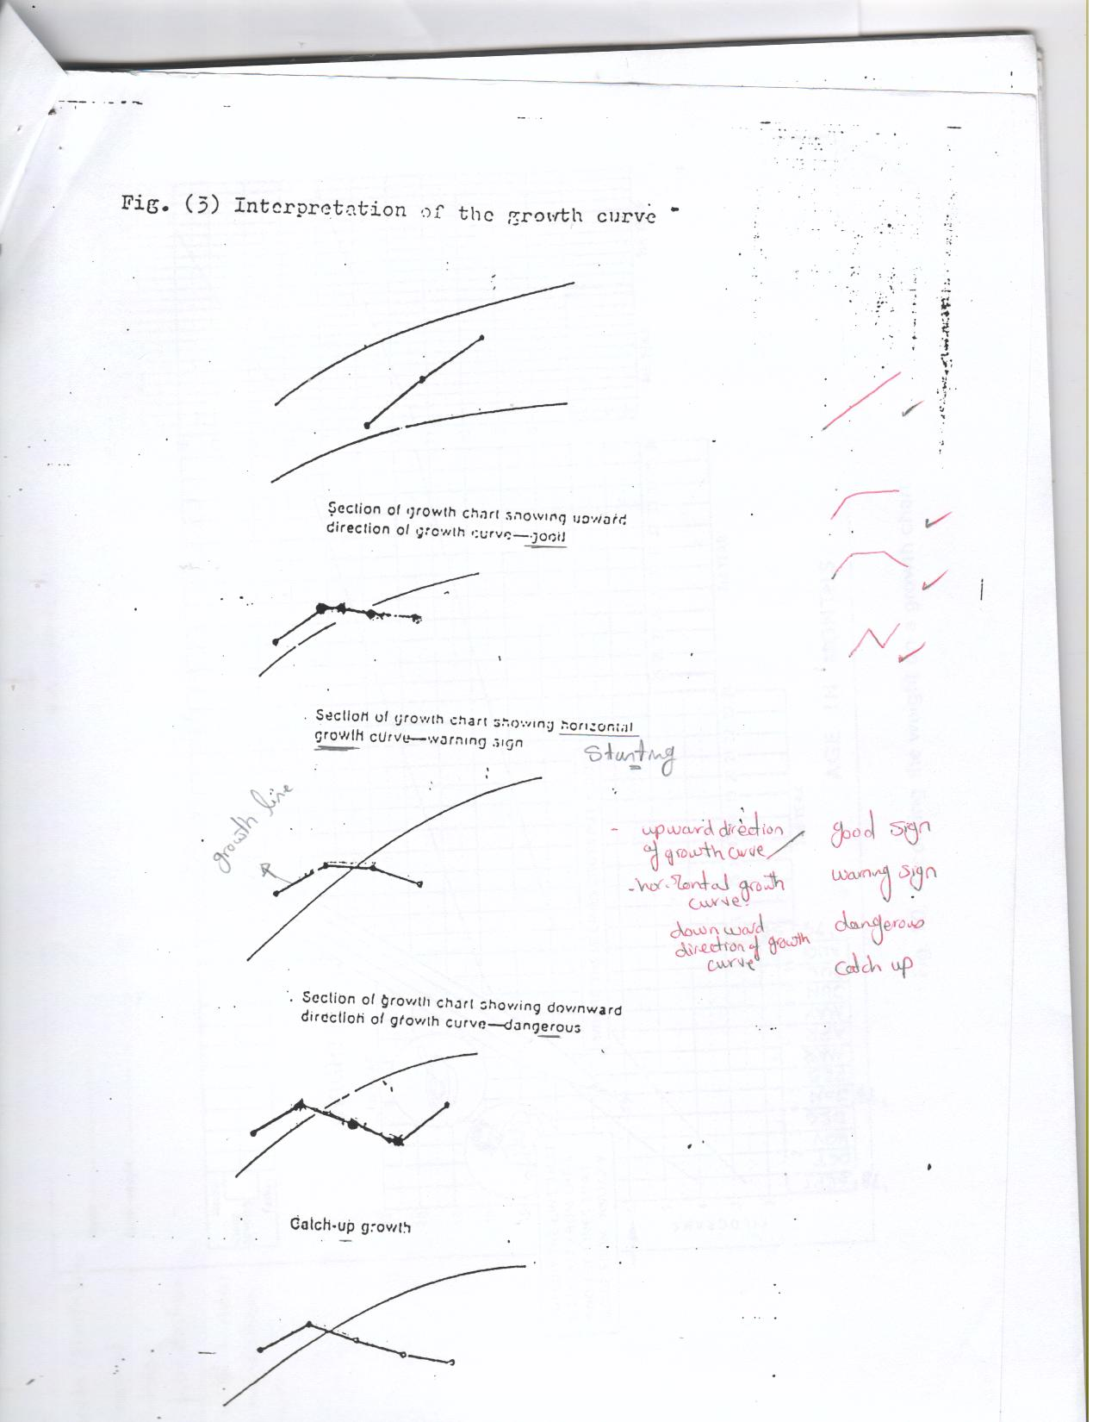
Interpretation of growth chart curves on proto type chart:
  a) Upward Growth Curve

Slide 24
  b) Horizontal Growth Curve

Slide 25
  c) Downward Growth Curve

Slide 26
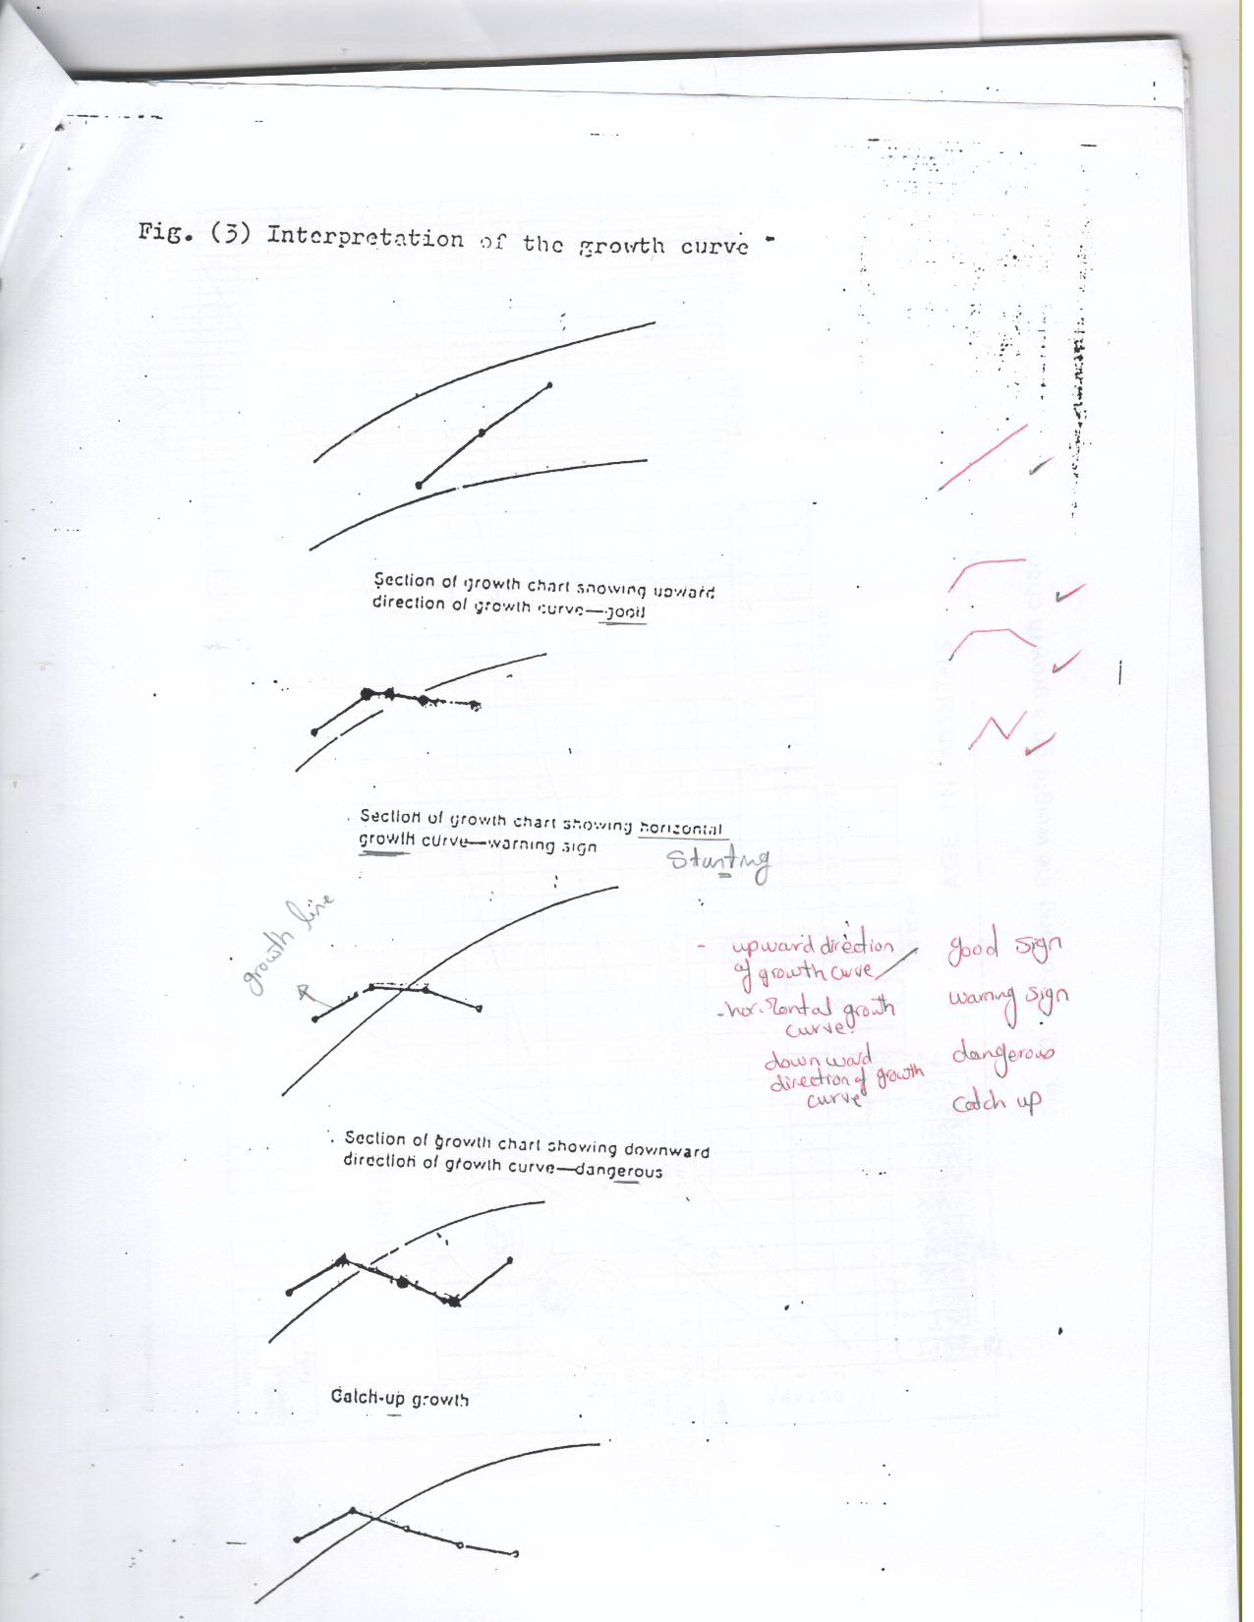
  d) Catch-up Growth Curve

Slide 27
d) Faltering Growth Curve

Slide 28
B-Interpretation of growth chart curves on percentile chart:
Child weight lies on the percentile | Means the child weight is
Above 97th | Obese
At 97th percentile | Normal above average.
Between 97th and 50th | Normal above average
At 50th percentile | Within average
Between 50th and 3rd | Normal a below average
<3rd | Underweight

