Slide 1
Community Health
Nursing Department
(Chronic Diseases)

Slide 2
Supervised by :-
Dr/Fatma Saied
Prepared by :-
1- lobna esmat
2- Laila abd elbaset ahmed
3- Gada abo zeed kama
4-abeer abdo mohamed
5- Mariam adel shnoda
6- Mariam nan zaky saleeb
7- Marwa ahmed abd elrahem
8- Marwa ahmed Mohamed
9- Marwa anwar rezk
10- Rehab kalaf Mahmoud
11- Azeza Mahmoud Mohamed
12- Somaya Mohamed Mohamed
13- Hend abd elrahem ragab
14- Rehab khale elm eldeen
15- Wesam moktar Mahmoud
16- Mona abd elrafee hamdy
17- Nehal ahmed dahy
18- walaa ahmed sheba

Slide 3
outlines
Introduction.
Definition of Chronic & Acute illness.
Differences between Acute and Chronic Disease.
Characteristics of chronic illness and related health problems.
Phases of Chronic illness.
Classification of chronic illness risk factors.
Effects of chronic illness.
Prevention of chronic illness.
Most common chronic illness in Egypt.
Example on chronic illness.

Slide 4
Breast cancer:-
Definition
Breast anatomy
pathophysiology
Risk factors
Signs and symptoms
Diagnosis
Management
Prevention
Breast self-examination
10- Role of community health nurse in chronic illness prevention.

Slide 5
Introduction
A chronic disease is one lasting 3 months or more, by the definition of the U.S. National Center for Health Statistics, Chronic diseases generally cannot be prevented by vaccines or cured by medication, nor do they just disappear. Chronic disease can hinder independence and the health of people with disabilities, as it may create additional activity limitations. People with chronic disease often think that they are free from the disease when they have no symptoms. Having no symptoms, however, does not necessarily mean that chronic disease has disappeared.

Slide 6
Definition of chronic disease
Chronic condition is a human health condition or disease that is persistent or otherwise long-lasting in its effects or a disease that comes with time. The term chronic is often applied when the course of the disease lasts for more than three months OR is a disease with slow onset and/or a long course.

Slide 7
Definition of Acute disease
Acute disease is a disease with a rapid onset and/or a short course with sudden and rapid appearance of symptoms.

Slide 8
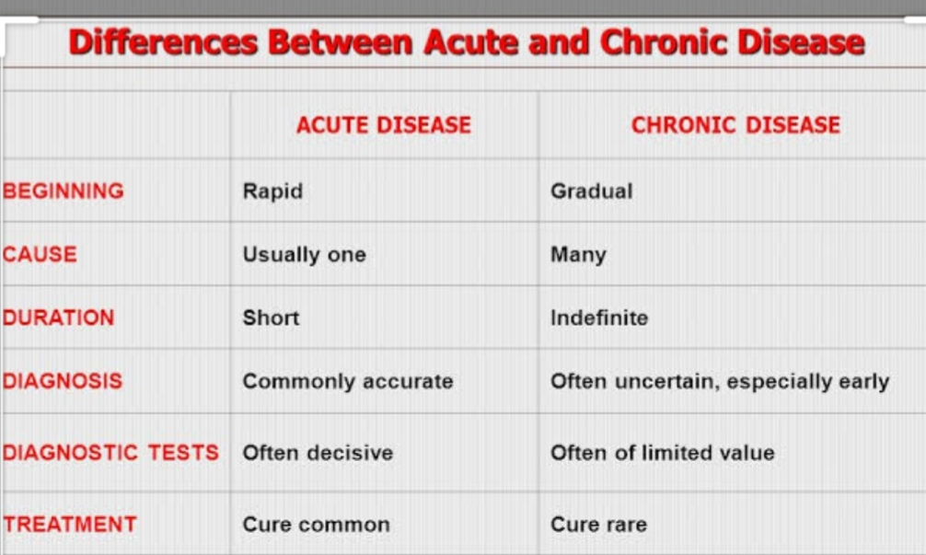
Differences Between Acute and Chronic Disease

Slide 9
Characteristics of chronic illness and related health problems.
Chronic illnesses are mostly characterized by:
complex causes
many risk factors
long latency periods (time between onset of the illness and feeling its effects)
a long illness
Functional impairment or disability.

Slide 10
Phases of Chronic illness.
Phase One: Crisis
Phase Two: Stabilization
Phase Three: Resolution
Phase Four: Integration

Slide 11
Phase One: Crisis
Phase one is characterized by crisis and chaos. In this phase you move from the actual onset of your illness to an emergency stage that usually forces you to seek some sort of relief.

Slide 12
Phase Two: Stabilization
In phase two, you have reached a plateau of symptoms, and because they stay more or less the same, they become familiar. You usually keep trying to behave as you did before you got sick, and this attempt frequently leads to relapses. These are very upsetting and feel like personal failures.

Slide 13
Phase Three: Resolution
Phase three may bring a plateau of symptoms or you may have relapses. You've also finally learned that you can’t be the person that you used to be before you got ill. This can be a devastating perception, one that can makes you experience a “dark night of the soul.”

Slide 14
Phase Four: Integration
In phase four, you may experience a plateau of symptoms or periodic relapses, but you’re now able to integrate parts of your old self from before the illness with the person you are now. Locate your illness experience within a larger philosophical or spiritual framework. In total integration; you arrive at a new, whole, complete life, of which illness is only one part, even if it is an important part.

Slide 15
Classification of chronic illness risk factors:-
1)-In individuals, the risks factors classify as follows:
Background risk factors, such as age, sex, level of education and genetic composition.
Behavioral risk factors, such as tobacco use, unhealthy diet and physical inactivity.
Intermediate risk factors, such as elevated blood lipids, diabetes, high blood pressure and overweight/obesity.

Slide 16
2)-In communities, the main factors that can impact health include:
Social and economic conditions, such as poverty, employment and family composition.
Environment, such as climate or air pollution.
Culture, such as practices, norms and values.
Urbanization, which influences housing, access to products and services.

Slide 17
According to the World Health Report 2010, the major risk factors include:
tobacco use
the harmful use of alcohol
raised blood pressure (or hypertension)
physical inactivity
raised cholesterol
overweight/obesity
unhealthy diet
raised blood glucose

Slide 18
Effects of chronic illness:-
Daily routines may change because the limitations of the ill member and the demands of treatment may require that others be more available.
Families may need to share caregiving responsibilities; this helps all members feel they are contributing to a loved one's welfare and it also protects any single member from caregiver fatigue.

Slide 19
Family members may experience strong emotions, such as guilt, anger, sadness, fear, anxiety and depressed mood. These are normal reactions to stress. It is useful to talk about these emotions within the family.
The ill member may need to find ways to be as independent as possible, given the limitations that the illness causes.

Slide 20
Despite the demands of the illness, families may need to work hard to maintain a sense of "normal" life. This can benefit the ill member, as well; it may help him or her integrate into family life more and may reduce the ill member's sense of guilt regarding the demands the illness places on the family as a whole.

Slide 21
Prevention of chronic illness.
1-Quit smoking
Stopping smoking (or never starting) lowers the risk of serious health problems, such as heart disease, cancer, type 2 diabetes, and lung disease, as well as premature death—even for longtime smokers.

Slide 22
2-Eat Healthy
Eating healthy helps prevent, delay, and manage heart disease, type 2 diabetes, and other chronic diseases. A balanced diet of fruits, veggies, whole grains, lean meats, and low-fat dairy products is important at any age. If you are overweight, losing even 5% to 7% of your body weight can help prevent or delay type 2 diabetes.

Slide 23
3-Get Regular Physical Activity
Regular physical activity can help you prevent, delay, or manage chronic diseases. Aim for moderate physical activity (like brisk walking or gardening) for at least 150 minutes a week.

Slide 24
4-Avoid Drinking Too Much Alcohol
Over time, excessive drinking can lead to high blood pressure, various cancers, heart disease, stroke, and liver disease. By not drinking too much, you can reduce these health risks.

Slide 25
5-Get Screened
To prevent chronic diseases or catch them early, visit your doctor regularly for preventive services.

Slide 26
6-Get Enough Sleep
Insufficient sleep has been linked to the development and poor management of diabetes, heart disease, obesity, and depression. Adults should get at least 7 hours of sleep daily.

Slide 27
7-Know Your Family History
If you have a family history of a chronic disease, like cancer, heart disease, diabetes, or osteoporosis, you may be more likely to develop that disease yourself. Share your family health history with your doctor, who can help you take steps to prevent these conditions or catch them early.

Slide 28
Most common chronic illness in Egypt:-
There are 12 major chronic conditions that are a significant burden in terms of morbidity, mortality and healthcare costs, including:
1- cardiovascular disease which include:-
Myocardial infarction(Heart attack)-
Ischemic heart disease(Coronary artery disease)-
Hypertension

Slide 29
2-Type 2 Diabetes mellitus.
3-Kidney Disease(End stage of renal disease).
4-Cancer which include:-
Breast cancer-
Colon cancer-
Liver cancer-
Lung cancer-
Prostate cancer

Slide 30
5-Liver diseases which include:-
-Hepatitis C
Liver cirrhosis-
6-Chronic Respiratory disease.

Slide 31
Example on chronic illness:-
Breast cancer

Slide 32
Definition:-
The term "breast cancer" refers to a malignant tumor that has developed from cells in the breast. Usually breast cancer either begins in the cells of the lobules, which are the milk-producing glands, or the ducts, the passages that drain milk from the lobules to the nipple.

Slide 33
Breast anatomy:-
The breasts are located between the second and sixth ribs over the pectoralis muscle from the sternum to the midaxillary line. An area of breast tissue, called the tail of Spence, extends into the axilla. Fascial bands, called Cooper’s ligaments, support the breast on the chest wall. The inframammary fold (or crease) is a ridge of fat at the bottom of the breast. Each breast contains 12 to 20 cone-shaped lobes, which are made up of glandular elements (lobules and ducts) and separated by fat and fibrous tissue that binds the lobes together. Milk is produced in the lobules and then carried through the ducts to the nipple.

Slide 35
Breast Cancer Pathophysiology
Breast cancer is a malignant tumor that starts in the cells of the breast. Like other cancers, there are several factors that can raise the risk of getting breast cancer. Damage to the DNA and genetic mutations can lead to breast cancer have been experimentally linked to estrogen exposure. Some individuals inherit defects in the DNA and genes like the BRCA1, BRCA2 and P53 among others. Those with a family history of ovarian or breast cancer thus are at an increased risk of breast cancer. The immune system normally seeks out cancer cells and cells with damaged DNA and destroys them.

Slide 36
Risk factors:-
A breast cancer risk factor is anything that makes it more likely you'll get breast cancer. But having one or even several breast cancer risk factors doesn't necessarily mean you'll develop breast cancer. Many women who develop breast cancer have no known risk factors other than simply being women. Factors that are associated with an increased risk of breast cancer include:

Slide 37
Factors that are associated with an increased risk of breast cancer include:
Being female
Increasing age
A personal history of breast conditions.
A personal history of breast cancer
A family history of breast cancer
Inherited genes that increase cancer risk.
Radiation exposure
Obesity.

Slide 38
Beginning your period at a younger age
Beginning menopause at an older age.
Having your first child at an older age.
Having never been pregnant
Postmenopausal hormone therapy..
Drinking alcohol.

Slide 39
Signs& symptom of breast cancer:-.
The most common symptom of breast cancer:- is a new lump or mass.A painless, hard mass that has irregular edges is more likely to be cancer, but breast cancers can be tender, soft, or rounded. They can even be painful. For this reason, it is important to have any new breast mass, lump, or breast change checked by a health care professional experienced in diagnosing breast diseases.

Slide 40
Other possible symptoms of breast cancer include:
Swelling of all or part of a breast (even if no distinct lump is felt)
Skin irritation or dimpling (sometimes looking like an orange peel)
Breast or nipple pain
Nipple retraction (turning inward)
Redness or thickening of the nipple or breast skin
Nipple discharge (other than breast milk)

Slide 41
Sometimes a breast cancer can spread to lymph nodes under the arm cause a lump or swelling there, even before the original tumor in the breast is large enough to be felt. Swollen lymph nodes should also be checked by a health care provider.
changes in the shape of the nipple

Slide 42
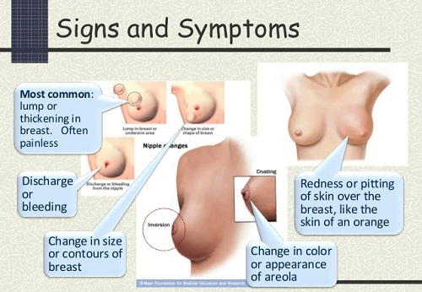

Slide 43
Diagnosis of breast cancer :-
Tests and procedures used to diagnose breast
cancer include :-
1-Breast exam:-Your doctor will check both of your breasts and lymph nodes in your armpit, feeling for any lumps or other abnormalities .
2- Mammography:- is a low-dose x-ray procedure that allows visu­alization of the internal structure of the breast. X-ray mammography remains the most sensitive method for the detection of small breast cancers.

Slide 44
3- Magnetic resonance imaging ( MRI ):- uses magnetic fields instead of x-rays to produce very detailed, cross-sectional images of the body. MRI exams for breast imaging use a contrast material (usually gadolinium DTPA) that is injected into a vein in the arm before or during the exam to improve the ability to capture detailed images of breast tissue.

Slide 45
4-Breast ultrasound:- is sometimes used to evaluate abnormal find­ings from a screening or diagnostic mammogram or physical exam. Ultrasound is very useful for the diagnosis of malignancy, but cannot be used to definitively differentiate benign from malignant solid lesions in the breast, but cannot be used to definitively differentiate benign from malignant solid lesions in the breast. Studies have shown that ultrasound detects more can­cer than mammography alone when screening women with dense breast tissue.

Slide 46
4- Cytology:-
The pathological finding would confirm the diagnosis. The two main methods which have evolved for the establishment of a diagnosis in breast disease are fine needle aspiration cytology which yields a cytological specimen (FNAC), and core needle biopsy (CNB). which yields a histological preparation.

Slide 47
fine needle aspiration cytology (FNAC) :-
FNAC of lump confirm the diagnosis immediately thus allowing an informed discussion with the patient about treatment options. It also reassures the patient .The advantage of doing an FNAC prior to a mammogram is that the obtains diagnosis without waiting . (FNA) is also useful in revealing the consistency of the lump, the gritty feel of carcinoma or the fluctuant nature of a cyst.

Slide 48
Core needle biopsy (CNB):-
It is a histopathological diagnosis as a core of tissue is examined. It is usually a tru-cut or needle biopsy but the sensitivity is however less than 100% . It is still higher than FNA as it yields adequate samples especially from solid lumps.

Slide 49
Management of B.C:-
Breast cancer management takes different approaches depending on physical and biological characteristics of the disease, as well as the age, over-all health and personal preferences of the patient .The mainstay of breast cancer management is surgery for the local and regional tumor, followed (or preceded) by a combination of chemotherapy, radiotherapy, endocrine (hormone) therapy, and targeted therapy. Research is ongoing for the use of immunotherapy in breast cancer management.

Slide 50
Prevention from breast cancer:-
These eight simple steps can help lower the risk of breast cancer. Not everyone applies to every woman, but together they can have a big impact.
Keep Weight in Check
It’s easy to tune out because it gets said so often, but maintaining a healthy weight is an important goal for everyone. Being overweight can increase the risk of many different cancers, including breast cancer, especially after menopause.

Slide 51
Be Physically Active
Exercise is as close to a silver bullet for good health as there is, and women who are physically active for at least 30 minutes a day have a lower risk of breast cancer. Regular exercise is also one of the best ways to help keep weight in check.
Eat fruits & Vegetables - and Avoid Too Much Alcohol
A healthy diet can help lower the risk of breast cancer. Try to eat a lot of fruits and vegetables and keep alcohol at moderate levels or lower (a drink a day or under). While moderate drinking can be good for the heart in older adults, even low levels of intake can increase the risk of breast cancer.

Slide 52
Don’t Smoke
Smokers and non-smokers alike know how unhealthy smoking is. On top of lowering quality of life and increasing the risk of heart disease, stroke, and at least 15 cancers - including breast cancer - it also causes smelly breath, bad teeth, and wrinkles. Now that’s motivation to stay smoke-free or work to get smoke-free.
Breastfeed, If Possible
Breastfeeding for a total of one year or more lowers the risk of breast cancer. It also has great health benefits for the child.

Slide 53
Avoid Birth Control Pills, Particularly After Age 35 or If You Smoke
Birth control pills have both risks and benefits. The younger a woman is, the lower the risks are. While women are taking birth control pills, they have a slightly increased risk of breast cancer. This risk goes away quickly, though, after stopping the pill. The risk of stroke and heart attack is also increased while on the pill - particularly if a woman smokes. However, long-term use can also have important benefits, like lowering the risk of ovarian cancer, colon cancer and uterine cancer - not to mention unwanted pregnancy - so there’s also a lot in its favor. If you’re very concerned about breast cancer, avoiding birth control pills is one option to lower risk.

Slide 54
Avoid Post-Menopausal Hormones
Post-menopausal hormones shouldn’t be taken long term to prevent chronic diseases, like osteoporosis and heart disease. Studies show they have a mixed effect on health, increasing the risk of some diseases and lowering the risk of others, and both estrogenonly hormones and estrogen-plus-progestin hormones increase the risk of breast cancer. If women do take post-menopausal hormones, it should be for the shortest time possible. The best person to talk to about the risks and benefits of post-menopausal hormones is your doctor.

Slide 55

Breast Self-Examination (BSE)

Slide 56
Definition:-
Breast self-examination is an easy way and can be a useful tool in detecting for breast cancer early when it is most treatable (Early detection is the best defense against breast cancer).

Slide 57
Some important tips to remember:
Examine your breasts once a month when they are least tender (usually 5-10 days from the first day of your period).
If you no longer have periods, choose one fixed day each month that will remind you to do BSE.
If you are breast feeding, empty your breasts first

Slide 58
Call your doctor or nurse if there are any changes.
Remember, most breast changes are NOT cancer, but DO check up to be sure!
Breast Self-Examination
At Age 20 and older......................... Once a month

Slide 59
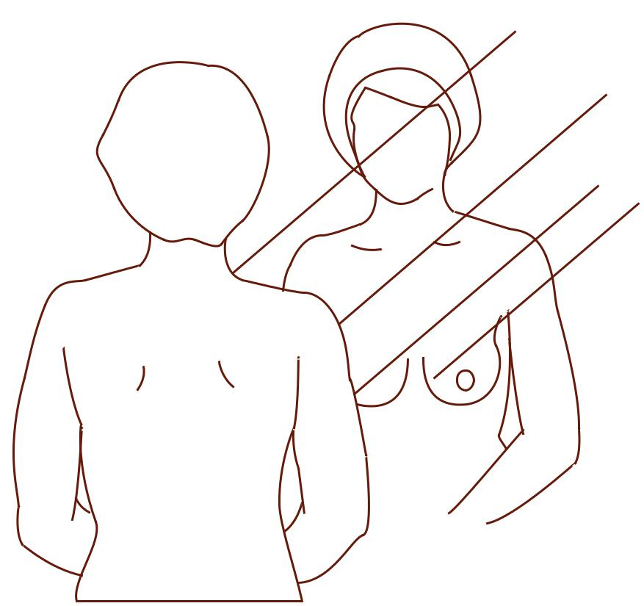
Breast Self-Examination (BSE)
Positions (Standing & Lying Down) Stand to look at your breasts:

Slide 60
Standing undressed to the waist in front of a mirror in three positions:
• Arm relaxed at sides.
• Arms raised above head.
• Press your hands firmly on your waist.

Slide 61
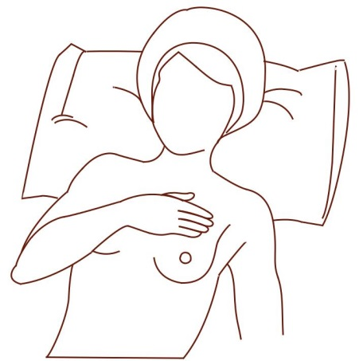
Look at your breasts for any changes in size, shape of the breasts, color, texture of the nipples, skin and direction of your nipples point (notice if there is any retraction of the nipple).Observe any stain on your night clothes or bra from your nipples, especially if only from one side. If there is any change or look unusual,
Lying down position to feel your breasts:-

Slide 62
Lie down on your back, so the breast tissue spreads more evenly over the chest wall, making it easier to feel all of the breast tissue.Place your right arm behind your head. Placing a pillow or rolled towel under the right shoulder (under the breast from the back) may be helpful.Use the finger pads of the 3 middle fingers of your left hand to feel for lumps in the right breast. Do the same way for the left breast.

Slide 63
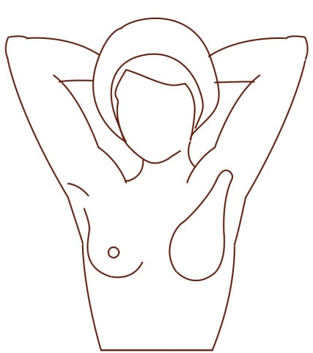
Perimeter (Where to Feel)
The area to be examined should include all the breast tissue and the arm-pit (as shown on the picture). The breast tissue is divided into four quadrants (parts) plus the area around the nipple. Most breast cancers are found in the upper outer part of the breast

Slide 64
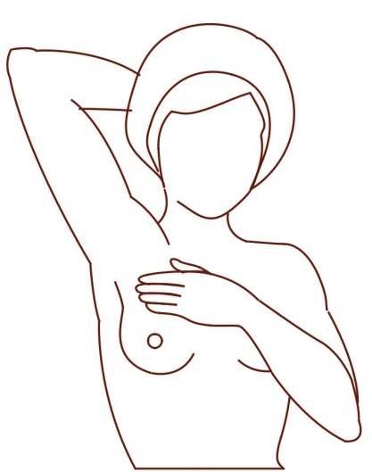
Palpation with Pads of Fingers (How to Feel)
Use over tapping dime-sized circular motions of your three middle finger pads to feel the breast tissue. Feel a small portion of the breast at a time until the entire breast has been checked. Do the same with the left breast.Do not lift your fingers from your breast between palpations. You can use powder or lotion to help your fingers slide from one spot to the next. Some women prefer to do the exam during the shower because fingers move smoothly over soapy skin, making it easy to feel the texture underneath.

Slide 65
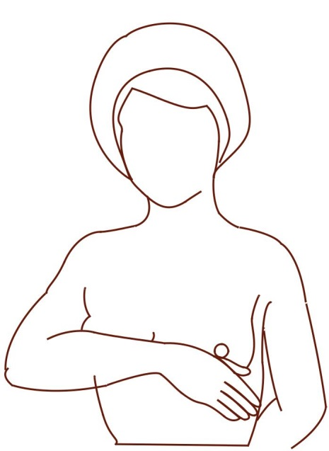
Pressure (How Deep to Feel)
Use three levels of pressure for each palpation, from light to deep, to examine the full thickness of your breast tissue. Using pressure is important because the breast is not flat. You need to feel all the way through the tissue to your ribs.

Slide 66


